Slide 1
Hematologic changes during normal pregnancy
40-50% increase in blood volume – mainly during 2nd trimester
EPO levels rise to about 150% of baseline
Increased RBC mass but Hct ↓due to ↑ plasma volume
Platelet count decreases 10-15% on average
WBC increases with mild left shift
CRP and ESR rise (higher globulins & fibrinogen)
Average 50% increase in spleen volume

Slide 2
Hemostatic balance changes during pregnancy
Increased vWF, FVIII, fibrinogen, FVII, FIX, FX
Decrease in total and free protein S
Increased PAI1, PAI2 → impaired clot lysis
High levels of tissue factor expression by trophoblasts, placenta
Procoagulant plasma microparticle levels increase

Slide 3
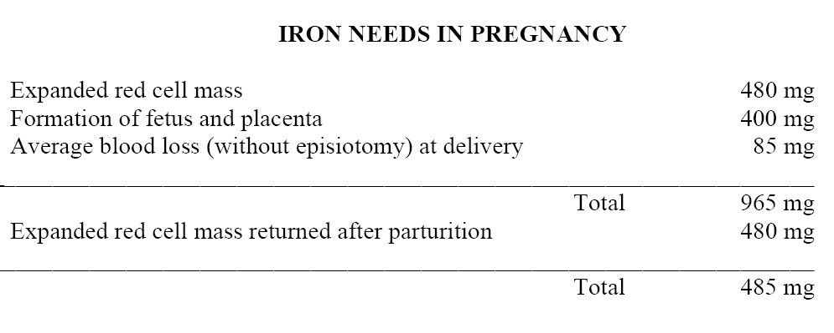
Pregnancy depletes iron stores
Normal iron stores in women = 200-400 mg
Iron deficiency during first two trimesters increases risk of preterm delivery, low birth weight

Slide 4
Folic acid in pregnancy
Folate deficiency 2nd most common nutritional deficiency in pregnancy
Folate requirements double during pregnancy
Anemia due to folate deficiency uncommon in U.S.
Mild folate deficiency can cause neural tube defects

Slide 5
Red cell aplasia in pregnancy
Rare
Begins early in pregnancy, resolves within weeks of delivery
Fetus not affected
Tends to recur in subsequent pregnancies

Slide 6
Von Willebrand Disease in pregnancy
VWF plasma levels rise during pregnancy from 2nd trimester on in type I VWD – may mask presence of disease
VWF activity does not increase during pregnancy in most women with type 2 or type 3 VWD
Moderate to severe thrombocytopenia may occur in type 2B or platelet-type VWD due to enhanced release of large, unfolded VWF multimers
VWF levels often drop sharply within 24 hours after delivery in type I VWD
VWF and factor VIII levels should be monitored closely during pregnancy and in postpartum period

Slide 7
Bleeding in pregnant women with VWD
Vaginal bleeding may occur in 1st trimester, but major hemorrhage unusual during pregnancy
  Exceptions: after spontaneous abortion or elective termination
Excessive postpartum bleeding is common (30-50%) in absence of prophylaxis
  Bleeding more common in type 2 VWD or if VWF activity <50% at term
  Bleeding may be delayed by 24 hours or more
Complete uterine evacuation and contraction are essential to limit bleeding

Slide 8
Bleeding in pregnant women with VWD (2)
Epidural anesthesia appears safe if VWF activity levels are maintained at normal (> 50%) levels
  Prompt catheter removal recommended due to potential for sharp drop in VWF levels postpartum
Infants with VWD at risk for intracranial bleeding or scalp hematomas
  Risk higher with invasive monitoring, use of forceps or other instrumentation

Slide 9
Management of VWD in pregnancy
Monitor VWF activity and F VIII in later stages of pregnancy and during/after delivery
Maintain VWF activity ≥ 50% in peripartum period
  Factor replacement (VWF concentrate preferred vs cryoppt)
  DDAVP in type I VWD only (if patient known to respond); monitor for hypnatremia
Antifibrinolytic Rx (TXA or Amicar)

Slide 10
Pregnancy in hemophilia carriers
Factor VIII or IX levels in carriers vary widely due to skewed inactivation of X chromosome during embryogenesis
In hemophilia A carriers factor VIII levels rise in latter stages of pregnancy so bleeding risk at delivery lower
Carriers with factor levels < 40% (particularly those who carry hemophilia B) should be monitored during pregnancy and postpartum period, may benefit from factor replacement at the time of delivery
DDAVP an option for hemophilia A carriers only
50% likelihood of hemophilia in male child

Slide 11
Acquired bleeding disorders & thrombocytopenia in pregnancy
Gestational thrombocytopenia
ITP
DIC
Thrombotic microangiopathies:
  TTP (most common cause in early pregnancy)
  aHUS
  HELLP/preeclampsia (most common cause in late pregnancy)
  Acute fatty liver of pregnancy

Slide 12

Reviewed 7351 deliveries at single institution between 2011-2014
During uncomplicated pregnancy (n=4568):
  10% of women had plts < 150K
  1% had plts < 100K
  0.3% had plts < 80K, most of whom had alternative explanations for low plts
During complicated pregnancy (n=2586)
  2.3% of women had plts < 100K
  1.2% had plts < 80K
In women with pre-existing thrombocytopenia (n=197: ITP, SLE, HIV, liver dz)
  Rate of decrease in platelets similar to that in normal pregnancy
  20% had plts < 150K at delivery
  9% had plts < 80K
Moderate or severe thrombocytopenia during pregnancy is usually caused by an underlying condition rather than pregnancy itself

Slide 13
Gestational thrombocytopenia
Affects 6-10% of pregnancies
Most common cause of thrombocytopenia in pregnancy
Mild thrombocytopenia (platelets usually ≥ 100K) in late 2nd or 3rd trimester
Unlikely to cause plts < 70K
Cause uncertain – hemodilution vs sequestration in placental circulation or spleen vs?
Low end of the spectrum of “physiologic” thrombocytopenia in pregnancy?
Benign, resolves after delivery (mean time to recovery ~ 7 weeks) but often recurs in subsequent pregnancies
Occasionally progresses to more severe thrombocytopenia and coagulopathy, suggesting a different pathogenesis related to HELLP and/or AFLP

Slide 14
ITP in pregnancy
Incidence: < 0.1% of pregnancies, accounts for 3-5% of pregnancy-associated thrombocytopenia
Most common cause of isolated thrombocytopenia in 1st trimester
Antiplatelet antibodies may cross placenta → fetal thrombocytopenia
  10% of newborns have plts < 50K
  1-5% have plts < 20K
  Count may drop further during 1st week postpartum

Slide 15
Management of ITP in pregnancy
If not bleeding, treat if plts < 20-30K in 1st and 2nd trimester or < 50K in 3rd trimester (or < 75K for epidural)
IVIG and judicious corticosteroid treatment 1st line
Splenectomy is feasible if above treatments fail
WinRho may be considered if Rh+
Rituximab often effective but delays neonatal B-cell development
Azathioprine can be given to pregnant women – little data in ITP
TRAs, calcineurin inhibitors not recommended
Percutaneous umbilical cord blood sampling risky, not routinely recommended
Caesarian section not routinely indicated

Slide 16
Preeclampsia
Gestational hypertension, proteinuria, edema, liver injury
3-4% of pregnancies; occurs after 20th week of pregnancy
More common in first pregnancy (4-10% incidence)
Evidence of platelet activation, thrombocytopenia, MAHA
Activation of clotting cascade with intravascular fibrin deposition
May recur in subsequent pregnancies
Eclampsia = preeclampsia + seizure or coma
Rx: deliver fetus (typically resolves in 3-5 days)

Slide 17
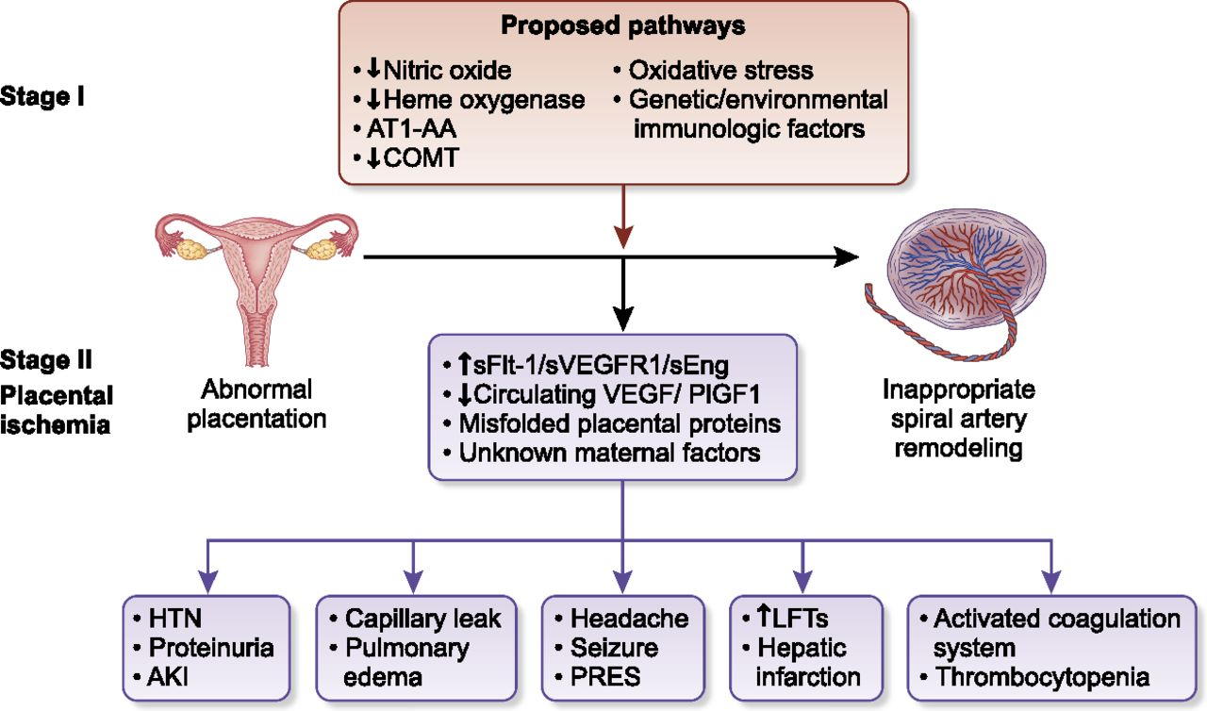
Preeclampsia: Placental insufficiency → endothelial injury
Phipps et al, 2016

Slide 18
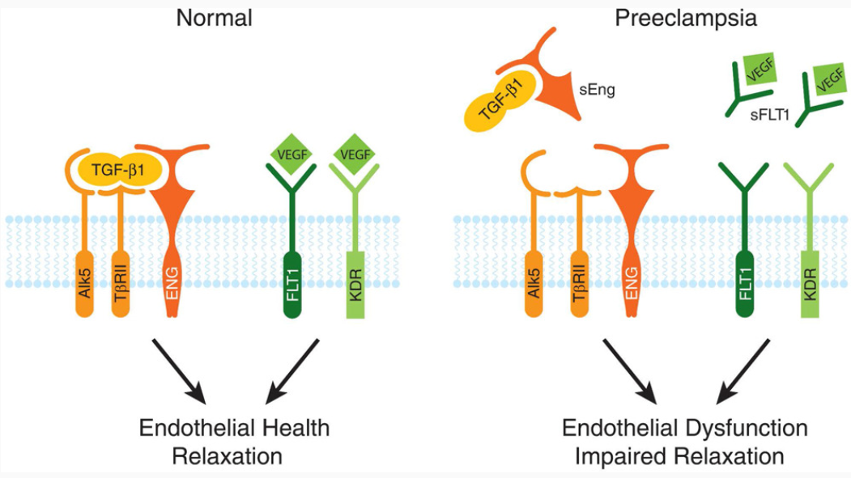
Placenta causes endothelial dysfunction in preeclampsia by secreting soluble endoglin and fms-like kinase that impair TGF and VEGF signaling
Rana et al, 2019

Slide 19
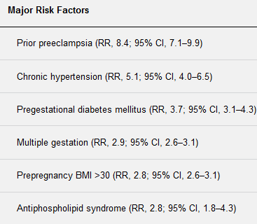
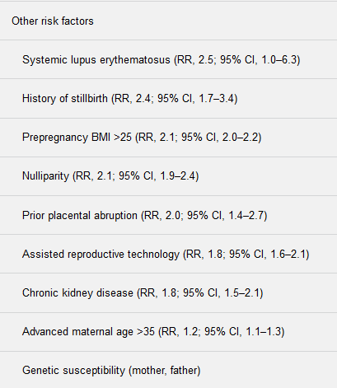
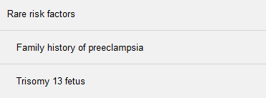
Risk factors for preeclampsia
Rana et al, 2019

Slide 20
HELLP Syndrome
Hemolysis, Elevated liver enzymes, Low Platelets
Most patients have preeclampsia
Incidence: 0.8% of pregnancies, 25% of severe pre-eclampsia cases
Usually late 3rd trimester
30% of cases Dx’d soon after delivery
MAHA (schistocytes & high LDH), elevated AST, platelets < 100K
Overt DIC in 5-10%
Partial syndromes without all 3 features can occur
Malaise, N/V, abdominal pain most common symptoms

Slide 21
HELLP Syndrome - DDx
Viral hepatitis
Cholecystitis
Appendicitis
Pancreatitis
Nephrolithiasis
ITP
Acute fatty liver of pregnancy (if prominent DIC/coagulopathy)
Systemic lupus erythematosus
Antiphospholipid syndrome
TTP (especially in early pregnancy)
aHUS (if prominent kidney injury)
Both predispose to preeclampsia/HELLP
Both more common in pregnancy

Slide 22
HELLP Syndrome - complications
Maternal complications:
  Cerebral hemorrhage
  Acute renal failure
  Hepatic necrosis
  Pulmonary edema
  Retinal detachment
  Placental abruption
Fetal complications:
  Intrauterine growth retardation
  Premature delivery
  Thrombocytopenia

Slide 23
HELLP Syndrome - management
Stabilize patient
  IV magnesium sulfate (prevents seizures)
  Aggressive antihypertensive therapy
  Transfuse platelets if count < 50K
Deliver fetus as soon as possible
  If fetal lung maturity inadequate give betamethasone, deliver within 48h
Platelets typically normalize within 10-14 days
If patient worsens after delivery consider
  Corticosteroids
  Plasma exchange

Slide 24
Acute fatty liver of pregnancy
Incidence ~5/100,000 deliveries
3rd trimester presentation most common, primagravid women at highest risk
Flu-like symptoms and RUQ pain
Rapid progression with coagulopathy (DIC), bleeding, hypoglycemia, pancreatitis, kidney injury (if severe consider aHUS)
Less hypertension, more coagulopathy than HELLP
Liver bx = microvesicular steatosis (not required for Dx)
Pathophysiology: fetal hepatic mitochondrial dysfunction (often due to inherited enzyme deficiency) with altered fatty acid metabolism; long-chain FAs enter maternal circulation, damage liver
Management: supportive care, urgent delivery

Slide 25
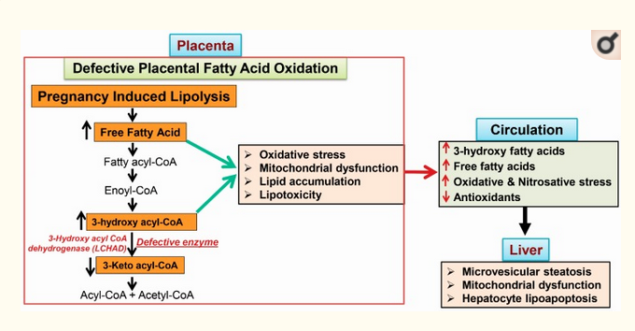
Defective fetal fatty acid metabolism in AFLP causes release of toxic metabolites into maternal blood
Int J Mol Sci. 2018; 19: 322

Slide 26
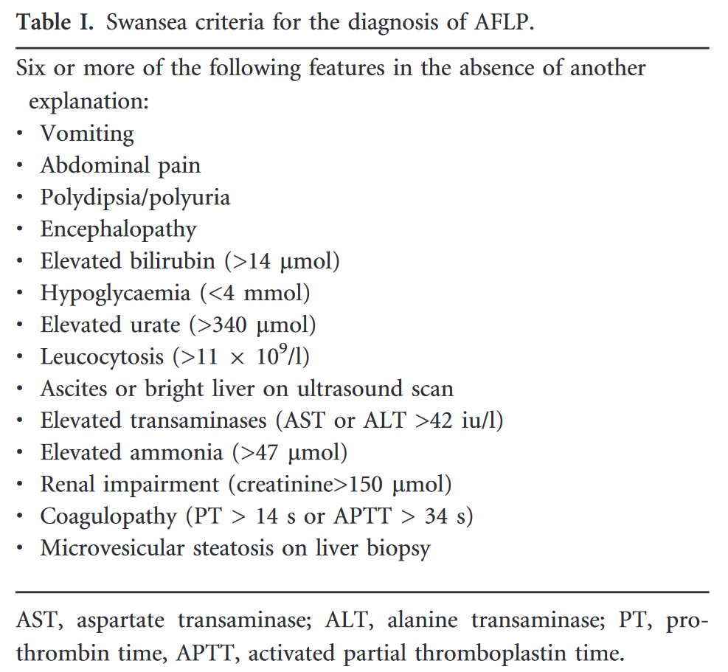

Slide 27
DIC in pregnancy
HELLP
Acute fatty liver of pregnancy
Placental abruption
Amniotic fluid embolism (+ lung injury, atonic uterine bleeding)
Sepsis/septic abortion
Postpartum hemorrhage
Retained dead fetus

Slide 28
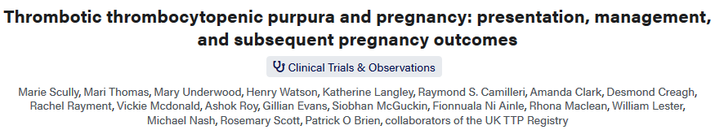
Describes 47 women with pregnancy-associated TTP
  Most presented at > 30 weeks gestation, some post-partum
  Early presentations associated with high rates of fetal demise due to placental insufficiency
  23 (66% of first TTP cases) had inherited ADAMTS13 deficiency recognized for the first time in pregnancy; many had hx of prior unsuccessful pregnancies
  12 had antibody-associated TTP (first episode)
  12 had prior episodes of antibody-associated TTP
Plasma exchange (+ steroids for antibody-associated TTP) allowed most women with later presentations to achieve successful pregnancy
Clinical presentations similar to TTP in general, not easy to distinguish from HELLP and other pregnancy-associated TMAs
Several women with acquired TTP had relapses during subsequent pregnancies; low ADAMTS13 activity at pregnancy onset predicted this

Slide 29
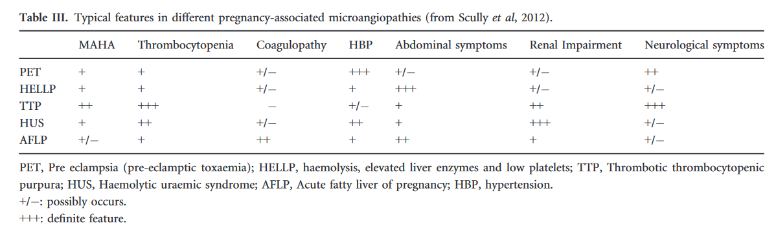
Hidden or unrecognized pregnancy should always be considered in a woman of childbearing age with MAHA or DIC
Thomas et al, BJH 2016

