Slide 1
NUTRITIONAL ANEMIAS
HYPOPROLIFERATIVE ANEMIAS
Eliot Williams, MD PhD
Dept. of Medicine

Slide 2
Learning Objectives
Describe normal iron metabolism, and list the factors that affect iron balance
Explain how iron deficiency is diagnosed and distinguished from other causes of microcytic anemia
List the most important causes of iron deficiency
Describe the pathophysiology, laboratory features, and clinical consequences of iron overload, both iatrogenic and due to hemochromatosis
Describe the pathophysiology, clinical and laboratory features of anemia due to inflammation
List several conditions in which subnormal erythropoietin production contributes to anemia

Slide 3
Nutrients required for normal erythropoiesis
Iron
Vitamin B-12 (cobalmin)
Folic acid
Proteins, amino acids, calories
Vitamin B6 (pyridoxine)
Vitamin B2 (riboflavin)
Nicotinic acid (niacin)
Vitamin C (ascorbic acid)
Vitamin A
Vitamin E
Copper
Cobalt

Slide 4
IRON METABOLISM
IRON DEFICIENCY
IRON OVERLOAD

Slide 5

IRON
10-15 mg/day in diet; 5-10% absorbed
  Absorption increased in iron deficiency, pregnancy, erythroid hyperplasia, hypoxia
Heme iron absorbed best
Fe²⁺ much better than Fe³⁺
  Some foods, drugs enhance and some inhibit absorption of ionic iron
  Ability to regulate absorption limited
Absorption in proximal small intestine
Yum!
mmph

Slide 6
IRON TRANSPORT AND STORAGE
Absorbed iron oxidized to Fe³⁺ form
Bound tightly to transferrin in blood
Iron is transferred to cells and reduced to Fe²⁺ form, then inserted into heme or stored
Storage iron (Fe³⁺) bound to ferritin
  Small amount of ferritin in blood (nanograms) correlates with body iron stores

Slide 7
Laboratory tests used to assess iron status
Serum iron: transferrin- bound iron being transported in the blood.
Total iron binding capacity (TIBC): the total amount of transferrin in blood.
  Transferrin saturation = serum iron/TIBC (%)
Serum ferritin: Serum ferritin levels usually reflect body iron stores.

Slide 8
ASSESSMENT OF BODY IRON
Serum iron low in iron deficiency, inflammation
TIBC high in iron deficiency, normal or low in inflammation
Serum ferritin low in iron deficiency, increases in inflammation
Marrow iron stores (assessed by marrow biopsy) absent in iron deficiency
Notes:
Most of the time you can determine what’s going on with respect to iron stores and availability using iron, TIBC, ferritin. We almost never do marrow biopsies solely to determine if someone is iron deficient. If we’re not sure based on blood test results a trial of iron will usually resolve the issue.

Slide 9
Interpreting iron tests
Low ferritin = iron deficiency
Low serum iron + high TIBC usually means iron deficiency
Low serum iron + normal or low TIBC found in inflammation, not necessarily indicative of iron deficiency
Serum iron may be normal in iron deficiency if patient has recently taken oral iron (food or supplement) or been given parenteral iron
Ferritin may be normal (usually low normal) despite iron deficiency in inflammatory states (ferritin is acute phase reactant) or liver disease (ferritin released from injured liver cells)

Slide 10
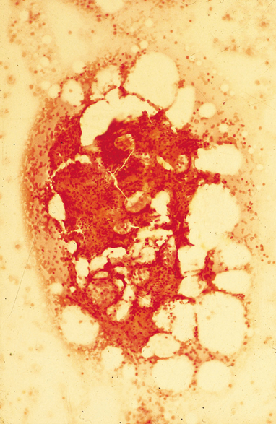
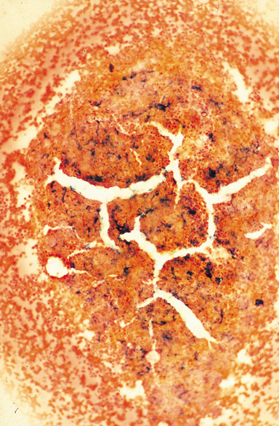
Marrow iron stores
Marrow aspirate stained with Prussian Blue
Absent iron stores
Normal iron stores
Notes:
However, when we do a marrow biopsy we do test it to see if there is any iron stored there. Iron incorporated into heme does not stain – so the blue color indicates stored iron in macrophages that has not yet been put into heme

Slide 11
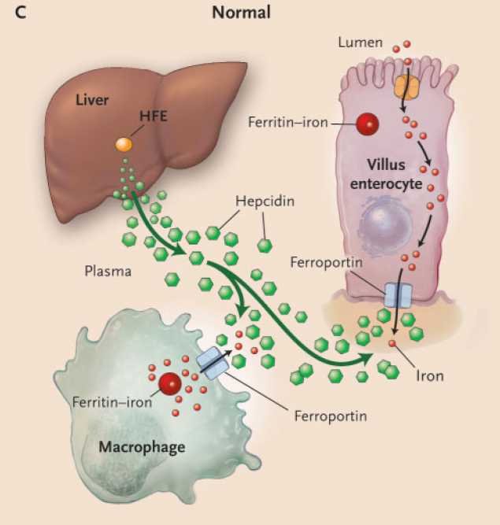
IRON METABOLISM
Hepcidin is a peptide produced in the liver.
Hepcidin interacts with ferroportin to inhibit iron release from villus enterocytes and macrophages.
Hepcidin production is upregulated by high plasma iron levels or inflammation.
Low iron levels decrease hepcidin production, which in turn stimulates iron absorption and release into the blood.
The HFE gene modulates hepcidin production.
Mutations in HFE can cause diminished hepcidin release, and can eventually cause iron overload (hereditary hemochromatosis).
N Engl J Med 2004;350:2383

Slide 12
Iron deficiency
HFE mutation
Hepcidin → Iron
Ineffective
erythropoiesis
Liver disease

Slide 13
Inflammation
Hepcidin → Iron
Iron excess

Slide 14
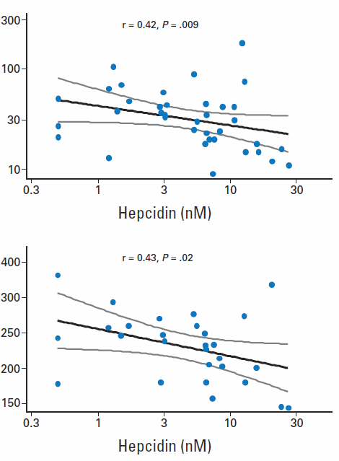
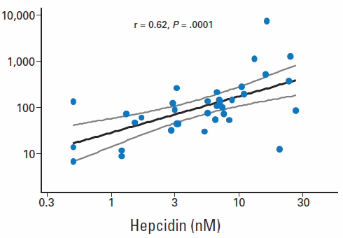
Hepcidin levels in patients with anemia of inflammation
Serum iron (mcg/dL)
Ferritin (ng/ml)
TIBC (mcg/dL)
↑ Hepcidin → ↑ serum ferritin (more iron stored)
↑ Hepcidin → ↓ iron and TIBC (less iron transported)
J Clin Oncol 2010;28:2538

Slide 15
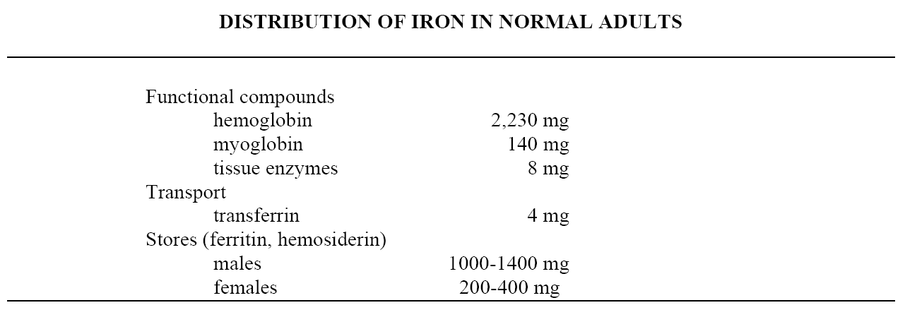
Most of your iron is in your red cells
1 cc of red cells contains about 1 mg iron
1 cc of whole blood contains 0.5 mg iron

Slide 16
IRON BALANCE
1-2 mg/day lost via desquamation, GI blood loss in adult
Normally we absorb about the same amount per day
Negative iron balance possible in early childhood
Menstruation, pregnancy, lactation promote negative balance
Positive balance (and eventual iron overload) can occur in inherited disorders (hemochromatosis), or as a result of repeated blood transfusions

Slide 17
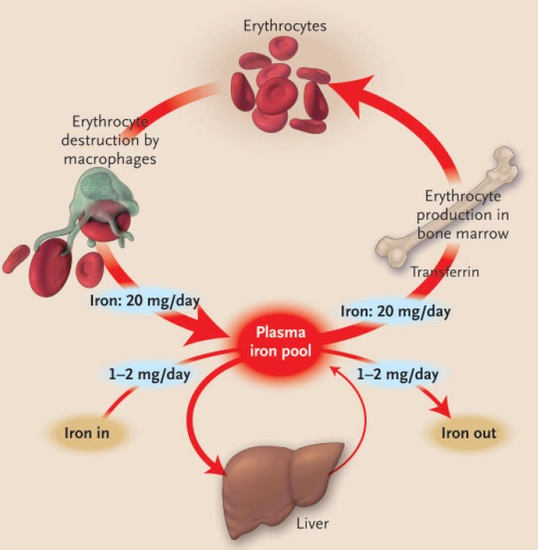
20 mg of iron per day required for erythropoiesis
Most of this iron is recycled from old RBC after they are eaten by macrophages
1-2 mg of “new” iron absorbed from gut
1-2 mg of iron lost via sloughing of enterocytes
Excess iron stored – mainly in liver
N Engl J Med 2004;350:2383

Slide 18
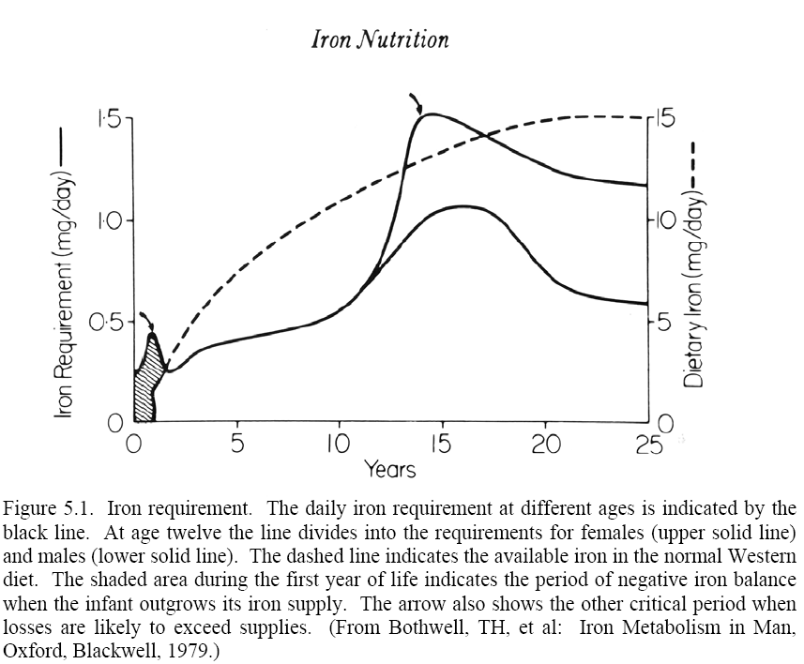
Daily iron requirements vs age
Dietary iron available
♀
Girls
♂
Boys
Iron requirements may exceed dietary availability in infants and adolescent girls

Slide 19
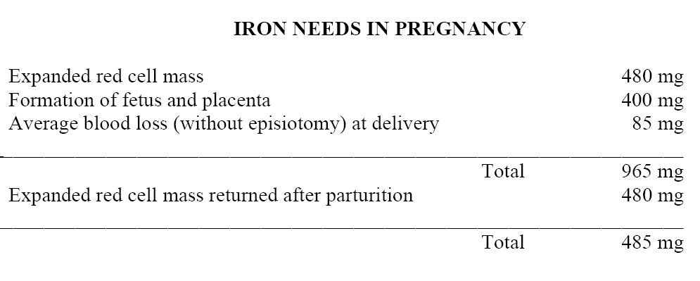
Pregnancy depletes iron stores
Normal iron stores in women = 200-400 mg

Slide 20
IRON DEFICIENCY
Most common cause of anemia worldwide
Usually due to chronic blood loss
  Exceptions: rapidly growing child, malabsorption
  In underdeveloped countries poor nutrition, GI infection with bleeding are major contributing factors
In young women iron deficiency is usually due to menstrual blood loss and/or pregnancy.
In anyone else: rule out GI blood loss
  Esophageal disease, hiatal hernia, ulcer, inflammatory bowel disease, angiodysplasia, hemorrhoids, cancer

Slide 21
IRON DEFICIENCY ANEMIA
Microcytic, hypochromic (MCV may be normal in early or mild deficiency)
Reticulocyte count not increased
Aniso- and poikilocytosis in more severe cases
Serum ferritin usually low
  Exception: inflammation or liver disease
Serum iron low, TIBC usually high
Platelet count often high

Slide 22
Why is the platelet count often high in iron deficiency? (FYI)
Low iron levels promote differentiation of progenitor cells toward megakaryocytes and away from erythrocytes
This is thought to be a protective mechanism to limit utilization of iron when stores become depleted
Xavier-Ferrucio et al. Blood 2019;134:1557

Slide 23
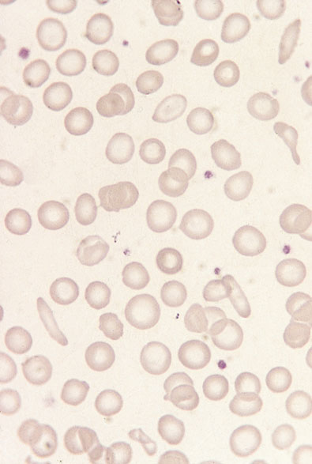
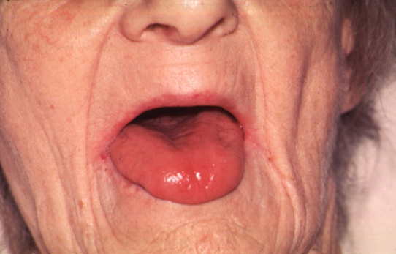



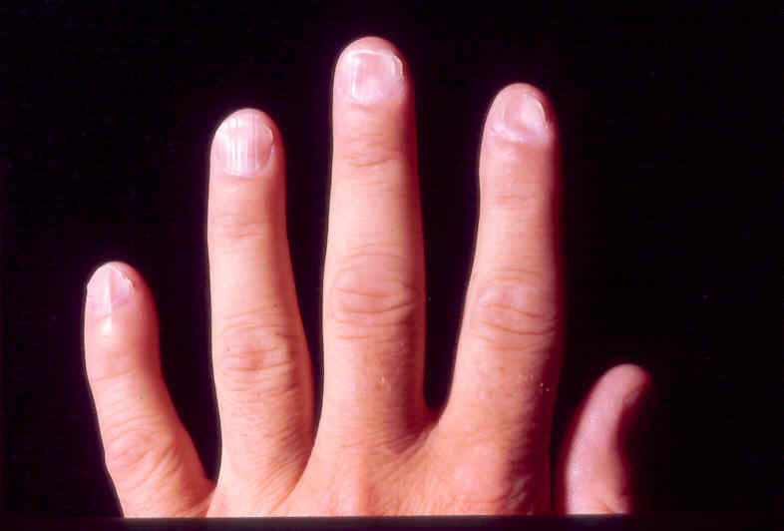
Iron deficiency
Atrophic glossitis
Restless leg syndrome
Atrophic glossitis
Pica
“Spoon nails”

Slide 24
Not all patients with a low serum ferritin are anemic
  Anemia does not appear until after iron stores depleted
Not all patients with iron deficiency anemia have a low MCV
  MCV normal in early stages of IDA
Microcytosis in the absence of anemia suggests thalassemia trait, not iron deficiency

Slide 25
Treating Iron Deficiency
Oral ferrous salts
  Many patients have GI side effects
  “Slow-release” forms often not well absorbed
  Once-daily dosing often sufficient
    Hepcidin levels rise after first dose so second dose less well absorbed
Oral iron-polysaccharide complex
IV iron dextran or iron sucrose
  If oral iron not absorbed or not tolerated
  Slight risk of anaphylaxis
Retics should increase within a week, hemoglobin within 2-3 weeks

Slide 26
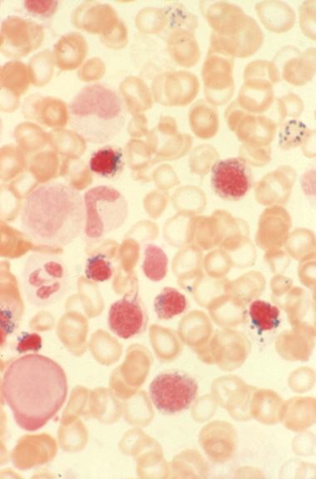
Other causes of microcytic anemia
Decreased hemoglobin production due to:
  Iron withheld from red cell precursors (increased hepcidin - anemia of inflammation)
  Globin gene defects (thalassemias)
  Defects in heme synthetic pathway (sideroblastic anemias)
    Heavy metal poisoning
    Myelodysplasia (more commonly macrocytic)
    Inherited conditions (rare)
Notes:
Sideroblasts are red cell precursors with stainable iron. Since iron that goes into a RBC precursor is normally inserted into heme so that it does not stain, this indicates that something is holding up this process – a defect in heme synthesis. The iron is retained in mitochondria, giving it this granular appearance.

Slide 27
Differential diagnosis of microcytic anemia
 | Iron deficiency | Thalassemia trait | Inflammation
MCV | Low in proportion to anemia (may be nl in early stage) | Low even in absence of anemia | Normal or slightly low
Serum iron | Low | Normal | Low
TIBC | High | Normal | Normal or low
Serum ferritin | Low | Normal | Normal or high
Marrow iron | Absent | Present | Present
Notes:
A very common mistake that physicians make is to assume all microcytic anemias are due to iron deficiency. We would like you not to make this mistake. Adding to this potential confusion is that both inflammation and iron deficiency cause microcytosis with low serum iron. To tell the difference you have to look at the TIBC and ferritin as well as the serum iron.

Slide 28
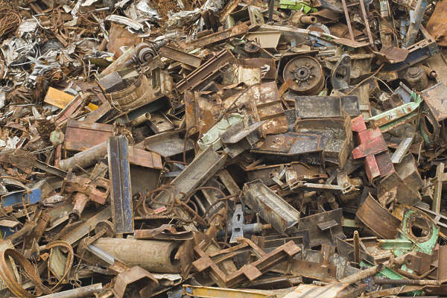
Iron Overload

Slide 29
IRON OVERLOAD
Hereditary hemochromatosis
  Autosomal recessive, HFE gene; genotype common but low penetrance
Other inherited disorders
  Mutations in other genes that regulate iron metabolism
Chronic ineffective erythropoiesis (decr hepcidin)
  Thalassemia
Repeated transfusion
  Toxicity after about 100 Units
Dietary
  15%+ incidence in sub-Saharan Africa due to high iron content in traditional beer; additional genetic factors may be involved

Slide 30
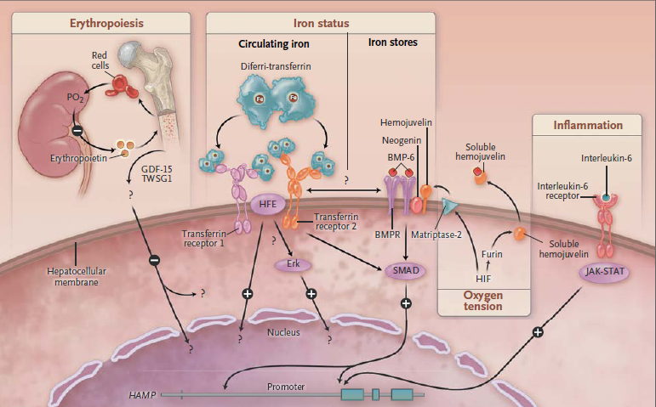
HFE mutations disrupt signaling that normally increases hepcidin production in response to increased iron levels
Hepcidin gene
NEJM 2012;366:360

Slide 31
Diagnosis of iron overload
Increased serum iron and high transferrin saturation (often >90% in hemochromatosis)
Very high serum ferritin (over 1000 in symptomatic patients)
Increased liver iron (liver biopsy or MRI)
DNA test available for hereditary HC

Slide 32
Complications of iron overload
Cirrhosis, hepatocellular carcinoma
Endocrine failure (diabetes, hypogonadism)
Arthropathy
Darkening (“bronzing”) of skin
Cardiomyopathy, heart failure
Treatment of hereditary HC by phlebotomy prevents these problems and can reverse early tissue damage

Slide 33
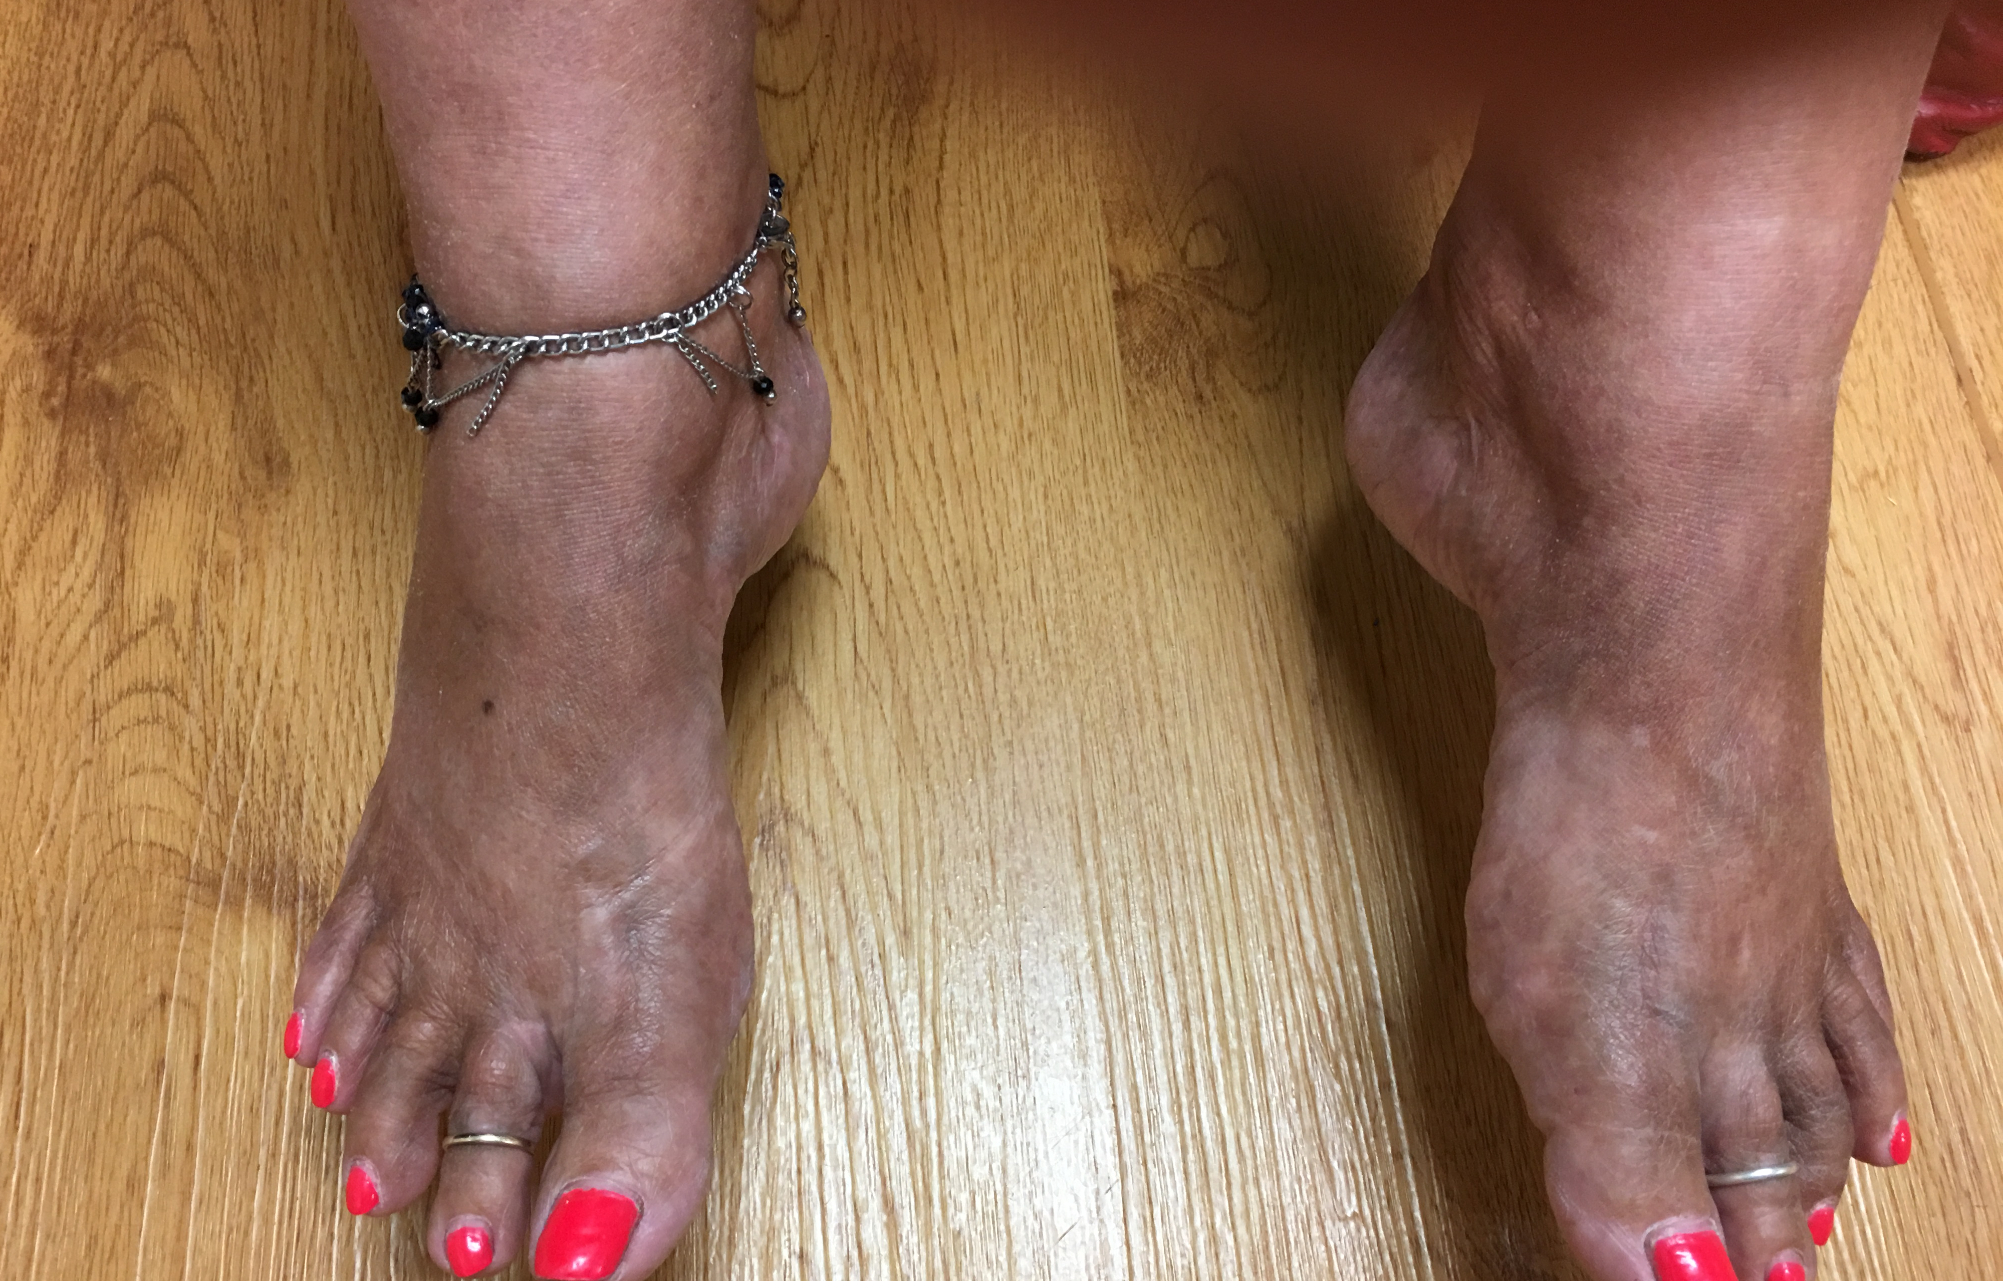
Skin discoloration in hemochromatosis

Slide 34
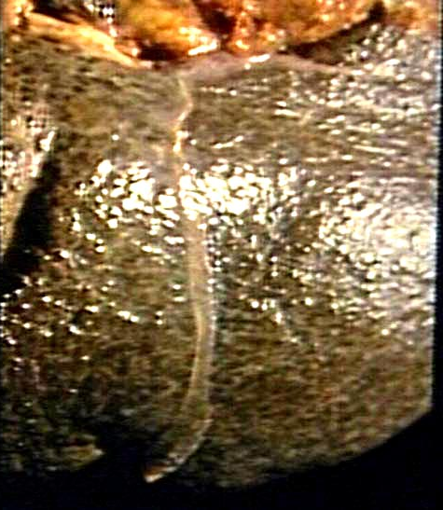
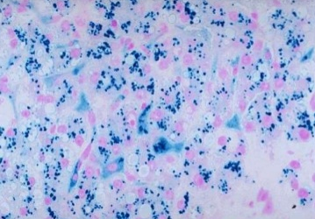
Liver disease in hemochromatosis

Slide 35
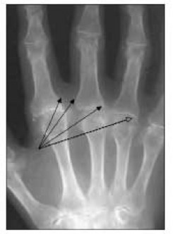
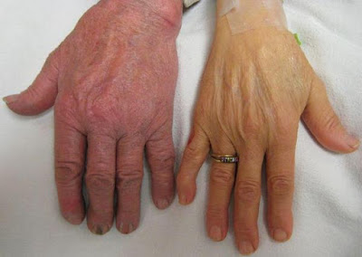
Joint disease in hemochromatosis

Slide 36
NON-NUTRITIONAL HYPOPROLIFERATIVE ANEMIAS

Slide 37
ANEMIA OF INFLAMMATION
AKA “anemia of chronic disease”
Most common cause of anemia in hospitalized patients
Anemia typically mild to moderate: Hb rarely < 8 unless additional factors present
Causes: infection, autoimmune disorders, cancer
Mechanisms:
  Inflammation → incr hepcidin expression → Impaired release of stored iron from macrophages
  lower EPO production
  Direct inhibition of red cell precursors by inflammatory cytokines
  Shortened red cell survival
Benefit: decreased iron available to bacteria, etc

Slide 38
Inflammatory cytokines increase hepcidin production
Hepcidin gene
NEJM 2012;366:360

Slide 39
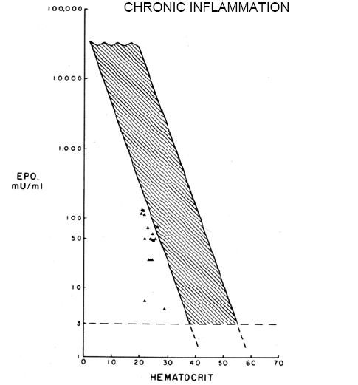
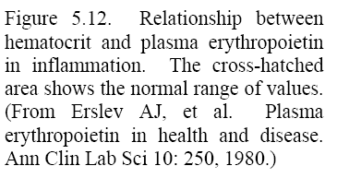
Erythropoietin levels are lower than expected for the degree of anemia in the presence of inflammation

Slide 40
ANEMIA OF INFLAMMATION
Laboratory findings
Normocytic or mild microcytosis
Not many shift cells
Low serum iron, normal or low TIBC, normal or high serum ferritin
Relatively low EPO level for degree of anemia

Slide 41
LOW ERYTHROPOIETIN ANEMIA
Renal failure
  May be compounded by blood loss during dialysis, inflammation, decreased rbc lifespan
  Reversible with EPO injections
Endocrine disorders
  Hypothyroidism, hypopituitarism
Protein-calorie malnutrition
Right-shifted hemoglobin O₂ dissociation curve

Slide 42
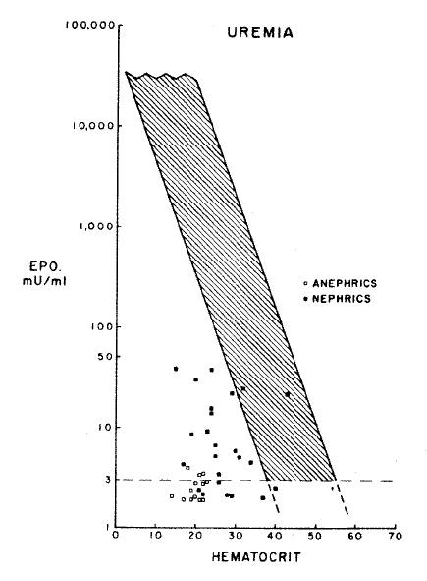
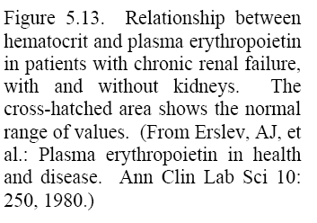
EPO levels in renal failure

