Slide 1
Inherited bleeding disorders
Hemophilia
Rare clotting factor deficiencies
Vascular disorders

Slide 2
HEMOPHILIA
Deficiency of factor VIII (hemophilia A) or factor IX (hemophilia B)
Sex-linked inheritance; almost all patients male
  Female carriers may have mild symptoms
Most bleeding into joints, muscles; mucosal and CNS bleeding uncommon
Severity inversely proportional to factor level
  < 1%: severe, bleeding after minimal injury
  1-5%: moderate, bleeding after mild injury
  > 5%: mild, bleeding after significant trauma or surgery

Slide 3
Factors VIII and IX
Central to the “propagation loop” of the clotting cascade.
Hemostatic role most important when tissue factor expression relatively low
Factor IX is made in hepatocytes
Site of factor VIII production less certain – probably reticuloendothelial cells in liver and other organs

Slide 4
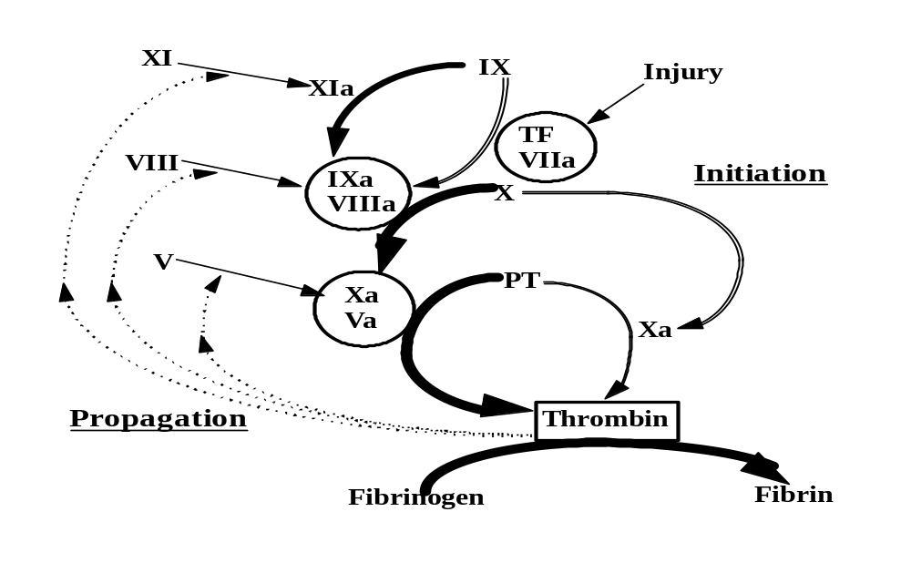
Deficiency of factor VIII or IX affects the propagation phase of coagulation
Most likely to cause bleeding where tissue factor exposure is relatively low

Slide 5
GENETICS OF HEMOPHILIA A
About half of cases of hemophilia A due to an inversion mutation in intron 1 (5%) or 22 (45%)
Remainder genetically heterogeneous
  Nonsense/stop mutations prevent factor production
  Missense mutations may affect factor production, activity or half-life
  15-20% of cases due to new mutations
  Over 600 missense mutations identified

Slide 6
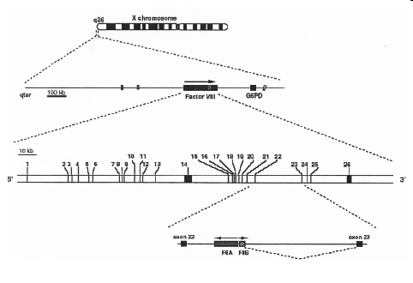
The factor VIII gene
Nested gene (“F8A”) of uncertain function in intron 22; 2 additional copies of this gene near the tip of the X chromosome

Slide 7
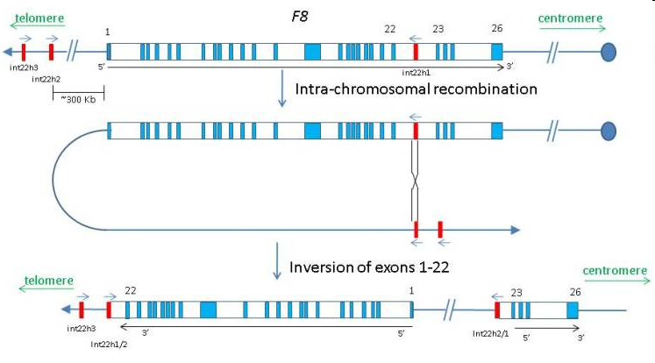
The “flip tip” inversion in the factor VIII gene
Crossover between internal F8A and one of the two external copies

Slide 8
GENETICS OF HEMOPHILIA B
Most cases associated with point mutations
Deletions in about 3% of cases
Promoter mutations in about 2%
  In these cases an androgen response element near transcription start site may allow factor level to rise after puberty (“hemophilia B Leyden”)
Severe disease (<1% factor) less common than in hemophilia A
Notes:
Queen Victoria (founder mutation?)
Tsar Nicholas and his family. His son Alexei had hemophlia. Queen Victoria was the maternal grandmother of Nicholas’ wife Alexandra.
Rasputin advised the family about treatment for Alexei. His involvement with the family helped discredit the Tsar and may have contributed to the downfall of the tsarist government.

Slide 9
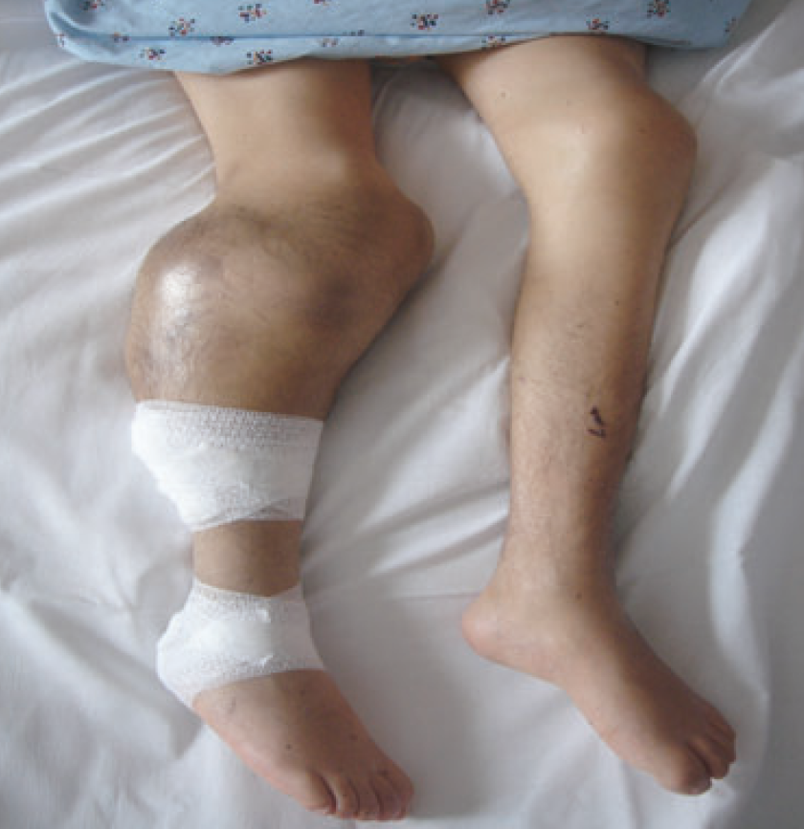
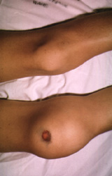
ACUTE COMPLICATIONS OF HEMOPHILIA
Hemarthrosis (joint bleeding)
Muscle hematoma (pseudotumor)

Slide 10
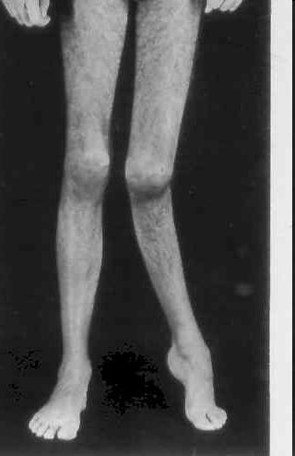
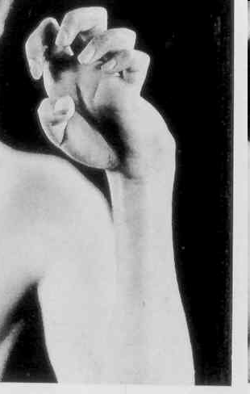
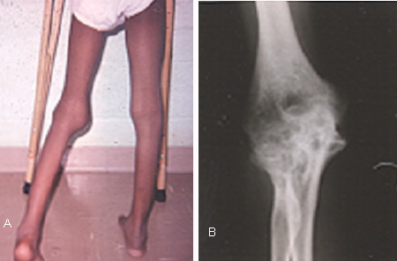
LONG-TERM COMPLICATIONS OF HEMOPHILIA
Joint destruction
Nerve damage

Slide 11
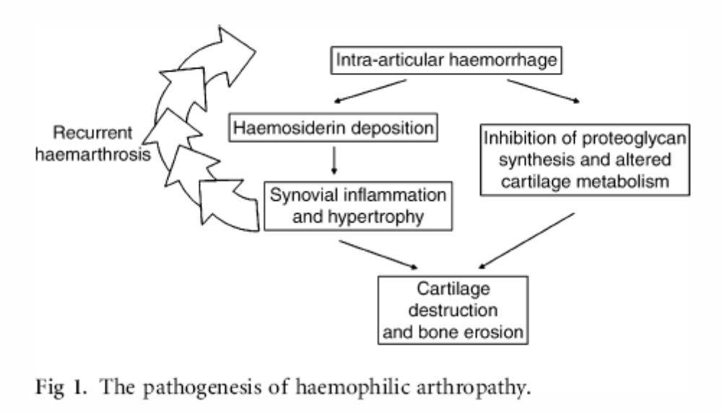
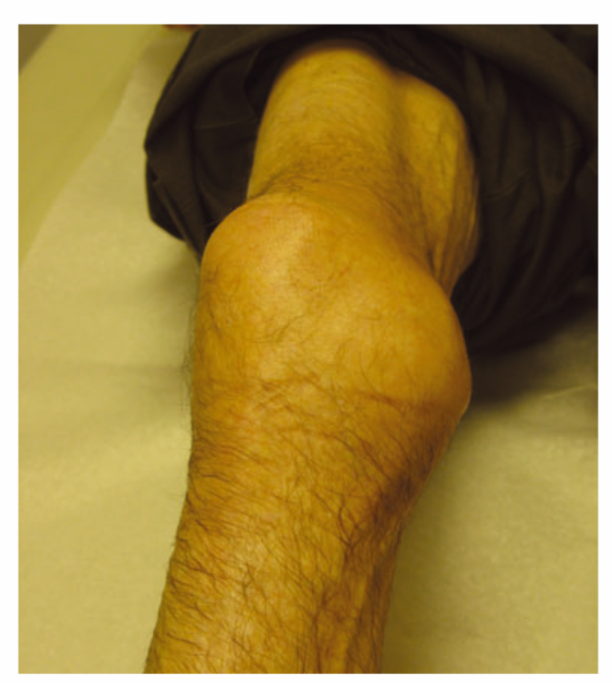
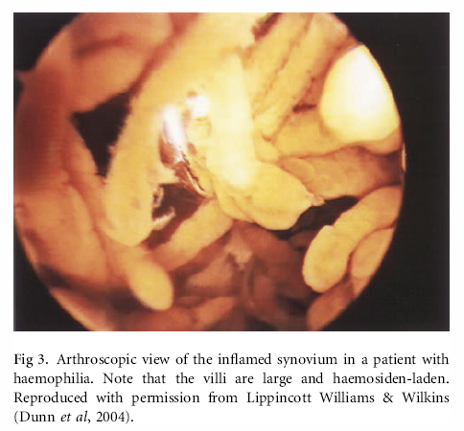
Hemophilic arthropathy
“Target joint” = irreversibly damaged joint with vicious cycle of injury and repeated bleeding

Slide 12
Management of hemophilic arthropathy
Physical therapy
Weight control
COX-2 inhibitors (eg, celecoxib) safe and effective
Judicious use of opioids
Surgical or radionuclide synovectomy
Joint replacement

Slide 13
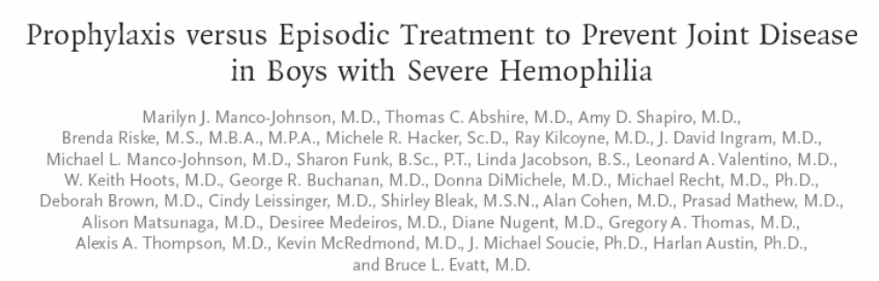
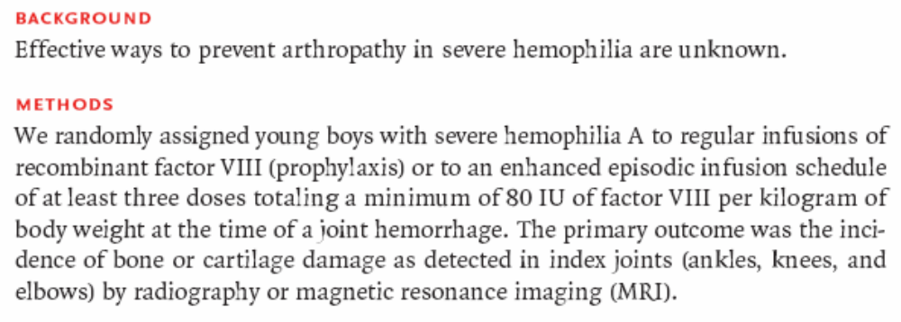
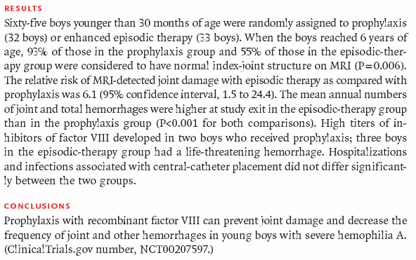
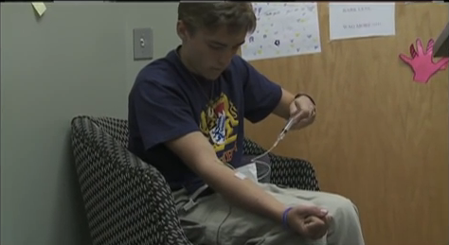


Slide 14
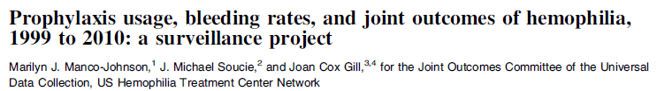
Blood 2017;129:2368-2374
Bleeding rates decreased dramatically from 1999 to 2010
This change occurred in parallel with increased use of prophylaxis
Prophylaxis started before age 4 preserved joint function

Slide 15
OTHER COMPLICATIONS OF HEMOPHILIA
Pseudotumor: gradually enlarging cyst in soft tissue or bone (requires surgery)
Retroperitoneal hemorrhage
Bowel wall hematoma
Hematuria → renal colic (rule out structural lesion)
Intracranial or intraspinal bleeding (rare but deadly) – usually after trauma

Slide 16
HEMOPHILIA
Treatment of bleeding episodes
Unexplained pain in a hemophilia should be considered due to bleeding unless proven otherwise
External signs of bleeding may be absent
Treatment: factor replacement, pain control, rest or immobilize joint
Test for inhibitor if unexpectedly low response to factor replacement

Slide 17
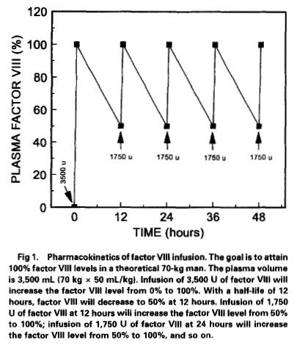
Dosing clotting factor concentrate
1 U/kg of factor VIII should increase plasma level by about 2% (vs 1% for factor IX)
Half-life of factor VIII 8-12 hours, factor IX 18-24 hours
Volume of distribution of factor IX about twice as high as for factor VIII
Steady state dosing about the same for both factors – initial dose of factor IX should be about 2x higher

Slide 18
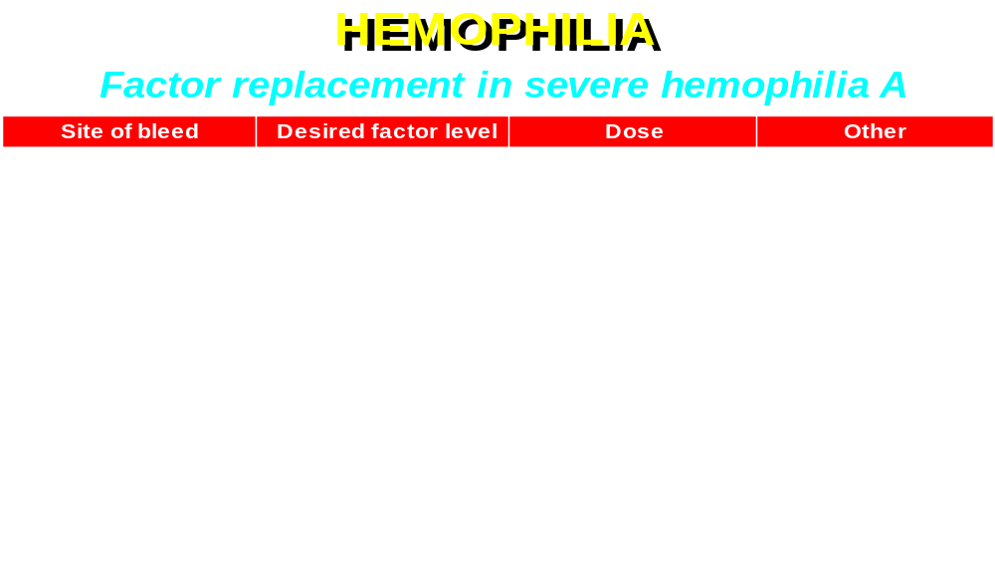
Give factor q 12 hours for 2-3 days after major surgery, continue with daily infusions for 7-10 days
Trough factor levels with q 12 h dosing after major surgery should be at least 50%
Most joint and muscle bleeds can be treated with “minor” (50%) doses for 1-3 days without monitoring

Slide 19
FACTOR VIII CONCENTRATE
Recombinant
  Virus-free, most expensive replacement
  Treatment of choice for younger/newly diagnosed hemophiliacs
  Somewhat lower plasma recovery than with plasma-derived concentrate
Plasma-derived, highly purified
  Solvent/detergent treated, no reports of HIV or hepatitis transmission
Intermediate purity (Humate-P™)
  Contains both factor VIII and von Willebrand factor
  Solvent/detergent treated, no reports of HIV or hepatitis transmission
  Mainly used to treat von Willebrand disease
Extended half-life products now available for prophylaxis

Slide 20
Emicizumab (Hemlibra®)
Bispecific antibody that simultaneously binds factors IXa and X, mimicking the action of FVIII
Long half-life – can be dosed every 1-4 weeks
Now FDA-approved for prophylaxis of bleeding in hemophilia A patients with or without inhibitors
Administration every one or two weeks reduced bleeding rate by >95% (vs no prophylaxis) in hemophilia A patients without inhibitors (NEJM 2018;379:811)
Effective in patients with inhibitors; reports of thrombosis and TMA when used in conjunction with bypassing agents

Slide 21
Measuring factor VIII in patients treated with emicuzumab
Emicizumab behaves just as FVIII in the clot-based assay system – cannot measure endogenous VIII with that assay in emicizumab-treated patients
Alternate assay utlilizes bovine factor IXa and X that do not bind emicizumab but do interact with human factor VIII
Readout is factor Xa activity, measured by chromogenic substrate

Slide 22
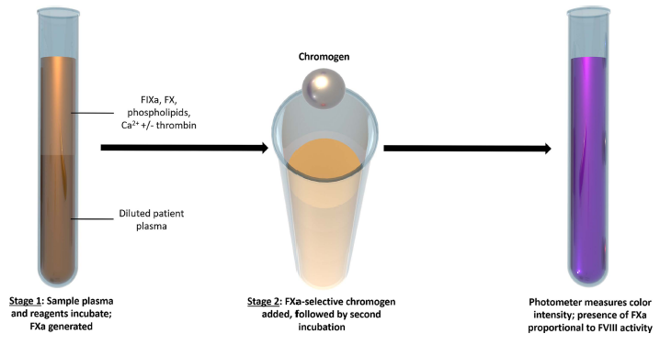
Chromogenic factor VIII assay
Assay is calibrated by comparing to results obtained with reference plasmas containing known amounts of factor VIII

Slide 23
FACTOR IX CONCENTRATE
Recombinant (slightly lower plasma recovery)
Plasma-derived (solvent/detergent treated, no reports of virus transmission)
Extended half-life products available for use in prophylaxis

Slide 24
DDAVP
Releases vWF/fVIII from endothelial cells
Factor VIII levels typically rise 2-4 fold after 30-60 min (IV form) or 60-90 min (intranasal)
Enhanced platelet adhesion due to ↑ vWF
Useful for mild hemophilia (VIII activity > 5%) prior to dental work, minor surgery etc
Trial dose needed to ensure adequate response
Cardiovascular complications possible in older patients

Slide 25
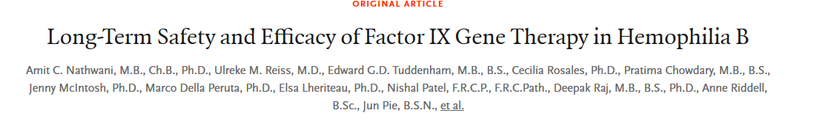

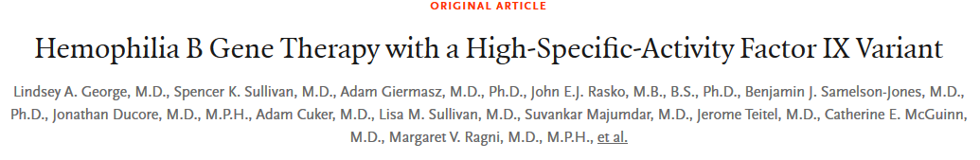

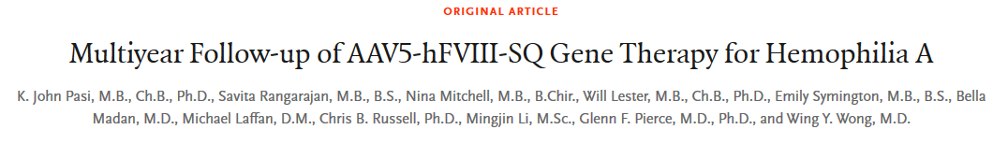


Slide 26
Inhibitor formation in hemophilia
More common in hemophilia A
  < 1% of hemophilia B patients develop inhibitors
7-10 x more common in severe hemophilia
  About 30% of patients with intron 22 inversion develop inhibitors
More common with use of recombinant factor
Other genetic factors also involved

Slide 27
When to test for an inhibitor?
If factor replacment less effective than usual
Prior to major surgery
Routine screening?
  Current pediatric recommendations recommend frequent screening
  Screening every 3-6 mo reasonable in high risk patients

Slide 28
Treatment of hemophiliacs with inhibitors
Recombinant factor VIIa
  Enhances TF-driven thrombin formation
FEIBA (Factor Eight Inhibitor Bypassing Activity)
  Mixture of partially activated vitamin K-dependent clotting proteases including VIIa
Porcine factor VIII (if available)
  Some inhibitors active against porcine VIII (need to test)
Emicizumab
Induction of tolerance with daily factor VIII infusions
  Optimal dose not established
  Role for concomitant immunosuppression?

Slide 29
Liver disease in hemophilia
Hepatitis C still a problem, though incidence falling with safer factor concentrates
Liver transplantation done occasionally (cures hemophilia)
All hemophiliacs should be vaccinated against hepatitis A and B

Slide 30
Hemophilia: carrier testing
Factor level alone should not be used
VIII:VWF ratio may be helpful
DNA testing should be done if possible
  Identification of causative mutation in an affected relative helpful, particularly for families with missense mutations

Slide 31
Rare clotting factor deficiencies

Slide 32
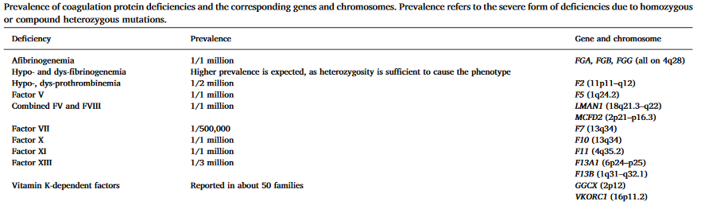
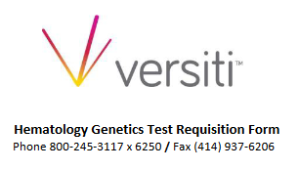
How rare?
Menegatti and Palla, Thromb Res 2020

Slide 33
Afibrinogenemia
Prevalence ~ 1:1,000,000
Recessive inheritance
  Most reported cases from consanguineous parents
May be due to failure of synthesis, intracellular transport or secretion of fibrinogen
Moderate to severe bleeding
  Death from intracranial bleeding in childhood may occur
  GI and other mucosal hemorrhage
  Menorrhagia
  Placental abruption
Treat with purified fibrinogen concentrate (preferred) or cryoprecipitate for bleeding, during pregnancy

Slide 34
Inherited dysfibrinogenemia
Prevalance uncertain (most cases asymptomatic)
Usually dominant inheritance
Most cases due to missense mutations
Mutations may affect fibrin polymerization, fibrinopeptide cleavage, or fibrin stabilization by FXIIIa
Variable clinical manifestations (mutation-dependent):
  Over 50% asymptomatic
  Approx 25% with bleeding tendency (mild to severe)
  20% have a thrombotic tendency (arterial, venous, or both)
    Decreased thrombin-binding (antithrombin effect) of fibrin?
    Altered fibrin clot structure?

Slide 35
Diagnosis of dysfibrinogenemia
Prolonged thrombin & reptilase times
  Reptilase = venom enzyme that clots fibrinogen, not inhibited by heparin/antithrombin
  PT, aPTT may be prolonged
Disparity (>30%) between fibrinogen activity and antigen
Family testing
Evaluate for liver disease/cancer (can cause acquired dysfibrinogenemia)

Slide 36
Recessively inherited clotting factor deficiencies
Rare (most common: XI, XII deficiency)
Homozygotes (often consanguineous parents) or compound heterozygotes
Quantitative (“type 1”) deficiency: parallel reduction in antigen and activity
Qualitative (“type 2”) deficiency: reduced activity with near-normal antigen
Complete deficiency of II, X not described (lethal?)
Mutation usually in gene encoding clotting factor
  Exceptions:
  Combined V, VIII deficiency
  Combined deficiency of vitamin K-dependent factors

Slide 37
Combined deficiency of factors V and VIII
Levels 5-20% of normal
Mutations of LMAN-1 (ERGIC-53) or MCFD2 disrupt intracellular trafficking of V and VIII

Slide 38
Deficiency of multiple vitamin-K dependent clotting factors
Levels of II, VII, IX, X, proteins C and S <1% to 30% of normal
Bleeding symptoms proportional to degree of deficiency
Usually caused by missense mutations in vitamin K epoxide reductase subunit 1 (VKORC1)

Slide 39
Factor XI

Slide 40
Factor XI deficiency
Recessive inheritance
Most common in individuals of Ashkenazi Jewish descent
  2 common mutations (one nonsense, one missense)
  Allele frequency as high as 10%, 0.1-0.3% homozygous
  Most affected patients compound heterozygotes with low but measurable levels of XI activity
Long aPTT, normal PT
  XI activity < 10% in most patients with bleeding tendency

Slide 41
Factor XI deficiency
Clinical features & treatment
Variable, generally mild bleeding tendency
  Bleeding after trauma & surgery
  Spontaneous bleeding uncommon
  Bleeding risk does not correlate well with XI level
Treatment: FFP
  15 ml/kg loading, 3-6 ml/kg q 12-24h
  Half life of factor >48 hours
  Antifibrinolytics useful after dental extraction, surgery
  rVIIa effective; thrombotic complications reported

Slide 42
Factor XIII
Transglutaminase: forms amide bonds between lysine and glutamic acid residues on different protein molecules
Heterotetramer (A₂B₂) in plasma
  A chains made by megakaryocytes and monocyte/macrophage precursors
  Platelet XIII (50% of total XIII) has only A chains
  B chains (non-catalytic) made in liver
Proenzyme activated by thrombin
Crosslinks and stabilizes fibrin clot
Can crosslink other proteins (e.g., antiplasmin) into clot

Slide 43
Inherited factor XIII deficiency
Autosomal recessive, rare (consanguineous parents)
Heterozygous woman may have higher incidence of spontaneous abortion
Most have absent or defective A subunit

Slide 44
Inherited factor XIII deficiency
Clinical features & treatment
Bleeding begins in infancy (umbilical cord)
Poor wound healing
Intracranial hemorrhage
Oligospermia, infertility
Diagnosis:
  Urea solubility test (not very sensitive)
  Measurement of XIII activity or antigen
  Rule out acquired deficiency due to autoantibody
Treatment: F XIII concentrate or recombinant factor XIII
  long half life, give every 4-6 weeks as prophylaxis

Slide 45
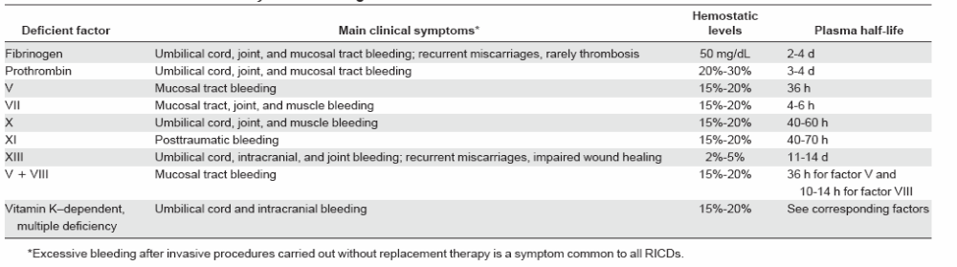
Clinical features of recessively inherited factor deficiencies
Blood 2004; 104:1243

Slide 46
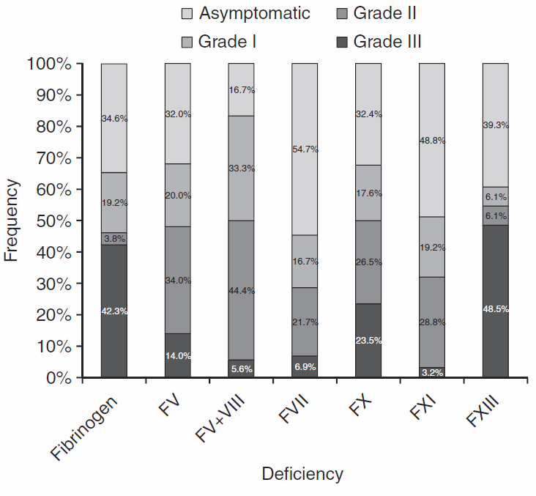
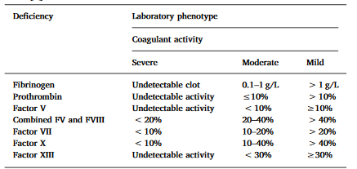
Severity of bleeding in rare inherited bleeding disorders
Frequency of bleeding episodes
ISTH definitions of severity
J Thromb Haemost 2012;10:615
Menegatti and Palla, Thromb Res 2020

Slide 47
Factor concentration vs bleeding severity in rare coagulation factor deficiencies
Deficiency | Asymptomatic | Grade I bleeding | Grade II bleeding | Grade III bleeding
Fibrinogen | 113 mg/dL | 73 mg/dL | 33 mg/dL | 0 mg/dL
Factor V | 12% | 6% | 0.01% | 0%
FV + F VIII | 43% | 34% | 24% | 15%
Factor VII | 25% | 19% | 13% | 8%
Factor X | 56% | 40% | 25% | 10%
Factor XI | 26% | 26% | 25% | 25%
Factor XIII | 31% | 17% | 3% | 0%
Grade 1: Bleeding after trauma or anticoagulant/antiplatelet drug ingestion
Grade 2: Spontaneous minor bleeding
Grade 3: Spontaneous major bleeding
European Network of Rare Bleeding Disorders: J Thromb Haemost 2012;10:615

Slide 48
Treatment of rare clotting factor deficiencies
FFP
Prothrombin complex concentrate (II, VII, IX, X) or specific factor concentrate (XIII – others available in Europe) when appropriate
Platelet transfusion an alternative to FFP for factor V deficiency (20% of FV in blood is in platelets)
Goal is to maintain “minimal hemostatic levels”
Antifibrinolytic drugs for mucosal hemorrhage
Routine prophylaxis appropriate for F XIII deficiency (long half-life, low levels adequate for hemostasis)
Otherwise treatment appropriate for active bleeding or pre-procedure

Slide 49
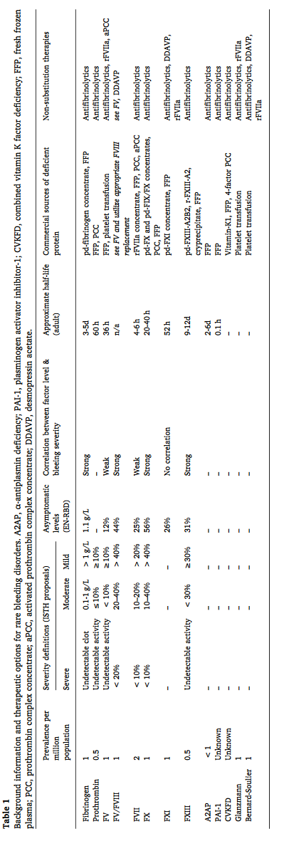
Treatment options
Shapiro, Thromb Res 2020
See also: Menegatti and Peyvandi. Treatment of rare factor deficiencies other than hemophilia. Blood 2019; 133:415

Slide 50
Vascular disorders

Slide 51
Hereditary Hemorrhagic Telangiectasia
Autosomal dominant inheritance
Caused by null alleles in one of 3 genes for endothelial cell proteins that affect growth factor signaling:
  Endoglin (ENG) (most common)
  Activin receptor-like kinase (ACVRL1)
  SMAD4 (also associated with juvenile polyposis)
Multiple small AVMs in skin, mouth, GI tract, lungs

Slide 52
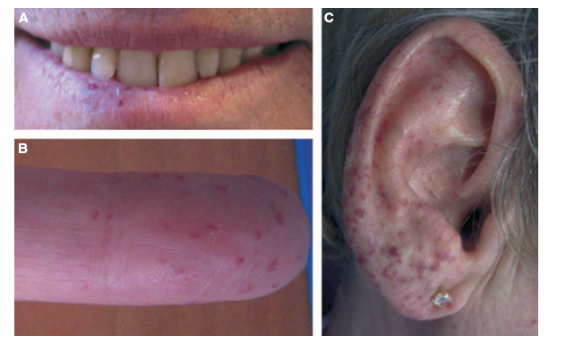
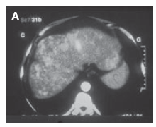
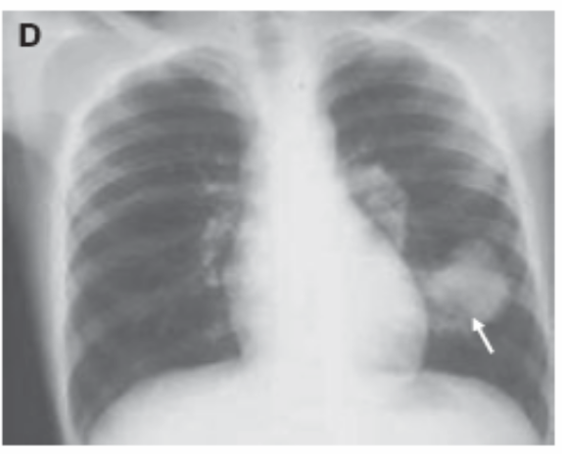
Hereditary hemorrhagic telangiectasia
J Thromb Haemost 2010;8:1447

Slide 53
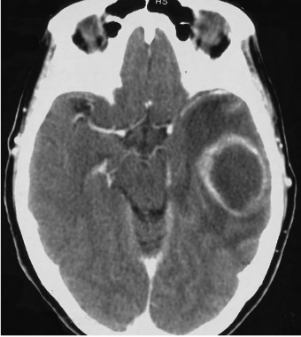
Hereditary hemorrhagic telangiectasia
Brain abscess following dental procedure
Corre et al, Br J Oral Maxillofac Surg 2010

Slide 54
Hereditary Hemorrhagic Telangiectasia
Clinical features
Epistaxis, GI bleeding – may be severe
  Severe iron deficiency common
Pulmonary or CNS bleeding often fatal
Gradual increase in bleeding risk with age
AVMs enlarge during pregnancy
Risk of brain abscess
Hypoxemia from pulmonary HTN and R→L shunting in lung

Slide 55
Hereditary Hemorrhagic Telangiectasia
Treatment
No consistently effective method for preventing bleeding
  Antifibrinolytics, thalidomide, estrogens sometimes beneficial
Aggressive iron replacement
Antibiotic prophylaxis for dental work etc
Screen for CNS lesions → consider surgical intervention

Slide 56
Ehlers-Danlos syndrome
Defective collagen structure
  Mutations in genes for various types of collagen
9 variants
  Type IV (mutation in type III collagen gene) most likely to cause bleeding
Bleeding due to weakening of vessel wall → vessel rupture
Conventional tests of hemostatic integrity normal

Slide 57
Ehlers-Danlos syndrome
Thin, weak skin with poor healing
  “Cigarette paper” scars
Bruising
Hypermobile joints
  Spontaneous joint dislocation
Median survival 48 years in type IV EDS
  Death from rupture of large vessels or colon perforation

Slide 58
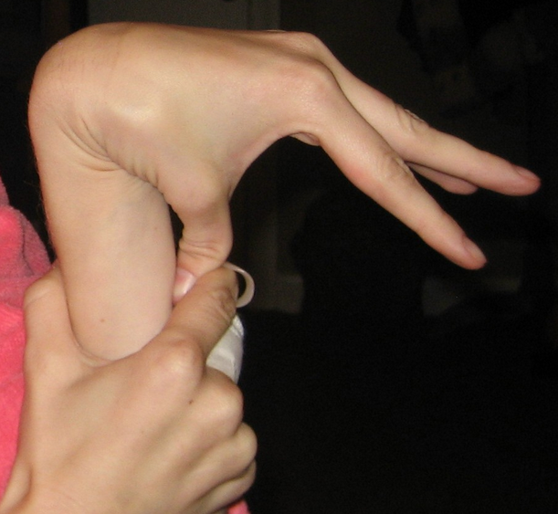
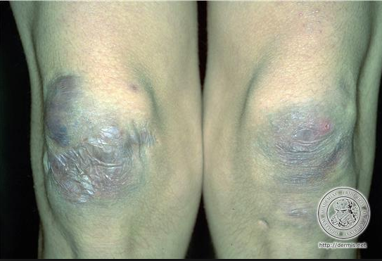
Ehlers-Danlos Syndrome
Lifewitheds.com
Morphopedics.wikdot.com

Slide 59
von Willebrand disease

Slide 60
VON WILLEBRAND DISEASE
Common (most common?) inherited bleeding disorder
Partial lack of VWF causes mild or moderate bleeding tendency
  Menorrhagia, bleeding after surgery, bruising
Typically autosomal dominant with variable penetrance
Laboratory:
  Defective platelet adherence (PFA-100) or long bleeding time
  Subnormal levels of von Willebrand antigen and factor VIII in plasma
  Low Ristocetin cofactor activity or VWF activity

Slide 61
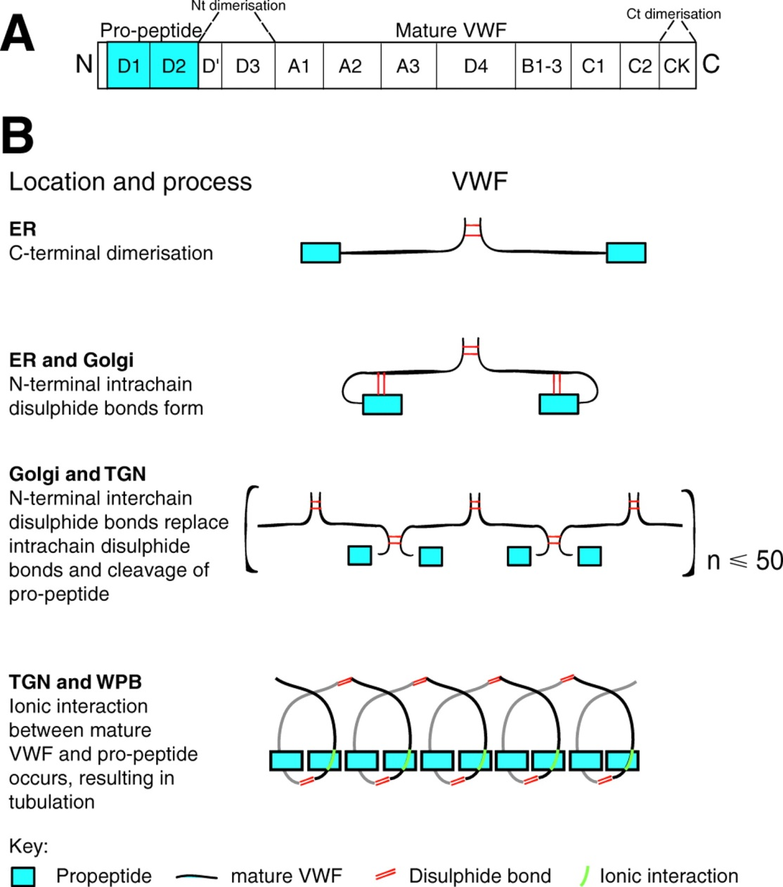
VWF multimer formation

Slide 62
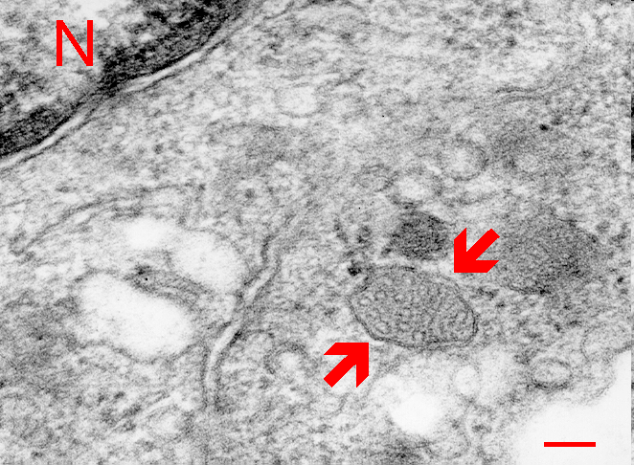
Endothelial cell
Weibel-Palade body (arrows) in the cytoplasm of endothelial cell. N - nucleus. Scale = 100 nm. (Human, skin.)

Slide 63
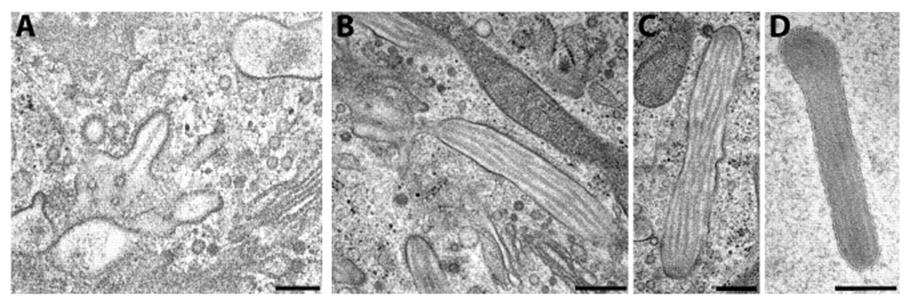
Tubular VWF arrays within Weibel-Pallade bodies
Metcalf D J et al. J Cell Sci 2008;121:19-27
Notes:
Biogenesis of WPBs in cultured human endothelial cells seen by HPF/FS. (A) Tubule formation in the TGN and the cooperation of AP1 and clathrin in initial formation. (B) Immature WPB with electron-lucent interior, but with a membranous stalk still attaching it to the TGN. (C) Immature WPB with clathrin-coated bud, which is presumably involved in retrieval of material not required in the mature WPBs. (D) Mature WPB showing the remarkable increase in electron density that occurs during maturation. Bars, 200 nm.

Slide 64
VON WILLEBRAND DISEASE
Type 1: VWF antigen and activity reduced proportionately
  VWF levels range from < 20% to ~30%
    Levels of >30-50% (“Low VWF”) fairly common, associated with mild bleeding in many patients
  Complex genetics – only 65% of cases associated with VWF gene mutations
  Autosomal dominant inheritance (dominant negative or null alleles)
  Variable penetrance (affected by blood type, other factors)
  Defects in VWF processing, storage or secretion may account for cases lacking VWF gene mutation
  Some variants cause accelerated VWF clearance

Slide 65
VON WILLEBRAND DISEASE
Genetics
Frequency of VWF gene mutations in type I VWD according to degree of deficiency:
  Mutations identified in 53% of the Type 1 VWD cohort
  Of the Type 1 VWD individuals with VWF levels <40, 74% had VWF gene mutations.
  87% with VWF:Ag of 2-10
  93% with VWF:Ag 11-20
  71% with VWF:Ag of 21-30
  67% with VWF:Ag of 31-40
  52% with VWF:Ag of >40
Montgomery et al, 2013 ASH abstract

Slide 66
VON WILLEBRAND DISEASE
Type 2 – qualitative defect (missense mutation)
  Four different types
  Usually a disproportionate decrease in vWF activity vs antigen
Type 3 – severe deficiency
  Antigen, activity undetectable; factor VIII levels < 10%
  Homozygosity for null alleles
  Hemophilia-like phenotype
  Recessively inherited (must distinguish from severe type I)

Slide 67
Type 2 vWD
2A: Deficiency of intermediate & large multimers
  Defective assembly (mutation in either of two domains involved in multimer formation), or
  Increased susceptibility to proteolysis (mutation in domain cleaved by ADAMTS-13)
2B: Largest multimers missing
  Gain of function mutation in platelet Gp Ib binding domain
  Largest multimers bind spontaneously to platelets and cleared from blood (platelet count may be low)
2M: Normal multimer pattern
  Loss of function mutation in GP Ib or collagen binding domain
2N: Decreased binding of factor VIII to vWF
  Phenotype and lab findings similar to mild hemophilia A
  Autosomal recessive

Slide 68
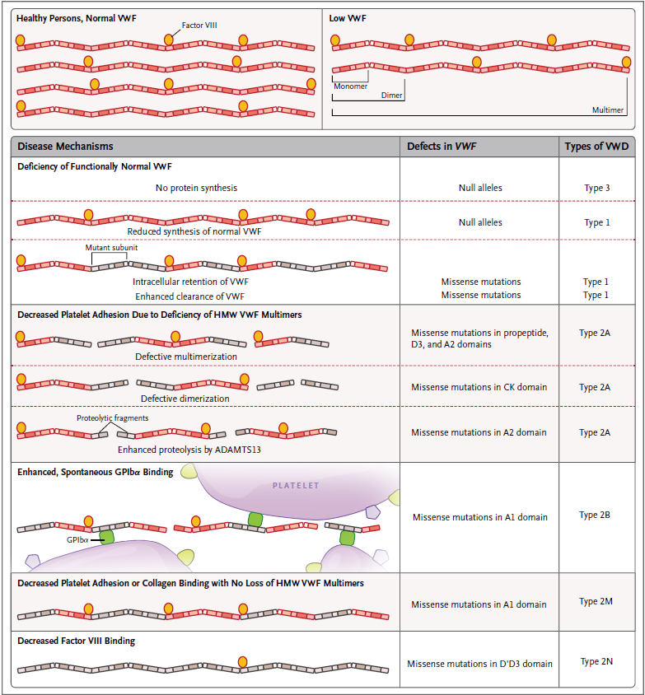
Subtypes of VWD
NEJM 2016;375:2067

Slide 69
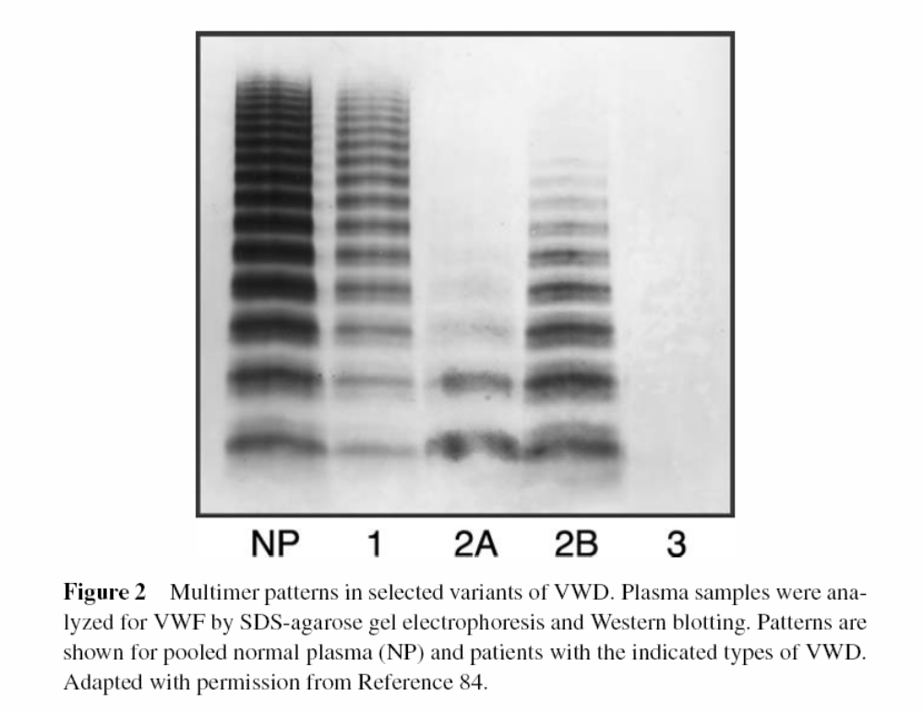

Slide 70
Platelet type von Willebrand disease
Gain of function mutation in GP Ib→ enhanced binding to VWF→ clearance of largest multimers from blood
Phenotype and lab findings similar to VWD 2B
Autosomal dominant
Platelet count often low
Can distinguish from 2B VWD by mixing studies with normal/pt platelets and plasma and low dose ristocetin, or by genetic testing

Slide 71
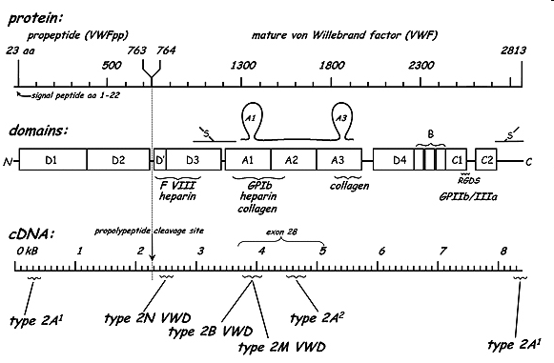
Genetics of VWD
Most type 1 VWD due to missense mutations (dominant negative – interference with intracellular transport of dimeric pro-VWF)
  Some forms with incomplete penetrance require co-inheritance of blood type O for expression (causes increased VWD proteolysis)
Most type 3 VWD due to null alleles

Slide 72
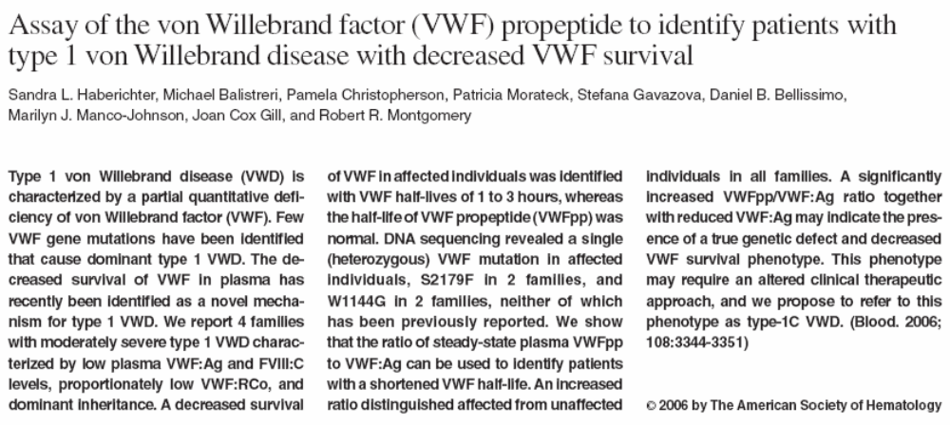

Slide 73
Desmopressin (DDAVP) in vWD
Releases vWF/fVIII from endothelial cells
IV or intranasal
  0.3 mcg/kg IV, or 150 mcg per nostril
Typically 2-4 fold increase in blood levels of vWF (in type 1 vWD), with half-life of 8+ hours
Response varies → trial dose necessary
  Peak response
  Duration of response
If response not adequate use vWF concentrate instead

Slide 74
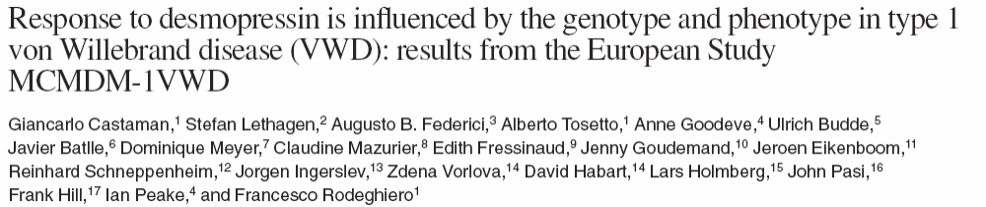
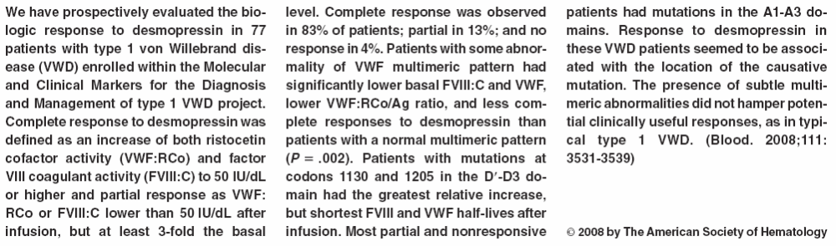

Slide 75
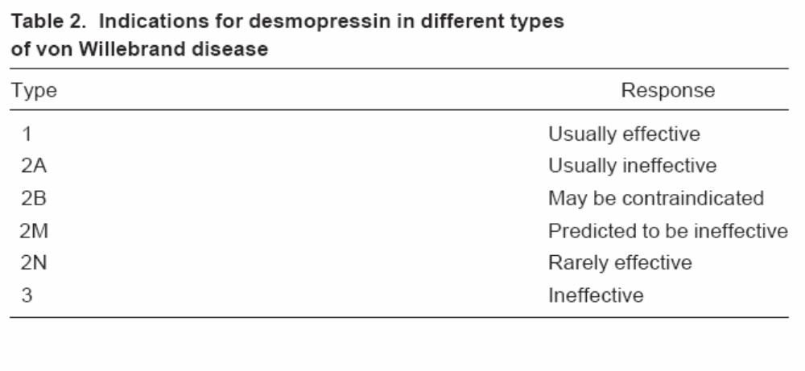

Slide 76
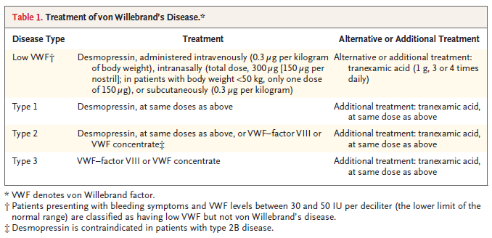
Treatment of vWD
Recombinant VWF now available – does not contain FVIII. Supplemental FVIII concentrate may be required when it is used
NEJM 2016;375:2067

Slide 77
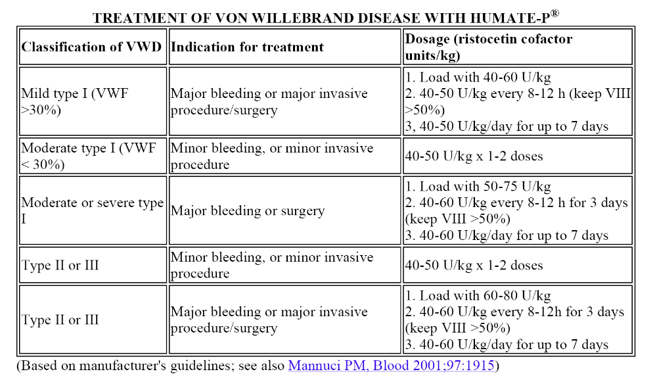

Slide 78
Inherited platelet disorders

Slide 79
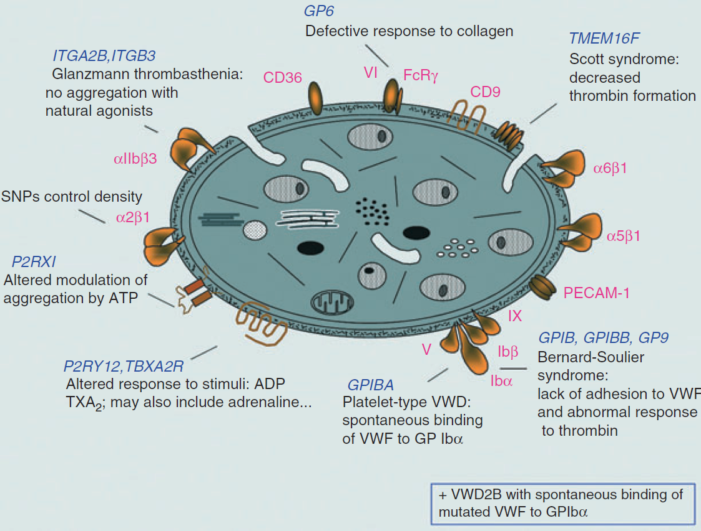
Defects in platelet surface molecules
J Thromb Haemost 2011; 9(suppl 1):77

Slide 80
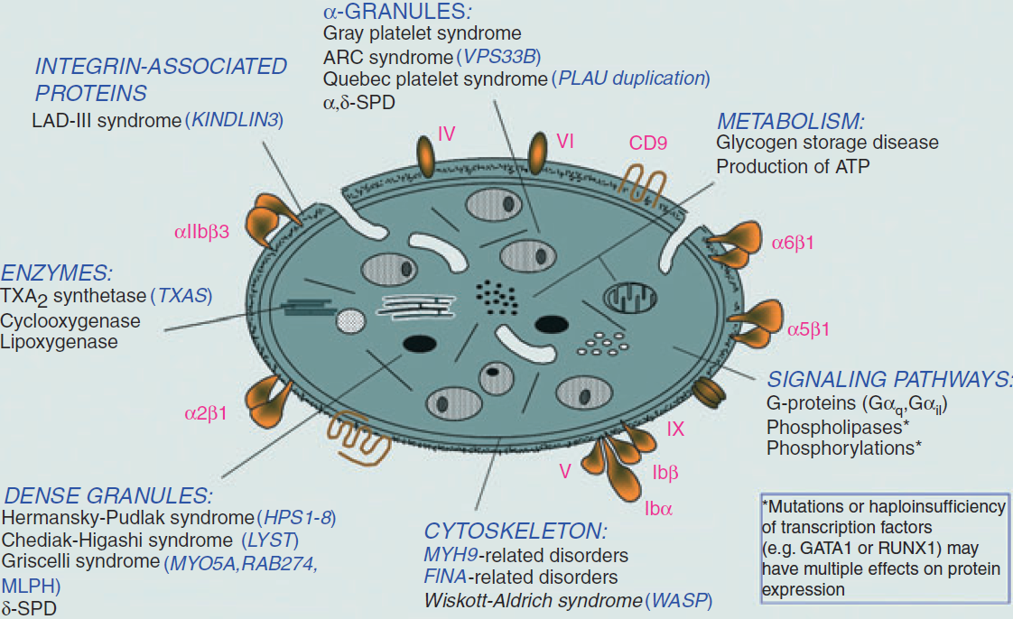
Defects in platelet organelles or cytosolic proteins
J Thromb Haemost 2011; 9(suppl 1):77

Slide 81
Bernard-Soulier syndrome
Deficiency of platelet membrane glycoprotein Ib-IX (VWF “receptor”)
Defective platelet adhesion
Moderate to severe bleeding
Autosomal recessive, rare
Giant platelets
Thrombocytopenia (20-100K) (Often confused with ITP)
Diagnosis:
  No agglutination with ristocetin, decr thrombin response, responses to other agonists intact
  Morphology
  Decreased GP Ib expression
  Genetic analysis

Slide 82
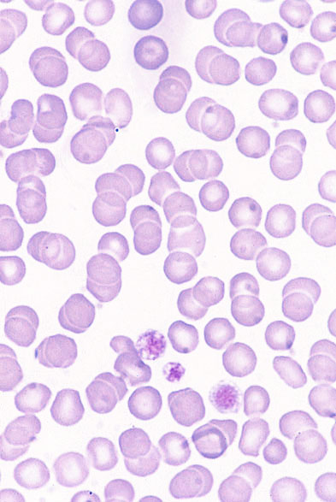
Bernard-Soulier syndrome

Slide 83
Glanzmann thrombasthenia
Deficiency of platelet membrane GPIIb-IIIa
Absent platelet aggregation with all agonists; ristocetin response intact
Moderate to severe bleeding
Autosomal recessive
Platelet number & morphology normal
Diagnosis:
  Characteristic defects in platelet aggregation
  Decreased GP IIb-IIIa expression (flow cytometry)
  Genetic analysis

Slide 84
Gray platelet syndrome
Empty platelet alpha granules
Mild bleeding
Autosomal dominant or recessive
Morphology:
  Hypogranular platelets
  Giant platelets
  Thrombocytopenia (30-100K)
Myelofibrosis in some patients
Diagnosis
  Variably abnormal platelet aggregation (can be normal)
  Abnormal platelet appearance on blood smear
  Electron microscopy showing absent alpha granules

Slide 85
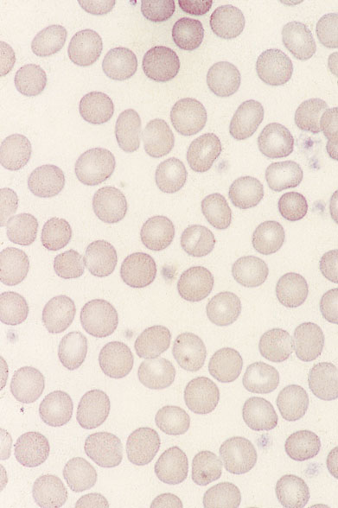
Gray platelet syndrome

Slide 86
Giant platelet syndromes with MYH9 mutations
May-Hegglin anomaly
Fechtner syndrome
Sebastian syndrome
Epstein syndrome
Mutations in the non-muscle myosin heavy chain gene MYH9
Thrombocytopenia with giant platelets
Deafness & kidney disease in some variants
Mild bleeding
Autosomal dominant inheritance
Normal platelet function
Diagnosis: clinical picture, family history, examination of blood smear for neutrophil inclusions

Slide 87
Giant platelet syndromes with MYH9 mutations
Syndrome | Neutrophil inclusions | Hereditary nephritis | Deafness
May-Hegglin | Yes | No | No
Fechtner | Yes | Yes | Yes
Sebastian | Yes* | No | No
Epstein | No | Yes | Yes
*Neutrophil inclusions have different structure from those in May-Hegglin

Slide 88

Neutrophil inclusions in May-Hegglin anomaly

Slide 89
Wiskott-Aldrich syndrome
Mutation in WASP signaling protein
Decreased secretion and aggregation with multiple agonists; defective T-cell function
Mild to severe bleeding
Eczema, immunodeficiency
X-linked
Thrombocytopenia (20-100K)
Small platelets with few granules
Diagnosis:
  Family hx
  Clinical picture
  Genetic testing

Slide 90

Wiskott-Aldrich syndrome

Slide 91
Hermansky Pudlak syndrome
Platelet dense granule deficiency: decreased aggregation & secretion with multiple agonists
Defective pigmentation
Defective lysosomal function
Mild to moderate bleeding
Oculocutaneous albinism
Lysosomal storage disorder with ceroid deposition, lung & GI disease
Autosomal recessive
Morphology: reduced or absent dense granules
Diagnosis
  Clinical picture
  Platelet EM showing dense granule deficiency
  Genetic testing

Slide 92

Hermansky-Pudlak syndrome
Br J Haematol 2007;138:671
Disaggregation after primary aggregation with ADP
Dense granule deficiency
Control platelet

