Slide 1
Hematologic Disorders after Solid Organ Transplantation
Passenger Lymphocyte Syndrome
Drug-Induced Anemia and Other Cytopenias
Thrombotic Microangiopathy
Viral Suppression of Hematopoiesis
GVHD
EBV Driven PTLD
Infection-Induced Hemophagocytic Syndrome

Slide 2
Passenger Lymphocyte Syndrome
ABO-mismatched SOT
  Minor mismatch: Donor preformed anti-A/B isohemagglutinins directed against recipient’s RBC antigens
  Passenger memory B lymphocytes from donor are stimulated by recipient Ag → Antibodies
Alloimmune hemolysis of recipient RBCs
Higher in heart-lung transplants (70%), lower in liver (29%) and kidney transplants (9%)
Abrupt onset 1-3 weeks after SOT
Can also occur in minor blood group mismatch
Self-limited usually resolving within 3 months

Slide 3
Drug-Induced Anemia/Cytopenias
Bactrim:
  Folate deficiency, Drug induce hemolysis, G-6PD associated hemolysis
Dapsone
  Drug induced hemolysis
Ganciclovir and valganciclovir
  Severe pancytopenia (reversible)
Calcineurin inhibitor- induced anemia
  Marrow suppression, TMA
MMF
  Leukopenia by marrow suppression
Sirolimus
  Anemia esp in renal transplant (iron hemostasis, direct anti proliferative effect, IL 10 activation)
Azathioprine
  Anemia/pancytopenia
Alemtuzumab: reports of PRCA and immune hemolysis
Pure red-cell aplasia : MMF, tacrolimus, azothioprine and ATG
Notes:
Iron hemostasis, a direct antiproliferative effect on the marrow, and induction of a chronic inflammatory state via interleukin-10 (IL-10)- dependent inflammatory autoregulation.8

Slide 4
Thrombotic Microangiopaty
Calcineurin inhibitors induced endothelial injury
Onset within first few weeks of SOT
Can occur months or years after
Most cases, CNI levels within therapeutic range
CMV, HIV, PV B19, hep C also implicated
Microangiopathy can be systemtic or limited to the vasculature of allografted organ
ADAMTS13 levels usually normal
T/M: Withdrawal of drug
Rechallenge with another agent
Case reports of response to eculizumab
Notes:
Can be seen in the context of organ rejection

Slide 5
Viral Suppression of Hematopoiesis
Parvovirus B19
  Erythroid maturation arrest at the pro-normoblast stage
  ELISA or PCR
  Bone marrow: Giant pro-erythroblasts and absence of intermediate- and late-stage normoblasts
  T/M: Reduction of immune suppression, IVIG, EPO
CMV
  Infection of hematopoietic stem cells and stromal cells, alters BM microenivornment
HHV6: Leukopenia
  Quantitative PCR diagnostic for reactivation
  Treated with ganciclovir/foscarnet/cidofovir
HHV8
EBV

Slide 6
GVHD after SOT
Very rare (0.1-1%) but lethal
Engraftment and proliferation of allograft-associated lymphocytes in immunosuppressed recipient
Occurs early with a median onset of 33 d (range 2-8 weeks)
Risk Factors:
  Quantity of lymphoid tissue in transplanted organ
  Order of frequency: Small bowel > liver > lung > kidney
  Greater degrees of HLA match between donor and recipient
  Donor age >65 years

Slide 7
Donor Chimerism in SOT
Number of lymphoid cells in a liver allograft is comparable to SCT
  10⁹ to 10¹⁰ donor lymphocytes remain in the portal tract of the graft after perfusion (Kohler et al.)
Transient lymphocyte chimerism occurs in recipients
Rapidly decreases by 3rd post op week (<1%)
Possible undetected levels in blood due to severe leukopenia
  Other sources: Buccal mucosa, bone marrow, GI tissue, skin tissue, lymphocyte enriched blood

Slide 8
Presentation
Fever
Rash
Diarrhea
Pancytopenia
  Profound marrow aplasia due to “graft-vs.-hematopoiesis”
Diagnosis:
  Histological features of GVHD
  Lymphocyte macrochimerism in the peripheral blood, marrow and/or affected tissues.

Slide 9
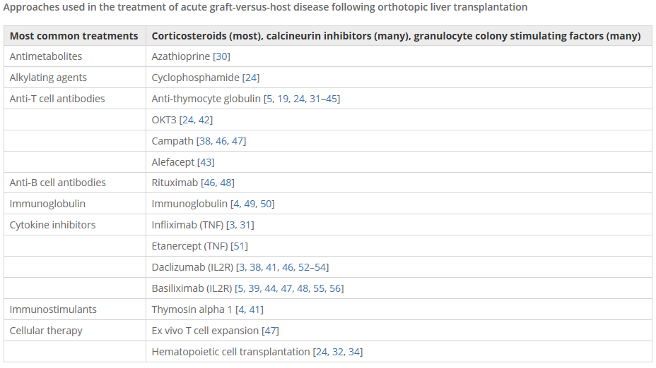
Management
No consensus or standard
High dose steroids
Various T-cell depleting agents
  Infliximab
  Daclizumab
  Basliximab
  Alfacept
  Etanercept

Slide 10
Prognosis
Frequently lethal
mortality rates
  75% in liver-transplant recipients
  100% in lung-transplant recipients
  30% in others
Overwhelming infections main cause of death

