Slide 1
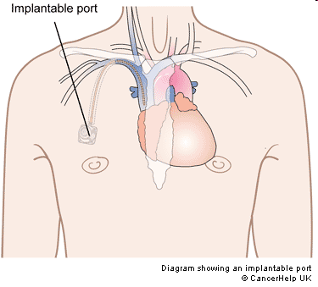
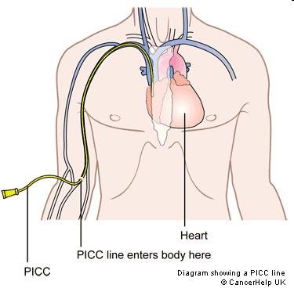
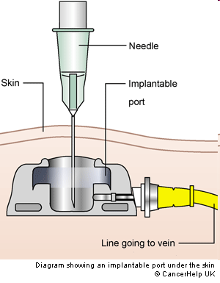

Slide 2
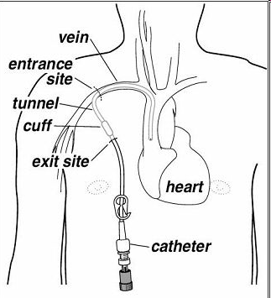
HICKMAN CATHETER

Slide 3
Thrombotic complications associated with venous access devices
Occlusion of lumen
Fibrin sheath formation
Venous thrombosis
  May occur at exit/entrance site, catheter tip, or anywhere in between

Slide 4
Intraluminal
Fibrin sheath
Venous thrombus

Slide 5
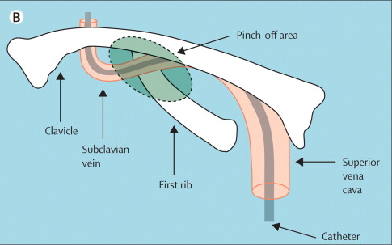
Baskin et al, Lancet 2009

Slide 6
CATHETER THROMBOSIS
Incidence of thrombosis ~10-15%
Risk with port less than half of that with PICC line
Risk increased 2 fold if prior hx of VTE
Risk increased 2 fold if catheter tip malpositioned
Bigger catheter (more lumens) → more risk
Association with catheter infection
Lower risk in patients having myeloablative chemotherapy (thrombocytopenia)
Saber et al, 2009

Slide 7
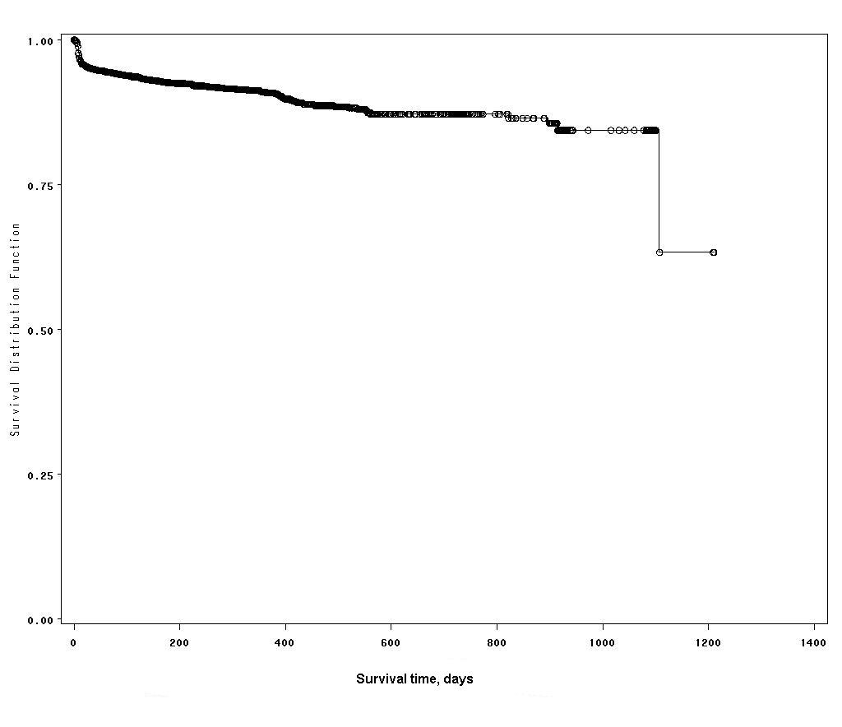
Thrombosis-free survival of venous access devices
Saber et al, 2009

Slide 8
Risk factors
Catheter size/#lumens
Percutaneous insertion
Prior catheter insertion
L sided placement
Subclavian vs internal jugular
Infection
Extrinsic vein compression
Thrombophilia?
Prior DVT
Certain cancers (ovarian)
Asparaginase Rx
Estrogen Rx
Erythropoietic agent Rx
Thalidomide Rx
Heparin-induced thrombocytopenia

Slide 9
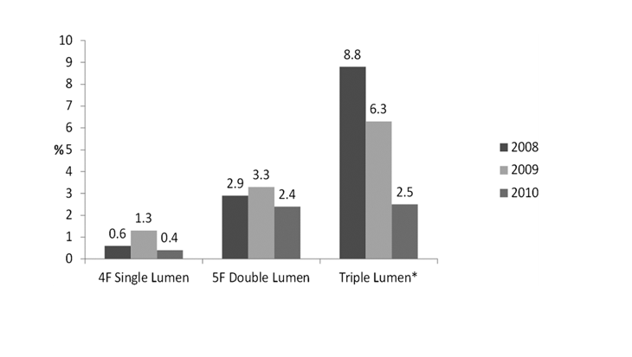
Single-lumen and smaller diameter PICC lines cause less symptomatic DVT
DVT incidence
Chest 2013;143:627-633

Slide 10
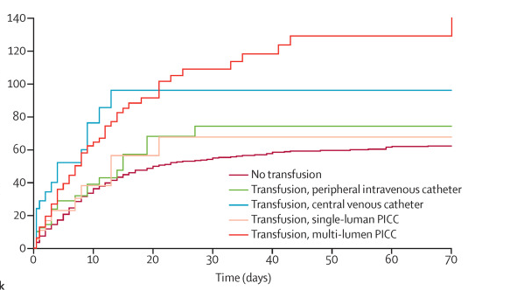
Transfusion through multi-lumen PICC increases risk of CRT
Cumulative DVT incidence
Per 1000 catheter-days
Lancet Haematol 2016;3:e563

Slide 11
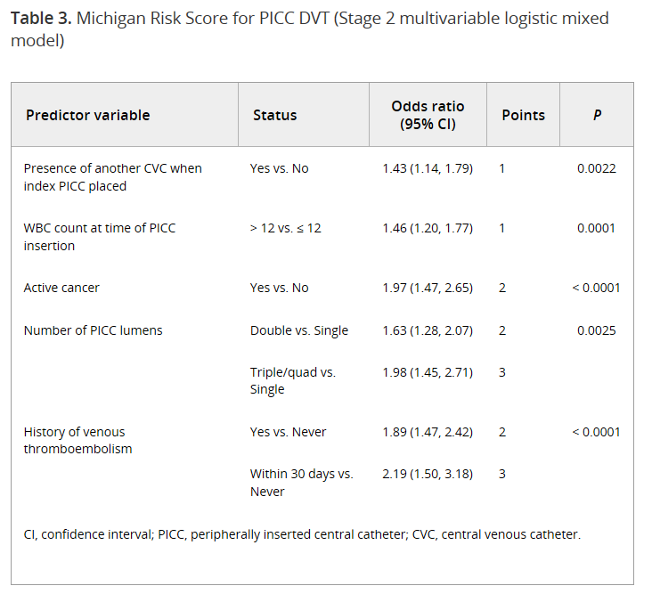
J Thromb Haemost 2017;15:1951

Slide 12
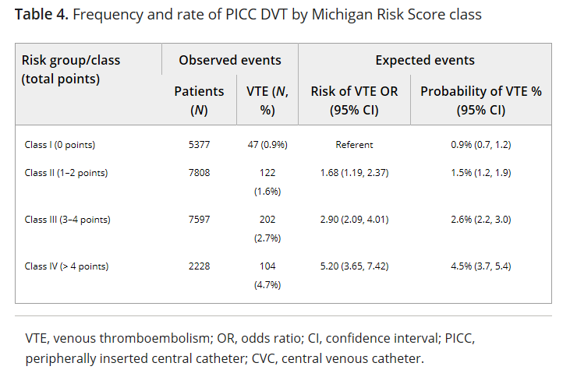
J Thromb Haemost 2017;15:1951

Slide 13
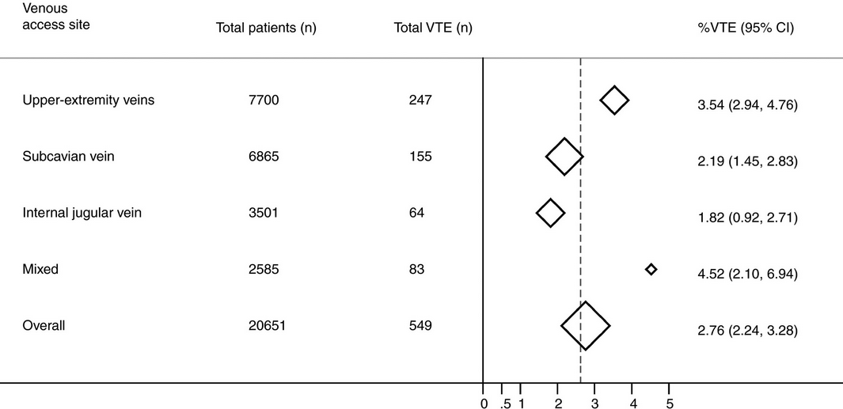
Thrombotic risk with implanted ports according to access site
J Thromb Haemost 2020;18:2253

Slide 14
Diagnosis
Signs and symptoms
Venography
Ultrasound (has limitations)
CT angio or MRI/MRA

Slide 15
Prophylaxis
Low dose warfarin
  Probably ineffective
Intermediate- or full-dose warfarin not adequately studied, likely effective given efficacy in other settings
LMWH likely effective Kahale et al, Cochrane Database Syst Rev 2018
  Dose?
  Duration?
  Risk vs benefit uncertain
DOAC?
Routine prophylaxis not recommended in latest ACCP guidelines
  Consider if prior hx cathether thrombosis or other thrombotic complications

Slide 16
DOAC Prophylaxis
CASSINI trial: low-dose rivaroxaban (10 mg/d) vs placebo to prevent VTE in high-risk cancer patients (NEJM 2019; 380:720)
In 424 trial patients with CVC, 0.5% of patients on rivaroxaban vs 2.4% on placebo had catheter-related thrombosis (post-hoc analysis) (NEJM 2019; 380:2180)

Slide 17
Management of symptomatic catheter-associated venous thrombosis
Catheter removed?
Y
N
Symptoms resolved?
Anticoagulate until removal is possible
N
Y
Short course of anticoagulation vs observation
Anticoagulate 6-12 weeks

