Slide 1
Primary and Secondary Prevention of Venous Thromboembolism
Eliot Williams, MD, PhD
University of Wisconsin

Slide 2
Objectives
• Identify appropriate strategies for preventing venous thromboembolism in hospitalized patients
• Recognize the appropriate strategies for preventing recurrent VTE

Slide 3
Primary prevention of VTE
Notes:
As internists you may be asked to provide recommendations for prophylaxis in surgical as well as medical patients

Slide 4
RATIONALE FOR THROMBOPROPHYLAXIS IN HOSPITALIZED PATIENTS
High prevalence of VTE
  Up to 80% in some patient groups
  Postop VTE 2nd most common medical complicaton
Adverse consequences of VTE
  PE most common cause of preventable hospital death
Effective means of prevention available
Notes:
VTE is a very common problem in hospitalized patients
It is difficult to predict which patients will have VTE
VTE is often clinically inapparent during the hospital stay

Slide 5
RISK FACTORS FOR VTE
Surgery
Trauma
Immobility
Obesity
Increasing age
Previous VTE
Hypercoagulable states
Notes:
Risk/benefit assessment. Most hospitalized patients have one or more of these risk factors

Slide 6
Hypercoagulable states
Cancer and cancer treatment
Pregnancy and the postpartum period
Estrogen therapy
Inflammatory bowel disease
Nephrotic syndrome
Myeloproliferative disorders
Antiphospholipid syndrome
Inherited thrombophilia: diagnosed by laboratory testing or suspected by family history
Notes:
Family history is at least as accurate in identifying patients with a high genetic risk for VTE as lab testing

Slide 7
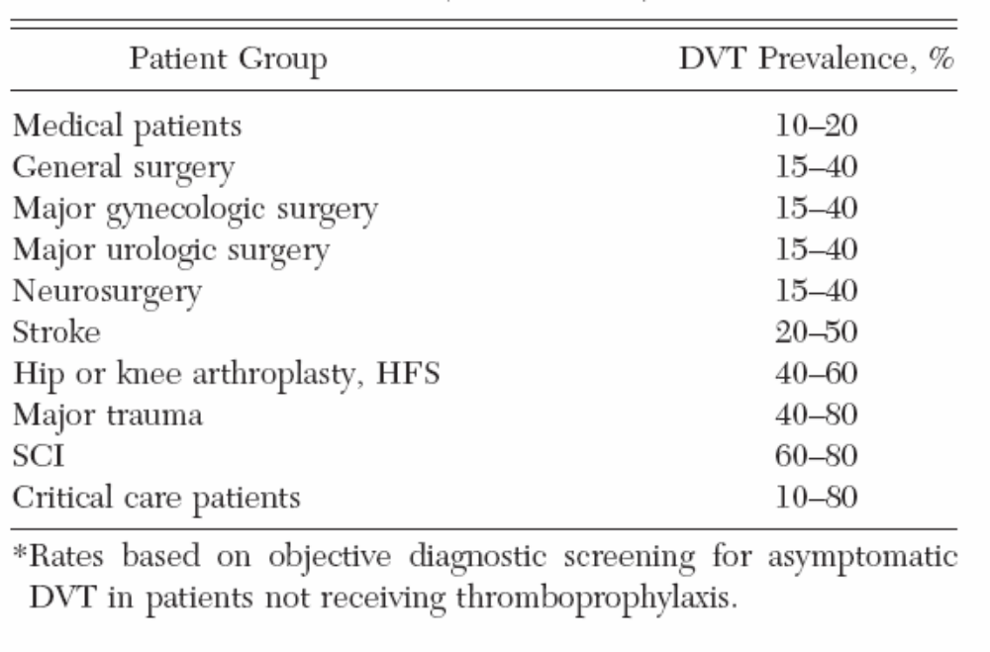
RISK OF DVT IN HOSPITALIZED PATIENTS NOT RECEIVING PROPHYLAXIS
Most thrombotic events occur after hospital discharge
Notes:
Some hospitalized patients have VTE risk as high as 80%
Note that most VTE events (esp in postop patients) occur, or at least become apparent, after hospital discharge

Slide 8
DRUG REGIMENS TO PREVENT VTE
Unfractionated heparin (5000 U subcutaneously q 8-12h)
Low molecular weight heparin (dalteparin 2500 U q 12-24h; enoxaparin 30 mg q 12h or 40 mg daily)
Fondaparinux (2.5 mg sq once daily) (orthopedic and abdominal surgery)
Warfarin: Adjust to target INR 2-3
Low-dose ASA
Rivaroxaban 10 mg/day (orthopedic patients)
Apixaban 2.5 mg twice daily (orthopedic patients)
Betrixaban 160 mg on day 1, then 80 mg/day (extended prophylaxis in medical pts)
Dabigatran 110 mg day 1, then 220 mg/day (hip replacement)
Notes:
These regimens all have demonstrated efficacy in prevention of VTE
The first two (LMWH and LDUH) are most commonly used, along with mechanical methods
DOACs appear to have safety and efficacy that is at least comparable to LMWH – limited FDA indications based on trial data
Warfarin less often used (need for monitoring/dose adj) – bleeding risk somewhat higher
ASA somewhat controversial

Slide 9
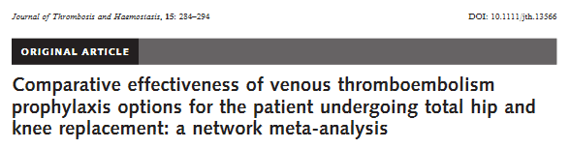
Data from RCTs published between 1990 and 2016:
Drug | Odds ratio for symptomatic DVT vs LMWH | 95% CI
Direct Xa inhibitors | 0.45 | 0.35-0.57
Warfarin (INR 2-3) | 1.56 | 1.14-2.14
ASA | 0.80 | 0.34-1.86
Bleeding risk with Xa inhibitors not statistically different from LMWH

Slide 10
Unfractionated vs LMW Heparin
Agent | Advantages | Disadvantages
Heparin | Cost | HIT risk Shorter half-life
LMWH | Lower risk of HIT Once daily dosing option | Cost Higher blood levels in renal failure
Notes:
UFH/LMWH most commonly used – which to pick?

Slide 11
LMWH vs unfractionated heparin prophylaxis
In acutely ill medical patient: nonsignificant reduction in risk of DVT and nonfatal PE, significant reduction in bleeding risk with LMWH (Chest 2012; 141:e195s)
In general surgery: no significant difference in risk of VTE or bleeding with LMWH vs UFH (Chest 2012; 141:e227s)
In orthopedic surgery: significant reduction in VTE risk with no increase in bleeding risk with LMWH (Chest 2012; 141:e278s)
Notes:
LMWH appears to be at least as safe and efficacious as UFH – trial data

Slide 12
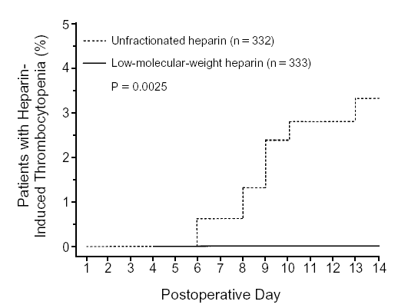
  UNFRACTIONATED HEPARIN IS MORE LIKELY TO CAUSE HIT THAN LMWH
Randomized trial in pts having hip surgery
Warkentin et al, NEJM 1995;332:1330
Notes:
3-4% incidence of HIT in hip surgery, probably the highest risk group

Slide 13
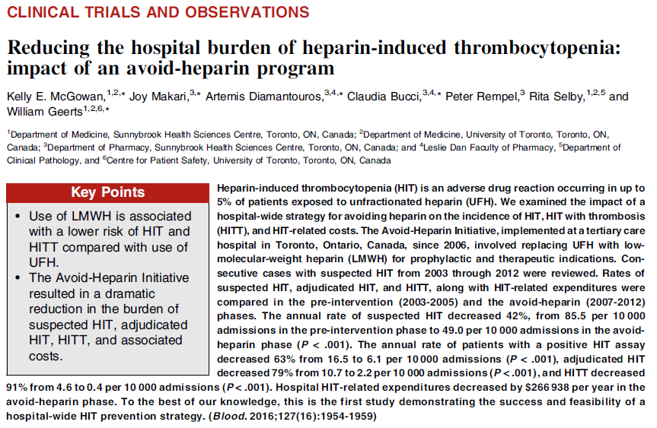
Switching from UFH to LMWH as the preferred agent for VTE prevention and treatment reduced incidence of HIT with thrombosis by 91%

Slide 14
MECHANICAL THROMBOPROPHYLAXIS
Graded compression stockings
  Knee- or thigh-high
Venous foot pump
Intermittent pneumatic compression – most effective if used properly
Notes:
Mechanical prophy – generally reserved for patients at high risk of bleeding
IPC most effective but compliance often poor

Slide 15
Thromboprophylaxis in acutely ill medical patients
2012 ACCP recommendations
Patients with increased VTE risk:
  LMWH, low-dose UFH or fondaparinux
Patients with low VTE risk:
  No prophylaxis
Patients who are bleeding or at high risk for bleeding:
  No anticoagulant prophylaxis
  Mechanical prophylaxis if VTE risk high
Chest 2012;141:7S-47S

Slide 16
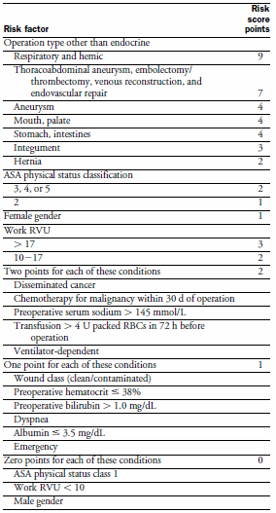
VTE Risk in Surgery: Rogers Score
J Am Coll Surg 2007;204:1211
Notes:
Risk assessment should be done to determine most appropriate prophy strategy
Two validated scoring systems for surgical pts

Slide 17
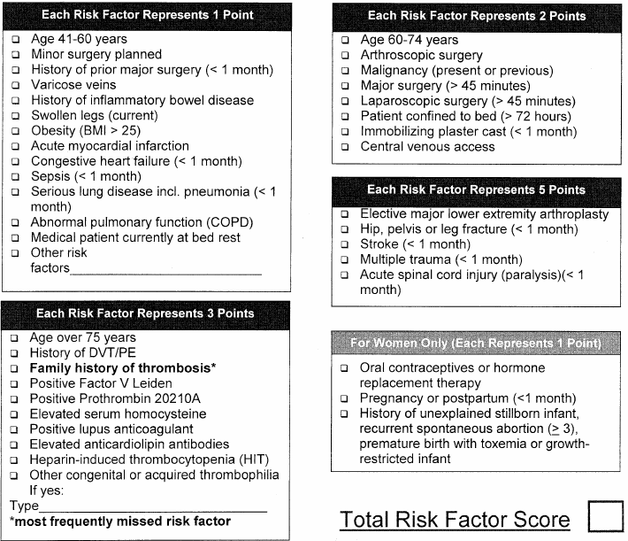
VTE Risk in Surgery: Caprini Score
Dis Mon 2005; 51:70

Slide 18
VTE Risk in Surgery
Very low risk (< 0.5%):
  Rogers score < 7
  Caprini score 0
Low risk (~ 1.5%)
  Rogers score 7-10
  Caprini score 1-2
Moderate risk (~ 3%)
  Rogers score > 10
  Caprini score 3-4
High risk (≥ 6%)
  Caprini score ≥ 5
Notes:
Risk stratification using either of these methods

Slide 19
Thromboprophylaxis in non-orthopedic surgical patients
2012 ACCP recommendations
Very low VTE risk:
  No prophylaxis, early ambulation
Low VTE risk:
  Mechanical prophylaxis (IPC preferred)
Moderate VTE risk, not high bleeding risk:
  LMWH, low dose UFH, or mechanical prophylaxis
Moderate VTE risk, high bleeding risk
  Mechanical prophylaxis (IPC)
High VTE risk, not high bleeding risk:
  LMWH or low dose UFH, plus mechanical prophylaxis
Chest 2012;141:7S-47S
Notes:
Prophy recs based on risk

Slide 20
Thromboprophylaxis in non-orthopedic surgical patients
2012 ACCP recommendations (2)
Cancer surgery, not high bleed risk:
  Extended duration LMWH (4 weeks)
High VTE risk, high bleed risk:
  Mechanical prophylaxis (IPC), pharmacologic prophylaxis once bleed risk diminishes
High VTE risk, LMWH and UFH contraindicated, not high bleed risk:
  Low dose ASA, fondaparinux, or mechanical
IVC filter should NOT be used for primary VTE prevention
Chest 2012;141:7S-47S
Notes:
Note the recommendation against IVC filter

Slide 21
Thromboprophylaxis in orthopedic surgical patients
2012 ACCP recommendations
Total hip or knee arthroplasty:
  LMWH (preferred), low-dose UFH, fondaparinux, adjusted-dose warfarin, apixaban, dabigatran, rivaroxaban, aspirin (controversial), plus IPC
Hip fracture surgery:
  LMWH (preferred), low-dose UFH, fondaparinux, adjusted-dose warfarin, aspirin (controversial), plus IPC
LMWH should be given at least 12 hours pre-op or 12 hours post-op rather than closer to the time of surgery
Prophylaxis should be continued for a minimum of 10-14 days
IPC only if high bleeding risk; IVC filter if there is contraindication to IPC
Chest 2012;141:7S-47S
Notes:
Note preference for LMWH; IVC filter limited to pts with contraindication to mechanical prophy

Slide 22
Prolonged Thromboprophylaxis Decreases VTE Risk in Major Orthopedic Surgery
Meta-analysis of 8 randomized controlled trials
Prolonged prophylaxis (≥ 21 days, vs 7-10 days) decreased VTE risk:
  86% reduction in risk of PE
  74% reduction in risk of symptomatic DVT
  71% reduction in risk of proximal DVT
2.4-fold increase in risk of minor bleeding with prolonged prophylaxis
Ann Intern Med 2012;156:720
Notes:
Most VTE events occur after discharge – prolonged prophy can substantially reduce risk. Consider DOACs and/or low dose ASA
Minor bleeding

Slide 23
KNEE ARTHROSCOPY
Symptomatic DVT rate < 1% without prophylaxis
Routine thromboprophylaxis not recommended
Prophylaxis (eg, LMWH) recommended for patients with prior hx of VTE
2012 ACCP guidelines
Notes:
Knee arthroscopy is typically a low-risk procedure; only selected patients need thromboprophylaxis

Slide 24
Variables That Should Be Considered In Choice Of Thromboprophylaxis
2012 ACCP recommendations
Patient preference
Compliance
Ease of administration (route and frequency)
Local factors affecting acquisition costs
Chest 2012;141:7S-47S
Notes:
Several effective options available – pick based on these cconsiderations

Slide 25
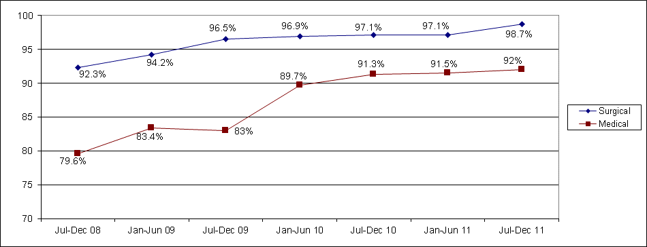
UW VTE prevention initiative
Percent of patients getting prophylaxis
Order sets
Education & Guidelines

Slide 26
Secondary prevention of VTE

Slide 27
Direct oral anticoagulants (DOACs) for treatment and secondary prevention of VTE
Dabigatran (Pradaxa®) – thrombin inhibitor
  FDA approval: Secondary prevention of VTE following UFH/LMWH treatment
Rivaroxaban (Xarelto®) – Xa inhibitor
  FDA approval: VTE treatment (single agent)
Apixaban (Eliquis®) – Xa inhibitor
  FDA approval: VTE treatment (single agent)
Edoxaban (Savayasa®) – Xa inhibitor
  FDA approval: Secondary prevention of VTE following UFH/LMWH treatment

Slide 28
DOACs
Advantages
Disadvantages
Oral adminstration
Do not require routine monitoring
Can be used as single agent for VTE treatment (rivaroxaban & apixaban)
Many patients won’t require hospitalization
Cost (about 10x warfarin)
Routine drug level measurement not widely available
Potential for accumulation in kidney or liver disease
Reversal agents for both dabigatran (idarucizumab) and the factor Xa inhibitors (andexanet alfa) now FDA-approved

Slide 29
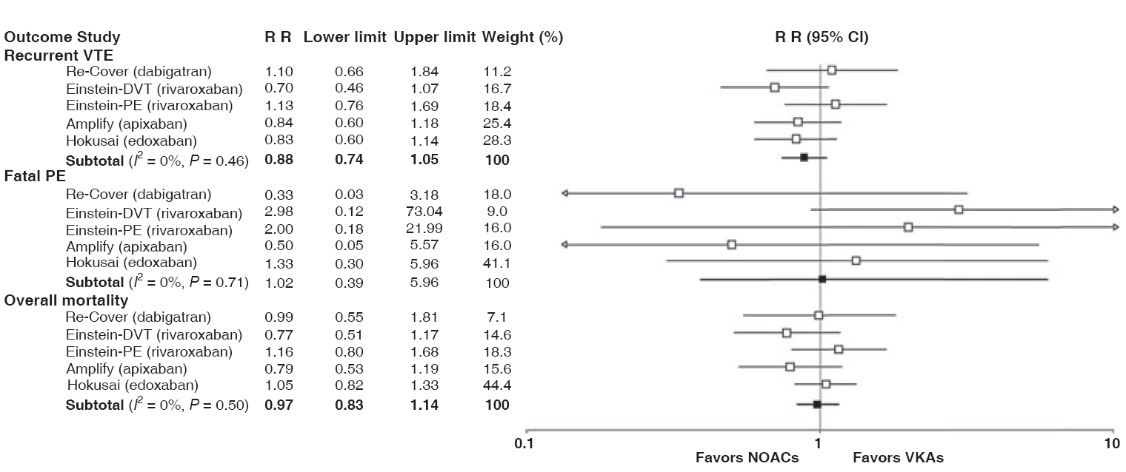
Efficacy of DOACs for treatment of acute VTE is comparable to warfarin meta-analysis of phase 3 trials
J Thromb Haemost 2014;12:320

Slide 30
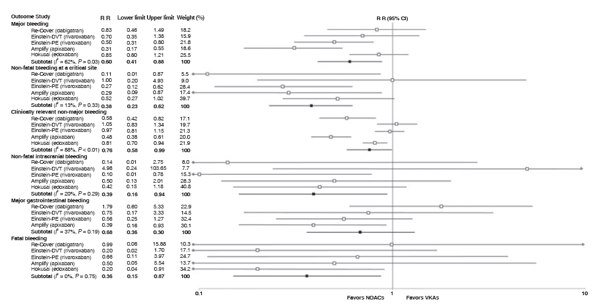
Safety of DOACs for treatment of acute VTE is superior to warfarin meta-analysis of phase 3 trials
J Thromb Haemost 2014;12:320

Slide 31
DOACs for treatment of VTE
Efficacy comparable to warfarin
Fewer bleeding complications
Less fatal bleeding despite lack of reversal agent
Practical advantages
  No monitoring
  No injections
  No transitioning – single agent treatment (apixaban & rivaroxaban)
  Shorter (or no) hospital stay

Slide 32
How long to treat?
Notes:
Strategies and methods for preventing and treating VTE are fairly well-defined. Duration of treatment is a trickier decision.

Slide 33
3 months of anticoagulant treatment is both necessary and sufficient for most patients after a first episode of VTE
Treatment should include a minimum of 5 days of a rapid-acting anticoagulant (UFH, LMWH, fondaparinux or a DOAC)

Slide 34
VTE recurs within 3 mo in about 50% of patients who do not get adequate anticoagulation (Hull et al, NEJM 1979)
Treatment failure 3 times more likely in patients treated with warfarin alone vs patients given an initial course of heparin (Brandjes et al, NEJM 1992)
VTE recurrence after inadequate initial anticoagulant therapy most often occurs in the same place as the original clot, probably reflecting clot “reactivation” (Lindmarker et al, J Intern Med 2000)

Slide 35
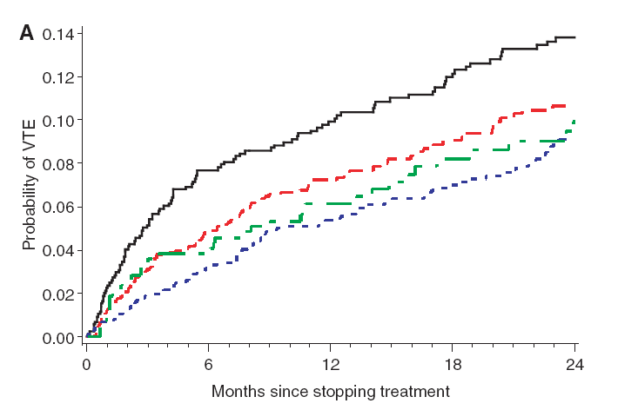
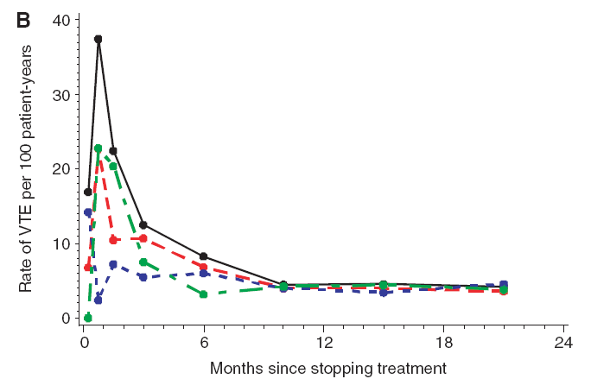
Extending treatment beyond 3 months does not significantly reduce the rate of recurrence after first episode of VTE
Pooled data from 7 randomized trials
Cumulative probability of recurrence
Rate of recurrence
Can we identify patients whose risk of recurrence is high enough to justify the risk of long-term anticoagulant therapy?
Boutitie et al, BMJ 2011
Notes:
Recurrence rate is higher if treatment is stopped before 3 months, but does not decrease further when it is continued beyond that time. Patients with a high recurrence risk are candidates to continue indefinitely; this requires balancing the risk of recurrence in the absence of anticoagulant therapy against the risk of bleeding while on such therapy

Slide 36
Patients with a high risk of recurrent VTE may benefit from prolonged anticoagulant treatment
The risk of recurrence must be weighed against the risk of bleeding

Slide 37
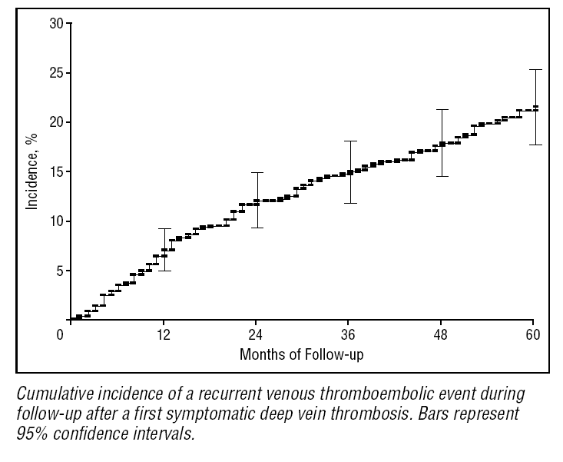
VTE recurs at a rate of about 5% per year within 5 years of the initial episode
Arch Intern Med 2000;160:769
Notes:
But this is an average recurrence rate. Some patients have higher risk, some lower.

Slide 38
Risk factors for VTE recurrence
Unprovoked VTE
Recurrent VTE
Location of DVT (proximal > distal)
Elevated D-dimer after stopping anticoagulation
Active cancer
Inflammatory bowel disease (when active)
Male gender
IVC filter
Antiphospholipid antibodies
Notes:
These are the most important factors that increase recurrence risk. Will consider them individually…

Slide 39
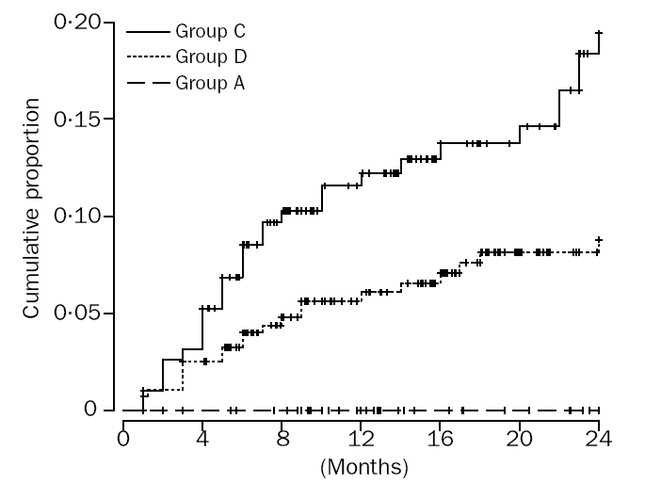
Unprovoked VTE is associated with a high recurrence rate
1 yr recurrence risk ~ 13%
Unprovoked
Other provoking factors
Postoperative
Lancet 2003;362:523
Notes:
Recurrence risk after a first VTE episode, according to whether episode was 1) totally unprovoked; 2) postop; 3) associated with any other risk factor besides surgery. Unprovoked VTE had a 13% recurrence risk in the first year after stopping anticoagulation.

Slide 40
VTE associated with “minor” provoking factor has a relatively high recurrence rate
Retrospective analysis of Einstein trial data
Provoking factor | Recurrence rate @ 1 year with placebo | Recurrence rate with aspirin 100 mg/day | Recurrence rate with Rivaroxaban 10 or 20 mg/day
Major transient | 0 | 0 | 0
Minor transient | 7.1% | 4.2% | 0.4%
None (unprovoked) | 10% | 5.9% | 2%
Major transient risk factors: Major surgery, major trauma, cesarean section
Minor transient risk factors: immobilization, travel >8 hours, pregnancy, postpartum state, estrogen use, leg trauma
Blood Adv 2018;2:788

Slide 41
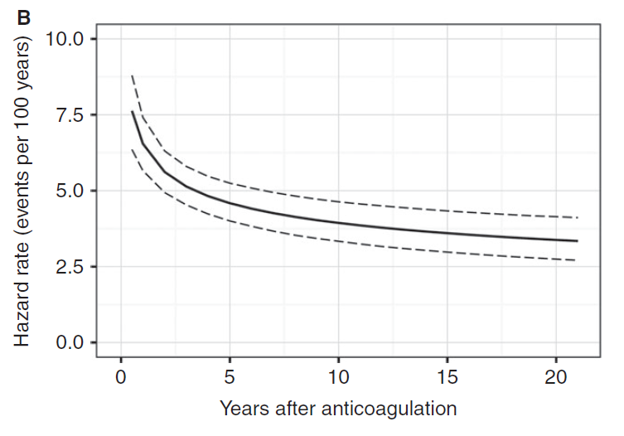
Recurrence rate of unprovoked VTE remains high for many years
J Thromb Haemost 2017;14:2402
Notes:
Risk of recurrence off anticoagulation is highest in the first 5 years after stopping but does not diminish much after that

Slide 42
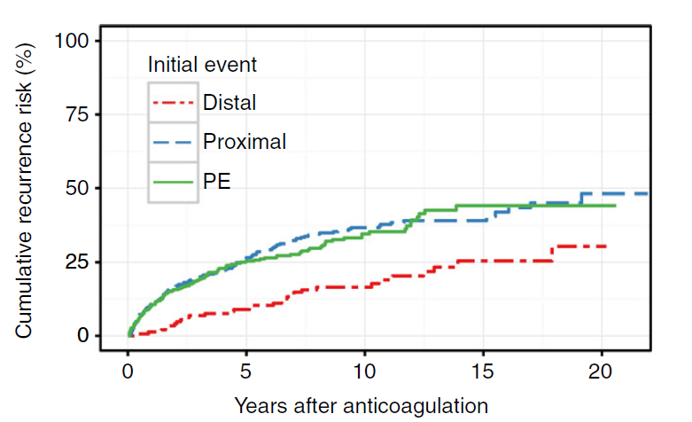
Long term recurrence risk is highest for proximal DVT and PE
J Thromb Haemost 2017;14:2402

Slide 43
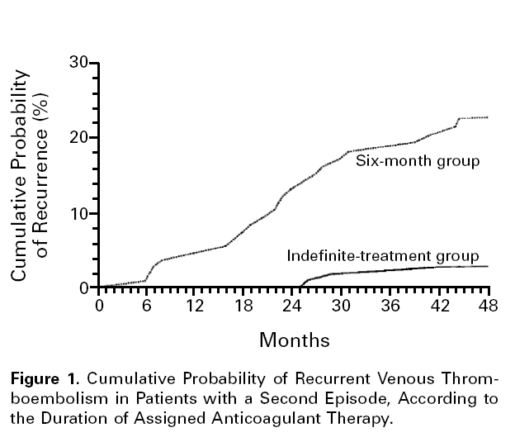
Risk of recurrence is high after a second episode of VTE
1 yr recurrence rate ~ 9%
NEJM 1997;336:393
Notes:
Recurrence rate is almost twice as high (9% vs 5% per year) after a second episode of VTE

Slide 44
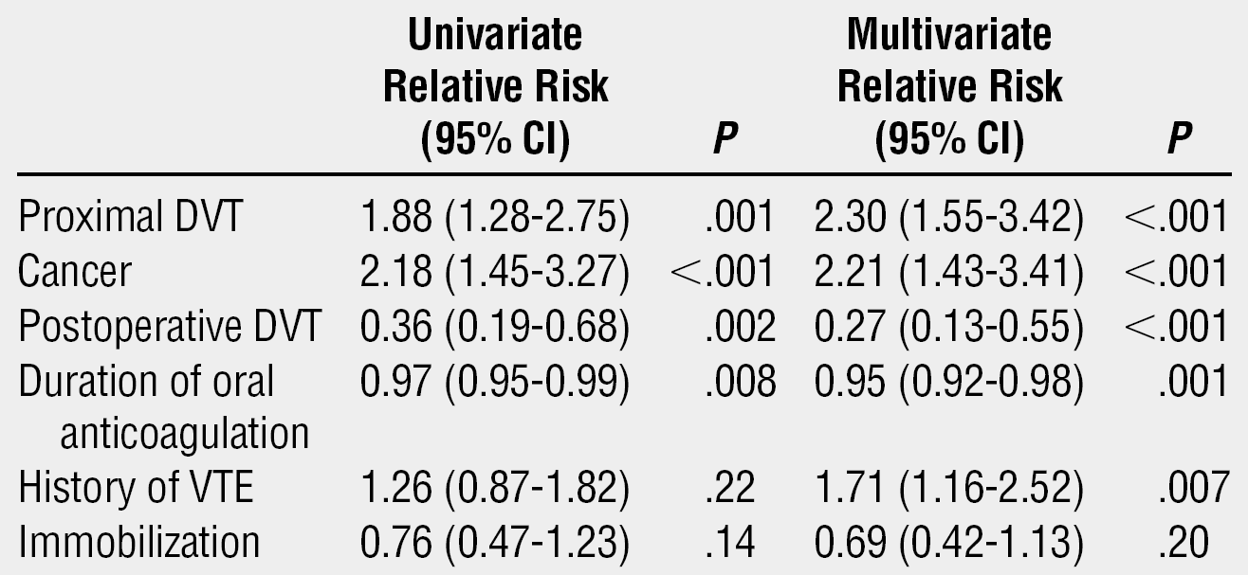
Cancer patients have a high risk of recurrent VTE
Arch Intern Med 2000;160:769

Slide 45
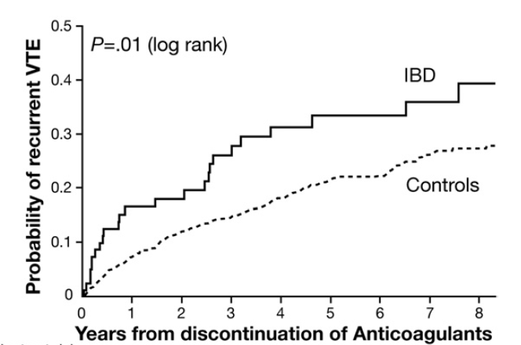
Inflammatory bowel disease increases VTE recurrence risk
1 yr recurrence rate ~ 18%
Gastroenterology 2010;139:779
Notes:
Active inflammatory bowel disease a strong risk factor for recurrence (about 18% vs 5%)

Slide 46
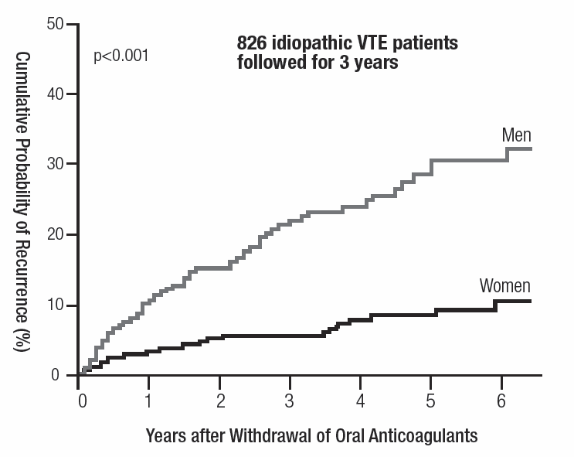
Men have a higher VTE recurrence risk than women
N Engl J Med 2004;350:2558-63

Slide 47
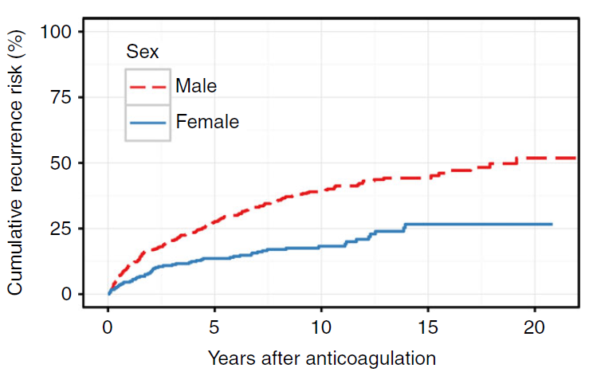
20-year recurrence rate twice as high for men than women
J Thromb Haemost 2017;14:2402

Slide 48
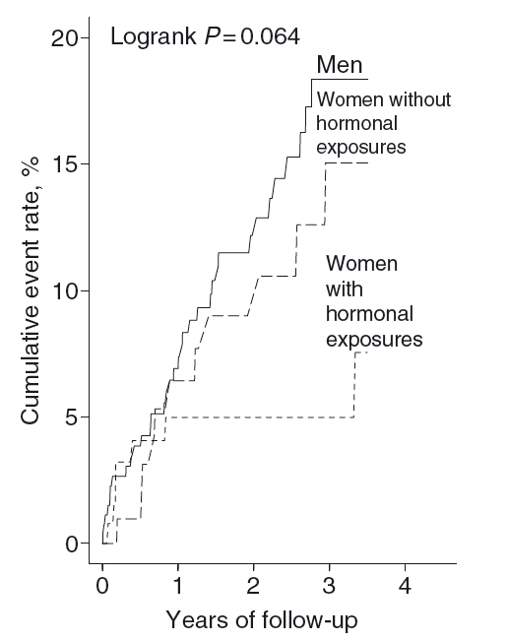
Estrogen-related VTE has a low risk of recurrence
J Thromb Haemost 2006;4:2199
Notes:
Hormone-related VTE in women has a low recurrence risk in the absence of further hormone exposure

Slide 49
IVC filters increase the risk of recurrent DVT
Outcome at 12 days
Outcome at 2 years
GROUP
Pulmonary Embolism
Death
Major Bleeding
Pulmonary embolism
Recurrent DVT
Death
Major Bleeding
Filter
1.1%
2.5%
4.5%
3.4%
20.8%
21.6%
8.8%
No Filter
4.8%
2.5%
3.0%
6.3%
11.6%
20.1%
11.8%
N Engl J Med 1998;338:409
Notes:
IVC filter doubles recurrence risk (this the only randomized controlled trial of filters)

Slide 50
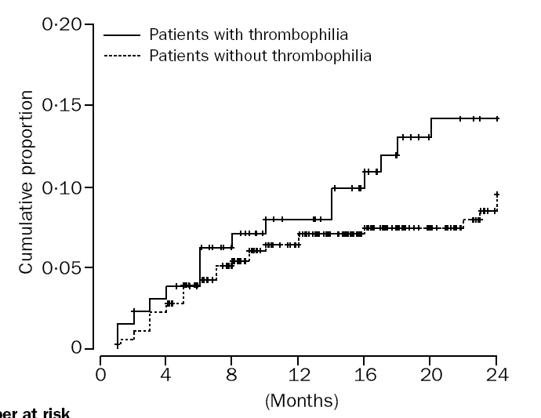
The presence of inherited thrombophilia does not significantly increase VTE recurrence risk
p = NS
Lancet 2003;362:523
Notes:
In contrast, presence of inherited thrombophila does NOT have a significant effect on recurrence risk and so should not be used as a basis for determining duration of treatment

Slide 51
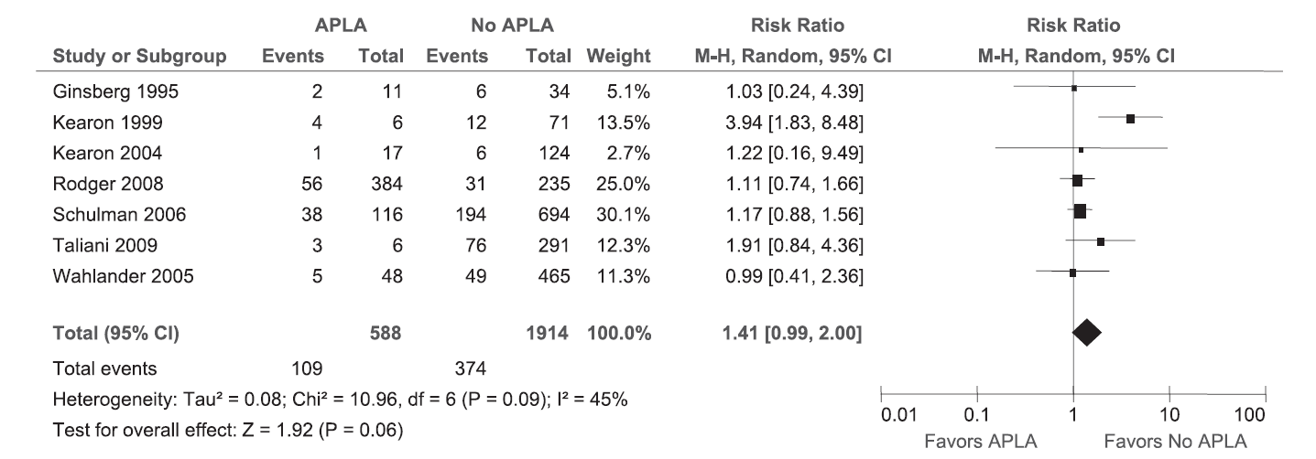
Antiphospholipid antibodies and VTE recurrence risk
“Although a positive APLA test appears to predict an increased risk of recurrence in patients with a first VTE, the strength of this association is uncertain because the available evidence is of very low quality”
Blood 2013;122:817
Notes:
APL appears to increase recurrence risk, though the evidence is not as strong as for some of the other risk factors we have discussed. Consensus that patients with VTE and clear evidence of APL (eg, triple-positives) should be considered for indefinite treatment

Slide 52
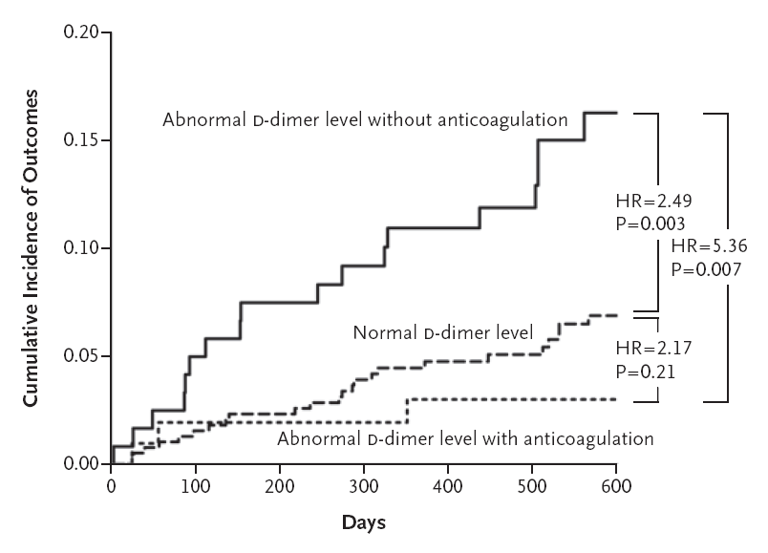
Elevated D-dimer level one month after stopping anticoagulation predicts higher VTE recurrence risk
N Engl J Med 2006;355:1780-9
Notes:
Elevated D-dimer after stopping anticoagulation predicts a recurrence risk about 2-fold higher (roughly 10% vs 5% per year) than if D-dimer normal

Slide 53
What is the bleeding risk with anticoagulant therapy?
Young patient with good anticoagulant control: <1%/yr
Elderly patient with multiple risk factors for bleeding: >4%/yr
Case fatality rates from bleeding while on anticoagulant therapy ≈ 20%
Blood 2014;123:1794
Thromb Haemost 2013; 110:834
Notes:
Bleeding risk on anticoagulants varies widely, but anticoagulant-related bleeding has a relatively high mortality across the board

Slide 54
Risk factors for anticoagulant-related bleeding
Age (>75)
History of bleeding
Metastatic cancer
Renal or liver failure
Other coagulation defects
Falls
Recent surgery
Poor performance status or cognitive status
Poor control of VKA therapy
Notes:
These are some of the factors that must be consider in estimating bleeding risk.

Slide 55
How high does the risk of recurrent VTE need to be to justify prolonged anticoagulant therapy?
ACCP guidelines
Bleeding risk | Risk of recurrence in 1 yr after stopping treatment | Indication for indefinite therapy
Low | >13% | strong
Low | 8-13% | weak
Intermediate | >16% | strong
Intermediate | 11-16% | weak
Blood 2014;123:1794
Notes:
Patients with no risk factors for bleeding but with one or more risk factors for recurrence (particularly unprovoked VTE, active cancer, IBD, APL) as discussed previously are candidates for prolonged treatment. If you are on the fence can use D-dimer as the tie-breaker. No exact formula for bleeding risk – must use clinical judgement

Slide 56
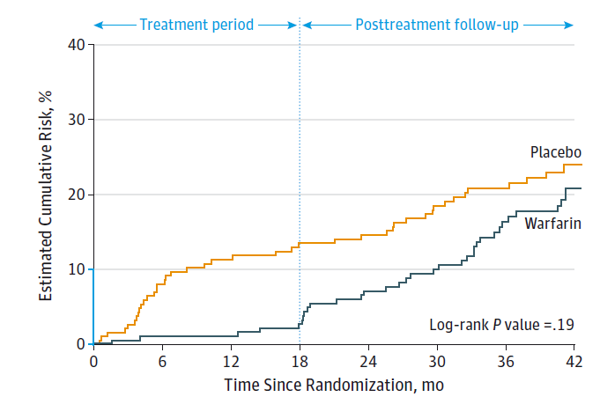
Cumulative risk of recurrent VTE + major bleeding with standard vs extended anticoagulant therapy
(24 mo vs 6 mo) after first unprovoked PE
Low risk of recurrent VTE during treatment period (3.3% vs 13.5% with placebo)
Major bleeding in 2% of patients taking warfarin and 0.5% of patients taking placebo
Benefit of extended therapy not maintained after therapy stopped
JAMA 2015; 314:31

Slide 57
Selected patients may benefit from treatment with a non-warfarin anticoagulant
Notes:
Who are candidates for treatment with drugs other than warfarin?

Slide 58
Alternatives to warfarin for prolonged anticoagulation
Reduced intensity warfarin less effective and no safer than standard warfarin treatment
Aspirin
Rivaroxaban or apixaban
Low molecular weight heparin (cancer)

Slide 59
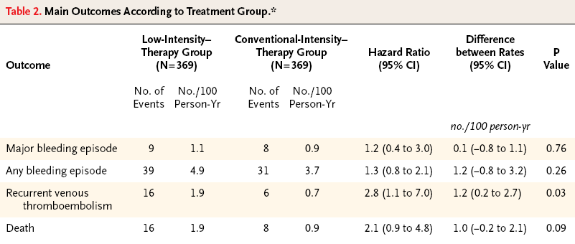
Standard warfarin Rx better than low intensity Rx for secondary prevention of VTE
738 patients with unprovoked VTE who had standard anticoagulant therapy for at least 3 mo randomly assigned to treatment with either:
  Standard warfarin treatment (target INR 2-3)
  Reduced intensity warfarin (target INR 1.5-1.9)
Outcomes:
NEJM 2003;349:631
Notes:
No benefit to reducing the intensity of warfarin treatment

Slide 60
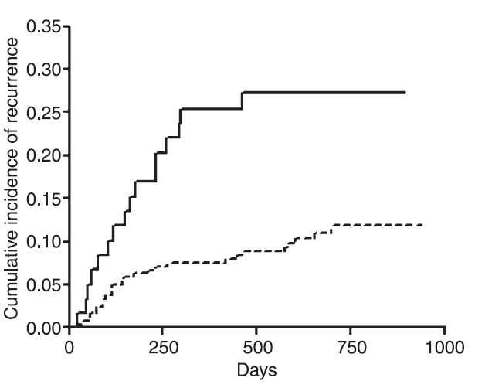
Poor anticoagulation control increases the risk of VTE recurrence
Upper quintile
(worse control)
Lower quintile
(better control)
VTE recurrence rate vs quality of anticoagulant control (percent time with INR <1.5) in first 90 days of treatment
J Thromb Haemost 2005;3:955
Notes:
Consider NOACs especially in patients with poor anticoagulant control

Slide 61
Low dose rivaroxaban or apixaban for extended treatment of VTE
Treatment | HR: Recurrent VTE | HR: Bleeding | Major Bleeding on treatment
RIV 20 mg/d vs ASA | 0.34 | 2.01 | 0.3% (none fatal)
RIV 10 mg/d vs ASA | 0.26 | 1.64 | 0.5% (none fatal)
NEJM 2017;376:1211
Treatment | HR: Recurrent VTE vs Placebo | HR: Major or Clinically Relevant Bleeding vs Placebo
APIX 2.5 mg bid | 0.19 | 1.20
APIX 5 mg bid | 0.20 | 1.62
NEJM 2013;368:699
Notes:
Low dose rivaroxaban and apixaban substantially reduce risk of recurrent VTE during extended therapy, with a low bleeding risk

Slide 62
Aspirin is moderately effective in preventing VTE recurrence with a low risk of bleeding
Subjects: 402 patients with first episode of unprovoked VTE who had completed 6-18 mo of standard anticoagulant therapy
Treatment: ASA 100 mg/day vs placebo
Outcome:
Treatment | ASA | Placebo | P value
Recur. VTE | 28 | 43 | 0.02
Bleeding | 4 | 4 | 0.97
NEJM 2012;366:1959
Notes:
Aspirin is a low-risk alternative, but not as effective as the other drugs discussed. Hard to justify use given the excellent safety data for apixaban/rivaroxaban unless financial/insurance constraints prevent use of these drugs

Slide 63
Patient preference must be considered when deciding whether or not to prolong the course of anticoagulation

Slide 64
There is wide variation in the relative values patients place on preventing VTE recurrence vs stopping anticoagulant treatment
Preference | % of patients (n = 118)
Stop regardless of risk | 25%
Stop if ≤15% risk | 8%
Stop if ≤ 10% risk | 23%
Stop if ≤ 5% risk | 21%
Continue regardless of risk | 23%
Thromb Haemost 2004; 92:1336

Slide 65
Summary
3 months of standard anticoagulant therapy is adequate for most patients with a first episode of VTE
The decision to prolong therapy should take into account:
  VTE recurrence risk
  Bleeding risk
  Patient preference
An oral direct Xa inhibitor may be preferable for long-term treatment for selected patients
LMWH is superior to warfarin in cancer patients
Aspirin is safer, but less effective, than warfarin for secondary prevention of VTE

