Slide 2
AN APPROACH TO THE ANEMIC PATIENT
Eliot Williams MD PhD
Department of Medicine

Slide 3
OBJECTIVES
Define anemia, describe its clinical features, and list the variables typically used to determine its presence
Describe and explain the variation in normal red cell values according to age and gender
Describe how to determine if anemia is due to marrow hypoproliferation, and the role of the reticulocyte count in this determination
Define hemolysis and ineffective erythropoiesis
Describe the expected marrow and peripheral blood findings in anemia due to blood loss, hypoproliferative states, hemolysis and ineffective erythropoiesis
Describe the role of red cell indices, and the MCV in particular, in the analysis of anemia

Slide 4
ANEMIA
Defined as decreased red cell mass
Usually decreased hematocrit, hemoglobin, rbc count
Exceptions:
  Acute blood loss or dehydration: decreased plasma volume can mask anemia
  Hemodilution (eg, excess IV fluid administration): low H/H can occur in absence of anemia

Slide 5
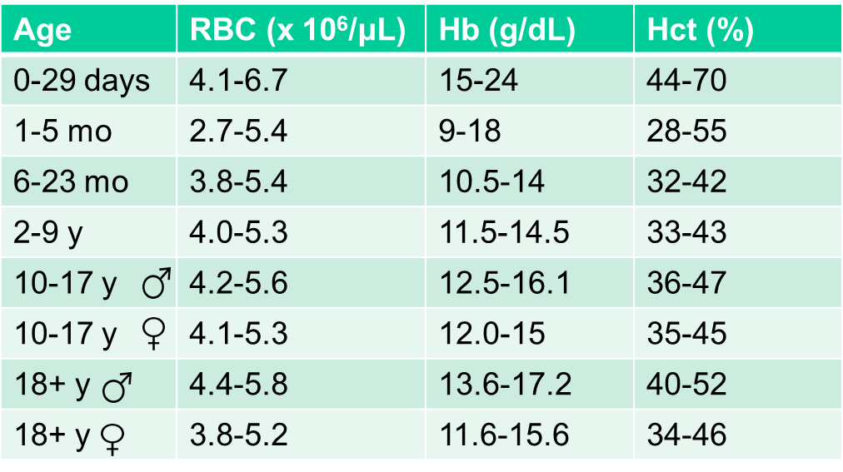
RBC numbers vs age & gender
Newborns have high counts (fetal Hb)
Iron availability limits RBC production during rapid growth
Adult men generally have higher counts than women (androgen effect)
Source: UWHC Clinical Lab
Notes:
The age and gender of a patient must be considered in deciding if a patient is truly anemic

Slide 6
CAUSES OF ANEMIA
  Decreased red cell production
  Increased red cell destruction (hemolysis)
  Bleeding

Slide 7
Clinical signs of anemia
Pallor (more evident in nailbeds, conjunctiva)
Tachycardia, flow murmur (compensatory increase in cardiac output)
Fatigue
Shortness of breath with exertion
Organ dysfunction in severe anemia (angina, confusion)

Slide 8
Factors that determine the clinical severity of anemia
Rate of development (slow onset → fewer symptoms)
Cardiovascular fitness and lung function
Level of physical activity
Hgb oxygen dissociation curve (2,3 DPG promotes oxygen delivery to tissues)
Healthy resting individuals tolerate isovolemic hemodilution to a hemoglobin of 5 g/dL without evidence of tissue ischemia or injury
Notes:
Symptoms of anemia roughly proportional to its severity in a given patient but the severity of symptoms for any given degree of anemia vary widely from patient to patient. Fatigue, shortness of breath with exertion, sometimes cardiovascular or neurologic problems in patients predisposed to problems in those areas.

Slide 9
FIRST QUESTIONS TO ASK
Is the bone marrow working?
What do the red cells look like?

Slide 10
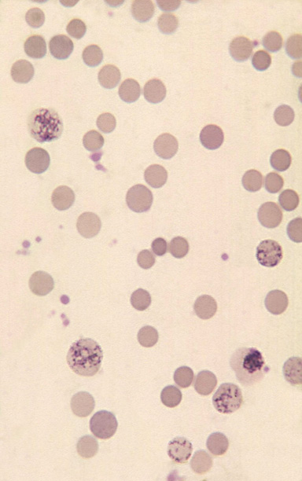
Is the marrow working?
Are the other blood counts (WBC, platelets) normal?
  If yes, marrow failure less likely
What is the reticulocyte count?
The reticulocyte count is the best indicator of red cell production!
Reticulocyte (ribosomal RNA stains with methylene blue stain)
Count usually determined by automated cell counter using fluorescent dye that binds to nucleic acid

Slide 11
What determines the normal reticulocyte count?
RBC lifespan ~ 120 days
1/120 or about 1% of red cells replaced each day
Newly released RBC identifiable as reticulocytes for about a day
Therefore, reticulocytes account for about 1% of circulating RBC
Normal RBC count ~ 5 million/microliter
1% of 5 million = 50,000
Therefore the normal absolute retic count is around 50,000 (UWHC lab normal range: 28-115,000)

Slide 12
Reticulocytes are released earlier from the marrow in most types of anemia
Anemia causes erythropoietin levels to rise
  Exceptions: inflammation, kidney disease
EPO stimulation leads to early release of reticulocytes from marrow
This can potentially double the reticulocyte count even in the absence of increased RBC production
More immature reticulocytes are larger and have more residual RNA, which gives them a blue tint on a Wright-stained blood smear. They are called polychromatophilic or “shift” cells

Slide 13
Steady State Reticulocyte Production & Release
Reticulocyte
Mature RBC
Retics spend 3 days in the Marrow
and 1 day in the Blood
EPO

Slide 14
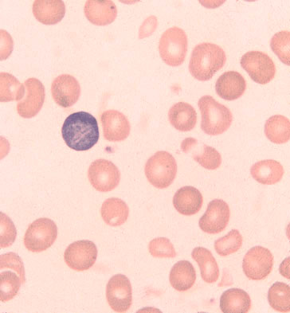
Acute hemorrhage - first 24 hours (“Shift”)
RBC production not yet increased,but retics released early from Marrow
Retic count doubles
EPO
“Shift cell” – more RNA→ blue color

Slide 15
Acute hemorrhage - 7 days
“Shift” + Increased Production
RBC production increased
and retics released early
Retic count 4x normal (or more)
EPO

Slide 16
How to use the reticulocyte count to tell if the marrow is working
A normal bone marrow should be able to at least double its production of red cells (and therefore the reticulocyte count) in the face of anemia.
Assuming that there is also early release of reticulocytes from the marrow (which can also double the retic count), an anemic patient with a normal bone marrow should have at least 50,000 x 2 x 2 = 200,000 reticulocytes per microliter of blood, assuming there has been time for the marrow to respond to anemia.

Slide 17
Interpreting the reticulocyte count
In an anemic patient an absolute reticulocyte count greater than 200,000 per microliter suggests adequate marrow function
  Reticulocyte counts over 300,000 usually associated with peripheral red cell destruction (hemolysis)
A steady state reticulocyte count less than 100,000 in the face of anemia (eg, Hgb < 10) indicates suboptimal red cell production
  Takes about a week for retic production to reach steady state after onset of anemia
100,000-200,000 retics is a “gray area”, may indicate a limitation on red cell production

Slide 18
What if retics are high but the patient is not very anemic?
In a patient with a normal or nearly normal Hct an absolute reticulocyte count of greater than about 100,000 suggests ongoing hemolysis or blood loss (i.e., a shortened red cell life span)
Approximate RBC lifespan =
(50,000/patient absolute retic count) x 120 d
in the absence of significant anemia (Hgb ≥ 10)

Slide 19
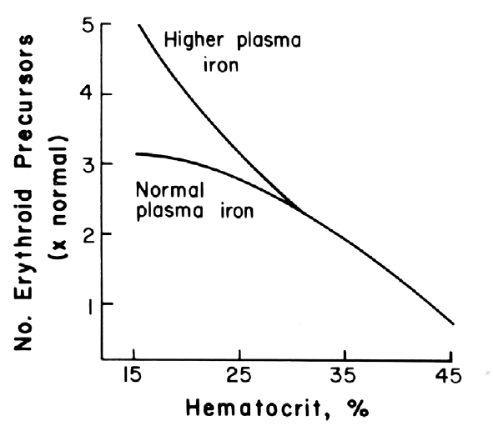
RBC production is usually faster in hemolysis than in blood loss anemia
(hemolysis)
Normal response requires intact EPO production, adequate folate, iron, B-12

Slide 20
KINETIC CLASSIFICATION OF ANEMIA
Inadequate RBC production (retics normal or low)
  Hypoproliferative: Impaired RBC production. Lower than expected numbers of RBC precursors in marrow.
  Ineffective erythropoiesis: Impaired RBC production despite increased marrow RBC precursors. Assemby line “rejects” (via apoptosis) defective RBC precursors.
Increased RBC destruction or loss (RBC precursors & retics high)
  Hemolysis: shortened lifespan of circulating RBC
  Blood loss
  More than one mechanism may contribute to anemia in some cases

Slide 21
Red cell production in anemia
Condition | Absolute retics | Marrow erythroid cellularity
Normal | ~50,000 | Normal
Acute blood loss | 50-100,000 | Normal
Blood loss after 7-10 days | >100,000 | High
Hemolysis | 300-800,000+ | High to very high
Ineffective hematopoiesis | <100,000 | High to very high
Hypoproliferation | <100,000 | Normal or low

Slide 22
MORPHOLOGIC CLASSIFICATION OF ANEMIA
(what do the red cells look like?)
Red cell indices: The erythrocyte can be characterized by ratios of three measurements; the hemoglobin, the hematocrit and the red count.
• Mean corpuscular volume (MCV, expressed in femtoliters) is the hematocrit (volume) divided by erythrocyte count. This value is the most useful in determining the likely cause of anemia.
• Mean corpuscular hemoglobin (MCH) is the hemoglobin concentration divided by erythrocyte count.
• Mean corpuscular hemoglobin concentration (MCHC) is the hemoglobin concentration divided by hematocrit.

Slide 23
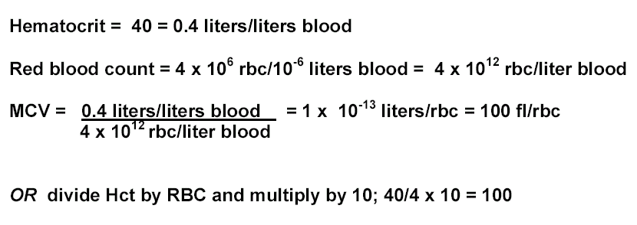
MCV calculation example
Rule of thumb: If calculated MCV is not between 45-150 you have probably not done the math properly!

Slide 24

MORPHOLOGIC CLASSIFICATION OF ANEMIA
Macrocytic: MCV > 100 fl (defective DNA synthesis or reticulocytosis)
Microcytic: MCV < 80 fl (decreased hemoglobin production)
Normocytic: MCV 80-100
Other useful morphologic findings:
  Poikilocytosis: variation in RBC shape
  Anisocytosis: variation in RBC size
    RDW = quantitative expression of variability in RBC size (high RDW = anisocytosis)
  Hypochromia: cells with large, pale centers (less hemoglobin per cell)

Slide 25
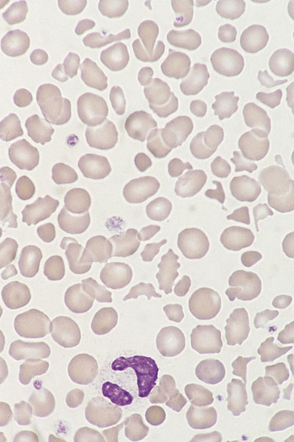
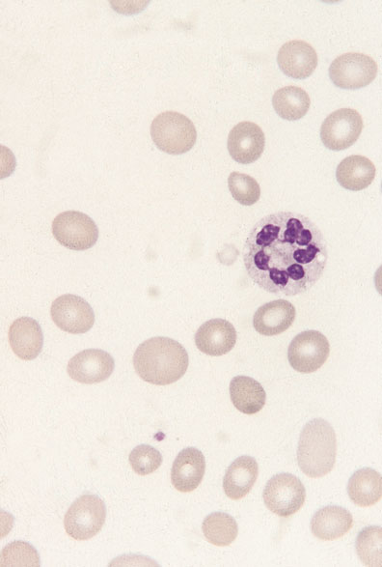
Poikilocytosis
Anisocytosis

Slide 26
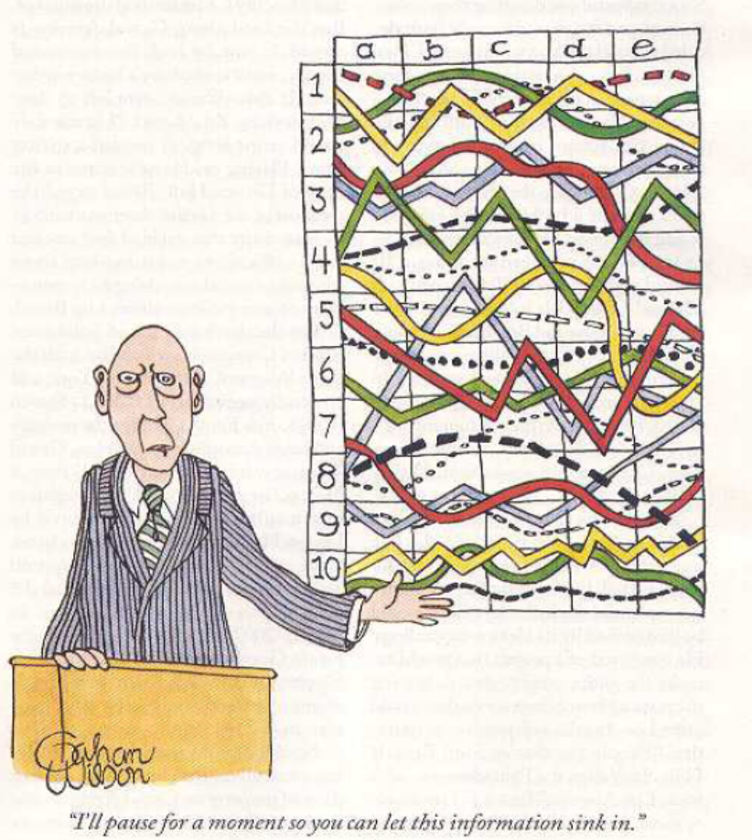
“I’ll pause for a moment to let this information sink in”

