Slide 1
An approach to the anemic patient

Slide 2
Is the patient really anemic?
Normal values for hemoglobin, hematocrit vary with age and gender
Always consider the possibility of hemodilution when anemia develops or worsens quickly in a hospitalized patient without evidence of major blood loss
  IV fluids
  Mobilization of 3rd space fluid

Slide 3
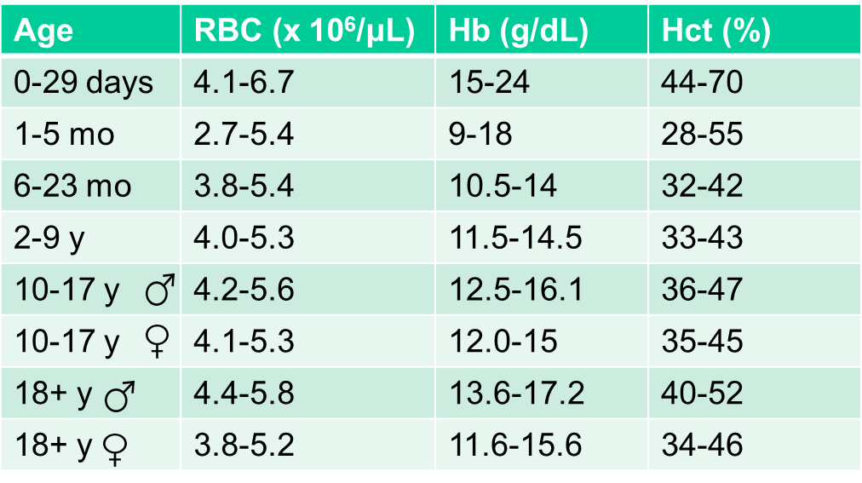
RBC numbers vs age & gender
Source: UWHC Clinical Lab

Slide 4
First questions to ask
Is the marrow working?
  Other blood counts normal?
  Abnormal differential?
  Reticulocyte count
What do the red cells look like?
  Blood smear
  MCV

Slide 5
Interpreting the reticulocyte count
Always use the absolute retic count, not the percent (RBC count x percent retics = absolute retics)
Absolute retics 200K/µL or more → not a marrow problem, anemia likely due to hemolysis or blood loss
Retics > 300K usually indicate hemolysis
Absolute retics less than 100K → inadequate marrow response
Retics < 10-20K → likely primary marrow problem

Slide 6
The MCV is a useful number
High MCV implies impaired DNA synthesis or reticulocytosis
  B12/folate deficiency
  Alcohol
  Liver disease
  Marrow dyscrasia
  Drugs (chemo, immunosuppressive)
Low MCV implies defective or diminished hemoglobin synthesis
  Iron deficiency
  Thalassemia
  Inflammation
  Heavy metal poisoning
  Sideroblastic anemias

Slide 7
Never overlook the low-hanging fruit
B12 deficiency
Folate deficiency
Iron deficiency
Thyroid disease
GI blood loss
The MCV is not a completely reliable guide to the presence or absence of B12/folate/iron deficiency.

Slide 8
Testing for B12 and folate deficiency
High serum homocysteine and methylmalonic acid levels are useful indicators of cellular vitamin deficiency
  Homocysteine high in B12 and folate deficiency
  MMA high only in B12 deficiency
  A low vitamin level with normal homocysteine and MMA levels is probably not the explanation for anemia
Falsely normal or high serum B12 assay results may occur in autoimmune pernicious anemia
  Anti-intrinsic factor antibody interferes with assay
  MMA and homocysteine levels helpful

Slide 9
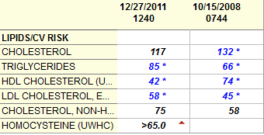
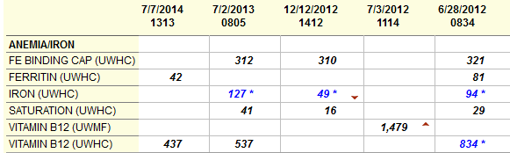
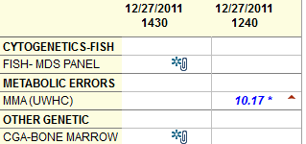
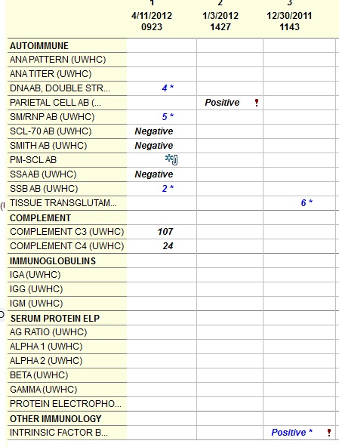
Falsely high B12 assay result in pernicious anemia

Slide 10
Testing for iron deficiency
Low ferritin + microcytic anemia is presumptive evidence of iron deficiency anemia
Low ferritin without anemia implies depleted iron stores, high risk for developing IDA
Ferritin may be normal in IDA if there is inflammation or liver injury
  (rarely > 100 ng/mL)
Normal serum iron may occur in IDA if patient is taking iron
Low serum iron with normal ferritin and normal or low TIBC usually indicates inflammation, not iron deficiency

Slide 11
Iron deficiency is usually due to blood loss, even if you can’t determine the source of bleeding
Exceptions:
  malabsorption (eg, celiac dz)
  pregnancy
  high iron demand due to rapid growth (children)
  inadequate diet (rarely sole cause)
  chronic intravascular hemolysis (eg, PNH - rare)
  genetic disorder (iron-refractory IDA - very rare)
A normal ferritin in a patient who has had multiple recent transfusions suggests ongoing blood loss.

Slide 12
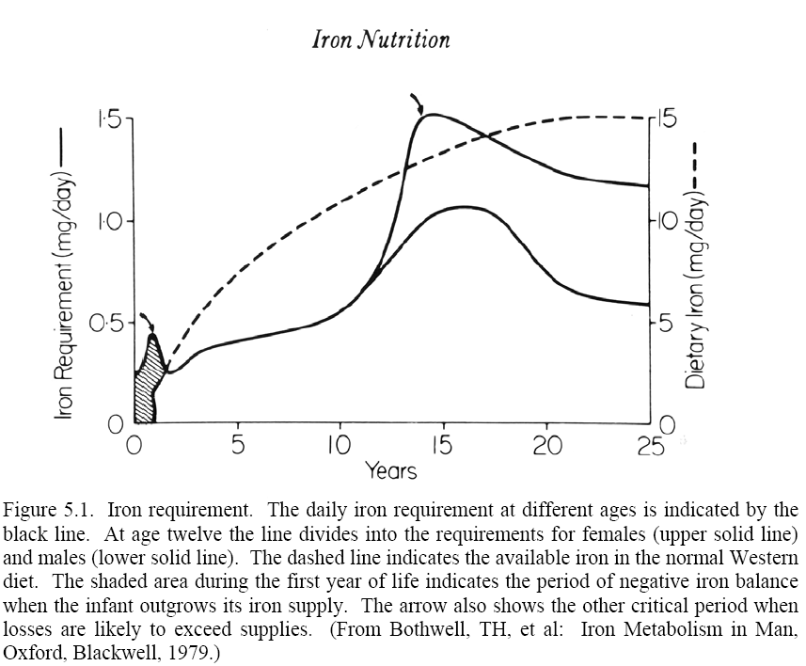
Daily iron requirements vs age
Dietary iron available
♀
Girls
♂
Boys
Iron requirements may exceed dietary availability in infants and adolescent girls

Slide 13
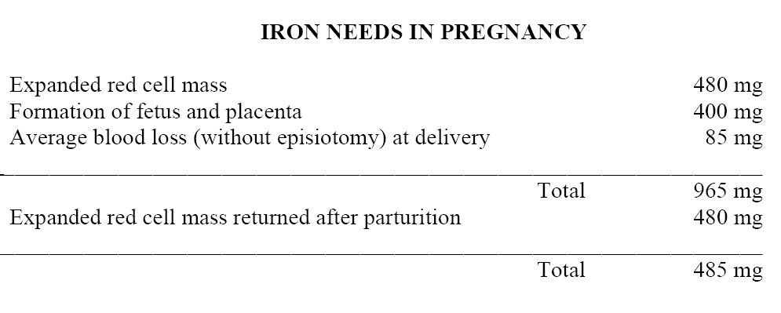
Pregnancy depletes iron stores
Normal iron stores in women = 200-400 mg

Slide 14
Treating iron deficiency with oral iron
GI side effects common
Too-frequent dosing may decrease efficacy of treatment (increased iron in transport compartment → increased hepcidin levels → decreased absorption of next dose)
Alternate day dosing can minimize both problems

Slide 15
Daily vs alternate-day iron dosing in iron-depleted women
 | Daily dosing x 14 days | Alternate day dosing x 28 days
Mean hemoglobin | 13.2 | 13.6
% patients with iron deficiency after treatment | 14% | 5%
Incidence of GI side effects 33% higher with daily dosing
Stoffel et al, Lancet Haematol 2017

Slide 16
Thalassemia
Decreased production of alpha or beta globin
Mild forms cause microcytosis ± anemia
More severe forms cause RBC destruction due to formation of alpha- or beta-globin tetramers
  Beta chain tetramers = hemoglobin H, form Heinz body-like structures that cause hemolysis
  Alpha chain tetramers cause intramedullary RBC destruction (ineffective erythropoiesis)

Slide 17
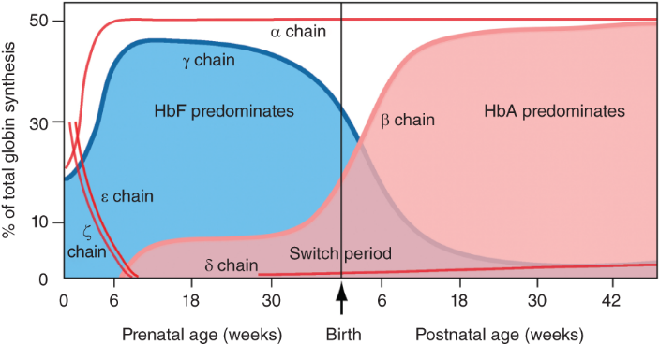
Hemoglobin through the ages
Hb A = α₂β₂ Hb F = α₂γ₂ Hb A₂ = α₂δ₂
Hb A₂ concentration constant throughout adult life but its proportion relative to Hb A is higher in β thalassemia

Slide 18
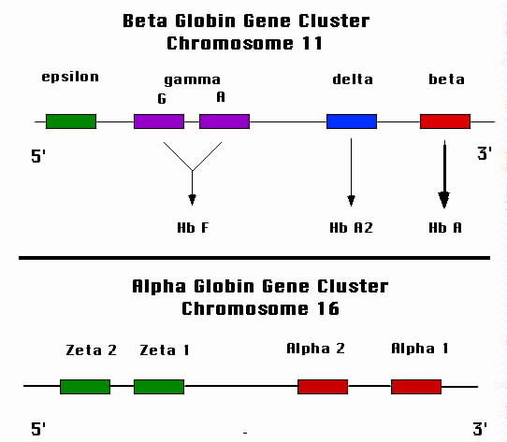

Slide 19
α-Thalassemia
4 alpha globin genes
Most forms due to gene deletions with discrete features:
  Single gene deletion = silent
  2 gene deletion = α-thal trait: microcytosis with mild nor no anemia
  3 gene delection = Hb H disease: chronic hemolysis with moderate to severe anemia
  4 gene delection = hydrops fetalis: usually lethal in utero due to severe anemia (gamma chain tetramers or Hb Barts) and organ damage from extramedullary hematopoiesis

Slide 20
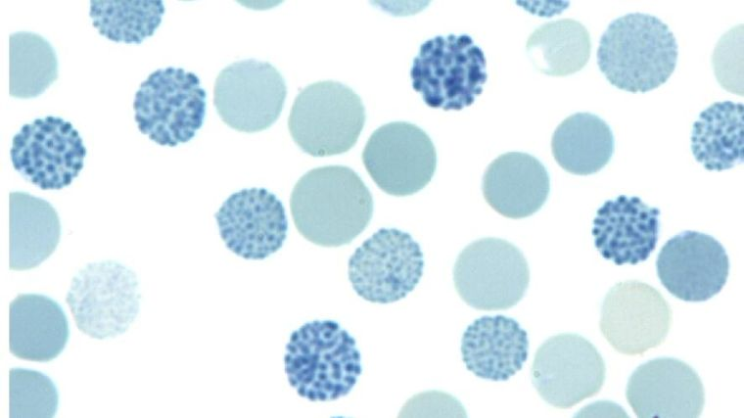
Hb H inclusions (supravital stain)

Slide 21
β-Thalassemia
Spectrum of disease – many variants show only partial reduction in β chain productions
β Thal major: both β globin genes deleted or inactive. Little or no beta chain, transfusion dependent anemia developing in first few months of life, must have chelation therapy to prevent severe iron overload
β Thal minor: One gene affected. β chain production reduced by half or less, microcytosis with mild or no anemia (usually more anemic than α thal trait)
β Thal intermedia: Both genes affected but some β chain production. Spectrum of disease between major and minor.

Slide 22
β-Thalassemia genotypes
ß⁰ß⁰ = thal major
ß⁰ß⁺ = thal intermedia
ß⁺ß⁺ = thal intermedia or thal minor
ß⁰ß^{WT} = thal minor
ß⁺ß^{WT} = thal minor (may be near normal)
ß^{WT}ß^{WT} = normal

Slide 23
Thalassemia trait causes microcytosis out of proportion to severity of anemia
Low MCV (mid 60s to high 70s) with mild or no anemia
  Alpha thal trait typically milder
  In iron deficiency anemia appears before microcytosis
Family history
Ethnic background (alpha thal very common in SE Asia)
Beta-thal trait – elevated hemoglobin A2 proportion
Alpha-thal trait – microcytosis with minimal anemia, normal hemoglobin A2
Hemoglobin E common in SE Asians (Hb electrophoresis) – phenotype similar to thal trait

Slide 24
What should I do if my patient has thalassemia trait?
Don’t treat with iron unless there is concomitant iron deficiency
Consider genetic counseling for individuals of child-bearing age

Slide 25
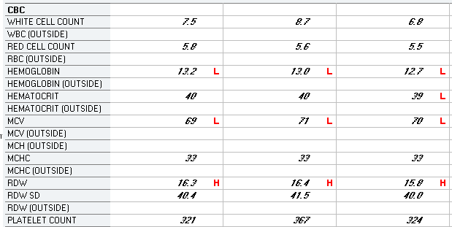

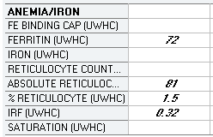
Presumed alpha thal trait

Slide 26
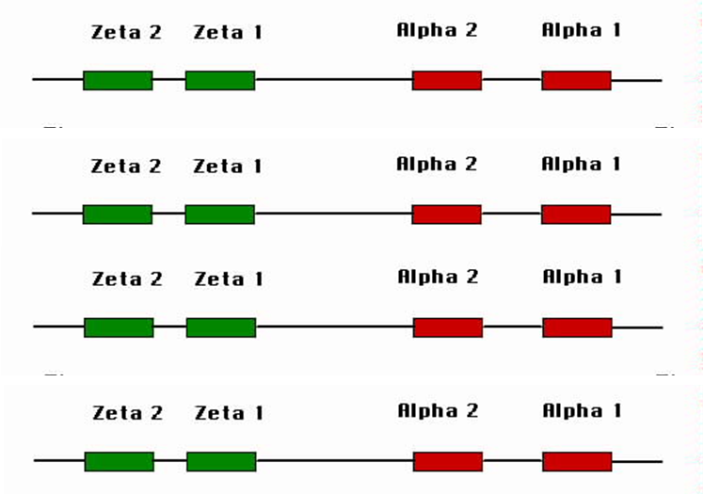
x
mom
x
All children will have thal trait
x
dad
x
x
x
mom
25% normal
50% thal trait
25% hydrops fetalis
x
x
dad

Slide 27
ANEMIA OF INFLAMMATION
AKA “anemia of chronic disease”
Hct rarely < 25 unless additional factors present
Causes: infection, autoimmune disorders, cancer
Mechanisms:
  Inflammation → incr hepcidin expression → Impaired release of stored iron from macrophages
  Impaired EPO production
  Direct inhibition of red cell precursors by inflammatory cytokines
  Shortened red cell survival

Slide 28
ANEMIA OF INFLAMMATION
Laboratory findings
Normocytic or mildly microcytic
  MCV rarely <70
Retics usually normal (<100K)
Low serum iron, normal or low TIBC, normal or high serum ferritin
Relatively low serum erythropoietin

Slide 29
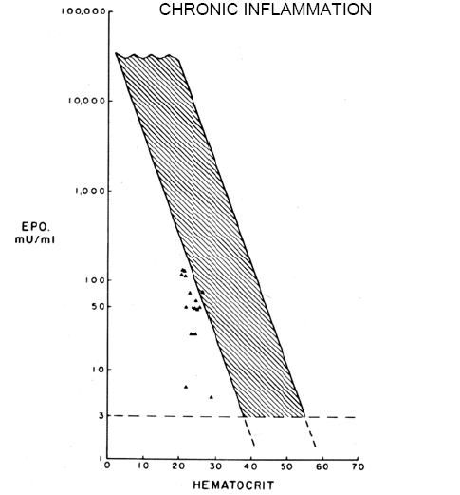
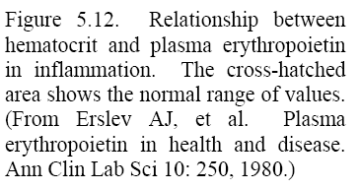
Erythropoietin levels are lower than expected for the degree of anemia in the presence of inflammation

Slide 30
Low-EPO anemia
A normal EPO level in an anemic patient implies an impaired EPO response to anemia
Hemoglobin usually ≥ 8 grams
  Exception: end stage kidney disease
Retic count usually normal
Normocytic or mildly microcytic

Slide 31
Causes of low-EPO anemia
Renal insufficiency (may be mild or even subclinical – eg, diabetic nephropathy)
Acute or chronic inflammation
Cancer
Hypothyroidism and other endocrinopathies
Malnutrition
Medications (eg, ACE inhibitors)
The effect of impaired EPO production on red cell production increases with age

Slide 32
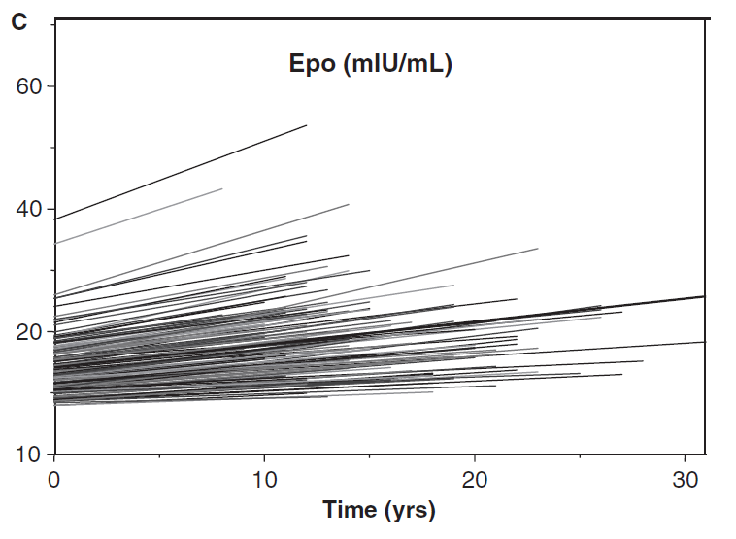
EPO levels rise with age in healthy people
J Am Geriatr Soc 2005;53:1360
Impairment of EPO production due to kidney disease, etc tends to have a disproportionate effect on red cell production in older patients

Slide 33
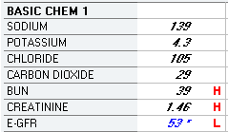
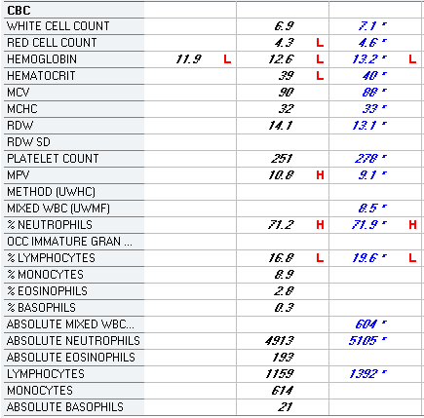
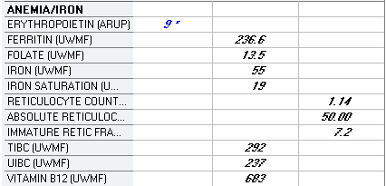
58 yo diabetic man

Slide 34
Is the patient hemolyzing?
If retic count >300K, or >200K without ongoing bleeding → probably
If hemoglobin not dropping rapidly and retic count not high → probably not
Haptoglobin is sensitive but not specific
  Low levels after transfusion, or with liver transplant, cancer, sarcoidosis, hemodilution, high estrogen states, B12 deficiency, thalassemia
  May be normal in mild extravascular hemolysis
LDH has moderate sensitivity, poor specificity
Indirect bilirubin has modest sensitivity, moderate specificity

Slide 35
Evaluating hemolytic anemia
Coombs test
Blood smear
Splenomegaly implies more chronic process
Family history
Medication review
Hb electrophoresis
Urine hemosiderin (implies intravascular hemolysis)
Specialized testing
  Osmotic fragility
  RBC enzymes
  PNH by flow cytometry
  Genetic testing
  Stain for Heinz bodies

Slide 36
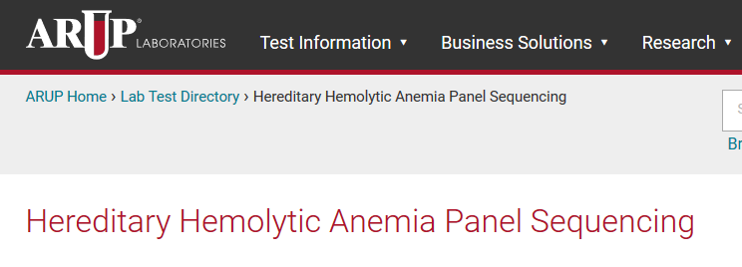
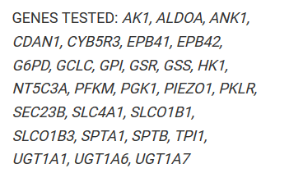

Slide 37
Coombs test
Direct Coombs or direct antiglobulin test
  Detects IgG or C3 on patient RBC
  IgG ± C3 = warm antibody
  C3 only = usually cold agglutinin (IgM)
  Positive in autoimmune or alloimmune hemolysis
  Positive test → blood bank can perform antibody identification to distinguish allo- from auto-antibody
Indirect Coombs
  Detects RBC antibodies in plasma
  Used to screen for alloantibodies prior to transfusion

Slide 38
An algorithmic approach to anemia - 1
CBC, differential, retic count, review blood smear
Look for “red flags”
  Immature or dysplastic cells
  Unexplained thrombocytopenia, leukopenia
  Very low (< 20K) or very high (> 300K) retics
  Severe anemia (Hb < 7) if bleeding and nutritional deficiency ruled out or unlikely
  Unexplained new constitutional symptoms
If any of the above present a primary hematologic disorder should be ruled out (marrow biopsy)

Slide 39
An algorithmic approach to anemia - 2
Look for readily treatable causes of anemia and treat if present
  Iron studies
  B-12 level (or MMA/homocysteine)
  Folate level
  Fecal occult blood testing
  Hypothyroidism
If anemia is mild, microcytic and iron deficiency ruled out, consider thal trait

Slide 40
An algorithmic approach to anemia - 3
Reticulocyte count > 100K: Consider hemolysis or blood loss
  If hemolysis suspected: order haptoglobin, LDH, total/direct bili, direct antiglobulin (Coombs) test
  If haptoglobin low and LDH high test for PNH and rule out MAHA
Reticulocyte count < 100K: measure EPO level
  EPO high, nutritional/iron deficiency ruled out: suggests marrow problem → consider marrow biopsy
  EPO normal or low: suggests “anemia of chronic disease”; consider causes of low-EPO state

Slide 41
An algorithmic approach to anemia - 4
If the following are true, consider watchful waiting – repeat counts in 3-6 mo and continue workup (or refer) if anemia worsens:
  Mild anemia (Hb ≥ 12 for male or 11 for female)
  No other “red flags”
  Patient asymptomatic or minimally symptomatic (eg, mild fatigue)
  Bleeding, iron deficiency and other readily treatable nutritional causes ruled out

