Slide 1
An approach to the patient with an abnormal CBC
Eliot Williams, MD PhD
Division of Hematology & Medical Oncology

Slide 2

Nothing to disclose

Slide 3
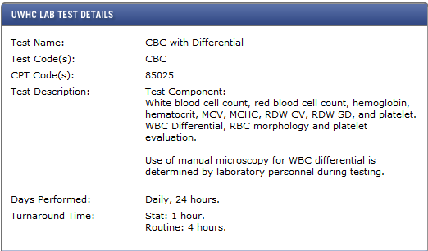
CBC with differential
26 variables → higher chance of finding an abnormality
~ 30% of outpatient CBCs done in UWHC lab have at least one abnormal finding

Slide 4
Some General Principles
A patient with an abnormal CBC is less likely to have a serious hematologic disorder if:
  The abnormalities are mild
  A single cell line is involved
  The abnormal finding has been present and relatively stable for several years
  There are no associated symptoms/abnormality found during routine screening
If #1 plus two or more of the other findings are present it a formal hematologic evaluation may not be necessary

Slide 5
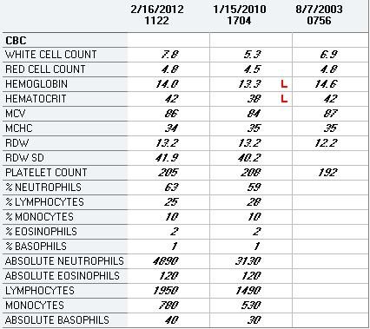
Asymptomatic 63 yo physician

Slide 6
ANEMIA
Is the marrow working?
  Check the reticulocyte count
  Other cell lines abnormal?
What do the red cells look like?
  MCV, blood smear
Always rule out readily treatable causes
  Blood loss, iron deficiency, B-12 or folate deficiency

Slide 7
ANEMIA
Initial workup
CBC with differential
Retic count
Serum ferritin, iron/TIBC, B-12, folate, TSH, creatinine
Fecal occult blood testing
Serum erythropoietin

Slide 8
Interpreting the reticulocyte count
Always use the absolute count, not the percent of retics
Retics > 200K = normal marrow response to anemia
  DDx = blood loss or hemolysis
  Very high retics (>300K) usually indicate hemolytic anemia
Retics < 100K indicates poor marrow response to anemia
  Primary marrow problem vs low-EPO state
  Very low retic count (<20K) usually indicates marrow failure

Slide 9
Microcytic anemia
Iron deficiency
  Normocytic in early stages
  Microcytosis without anemia is generally not iron deficiency
Thalassemia trait
  Can cause microcytosis without anemia
Anemia of inflammation

Slide 10
Assessing Iron Stores
Serum ferritin reflects storage compartment
  Can be low in absence of anemia
  Low level + anemia firm evidence of IDA
  Can be normal if there is iron deficiency + inflammation
Serum iron = transport compartment
  Low in iron deficiency and anemia of inflammation
  TIBC typically high in IDA, normal or low in inflammation
Normal serum iron usually rules out iron deficiency
  Exception: patient being treated with iron
MCV may be normal in early stages of iron deficiency anemia

Slide 11
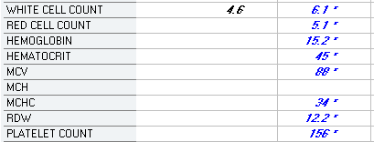
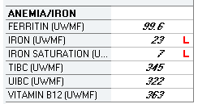
Iron deficiency?
No

Slide 12
Iron deficiency
Bleeding >> malabsorption >> chronic intravascular hemolysis (eg, PNH)
Failure to find a bleeding source by endoscopy etc does not rule out bleeding as a cause

Slide 13
Q: My patient is iron deficient. Upper and lower endoscopy, capsule endoscopy all negative. No evidence of malabsorption. What’s going on?
A: Bleeding (usually GI or menstrual)

Slide 14
Thalassemia trait
Low MCV (mid 60s to high 70s) with mild or no anemia
  Alpha thal trait typically milder
Family history
Ethnic background (alpha thal very common in SE Asia)
Beta-thal trait – elevated hemoglobin A2
Alpha-thal trait – microcytosis with minimal anemia, normal hemoglobin A2
Hemoglobin E common in SE Asians (Hb electrophoresis) – phenotype similar to thal trait

Slide 15
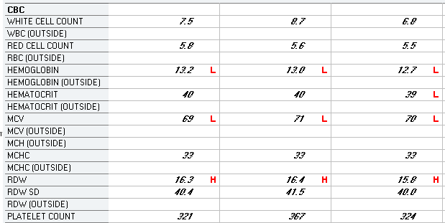

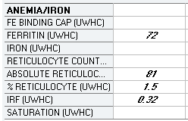
Presumed alpha thal trait

Slide 16
Low-EPO anemia
A normal EPO level in an anemic patient implies an impaired EPO response to anemia
Hemoglobin usually ≥ 8 grams
  Exception: end stage kidney disease
Retic count usually normal
Usually normocytic
May be seen in a variety of chronic diseases

Slide 17
Causes of low-EPO anemia
Renal insufficiency (may be mild or even subclinical – eg, diabetic nephropathy)
Acute or chronic inflammation
Cancer
Hypothyroidism and other endocrinopathies
Malnutrition
Aging
Medications (eg, ACE inhibitors)

Slide 18
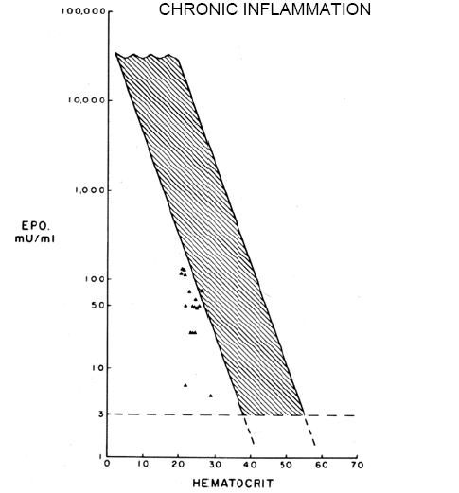
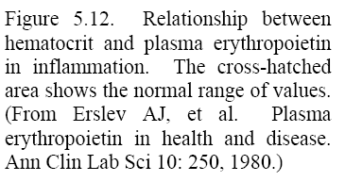
Erythropoietin levels are lower than expected for the degree of anemia in the presence of inflammation
EPO
Hematocrit

Slide 19
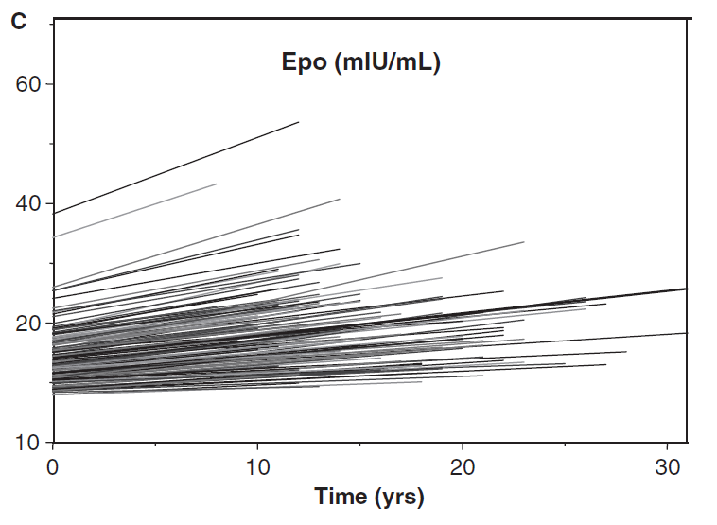
EPO levels rise with age in healthy people
J Am Geriatr Soc 2005;53:1360
Mild Impairment of EPO production due to kidney disease, etc tends to have a disproportionate effect on red cell production in older patients

Slide 20
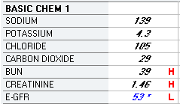
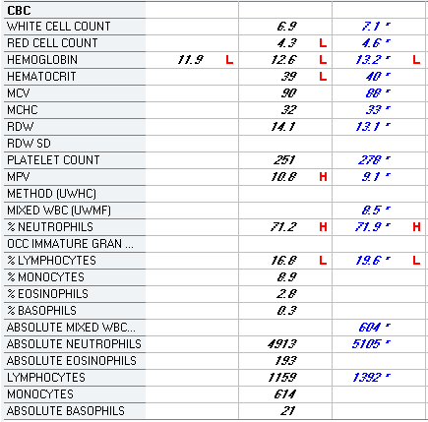
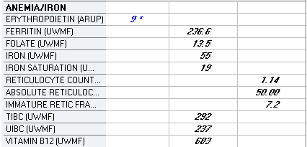
58 yo diabetic man

Slide 21
Macrocytic anemia
B-12 or folate deficiency
  Can cause pancytopenia
Hemolysis (reticulocytosis)
Alcohol
Liver disease
Drugs
  Antimetabolites, hydroxyurea, antiretrovirals
Primary marrow disorder (MDS, aplastic anemia)

Slide 22
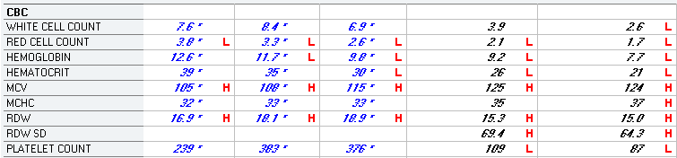
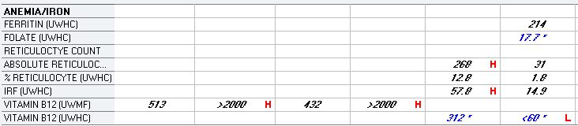
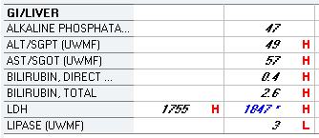

Pernicious anemia

Slide 23
Evaluation of macrocytic anemia
Measure retic count
Measure B-12, folate levels
  If low or borderline consider measuring methylmalonate (elevated in B-12 deficiency) or homocysteine (elevated in both)
Inquire re: EtOH use, antifolate drugs or antimetabolites, risk factors for liver disease

Slide 24
An algorithmic approach to anemia - 1
CBC, differential, retic count
Look for “red flags”
  Immature cells
  Very low retic count (< 20K)
  Severe anemia (Hb < 8) if bleeding ruled out or unlikely
  New onset of major constitutional symptoms
If any of the above present, abort workup and consult hematology

Slide 25
An algorithmic approach to anemia - 2
Look for readily treatable causes of anemia and treat if present
  Iron studies
  B-12 level
  Folate level
  Fecal occult blood testing
  Hypothyroidism
If anemia is mild, microcytic and iron deficiency ruled out, consider thal trait

Slide 26
An algorithmic approach to anemia - 3
Reticulocyte count > 100K: Consider hemolysis or blood loss
  Order haptoglobin, LDH, direct antiglobulin (Coombs) test
  Refer to hematology if hemolysis seems most likely or if no evidence of bleeding
Reticulocyte count < 100K: measure EPO level
  EPO above normal, nutritional deficiency ruled out: suggests marrow problem → refer
  EPO normal or low: suggests “anemia of chronic disease”; consider causes of low-EPO state

Slide 27
An algorithmic approach to anemia - 4
If the following are true, consider watchful waiting – repeat counts in 3-6 mo and continue workup if anemia persists or worsens:
  Mild anemia (Hb ≥ 12 for male or 11 for female)
  No other “red flags”
  Patient asymptomatic or minimally symptomatic (eg, mild fatigue)
  Bleeding, iron deficiency and other readily treatable nutritional causes ruled out

Slide 28
Erythrocytosis
Primary: Polycythemia vera
Secondary: chronic or intermittent hypoxemia
Ectopic EPO production (tumor)
Renal disease (cysts, post-transplant)
EPO doping
Smoking
Familial (rare)

Slide 29
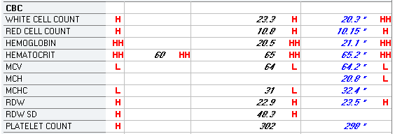
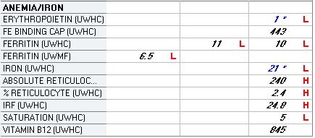
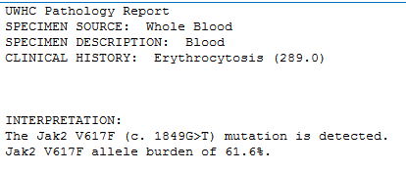
Polycythemia vera
Chronic myeloproliferative disorder
>95% have JAK2 V617F mutation
WBC and/or platelets often increased
EPO level low
Constitutional sx, pruritus, splenomegaly

Slide 30
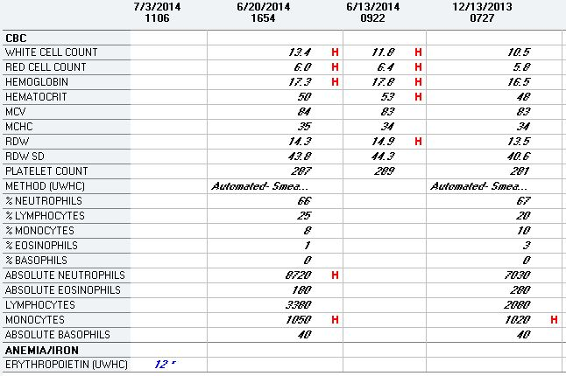
Secondary erythrocytosis in a patient with obstructive sleep apnea
Normal EPO level suggests “physiologic” erythrocytosis

Slide 31
Referral guidelines - erythrocytosis
A watch-and-wait approach may be appropriate in patients with the following characteristics:
  Hemoglobin <19
  Normal EPO level
  No symptoms
Such patients should be evaluated for causes of secondary erythrocytosis

Slide 32
Thrombocytopenia
Consumptive
  Immune (autoimmune, drugs)
  Coagulopathy
  Bacterial or viral Infection (R/O HIV)
Decreased production
  Marrow failure
  Hereditary
Sequestration
Pregnancy (multifactorial)
Pseudothrombocytopenia

Slide 33
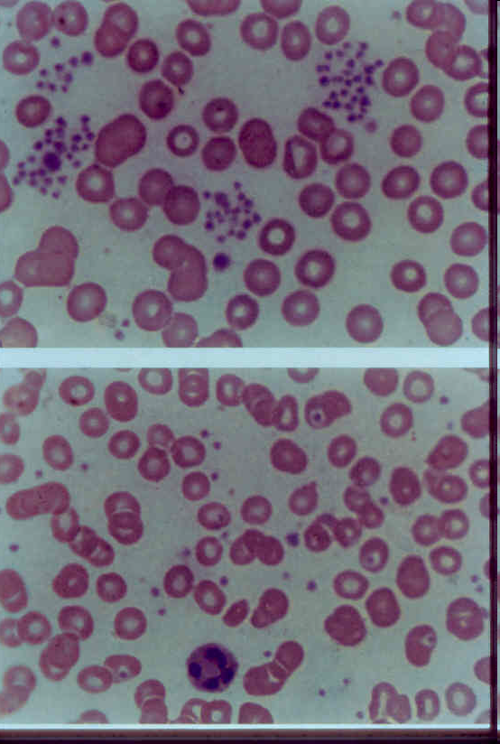
PSEUDOTHROMBOCYTOPENIA
Platelet clumping in EDTA
No clumping in heparin
This lab artifact should always be ruled out as a cause of a low reported platelet count
Notes:
Anticoagulant-dependent clumping of platelets in pseudothrombocytopenia.

Slide 34
Some drugs that cause thrombocytopenia
Antiarrhythmics (quinine/quinidine, procaineamide, amiodarone)
Gold salts
Interferon
Anti-epileptics (carbamazepine, phenytoin valproic acid)
Antibiotics (beta-lactams, sulfa, vancomycin)
Diuretics (thiazides)

Slide 35
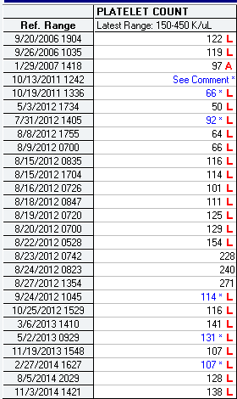
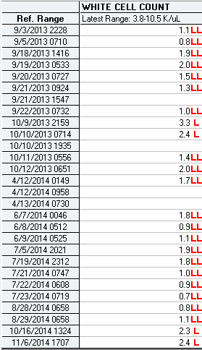
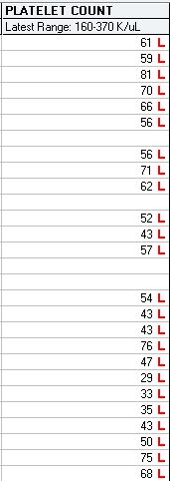
Thrombocytopenia and portal hypertension
Stents placed
Infection
42 yo man with hepatic & portal venous occlusion
39 yo woman with autoimmune liver disease

Slide 36
Benign thrombocytopenia of pregnancy
Accounts for 2/3 of cases of thrombocytopenia in pregnancy
6-7% of pregnant women
Platelet count usually 100K or above
Develops in late 2nd or 3rd trimester
Asymptomatic, resolves after delivery

Slide 37
Referral guidelines for thrombocytopenia
Rule out pseudothrombocytopenia
Rule out HIV infection
Consider watchful waiting if:
  Asymptomatic
  Other counts normal
  Platelets > 100K OR
  Platelets > 50K with portal hypertension or splenomegaly (WBC may be low as well)
  Platelet count stable over time

Slide 38
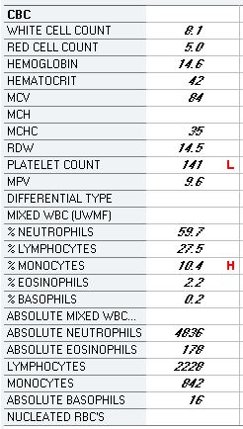
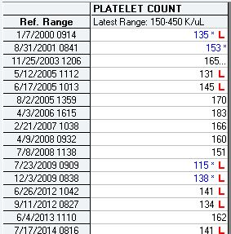
71 yo man with fatigue, arthritis, hx of prostate CA

Slide 39
Thrombocytosis
Marrow disorders
  Myeloproliferative dz (P vera, essential thrombocytosis, myelofibrosis)
  Chronic myelogenous leukemia
  Myelodysplasia
Reactive
  Inflammation
  Cancer
  Iron deficiency
  Hemolysis
  Post-splenectomy
  Rebound from thrombocytopenia

Slide 40
Evaluation of Thrombocytosis
CBC, differential, retic count
Iron studies
Inflammatory markers
Consider occult malignancy
For persistent/unexplained thrombocytosis (>600K) or if other abnormalities in CBC:
  JAK2 V617F testing: positive in 95+% of P vera, about 50% of ET and myelofibrosis cases. Positive result confirms presence of disease, negative result does not rule it out
  Rule out CML (PCR for BCR-ABL transcripts in blood)
  Marrow biopsy if MDS or myelofibrosis suspected

Slide 41
Referral Guidelines for Thrombocytosis
Referral appropriate if any of the following true:
Persistent thrombocytosis > 600K with no apparent cause of reactive thrombocytosis, or thrombocytosis persists despite treatment of potential cause
Other abnormalities in CBC: anemia or erythrocytosis, marked leukocytosis or abnormal differential
Unusual bleeding, thrombosis, unexplained neuro symptoms, or constitutional sx
Splenomegaly

Slide 42
White cells
Always consider absolute numbers rather than percentages

Slide 43
Neutropenia
Marrow dyscrasia
B-12 or folate deficiency
Generalized malnutrition
Congenital
Cyclic
Immune (autoimmune, drug-induced)
Sequestration (hypersplenism)
Marrow suppression by drugs
Rapid turnover due to infection
Chronic benign neutropenia
Chronic “ethnic” neutropenia

Slide 44
Chronic Benign Neutropenia
Asymptomatic, persistent neutropenia (may be severe)
Marrow neutrophil production normal
Other blood counts normal
Risk of infection not increased
About 25% of individuals of African and middle eastern descent have persistently low neutrophil counts with no evidence of compromised immune function
Watchful waiting appropriate in a patient with chronic mild to moderate neutropenia (ANC >500), otherwise normal blood counts, and no symptoms

Slide 45
Neutrophilia
Secondary
  Reactive (infection, inflammation, non-heme CA)
  Demargination (glucocorticoids, exercise)
  Smoking
  Idiopathic
Neoplastic
  Myeloproliferative disorders
  Myelodysplasia
  Chronic myelogenous leukemia

Slide 46
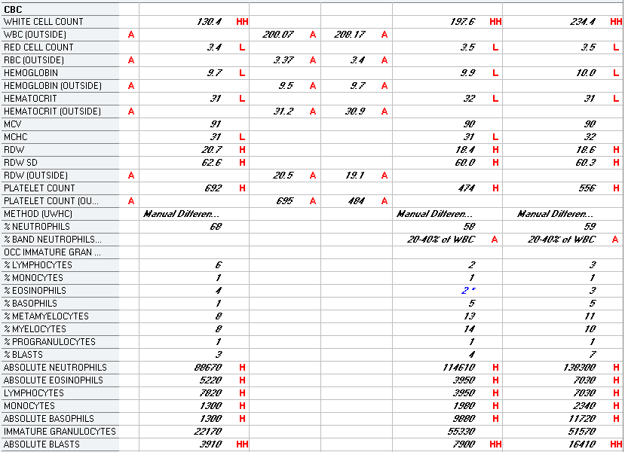
57 yo woman with fatigue (CML)
Cytogenetic analysis showed (9;22) translocation in all cells

Slide 47
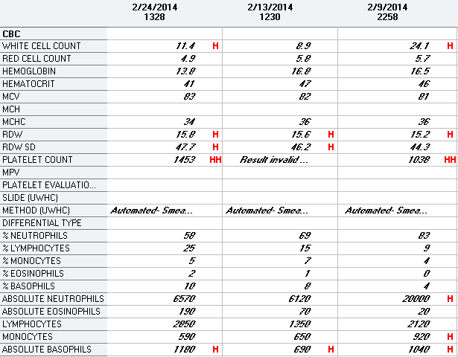
55 yo man with prostatitis (CML)
Cytogenetics: t(9;22) and t(6;20) in all cells

Slide 48
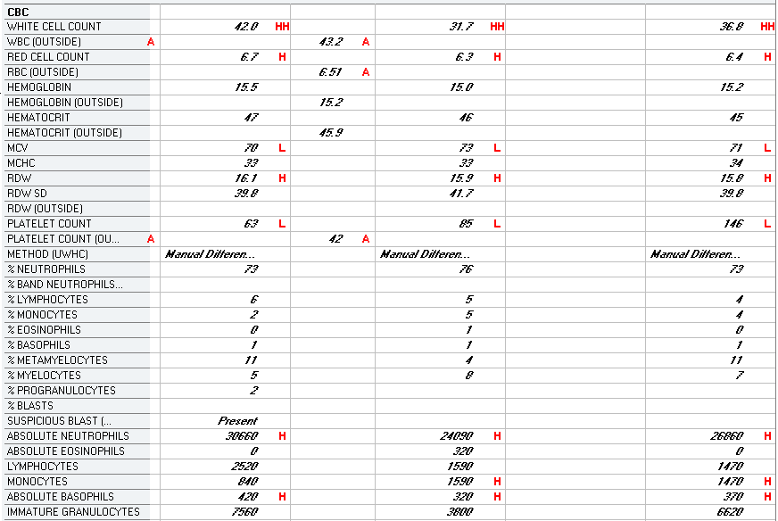
75 yo man with fatigue (MDS)
Cytogenetics: 7/29 cells had a rearrangement involving the long arm of chromosome 21

Slide 49
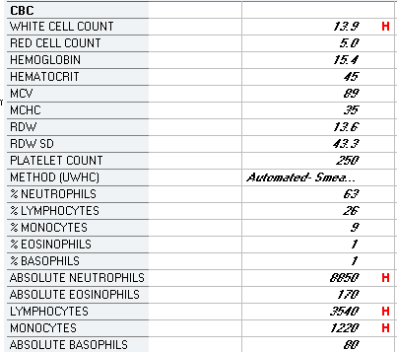
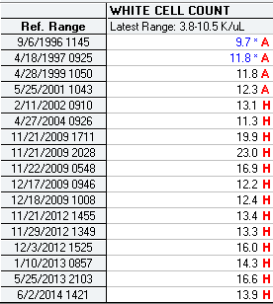
72 yo woman with fatigue (benign)

Slide 50
Benign Lymphocytosis
EBV and other viral infections
Bordetella pertussis (can cause dramatic lymphocytosis in children)
Stress
Post-splenectomy
Autoimmune disease (eg, RA)
Smoking
Hypersensitivity

Slide 51
Clonal (Neoplastic) Lymphocytosis
Chronic lymphocytic leukemia
Hairy cell leukemia
Adult T-cell leukemia
Large granular lymphocyte leukemia
Leukemic phase of lymphomas
Persistent lymphocytosis of > 5000/µL in an adult usually indicates a clonal or neoplastic disorder

Slide 52
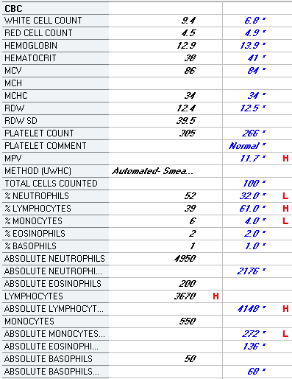
Asymptomatic 62 yo woman
Flow cytometry: T-cells make up the majority of lymphocytes and appear polytypic. The CD4:CD8 ratio is approximately 3:1. B-cells make up a small subset of lymphocytes and are polyclonal. No monoclonal B-cell population is identified.
FINAL DIAGNOSIS: Polytypic T-cells and polyclonal B-cells, no evidence of
B-lymphoproliferative disorder

Slide 53
Monoclonal B-cell lymphocytosis
Expanded population of monoclonal B-cells in blood
Most patients entirely asymptomatic with no other evidence of lymphoproliferative disease
Absolute lymphocyte count < 5000
Occasionally progresses to CLL
No treatment needed – monitor for progression

Slide 54
Lymphopenia (partial list)
Immunodeficiency syndromes
Infections (HIV and other viruses, TB, sepsis)
Iatrogenic (immunosuppressive drugs, radiation, marrow or organ transplant)
Autoimmune disease
Hodgkin disease
Aplastic anemia
Isolated lymphopenia usually not due to a primary hematologic disorder

Slide 55
Eosinophilia
Non-clonal/secondary (common)
Clonal (several conditions - uncommon)
Idiopathic hypereosinophilic syndrome
Mild: AEC 500-1500
Moderate: AEC 1500-5000
Severe: AEC > 5000

Slide 56
Secondary Eosinophilia
Infection (usually parasitic)
Allergy
Autoimmune/inflammatory disorders (many)
Paraneoplastic
  Solid tumors, lymphomas (Hodgkin>NHL)
Endocrinopathy
  Adrenal insufficiency, growth hormone deficiency
Patients with mild or intermittent eosinophilia should be evaluated for the above problems. If a potential cause is present, marrow biopsy and other testing for clonal eosinophilia can usually be deferred

