Slide 1
Venous thromboembolism: how long to treat?
Eliot Williams, MD PhD
Department of Medicine
Division of Hematology & Medical Oncology

Slide 2
3 months of anticoagulant treatment is both necessary and sufficient for most patients after a first episode of VTE
Treatment should include a minimum of 5 days of a rapid-acting anticoagulant

Slide 3
Patients with proximal DVT have a high risk of recurrence within 3 months in the absence of adequate anticoagulation
88 patients with VTE randomized to treatment with heparin followed by warfarin (INR ~ 2-3) vs low dose sq heparin
47% of patients with proximal DVT treated with low dose heparin recurred within 3 mo
No patients treated with warfarin recurred
Hull et al, NEJM 1979;301:855
Notes:
What happens if you don’t give adequate anticoagulant treatment (50% recurrence rate)

Slide 4
High treatment failure rates if initial treatment of VTE does not include a rapid-acting anticoagulant
Results of DVT treatment with a vitamin K antagonist alone
vs heparin followed by a VKA
14
Heparin + VKA
12
VKA alone
10
8
Cumulative failures
6
4
2
0
1
2
3
4
5
6
7
8
9
10
11
12
13
14
15
16
17
18
19
20
21
22
Weeks
Brandjes et al, NEJM 1992;327:1485
Notes:
What happens if you don’t include a rapid acting anticoagulant in the initial treatment regimen (higher recurrence rate in first 3 months)

Slide 5
Duration of treatment influences the location of recurrent DVT
DURAC 1 study randomized patients to 1.5 mo vs 6 mo of anticoagulation after first DVT
High risk of recurrence in patients treated for 1.5 mo: most recurrences in ipsilateral leg
Inadequate treatment of DVT →“reactivation” of initial thrombus→ early recurrence
In patients treated for 6 mo many recurrences in the contralateral leg
Late recurrences may reflect inherent thrombotic tendency
J Int Med 2000; 247:601
Notes:
Recurrences if treatment stopped early (before 3 months) tend to be in the same place as the original clot. Late recurrences often elsewhere

Slide 6
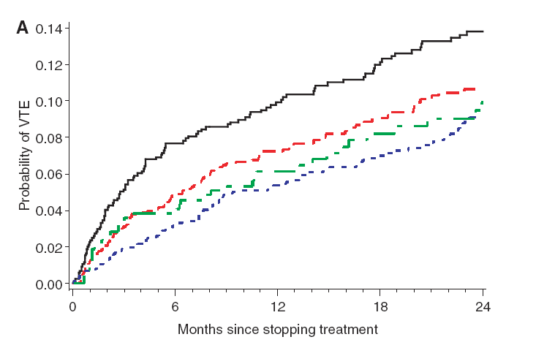
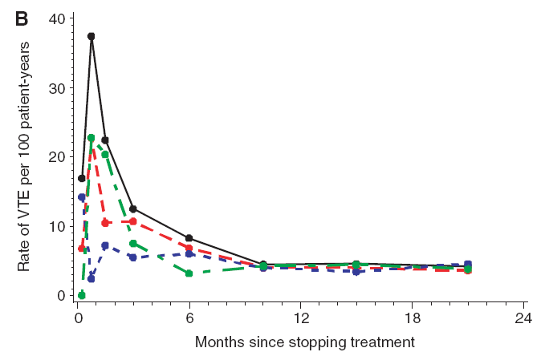
Extending treatment beyond 3 months does not significantly reduce the rate of recurrence after first episode of VTE
Pooled data from 7 randomized trials
Cumulative probability of recurrence
Rate of recurrence
Can we identify patients whose risk of recurrence is high enough to justify the risk of long-term anticoagulant therapy?
Boutitie et al, BMJ 2011
Notes:
Recurrence rate is higher if treatment is stopped before 3 months, but does not decrease further when it is continued beyond that time. Patients with a high recurrence risk are candidates to continue indefinitely; this requires balancing the risk of recurrence in the absence of anticoagulant therapy against the risk of bleeding while on such therapy

Slide 7
Patients with a high risk of recurrent VTE may benefit from prolonged anticoagulant treatment
The risk of recurrence must be weighed against the risk of bleeding

Slide 8
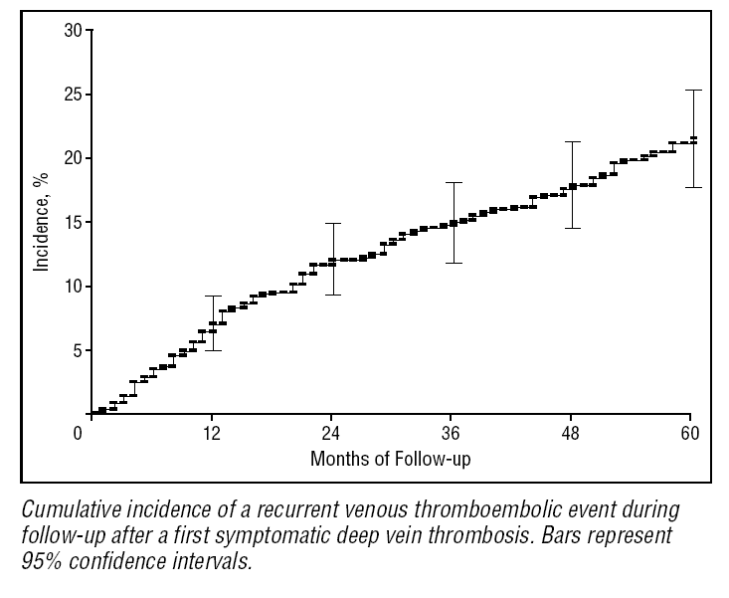
VTE recurs at a rate of about 5% per year within 5 years of the initial episode
Arch Intern Med 2000;160:769
Notes:
But this is an average recurrence rate. Some patients have higher risk, some lower.

Slide 9
Risk factors for VTE recurrence
Unprovoked VTE
Recurrent VTE
Location of DVT (proximal > distal)
Elevated D-dimer after stopping anticoagulation
Active cancer
Inflammatory bowel disease (when active)
Male gender
IVC filter
Antiphospholipid antibodies
Notes:
These are the most important factors that increase recurrence risk. Will consider them individually…

Slide 10
What does “unprovoked” mean?
ISTH definitions
Absence of any of these risk factors
Persistent risk | Major transient risk | Minor transient risk
Active cancer | Surgery with anesthesia >30 min | Surgery with anesthesia <30 min
 | Confined to bed at least 3 days with acute illness | Hospitalized or confined to bed <3 days with acute illness
 | Caesarian section | Pregnancy or puerperium
 |  | Leg injury with reduced mobility at least 3 days
J Thromb Haemost 2016;14:1480

Slide 11
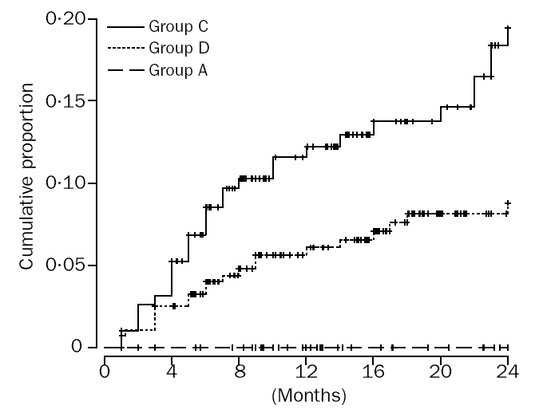
Unprovoked VTE is associated with a high recurrence rate
1 yr recurrence risk ~ 13%
Unprovoked
Other provoking factors
Postoperative
Lancet 2003;362:523
Notes:
Recurrence risk after a first VTE episode, according to whether episode was 1) totally unprovoked; 2) postop; 3) associated with any other risk factor besides surgery. Unprovoked VTE had a 13% recurrence risk in the first year after stopping anticoagulation.

Slide 12
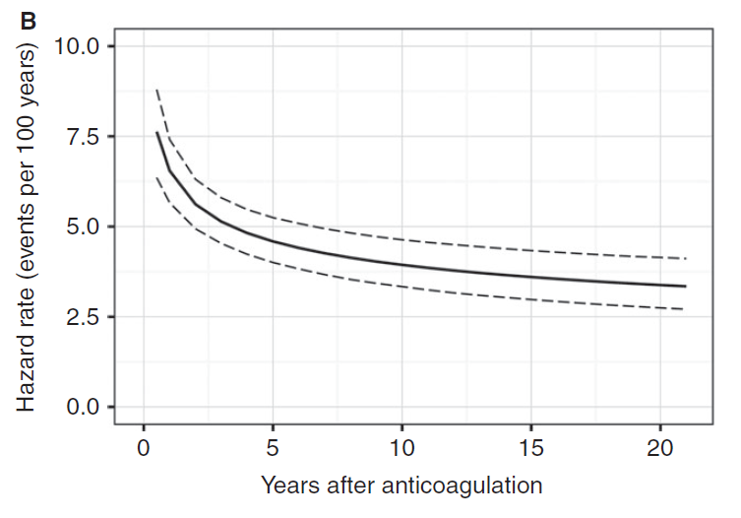
Recurrence rate of unprovoked VTE remains high for many years
J Thromb Haemost 2017;14:2402

Slide 13
10 year cumulative event rates after stopping anticoagulation for unprovoked VTE
Systemic review & meta-analysis of 18 studies involving 7515 patients
VTE | DVT | PE | Fatal PE
36.1% (28-45) | 25.1% (17-34) | 11.2% (6-18) | 1.5% (0.4-3.6)
BMJ 2019; 366:I4363

Slide 14
Proximal DVT has higher recurrence risk
Location of DVT | Recurrence risk @ 2 yrs
Unilateral distal | 7.7%
Bilateral distal | 13.3%
Unilateral proximal (popliteal/femoral/iliac) | 14%
Bilateral proximal | 13.2%
J Thromb Haemost 2005;3:1362-7
Notes:
Proximal DVT has about twice as high a recurrence risk as distal DVT

Slide 15
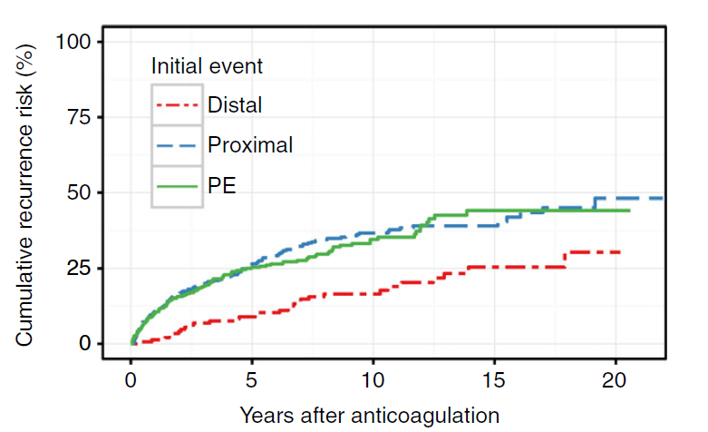
Long term recurrence risk is highest for proximal DVT and PE
J Thromb Haemost 2017;14:2402

Slide 16
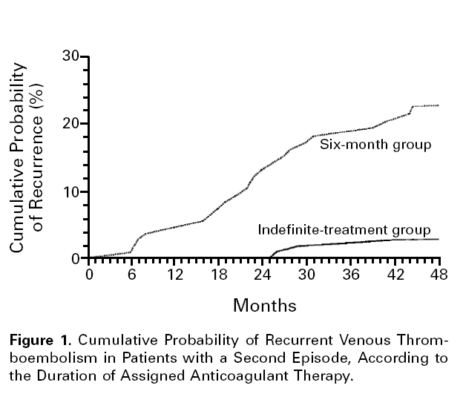
Risk of recurrence is higher after a second episode of VTE
1 yr recurrence rate ~ 9%
NEJM 1997;336:393
Notes:
Recurrence rate is almost twice as high (9% vs 5% per year) after a second episode of VTE

Slide 17
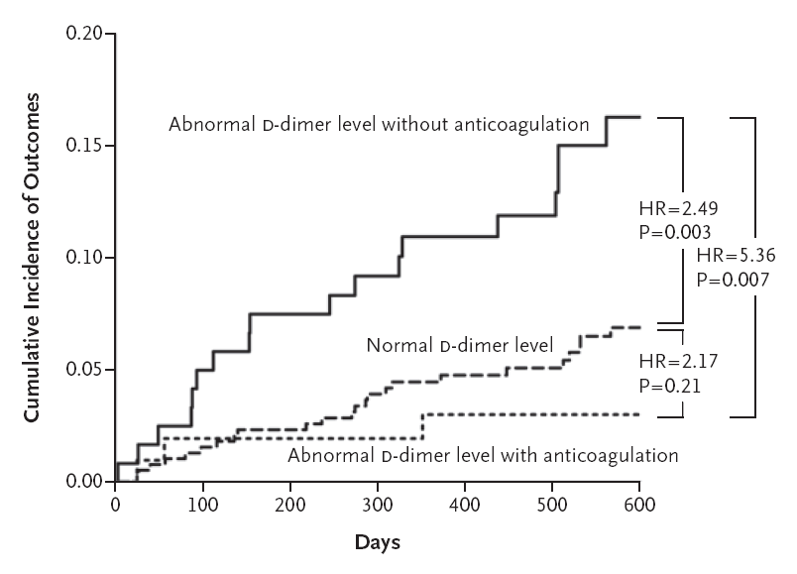
Elevated D-dimer level one month after stopping anticoagulation predicts higher VTE recurrence risk
N Engl J Med 2006;355:1780-9
Notes:
Elevated D-dimer after stopping anticoagulation predicts a recurrence risk about 2-fold higher (roughly 10% vs 5% per year) than if D-dimer normal

Slide 18
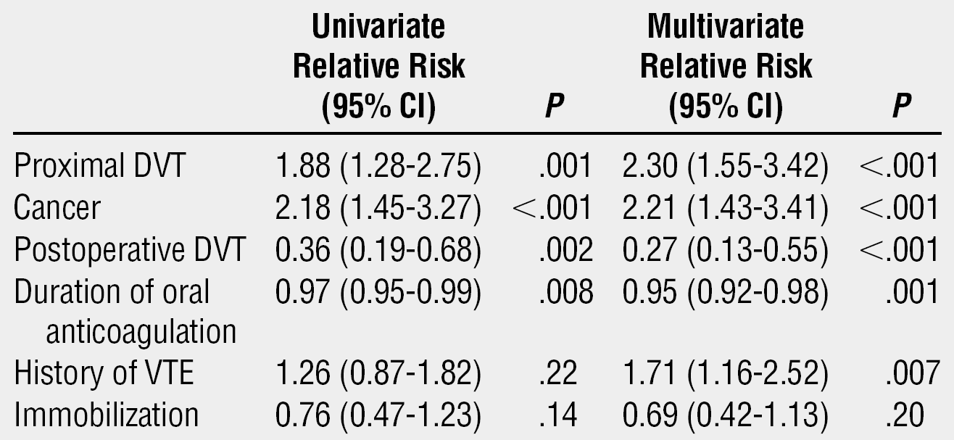
Cancer patients have a high risk of recurrent VTE
Arch Intern Med 2000;160:769

Slide 19
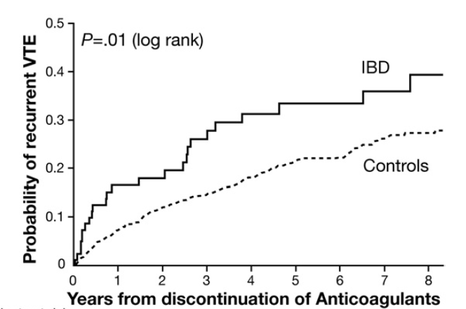
Inflammatory bowel disease increases VTE recurrence risk
1 yr recurrence rate ~ 18%
Gastroenterology 2010;139:779
Notes:
Active inflammatory bowel disease a strong risk factor for recurrence (about 18% vs 5%)

Slide 20
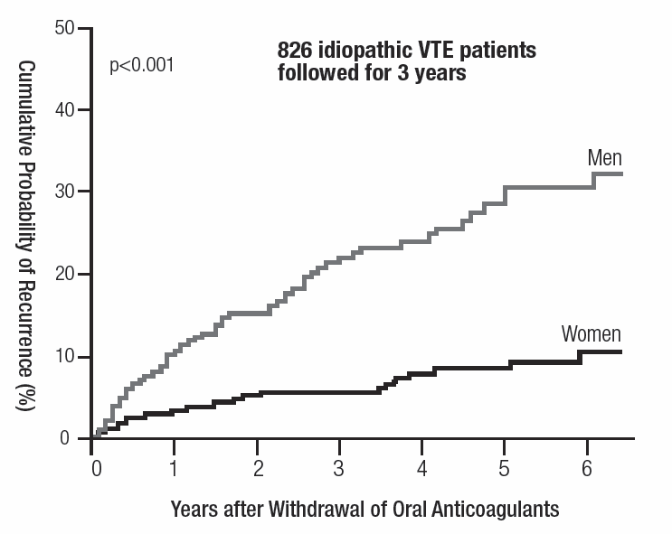
Men have a higher VTE recurrence risk than women
N Engl J Med 2004;350:2558-63

Slide 21
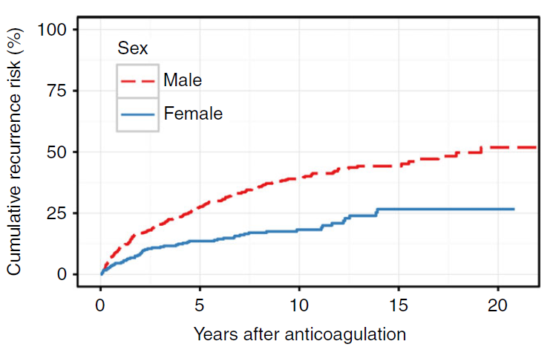
20-year recurrence rate twice as high for men than women
J Thromb Haemost 2017;14:2402

Slide 22
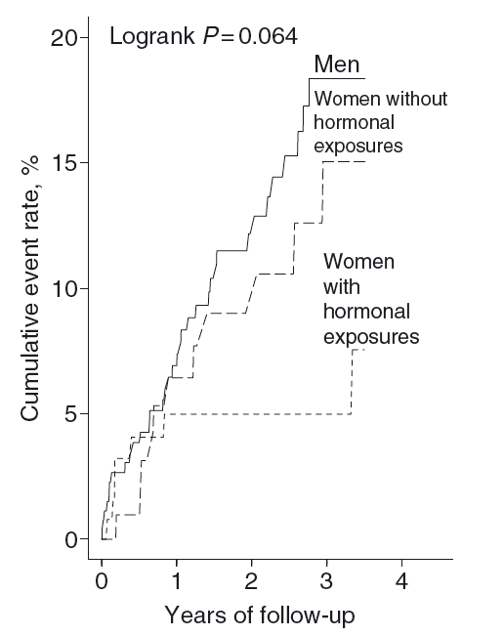
Estrogen-related VTE has a low risk of recurrence
J Thromb Haemost 2006;4:2199
Notes:
Hormone-related VTE in women has a low recurrence risk in the absence of further hormone exposure

Slide 23
IVC filters increase the risk of recurrent DVT
Outcome at 12 days
Outcome at 2 years
GROUP
Pulmonary Embolism
Death
Major Bleeding
Pulmonary embolism
Recurrent DVT
Death
Major Bleeding
Filter
1.1%
2.5%
4.5%
3.4%
20.8%
21.6%
8.8%
No Filter
4.8%
2.5%
3.0%
6.3%
11.6%
20.1%
11.8%
N Engl J Med 1998;338:409
Notes:
IVC filter doubles recurrence risk (this the only randomized controlled trial of filters)

Slide 24
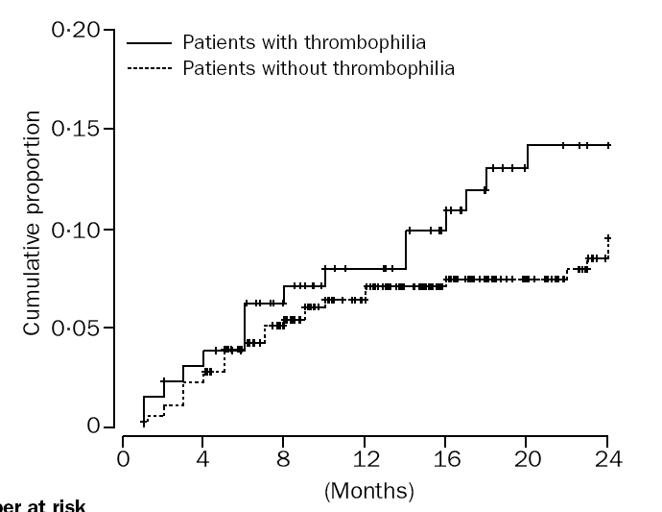
The presence of inherited thrombophilia does not significantly increase VTE recurrence risk
p = NS
Lancet 2003;362:523
Notes:
In contrast, presence of inherited thrombophila does NOT have a significant effect on recurrence risk and so should not be used as a basis for determining duration of treatment

Slide 25
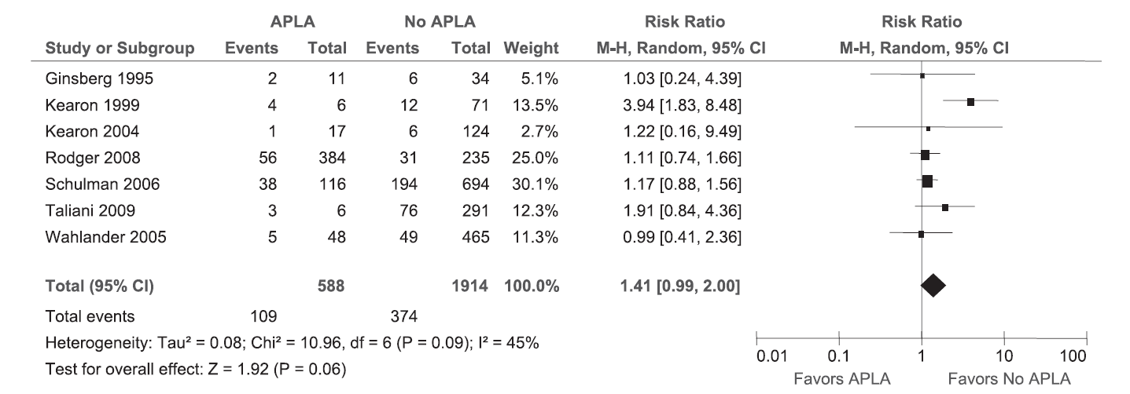
Antiphospholipid antibodies and VTE recurrence risk
“Although a positive APLA test appears to predict an increased risk of recurrence in patients with a first VTE, the strength of this association is uncertain because the available evidence is of very low quality”
Blood 2013;122:817
Notes:
APL appears to increase recurrence risk, though the evidence is not as strong as for some of the other risk factors we have discussed. Consensus that patients with VTE and clear evidence of APL (eg, triple-positives) should be considered for indefinite treatment

Slide 26
What is the bleeding risk with anticoagulant therapy?
Young patient with good anticoagulant control: <1%/yr
Elderly patient with multiple risk factors for bleeding: >4%/yr
Case fatality rates from bleeding while on anticoagulant therapy ≈ 20%
Blood 2014;123:1794
Thromb Haemost 2013; 110:834
Notes:
Bleeding risk on anticoagulants varies widely, but anticoagulant-related bleeding has a relatively high mortality across the board

Slide 27
Risk factors for anticoagulant-related bleeding
Age (>75)
History of bleeding
Metastatic cancer
Renal or liver failure
Other coagulation defects
Falls
Recent surgery
Poor performance status or cognitive status
Poor control of VKA therapy
Notes:
These are some of the factors that must be consider in estimating bleeding risk.

Slide 28
How high does the risk of recurrent VTE need to be to justify prolonged anticoagulant therapy?
ACCP guidelines
Bleeding risk | Risk of recurrence in 1 yr after stopping treatment | Indication for indefinite therapy
Low | >13% | strong
Low | 8-13% | weak
Intermediate | >16% | strong
Intermediate | 11-16% | weak
Blood 2014;123:1794
Notes:
Patients no risk factors for bleeding but with one or more risk factors for recurrence (particularly unprovoked VTE, active cancer, IBD, APL) as discussed previously are candidates for prolonged treatment. If you are on the fence can use D-dimer as the tie-breaker. No exact formula for bleeding risk – must use clinical judgement

Slide 29
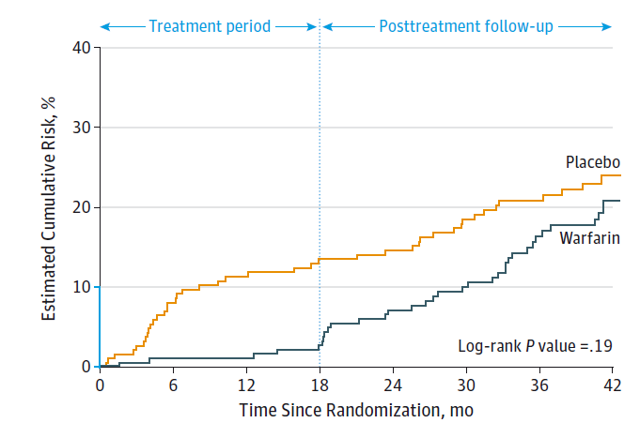
Cumulative risk of recurrent VTE + major bleeding with standard vs extended anticoagulant therapy
(24 mo vs 6 mo) after first unprovoked PE
Low risk of recurrent VTE during treatment period (3.3% vs 13.5% with placebo)
Major bleeding in 2% of patients taking warfarin and 0.5% of patients taking placebo
Benefit of extended therapy not maintained after therapy stopped
JAMA 2015; 314:31

Slide 30
Selected patients may benefit from treatment with a non-warfarin anticoagulant
Notes:
Who are candidates for treatment with drugs other than warfarin?

Slide 31
Alternatives to warfarin for prolonged anticoagulation
Reduced intensity warfarin less effective and no safer than standard warfarin treatment
Aspirin
Rivaroxaban or apixaban
Low molecular weight heparin
Fondaparinux

Slide 32
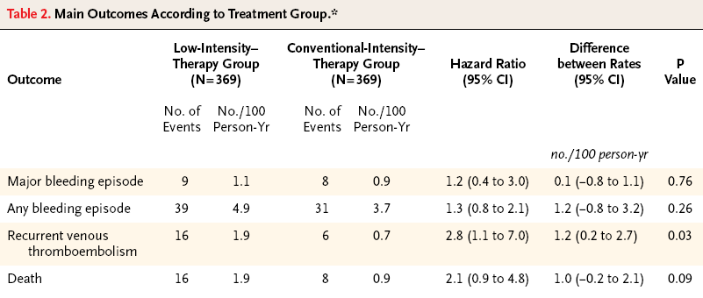
Standard warfarin Rx better than low intensity Rx for secondary prevention of VTE
738 patients with unprovoked VTE who had standard anticoagulant therapy for at least 3 mo randomly assigned to treatment with either:
  Standard warfarin treatment (target INR 2-3)
  Reduced intensity warfarin (target INR 1.5-1.9)
Outcomes:
NEJM 2003;349:631
Notes:
No benefit to reducing the intensity of warfarin treatment

Slide 33
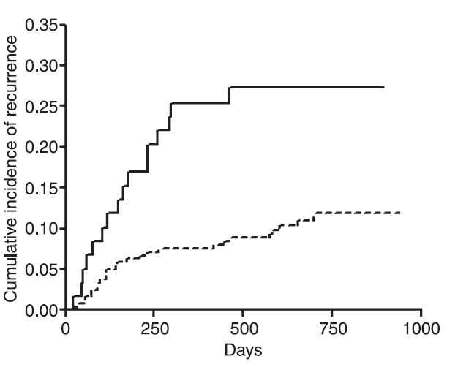
Poor anticoagulation control with warfarin increases the risk of VTE recurrence
Upper quintile
(worse control)
Lower quintile
(better control)
VTE recurrence rate vs quality of anticoagulant control (percent time with INR <1.5) in first 90 days of treatment
J Thromb Haemost 2005;3:955
Notes:
Consider NOACs especially in patients with poor anticoagulant control

Slide 34
Rivaroxaban or Apixaban for extended treatment of VTE
Treatment | Recurrent VTE | Major or clinically relevant bleeding | Death
RIV 10 mg/d | 1.2%* | 3.2% | 0.2%
RIV 20 mg/d | 1.5%* | 2.4% | 0.7%
ASA 81 mg/d | 4.4% | 2.1% | 0.6%
*P<0.001 vs placebo
NEJM 2017;376:1211
Treatment | Recurrent VTE | Major or clinically relevant bleeding | Death
APIX 2.5 mg bid | 1.7%* | 4.3% | 0.8%
APIX 5 mg bid | 1.7%* | 3.2% | 0.5%
Placebo | 8.8% | 7.8% | 1.7%
*P<0.001 vs placebo
NEJM 2013;368:699
Notes:
Direct Xa inhibitors may offer a safety advantage as well as practical advantage (no monitoring)

Slide 35
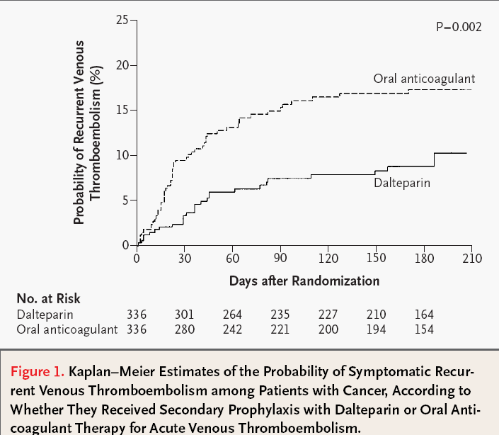
LMWH is more effective than warfarin for secondary prevention of VTE in cancer patients
NEJM 2003;349:146-53

Slide 36
DOACs for cancer-associated VTE
Hokusai trial: edoxaban lowered VTE incidence vs dalteparin but had higher bleed rate (NEJM 2018;378:615)
Select-D trial: rivaroxaban lowered VTE recurrence rate vs dalteparin but caused more bleeding (J Clin Oncol 2018;36:2017)
Caravaggio trial: apixaban lowered VTE recurrence rate vs LMWH, bleeding risk similar (NEJM 2020;382:1599)
Bleeding risk with DOACs appears higher in patients with GI or GU cancers

Slide 37
Aspirin is moderately effective in preventing VTE recurrence with a low risk of bleeding
Subjects: 402 patients with first episode of unprovoked VTE who had completed 6-18 mo of standard anticoagulant therapy
Treatment: ASA 100 mg/day vs placebo
Outcome:
Treatment | ASA | Placebo | P value
Recur. VTE | 28 | 43 | 0.02
Bleeding | 4 | 4 | 0.97
NEJM 2012;366:1959
Notes:
Aspirin is a low-risk alternative, but not as effective as the other drugs discussed.

Slide 38
Patient preference must be considered when deciding whether or not to prolong the course of anticoagulation

Slide 39
There is wide variation in the relative values patients place on preventing VTE recurrence vs stopping anticoagulant treatment
Preference | % of patients (n = 118)
Stop regardless of risk | 25%
Stop if ≤15% risk | 8%
Stop if ≤ 10% risk | 23%
Stop if ≤ 5% risk | 21%
Continue regardless of risk | 23%
Thromb Haemost 2004; 92:1336

Slide 40
Summary
3 months of standard anticoagulant therapy is adequate for most patients with a first episode of VTE
The decision to prolong therapy should take into account:
  VTE recurrence risk
  Bleeding risk
  Patient preference
An oral direct Xa inhibitor may be preferable for long-term treatment for selected patients
LMWH or DOACs are preferred treatment for cancer-associated VTE
Aspirin is safer, but less effective, than warfarin for secondary prevention of VTE

