Slide 1
Thrombotic Disorders
Notes:
This morning I am going to provide an overview of thrombotic disorders, the differences between the typical pathology of arterial and venous thrombosis, and spend some time on risk assessment, diagnosis, and treatment of VTE.

Slide 2
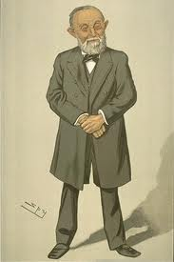
Virchow’s triad
Rudolph Virchow, 1821-1902
Vessel wall injury
Hypercoagulability of blood
Stasis of blood

Slide 3
Arterial Thrombosis - 1
Interruption of blood flow causes ischemic necrosis of involved organ/limb
Vessel wall injury (eg, atheroma) initiates most events
Emboli may cause downstream small vessel infarction (ie. embolic stroke)
Examples: MI, stroke, limb ischemia/gangrene

Slide 4
Arterial Thrombosis - 2
High shear in arterial circulation → platelets play greater role than thrombin/fibrin formation in initiating thrombosis
  Antiplatelet agents preferred for prevention of arterial events in most cases
  Inherited conditions that promote thrombin formation (inherited thrombophilia) are not major risk factors for arterial thrombosis

Slide 5
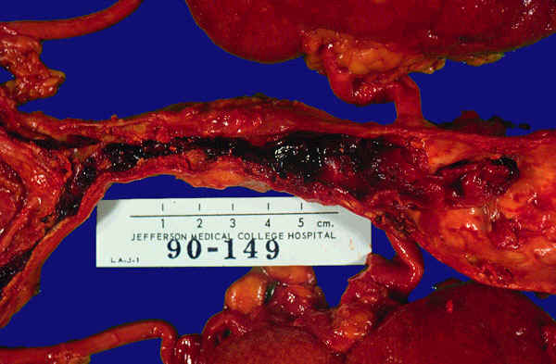
Arterial Thrombosis
(From: Fishback, J., Dept of Pathology, University of Kansas Medical Center)

Slide 6
Pathophysiology of Arterial Thrombosis
Atherosclerotic vessel disease is major risk factor
Atherosclerosis is a complex process associated with endothelial injury and inflammation

Slide 7
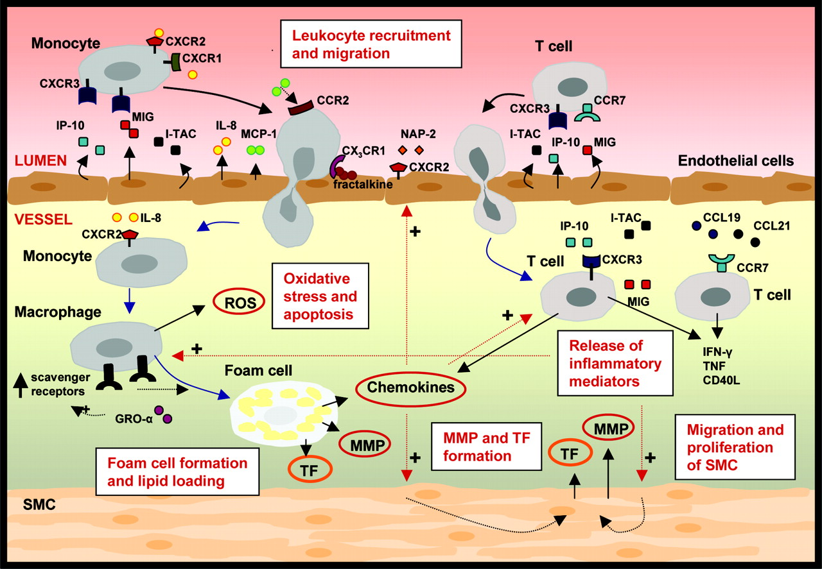
Atherogenesis is a complex process
Arteriosclerosis, Thrombosis, and Vascular Biology 2008

Slide 8
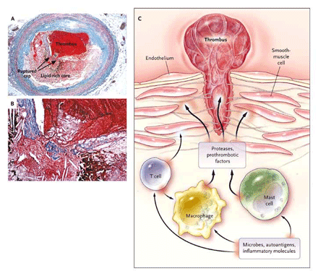
Plaque Rupture and Arterial Thrombosis in Atheromatous Disease
From Hansson, NEJM 2005

Slide 9
Risk Factors for Atherosclerosis
Smoking
Hypertension
Hypercholesterolemia
Diabetes/metabolic syndrome
Family history
Age
Obesity
Sedentary life style

Slide 10
Venous Thrombosis - 1
Obstruction to venous outflow causes edema, swelling, pain, and inflammation in the area drained by the affected vein
Most common in deep veins of the legs/pelvis, associated with venous stasis.
Complicated by pulmonary embolism (PE), where thrombus breaks free and follows the venous return through the right side of the heart into the pulmonary arteries.
Massive PE (typically from large proximal leg or pelvic veins) can cause hypoxemia, shock and death. Mortality rate from PE averages about 5%.
Rarely, paradoxical embolus enters arterial circulation via patent ductus arteriosus or atrial septal defect causing arterial occlusion (stroke, limb ischemia, etc).

Slide 11
Venous Thrombosis - 2
Low shear and stasis allows accumulation of activated clotting factors, so clots are fibrin-rich.
  Drugs that slow or block thrombin generation preferred over antiplatelet drugs for prevention and treatment of venous thrombosis
  Inherited or acquired conditions that promote thrombin formation increase risk of venous thrombosis

Slide 12
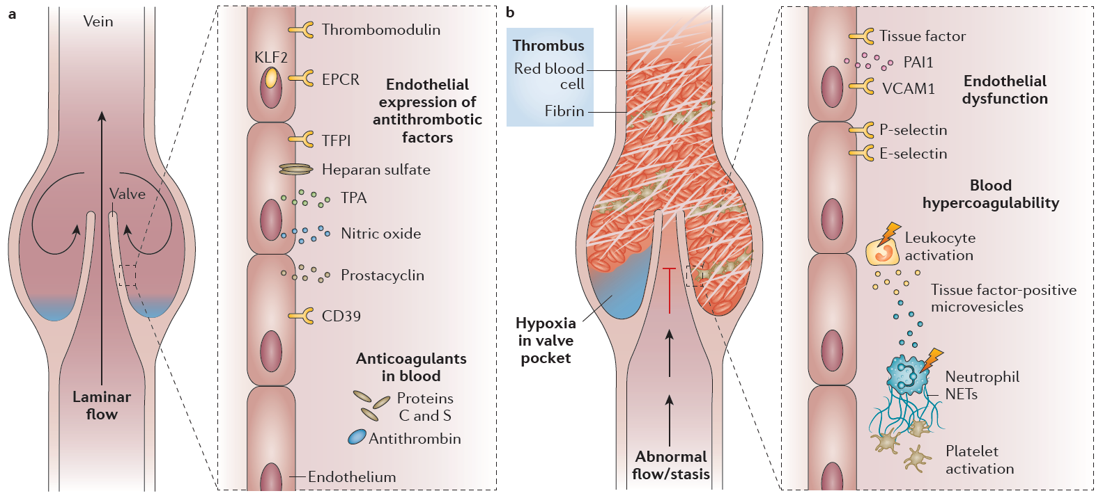
Health
Disease
Normal flow
Healthy endothelium
Hemostasis in balance
Stasis
Endothelial injury
Hypercoagulability
Wolberg et al, Nature Collections 2019

Slide 13
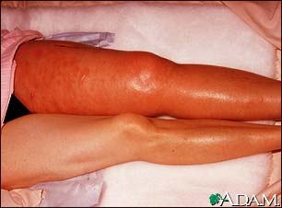
Deep Venous Thrombosis
(image from NLM)
Notes:
Point out that DVT is sometimes silent, with normal or near-normal exam and few if any symptoms – PE may be first clinical manifestation

Slide 14
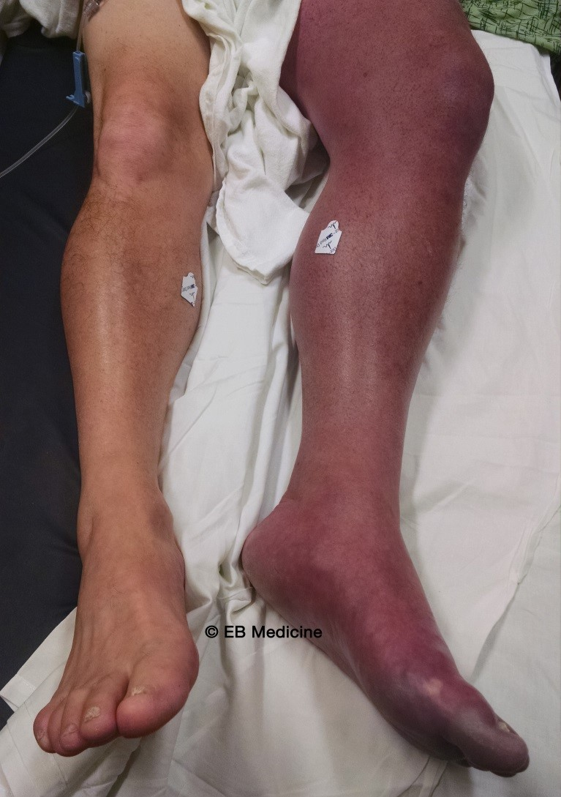
DVT causing leg ischemia
(Phlegmasia cerulea dolens)

Slide 15
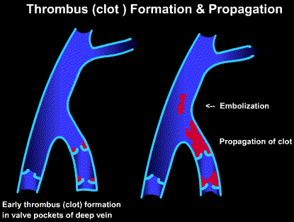
Pulmonary Embolism
Notes:
Propagation/Extension of clot:
Extensive clot can cause valvular dysfunction (with scarring) resulting in post-phebitic syndrome
Friability/breaking off of clot can cause pulmonary embolus of varying sizes

Slide 16
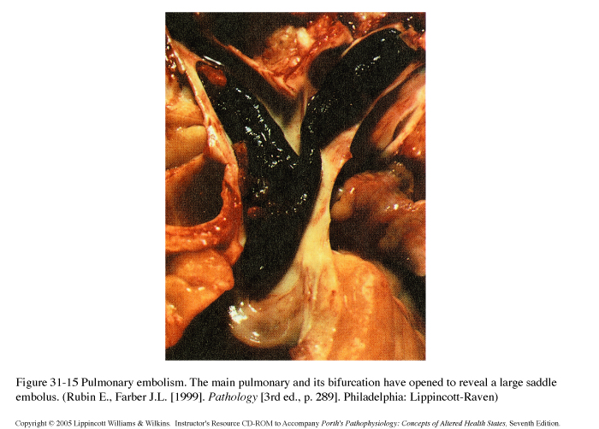
Pulmonary Embolism

Slide 17
Vessel wall injury
Hypercoagulability of blood
AKA “Thrombophilia”
(acquired or inherited)
Stasis of blood

Slide 18
Some Causes of Venous Stasis
Surgery or major trauma
Cancer (vessel obstruction by tumor)
Immobilization (prolonged bedrest, paralysis, leg cast, long airplane trips, etc)
Obesity
Pregnancy
Congestive heart failure
Venous insufficiency or obstruction
Notes:
Familiar with most of these clinical risk factors
Can understand them in terms of Virchow’s triad
Some in more than one category- many represent vessel injury or forms of stasis
Mention LA- importance in recurrent cases or mixed art and venous
WHAT ABOUT CASES THAT ARE NOT ASSOCIATED WITH ANY OF THESE FACTORS???

Slide 19
Acquired Hypercoagulability - 1
Age
Surgery or trauma
Cancer (and cancer chemotherapy)
Myeloproliferative disorders (e.g., polycythemia vera)
Pregnancy and post-partum period
Estrogens (oral contraceptives, postmenopausal hormone replacement)
Notes:
Familiar with most of these clinical risk factors
Can understand them in terms of Virchow’s triad
Some in more than one category- many represent vessel injury or forms of stasis
Mention LA- importance in recurrent cases or mixed art and venous
WHAT ABOUT CASES THAT ARE NOT ASSOCIATED WITH ANY OF THESE FACTORS???

Slide 20
Acquired Hypercoagulability - 2
Antiphospholipid syndrome
Heparin-induced thrombocytopenia
Notes:
Familiar with most of these clinical risk factors
Can understand them in terms of Virchow’s triad
Some in more than one category- many represent vessel injury or forms of stasis
Mention LA- importance in recurrent cases or mixed art and venous
WHAT ABOUT CASES THAT ARE NOT ASSOCIATED WITH ANY OF THESE FACTORS???

Slide 21
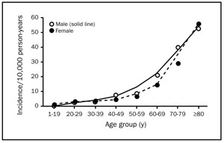
The Incidence of Venous Thromboembolism (VTE) Rises with Age
Figure 2. Average annual sex- and age-specific incidence of venous thromboembolism among community residents of Olmsted County, Minnesota, from 1980 through 1990. (From: Heit, J MAYO CLIN PROC. 2001)

Slide 22
Antiphospholipid Antibodies
  Antiphospholipid antibodies (APA)
    A general term for antibodies directed against a variety of epitopes present on phospholipid/protein complexes.
      Examples: anticardiolipin Ab, anti-beta-2 glycoprotein I Ab
    These are relatively common. Many patients asymptomatic, more likely to be associated with disease when present in high titers
  Lupus anticoagulants (LAC)
    Subset of antiphospholipid antibodies that inhibit in vitro coagulation.
    Misleading name – many patients don’t have systemic lupus erythematosous (SLE), and these antibodies much more likely to be associated with arterial or venous thrombosis than bleeding.
    Acts as an anticoagulant in vitro only – prolongs aPTT and other phospholipid-dependent clotting tests.

Slide 23
Antiphospholipid Syndrome
    Laboratory: persistently positive tests for antiphospholipid antibodies (LAC and other high titer APA)
    Clinical manifestations:
      Arterial and/or venous thrombosis
      Recurrent fetal loss
      Autoimmune thrombocytopenia or hemolytic anemia
    Uncertain pathophysiology
    May be associated with SLE, or with no associated condition (primary antiphospholipid syndrome).
    Occasional “catastrophic” presentation with multiple organ failure
    Some patients require lifelong anticoagulation

Slide 24
Genetic Risk Factors for VTE
Deficiency of major coagulation Inhibitors: uncommon, genetically heterogeneous conditions associated with up to 20 fold increased VTE risk in some families
  Antithrombin Deficiency
  Protein C Deficiency
  Protein S Deficiency
Other conditions- more common but less risky (3-5 fold increased VTE risk)
  Factor V Leiden (~ 5% of US population)
  Prothrombin G20210A polymorphism (~ 2%)
There are many other candidate genes! Risks associated with mutations in these are unknown

Slide 25
Procoagulant
Antifibrinolytic
Anticoagulant
Profibrinolytic

Slide 26
VTE is a multigenic disease
Gene defect ≠ disease!
  Most people with single gene defects are asymptomatic
The most common known genetic risk factors are only present in a minority of VTE cases
  FV Leiden in 20-40% of VTE cases
  Antithrombin, protein C, protein S in 5% or less
Multiple genetic factors contribute to risk but the contributions of most cannot be quantified
Family history is very helpful in assessing genetic risk

Slide 27
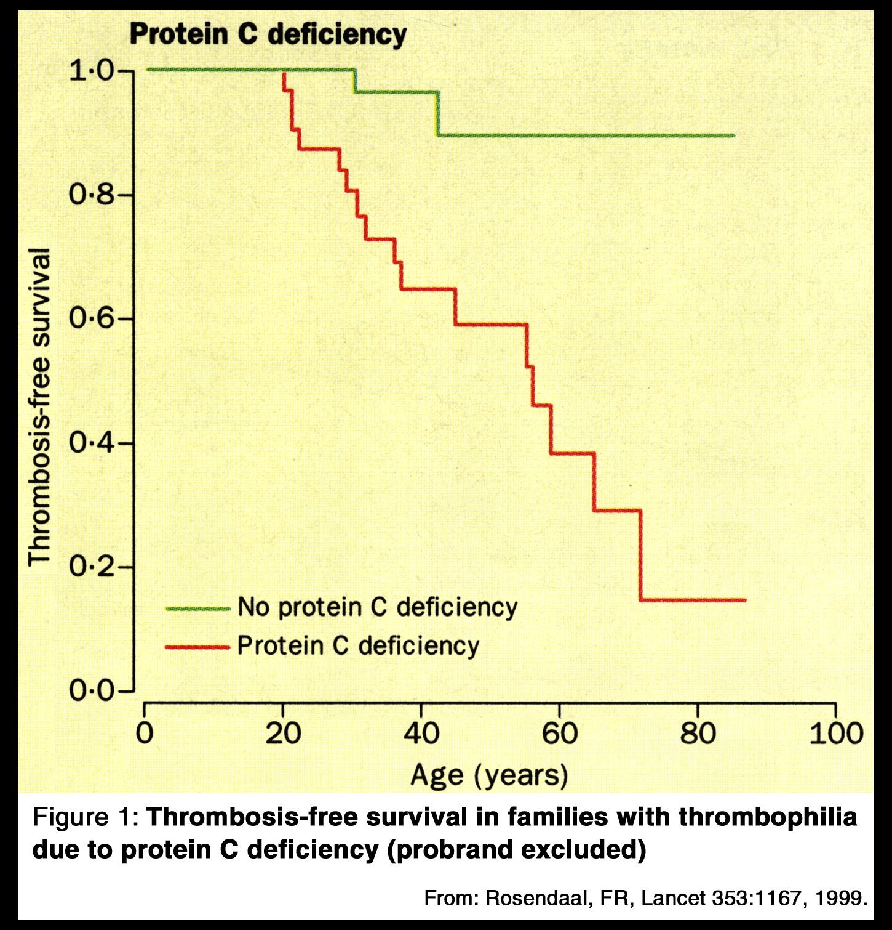
Thrombosis-free survival in a family with protein C deficiency; unusually high incidence of VTE in members without protein C deficiency
Notes:
Thrombosis-free survival in families with thrombophilia due to PC Deficiency

Slide 28
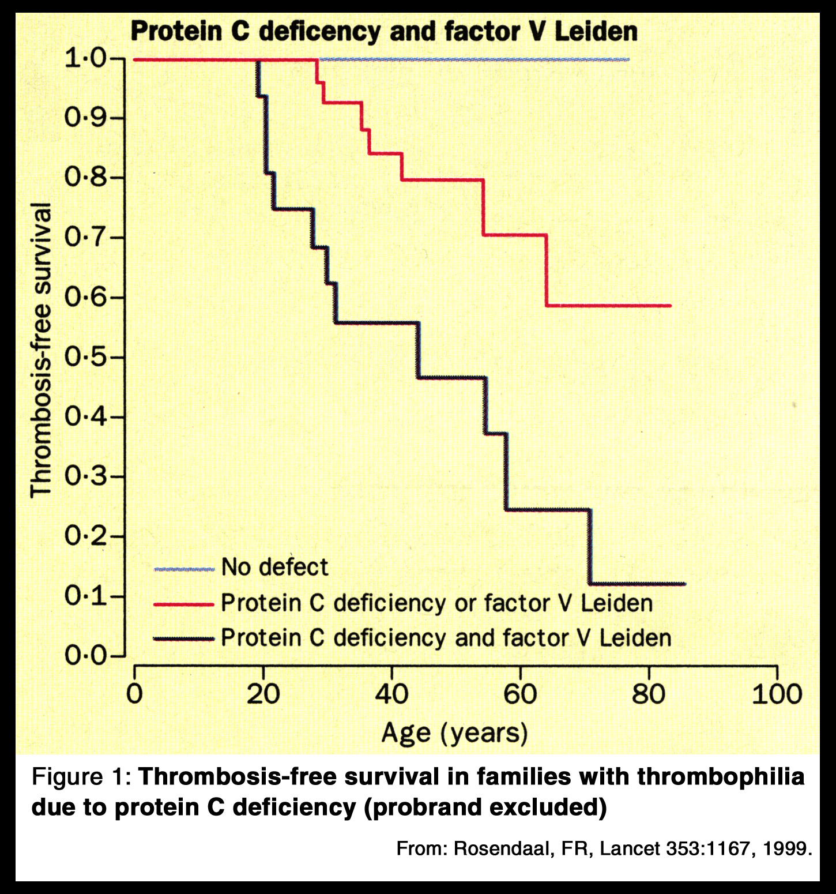
Many members of this family also had factor V Leiden; co-inheritance of FVL with protein C deficiency created highest risk of thrombosis
Notes:
With discovery of FVL, the risk of thrombosis can be further analyzed, demonstrating that the dual gene defects are at substantially higher risk, and those with neither defect have virtually no risk
Thus, FVL clearly modulates the phenotype of PC deficiency in those families, and vice versa

Slide 29
Family history predicts thrombotic risk just as well as laboratory testing for thrombophilia
A case-control study
Fam Hx VTE | % VTE pts | % controls | Odds Ratio for VTE (95% CI)
Negative | 68.5 | 82.7 | 1
Any relative | 31.5 | 17.3 | 2.2 (1.9-2.6)
Relative < 50 | 15.0 | 6.7 | 2.7 (2.2-3.4)
> 1 Relative | 6.0 | 1.9 | 3.9 (2.7-5.7)
ARCH INTERN MED 2009;169:610

Slide 30
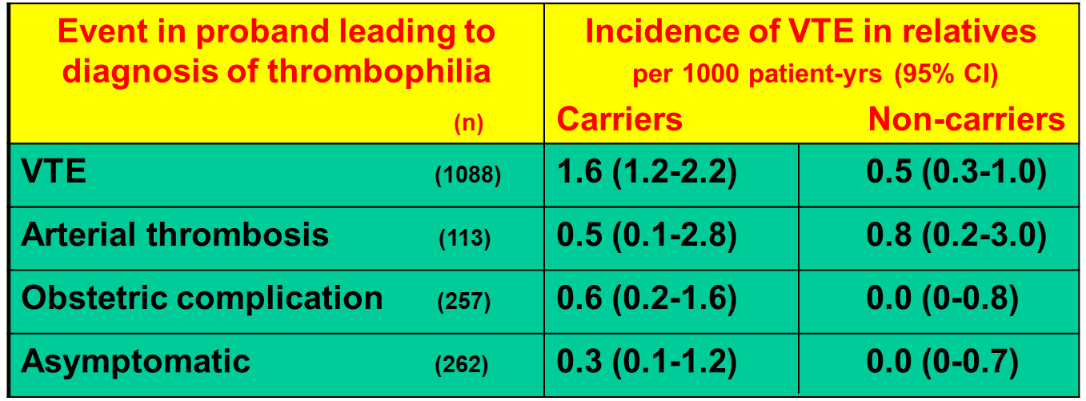
Thrombophilic mutations do not predict thrombotic risk well in the absence of a family hx of VTE
Thromb Haemost 2011;106:646

Slide 31
Absolute vs Relative Risk

Slide 32
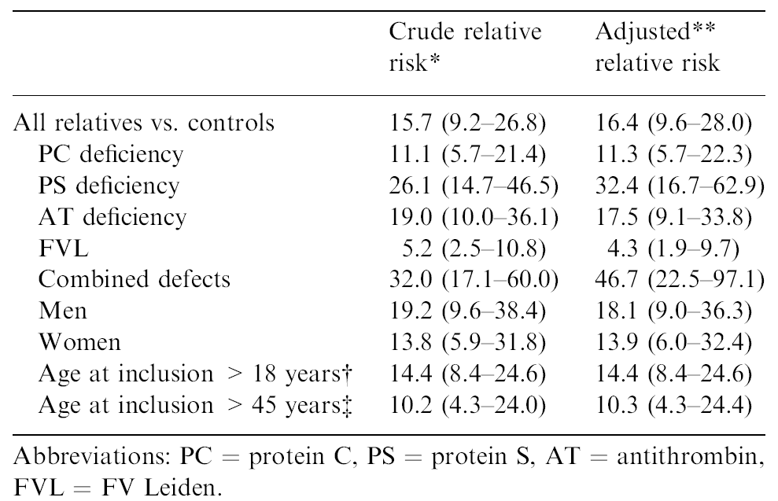
THE RELATIVE RISK OF VENOUS EVENTS IN RELATIVES OF PATIENTS WITH THROMBOPHILIA SEEMS HIGH…
Vossen et al, J Thromb Haemost 2004;2:1526

Slide 33
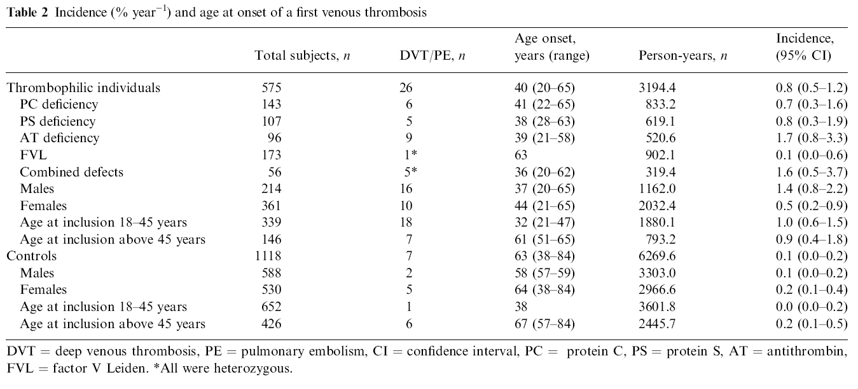
BUT THE ABSOLUTE RISK IS LOW!
Vossen et al, J Thrombos Haemost 2005;3:459
Bleeding risk with long term anticoagulation estimated at 1-3%/year

Slide 34
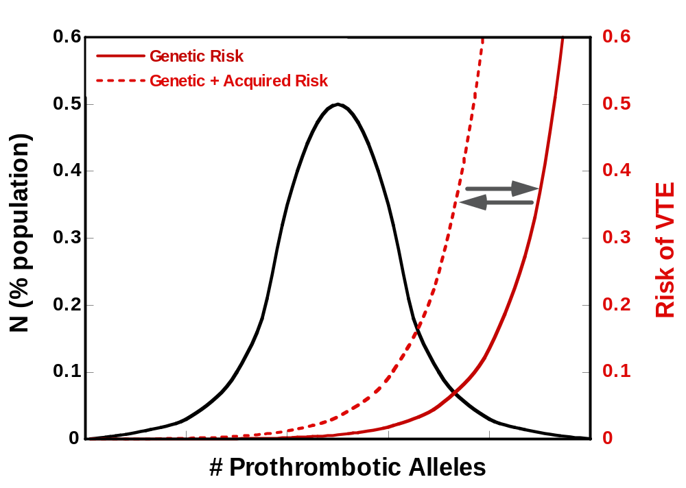
VTE risk is determined by multiple inherited and acquired factors
Notes:
This model for VTE risk function is presented to provide a conceptual framework for thinking about “hypercoagulable states”. It does not represent actual data, and you will not be tested on this model.
The model has the following components:
A normal population distribution (black line)
An exponential function for occurrence of venous thromboembolism based on genetic risk(solid red line)
An X axis that has an undefined number of prothrombotic alleles (alleles that increase VTE risk like FV Leiden)
A similar function for occurrence of venous thromboembolism based on genetic plus acquired risk (dashed red line). This example demonstrates a five-fold increase in risk.
Comments:
Part of the uncertainty involved in laboratory evaluation of “hypercoagulable states” is our incomplete knowledge of the genes involved. We do not know whether we are dealing with 10 or 50 (or more) alleles that make significant contribution to the risk of VTE. Thus, it is currently not possible to give a global risk assessment based on the activity of a few genes (protein C, factor V Leiden, etc.).
Clinical scenarios associated with VTE (ie. surgery, pregnancy, immobilization) place a significantly larger proportion of the population at risk compared with their baseline (genetic) state. This acquired risk may be substantial in the short term but ultimately reversible (ie. hip replacement surgery), or may represent a chronic ongoing condition (stroke with dense hemiplegia, CHF). The arrows in both directions represent the potential reversibility of some acquired risk factors.

Slide 35
Idiopathic VTE is more likely to recur than provoked VTE
Any event that occurs in the absence of a precipitating event or clinical risk factor for VTE
Associated with recurrence rates in the 20-30% range
The occurrence of idiopathic VTE is a better predictor of recurrence than laboratory evaluation for “hypercoagulable states”

Slide 36
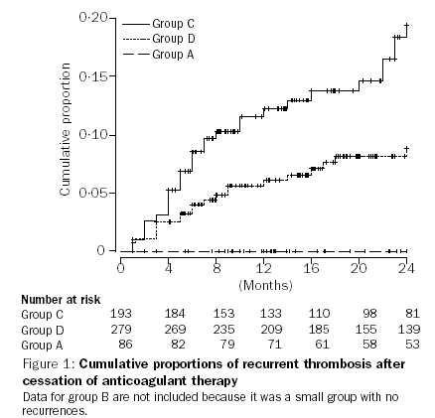
The risk of recurrent venous thromboembolism is higher in patients with idiopathic events
Lancet 2003; 362: 523–26
Idiopathic VTE
Other risk factor
Postop VTE

Slide 37
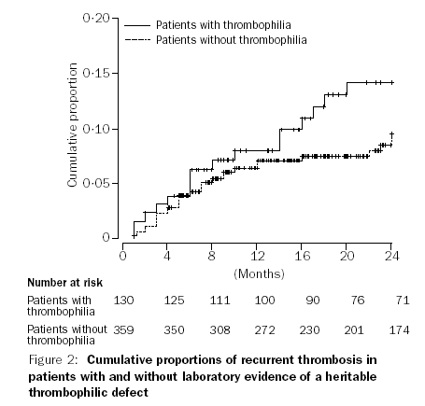
The risk of recurrent VTE is not strongly affected by the presence of inherited thrombophilia
Lancet 2003; 362: 523–26
Hazard ratio 1.50
(95% CI = 0.82-2.77)
p=0.187

Slide 38
Diagnosis of Venous Thromboembolism
Symptoms & physical examination are not sufficiently sensitive or specific to diagnose VTE
D-dimer level- sensitive but not specific (negative test makes VTE unlikely)
Objective documentation of thrombus is essential to establishing the diagnosis

Slide 39
Objective Testing for VTE
Deep Venous Thrombosis
Duplex Doppler ultrasonography
Contrast or MR venography
Pulmonary Embolism
Spiral computed tomography (CT)
Ventilation-perfusion scan (V/Q scan)
MR angiography

Slide 40
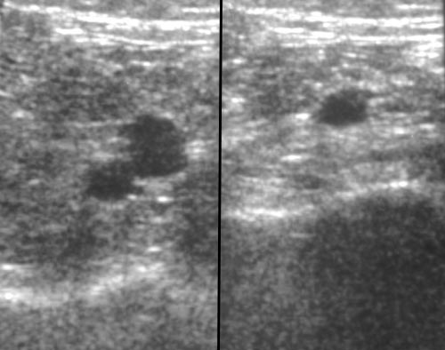
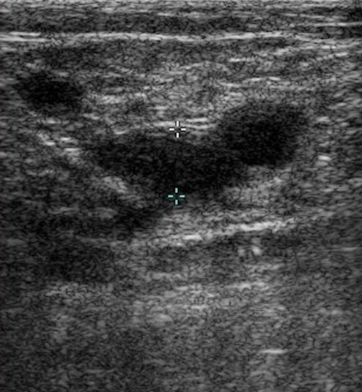
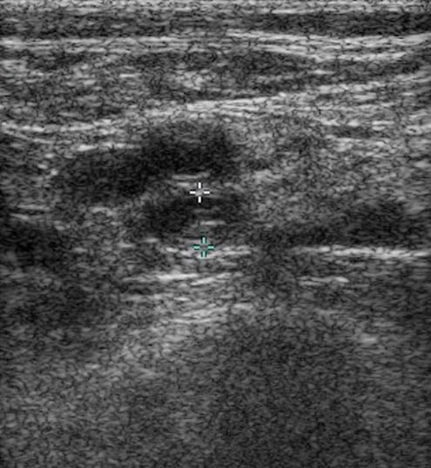
DVT - DOPPLER ULTRASOUND
A
V
Vein (V) compressible - no DVT
Vein not completely compressible - DVT

Slide 41
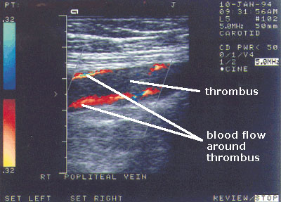
DVT - DOPPLER ULTRASOUND
Notes:
Compressibility and Flow data are sensitive for detecting thrombus from proximal to the popliteal vein

Slide 42
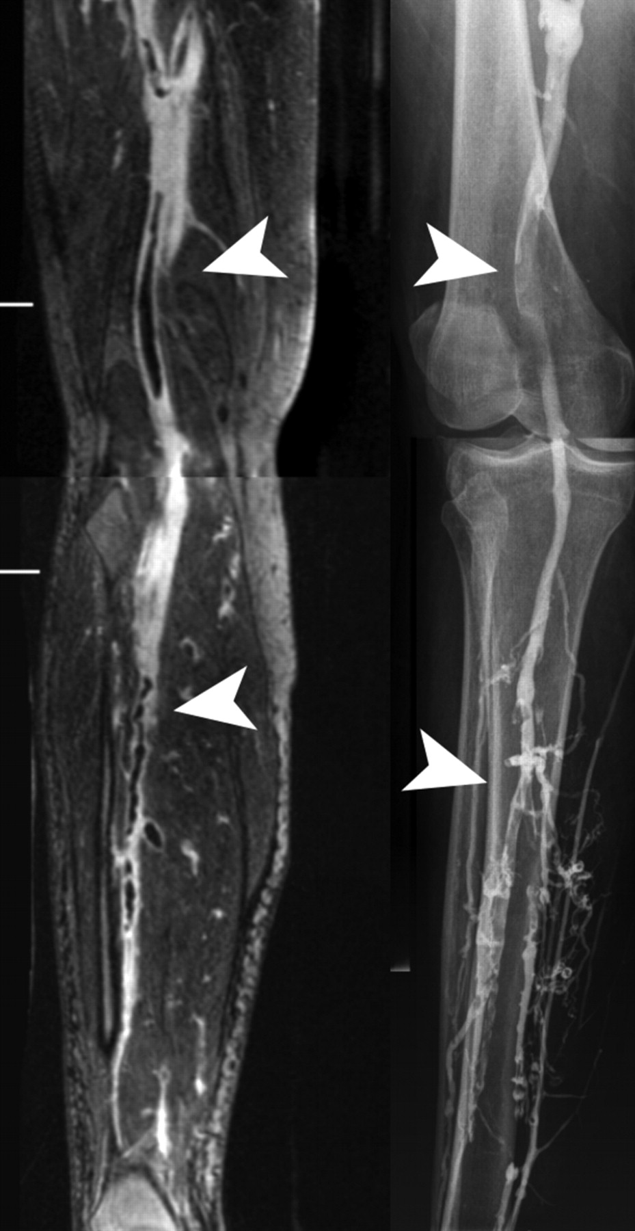
DVT- MR vs Contrast Venography
MR
Contrast

Slide 43
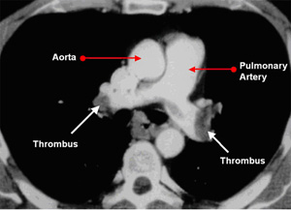
Pulmonary Embolism-Spiral CT
Notes:
Enhanced sensitivity of CT detectors
Timed contrast injection protocol
Also provides information on alternative diagnoses

Slide 44
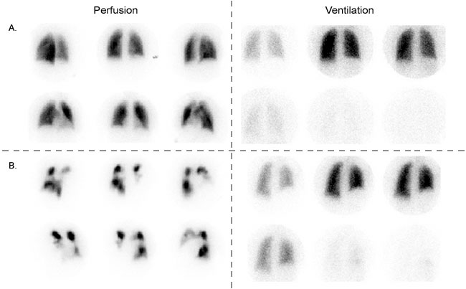
Ventilation-Perfusion Scans
(From: www.massgeneralimaging.org/newsletter/july_2003/)
Normal
High probability
of PE
Ventilation without perfusion suggests pulmonary embolus

