Slide 1
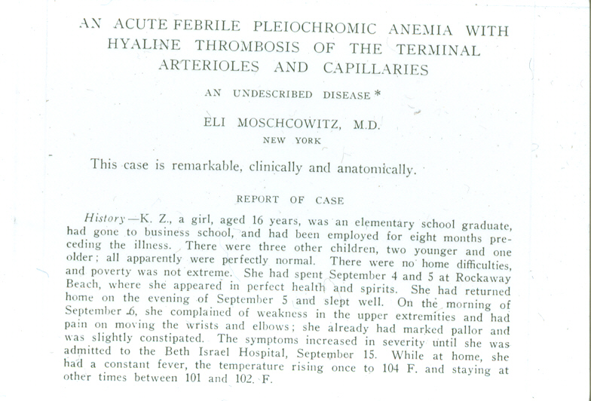
Arch Intern Med 1925; 36: 89-93

Slide 2
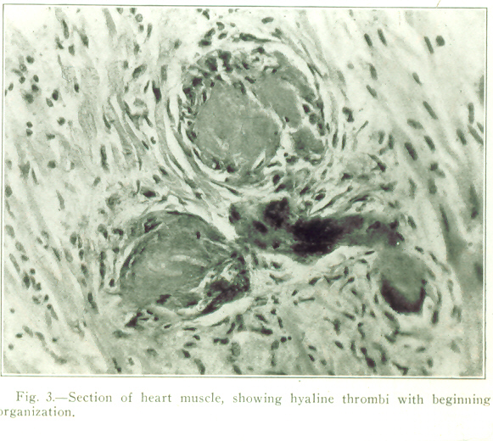

Slide 3
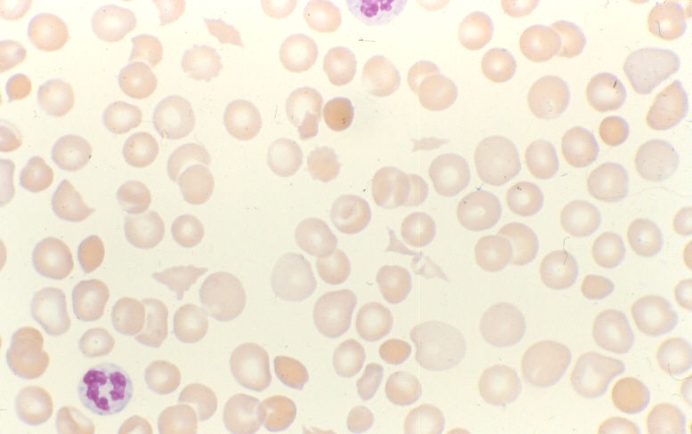

Slide 4
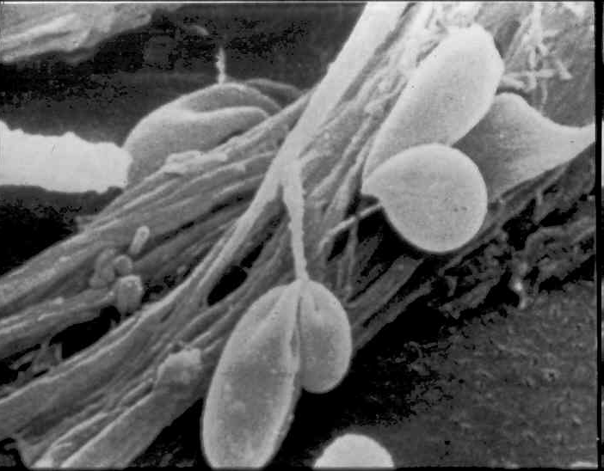
RED CELL FRAGMENTATION

Slide 5
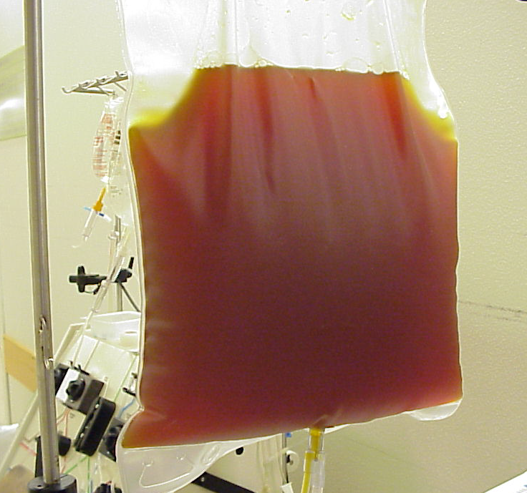
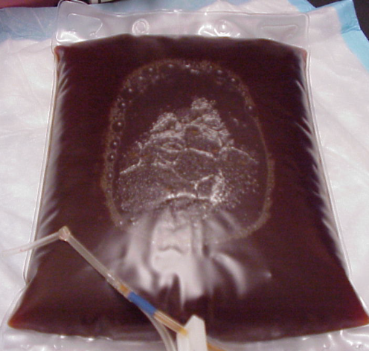
TTP plasma
LDH 2000
LDH 5000

Slide 6
TTP ≠ DIC
"Hyaline thrombi" in arterioles, capillaries contain mostly platelets, von Willebrand factor; relatively little fibrin
Thrombin generation minimal
  Clotting factors not consumed
  Clotting times not prolonged
  Modest increase in fibrinolytic activity (D-dimer, FDP)
No benefit from anticoagulant treatment

Slide 7
DDX OF THROMBOTIC MICROANGIOPATHY
Thrombotic thrombocytopenic purpura (TTP)
Hemolytic uremic syndrome (HUS, “atypical” HUS)
Pregnancy (HELLP syndrome, eclampsia)
DIC
Vasculitis (SLE, antiphospholipid syndrome, scleroderma)
Drugs
Metastatic Cancer
Bone marrow transplantation
Organ transplantation/ allograft rejection
Pulmonary hypertension; malignant hypertension
Sepsis
Other infections (viral, fungal)

Slide 8
Drugs that can cause TMA
Ticlopidine, Clopidogrel (low ADAMTS13)
Calcineurin inhibitors
Heparin (HIT)
Quinine (pills or tonic water)
Interferon
Chemotherapy agents
  Mitomycin C
  Oxaliplatin
  Gemcitabine
  Bevacizumab
Quetiapine
Cocaine, IV oxymorphone

Slide 9
TTP
Clinical and laboratory features
Microangiopathic hemolytic anemia/thrombocytopenia
  Bleeding, fatigue, weakness etc
Platelets usually < 30K, ↓ haptoglobin, ↑ LDH
Fever less common than in older reports
Neurologic: headache, confusion, stroke, coma, seizures
Renal: proteinuria/hematuria; acute renal failure uncommon
Cardiac and mesenteric ischemia may occur

Slide 10
TTP
Epidemiology
Incidence: 1-2 new cases per million per year
F:M ratio about 2:1
Peak incidence in 30s-40s
Rare in children (suspect inherited TTP)
More common in blacks

Slide 11
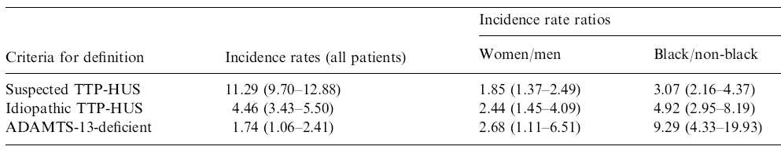
INCIDENCE OF TTP/HUS
Data from the Oklahoma TTP/HUS Registry
Annual incidence rates per million (all patients)
J Thrombos Haemost 2005;3:1432-6

Slide 12
TTP
Associated Conditions
Autoimmune disease (SLE, etc)
HIV infection
Drug reaction (ticlopidine, clopidogrel)
Pregnancy (may trigger TTP in inherited ADAMTS13 deficiency)
Most patients have no identifiable risk factor or associated disease

Slide 13
HEMOLYTIC UREMIC SYNDROME
Most common in children
Complement-mediated kidney injury predominant - some with permanent renal damage
Case clusters common
GI prodrome, often due to infection with E coli 0157:H7 or other Shiga toxin-producing strain
Shiga-like toxins injure renal endothelial cells
Most cases self-limited, resolve without plasma therapy
Cases without GI prodrome often associated with inherited or acquired deficiency of complement regulating proteins (“atypical” HUS, may become chronic or recur)

Slide 14
AN INHERITED SYNDROME THAT RESEMBLES TTP
(Upshaw-Schulman Syndrome)
Schulman et al (1960) and Upshaw (1978) described patients with inherited lifelong history episodic microangiopathic thrombocytopenia and dramatic improvement after plasma infusion.

Slide 15
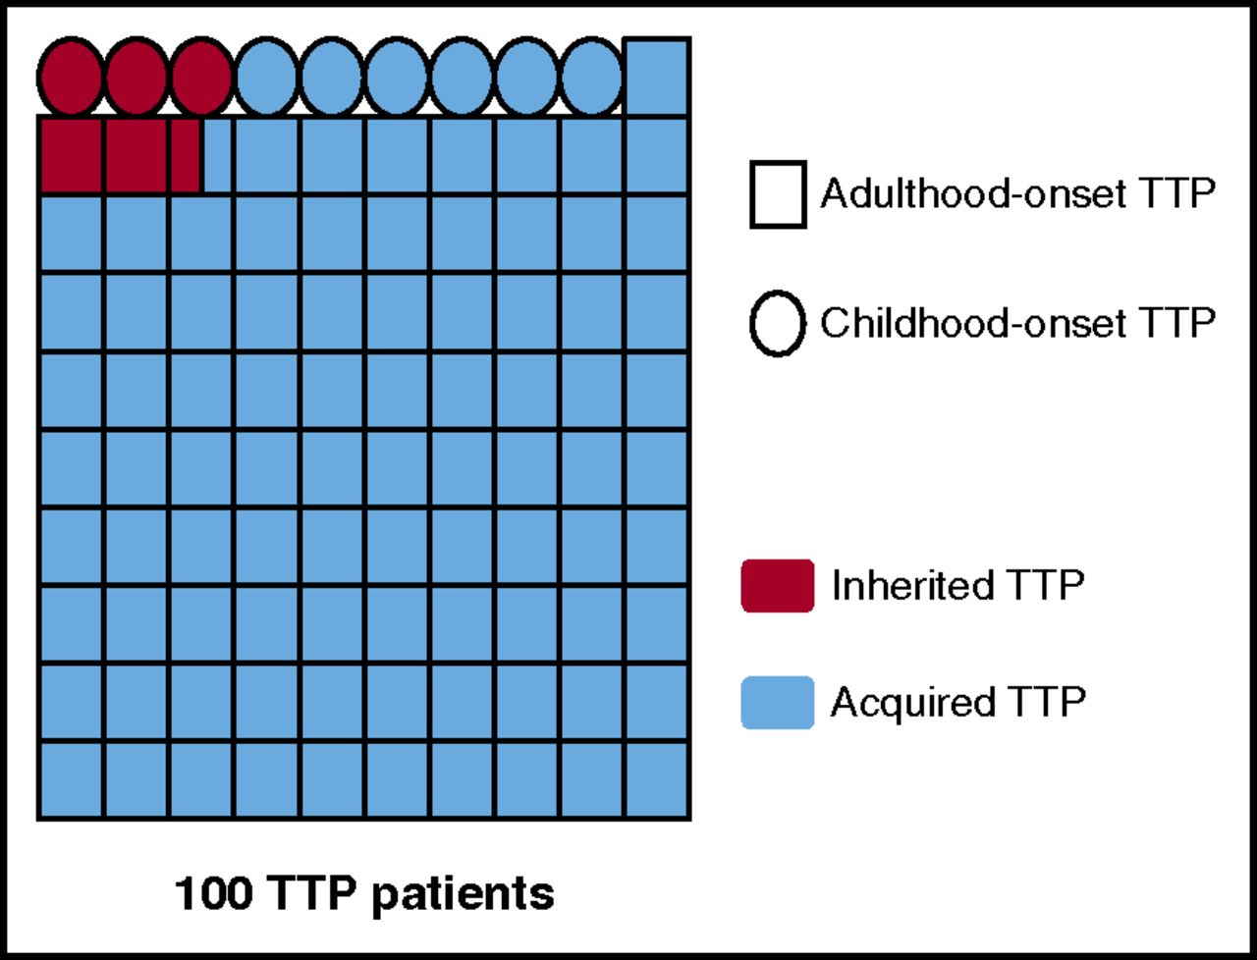
Blood 2017;129:2836

Slide 16
TTP PATHOPHYSIOLOGY
Role of von Willebrand Factor (1)
VWF is large multimeric protein produced by endothelial cells and secreted into plasma and subendothelium
VWF released from endothelial cells mediates platelet adhesion in normal hemostasis
  Largest VWF multimers most effective
  Regulation of multimer size is important to maintain hemostatic balance
Normal plasma contains VWF multimer-cleaving activity - very large multimers secreted by endothelial cells broken down into smaller forms

Slide 17
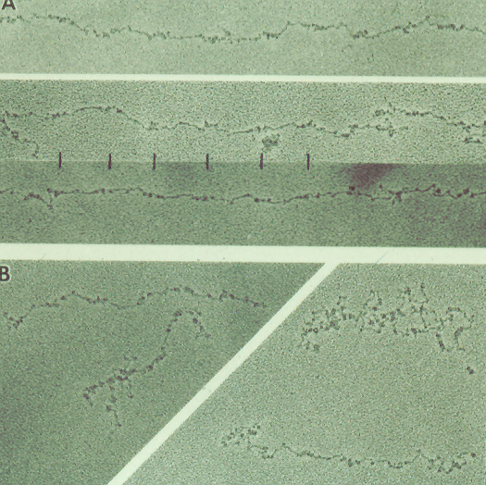
VWF – ELECTRON MICROSCOPIC IMAGES

Slide 18
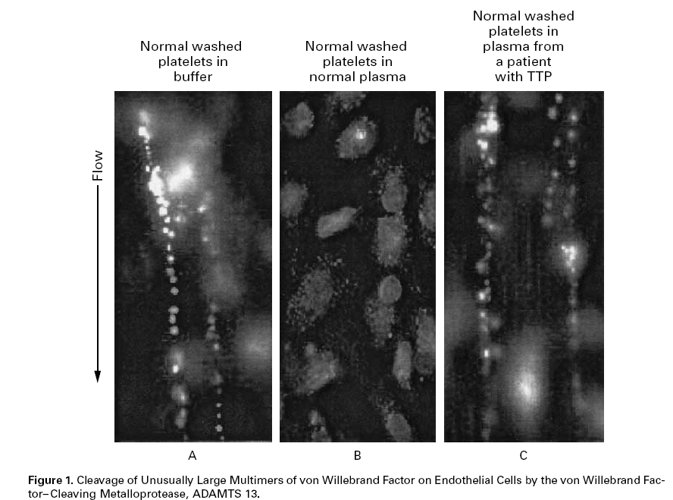
PLASMA CONTAINS VWF MULTIMER-CLEAVING ACTIVITY
NEJM 2002;347:689

Slide 19
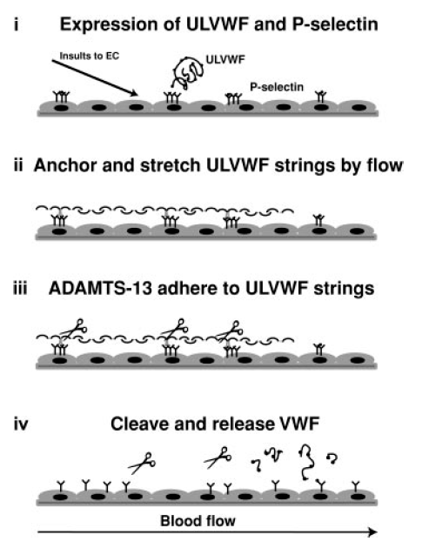
REGULATION OF VWF MULTIMER SIZE
Blood 2004;103:2150

Slide 20
TTP PATHOPHYSIOLOGY
Role of von Willebrand Factor (2)
Unusually large multimers of VWF (UL-VWF) found in patients with chronic relapsing TTP
  These UL-VWF resemble unprocessed multimers secreted by endothelial cells
  Levels fluctuate in parallel with clinical course of disease
  UL-VWF not found in patients in remission from HUS or other microangiopathies

Slide 21
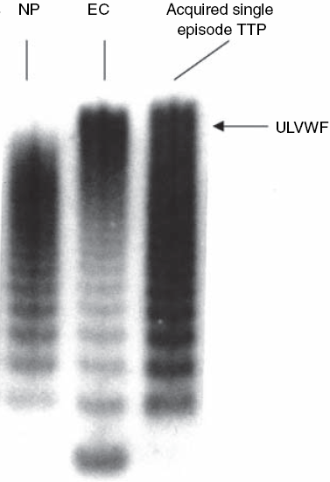
Von Willebrand factor multimers in a TTP patient resemble the forms released from endothelial cells (EC). There are more unusually large multimers (ULVWF) than in normal plasma (NP)
(Moake, J Thromb Haemost 2004;2:1517)

Slide 22
TTP PATHOPHYSIOLOGY
Role of von Willebrand Factor (3)
High shear stress causes unfolding of VWF and enhances its binding to platelets
Exposure of blood to high shear stress causes activation-independent, VWF-dependent platelet adhesion and clumping
Under normal circumstances this process is limited because high shear also increases susceptibility of VWF to proteolytic cleavage

Slide 23
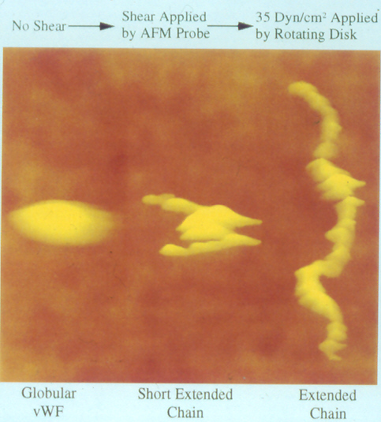
VWF UNFOLDS UNDER SHEAR STRESS

Slide 24
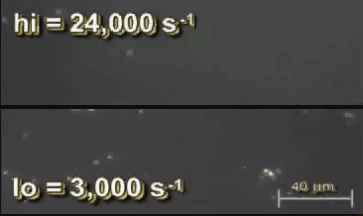
ACTIVATION-INDEPENDENT PLATELET ADHESION AND AGGREGATION IN RESPONSE TO HIGH SHEAR STRESS
Ruggeri et al, Blood 2006;108:1903
Anticoagulated blood perfused over collagen-coated surface
High shear: large platelet aggregates form
Low shear: single platelets adhere
Flow

Slide 25
TTP PATHOPHYSIOLOGY
Evidence of autoimmunity
Association with SLE, etc in some pts
Low titer ANA, circulating immune complexes in many pts
Elevated cytokine levels (TNF, IL-1, IL-6, etc)
Chronic/relapsing course similar to autoimmune disorders
Response to immunosuppressive Rx

Slide 26
TTP is associated with deficiency of von Willebrand factor-cleaving plasma protease
Furlan et al, NEJM 1998;339:1578
Tsai and Lian, NEJM 1998;339:1585
Acquired TTP associated with severe deficiency (<5% normal activity) of VWF-cleaving enzyme in 61/61 cases
No deficiency found in normal individuals
Severe deficiency not found in HUS (2/13 had mild deficiency)
Most patients in remission from TTP had mild or no deficiency
IgG antibodies to protease demonstrable in a majority of cases of acquired TTP
Inherited TTP associated with non-immune protease deficiency

Slide 27
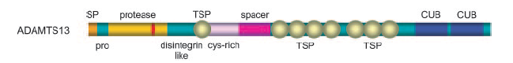
ADAMTS-13
A disintegrin-like and metalloproteinase with thrombospondin type I motif 13
  At least 19 known ADAMTS family members
145 Kd multidomain plasma protein
Liver is main site of synthesis
Responsible for plasma VWF-cleaving activity
Currently available functional assays show reasonably good sensitivity and specificity for TTP

Slide 28
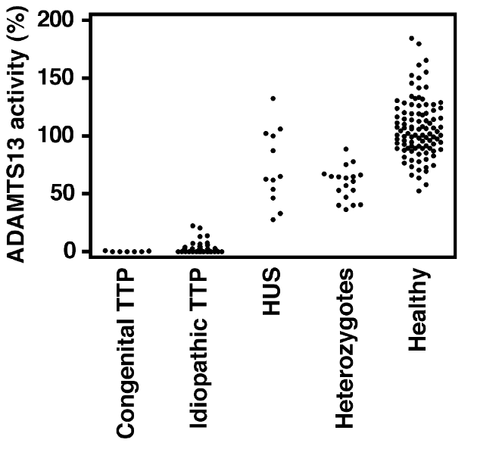
PLASMA ADAMTS-13 ACTIVITY IN TTP AND OTHER CONDITIONS
Br J Haematol 2005;129:93

Slide 29
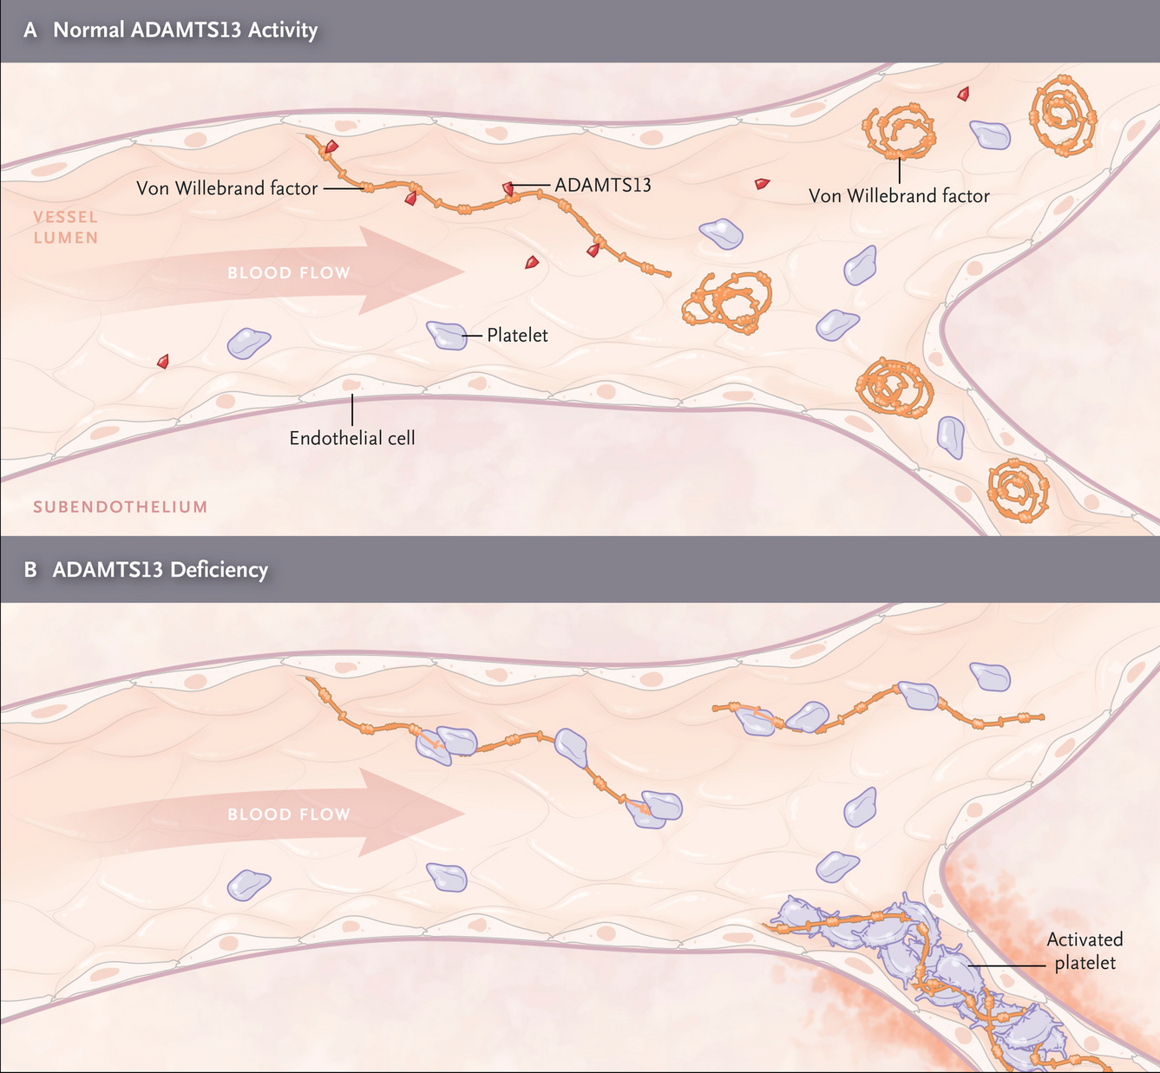
TTP pathophysiology
Hovinga & George, NEJM 2019

Slide 30
Endothelial cells secrete UL-VWF
(Triggering event?)
Autoantibody depletes ADAMTS-13
Persistence of UL-VWF in blood
Platelet agglutination
(Triggering event?)
Red cell destruction
Unfolding of UL-VWF
Microthrombi
Increased shear stress
Organ dysfunction
Plasma exchange removes autoantibody and UL-VWF, restores ADAMTS-13

Slide 31
TTP: Diagnosis
Clinical suspicion
Blood smear
  Red cell fragmentation not always striking at presentation
High LDH (usually at least 3X normal)
Low haptoglobin (very sensitive)
Consider other causes of microangiopathy
  Pregnancy, cancer, etc
ADAMTS-13 < 10% (very specific)
  Moderate ADAMTS-13 deficiency common in other TMAs
Plasma exchange warranted even if Dx uncertain

Slide 32
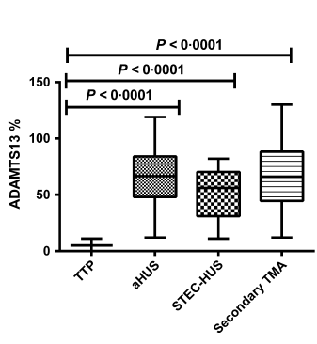
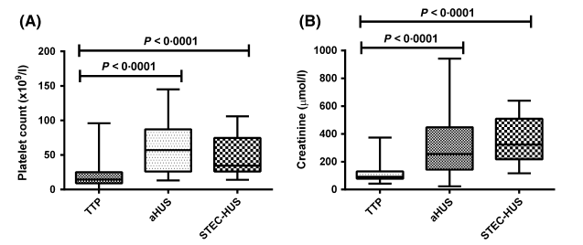
Low ADAMTS13 distinguishes TTP from other TMAs
ADAMTS13
PLATELETS
CREATININE
Br J Haematol 2015;171:830

Slide 33
Severe ADAMTS13 deficiency associated with better outcomes in TMA
OUTCOME | ADAMTS13 ≤ 10% (n=68) | ADAMTS13 > 10% (n=186)
Alive at 90 days | 95.2% | 57.1% | p < 0.0001
Alive at 360 days | 93% | 47.5% | p < 0.0001
Overall Survival, d | 1384 (513-2293) | 126 (13-1044) | p < 0.0001
Br J Haematol 2015;171:836

Slide 34
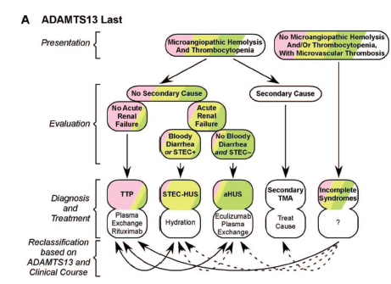
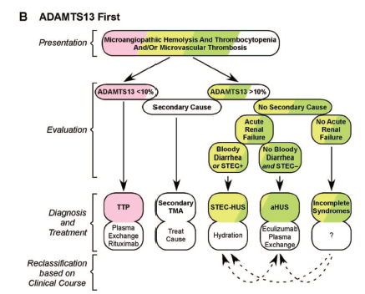
Distinguishing TTP from other TMAs
Sadler, 2015 ASH Education Book

Slide 35
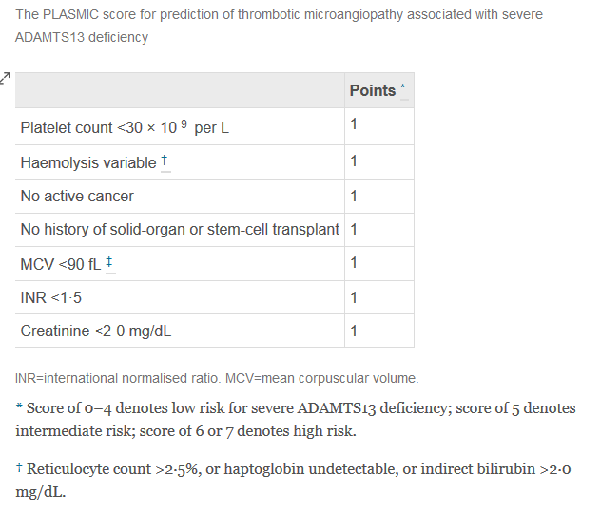
Lancet Haematol 2017; 4:e157

Slide 36
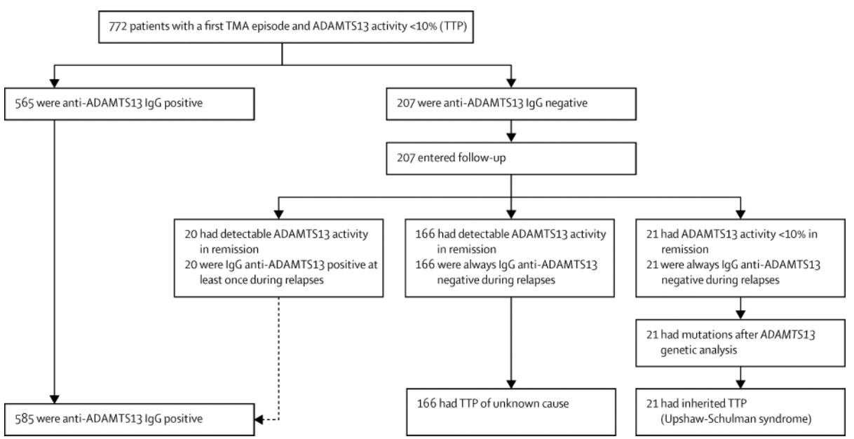
Not all patients with severe ADAMTS13 deficiency have autoantibodies
Lancet Haematol 2016;3:e237

Slide 37
TTP
Treatment
Plasma
  plasma exchange superior to plasma infusion
  whole plasma vs cryosupernatant?
Immune suppression/modulation
  Corticosteroids, rituximab
Caplacizumab (blocks VWF binding to plts)
Supportive care
  Platelet transfusion may cause deterioration by “feeding the fire”

Slide 38
TTP
Plasma Therapy
1925: Original case report by Moschcowitz
1959: 97% mortality in 116 published cases (Cahalane and Horn).
1966: 72% of 251 published cases died within 90 days of diagnosis (Amorosi and Ultmann). Treatments included corticosteroids, splenectomy, antiplatelet drugs.
1976: 54% remission rate, 38% survival with exchange transfusion reported by Bukowski et al.
1977: Reports of dramatic response to plasma infusion (Byrnes and Khurana) and plasma exchange (Bukowski et al)
1991: Canadian trial shows superiority of plasma exchange over plasma infusion (78% vs 63% six month survival)

Slide 39
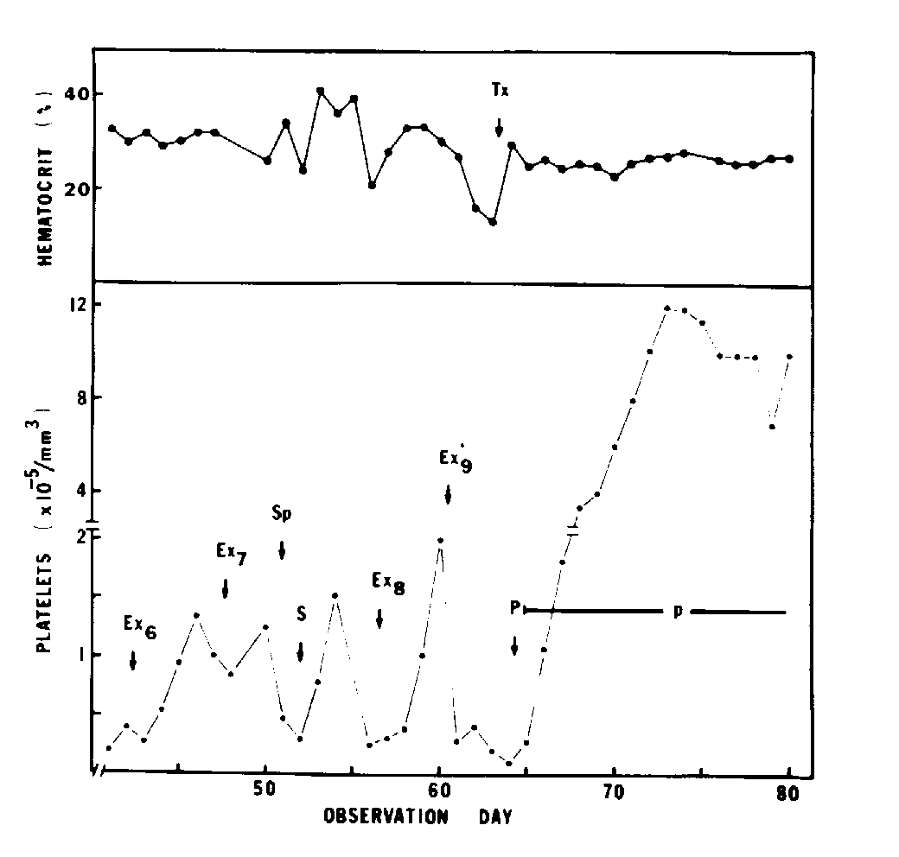
TTP
Response to plasma infusion
Byrnes and Khurana, NEJM 1977;297:1386

Slide 40
TTP
Plasma exchange vs plasma infusion
102 patients, randomly assigned to plasma exchange vs plasma infusion. All received aspirin and dipyridamole (NEJM 1991;325:393-7)
Outcome | Plasma exchange | Plasma infusion | p value
Response rate: day 9 | 47% | 25% | 0.025
Response rate: 6 months | 78% | 49% | 0.002
Mortality at 6 months | 22% | 37% | 0.036

Slide 41
Rituximab therapy in TTP
Rituximab given during initial treatment of TTP associated with lower relapse rates (11% vs 55%) vs historical controls (Scully et al, Blood 2011;118:1746)
21/21 patients with refractory TTP responded to rituximab (Froissart et al, Crit Care Med 2012;40:104)

Slide 42
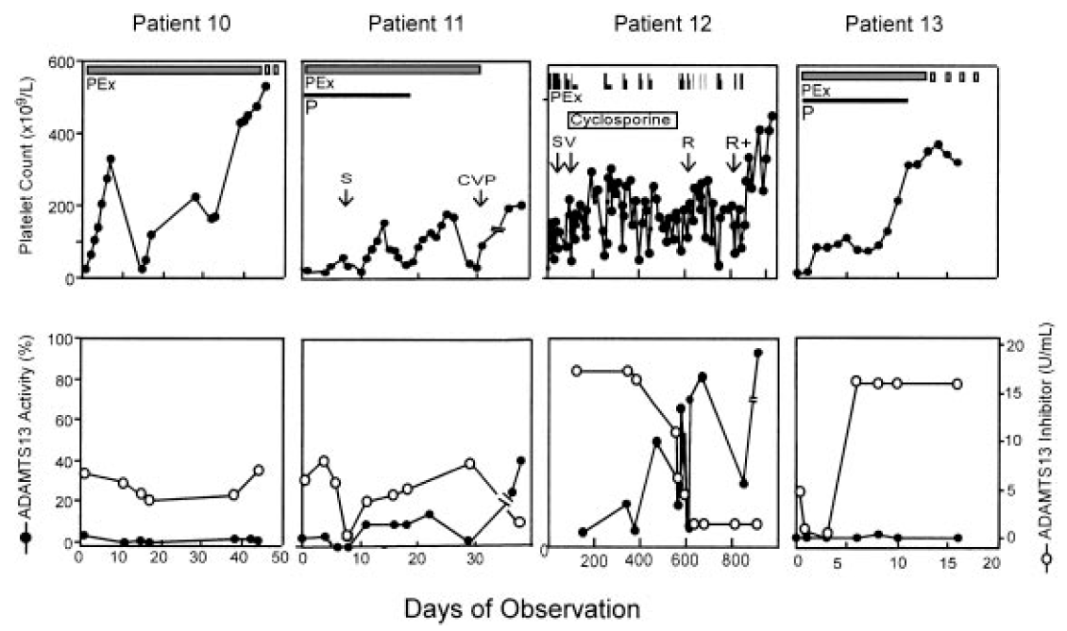
REMISSION IN TTP IS POSSIBLE DESPITE PERSISTENCE OF INHIBITOR AND SEVERE DEFICIENCY OF ADAMTS 13
ZHENG ET AL, BLOOD 2004;103:4043
Platelet count normalizes
ADAMTS 13 inhibitor level remains high
ADAMTS13 plasma level remains very low

Slide 43
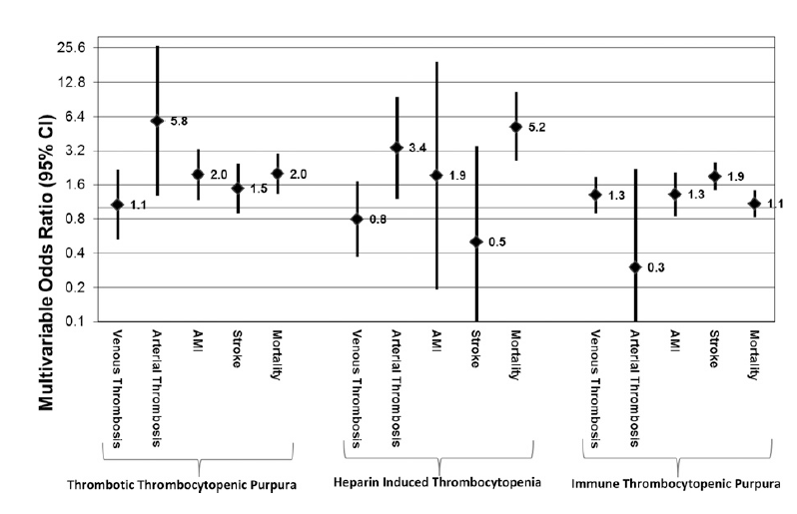
Platelet transfusions are associated with worse outcomes in HIT & TTP
Blood 2015;125:1470

Slide 44
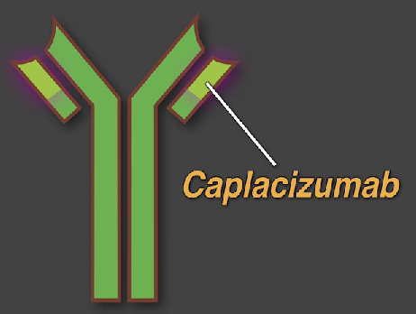
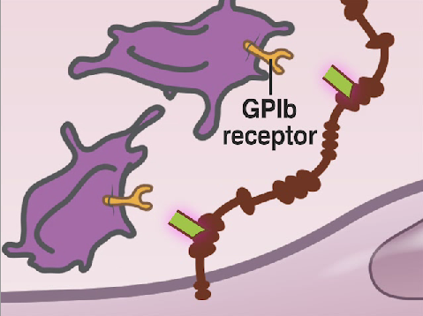
Caplacizumab
Humanized anti-VWF nanobody
Inhibits VWF binding to platelets
NEJM 2016;374:511

Slide 45
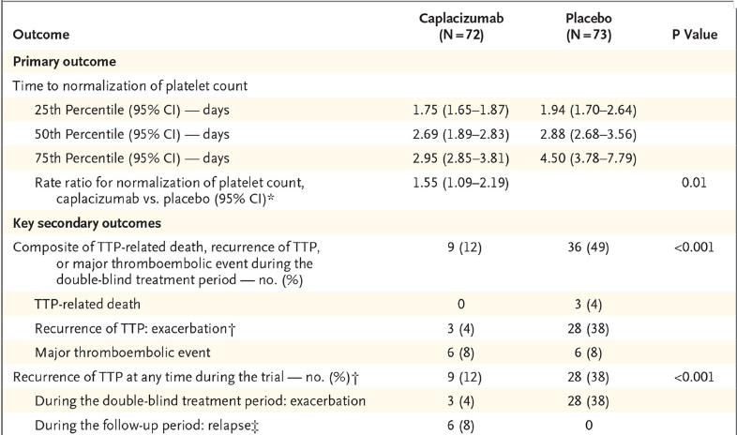
Caplacizumab vs placebo for TTP
NEJM 2019;380:325-34

Slide 46
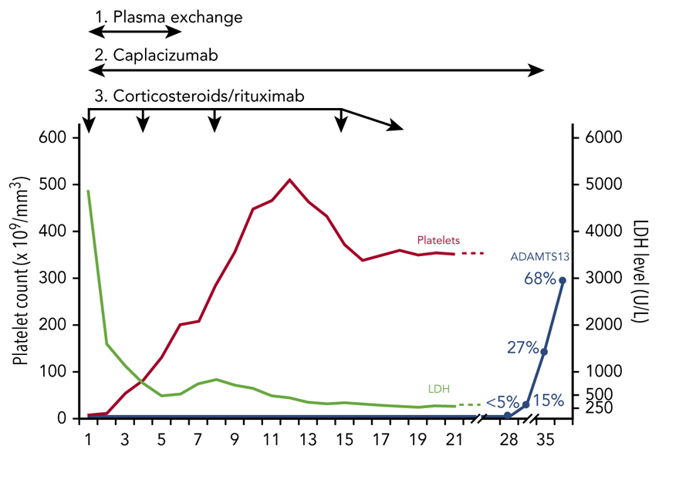
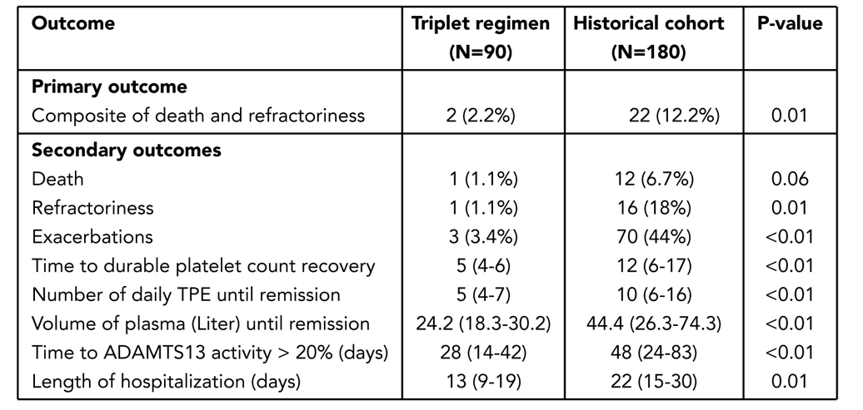
Caplacizumab, plasma exchange and upfront rituximab improves outcomes in TTP
Historical cohort treated with PE & steroids, rituximab as salvange therapy
Blood 2021;137:733

Slide 47
RELAPSES IN TTP
Relapse rate 20-60%
Most within 1-2 years, but some > 5 years
20%+ have > 1 relapse
Some patients develop chronic relapsing disease

Slide 48
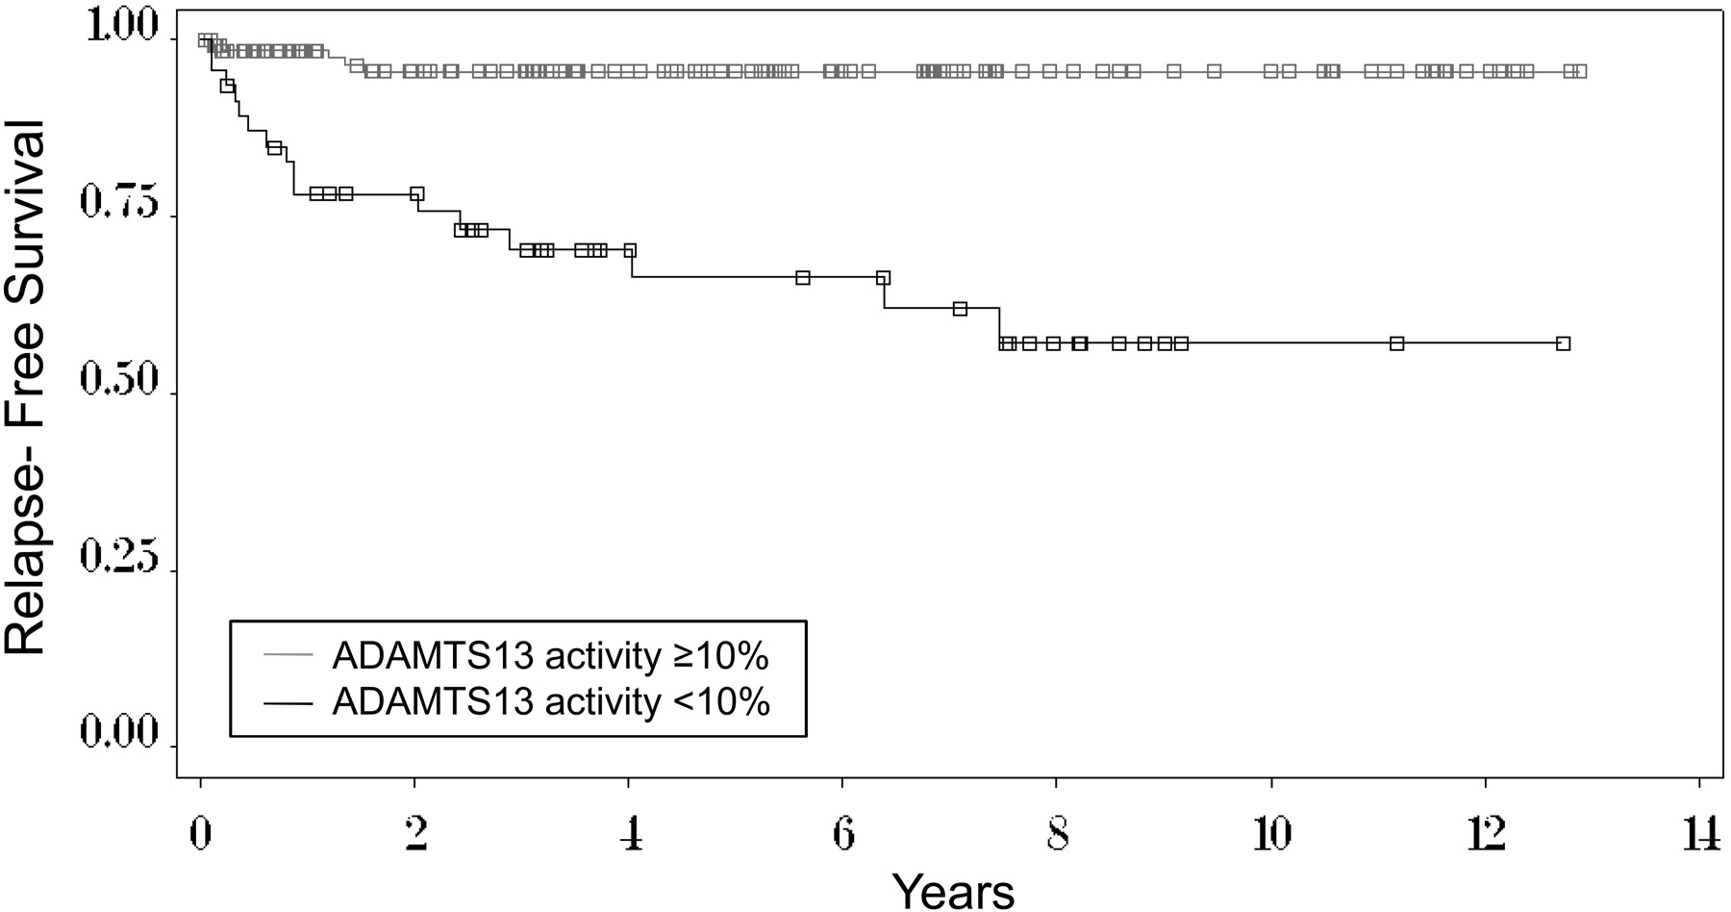
A LOW ADAMTS13 ACTIVITY DURING REMISSION PREDICTS RELAPSE OF TTP
Hovinga, J. A. K. et al. Blood 2010;115:1500-1511

Slide 49
TTP
Treatment options for relapsing or refractory disease
Rituximab
Ofatumumab (if rituximab not tolerated)
Corticosteroids
Splenectomy
Immunosuppressive drugs: mycophenolate, cyclosporine, cyclophosphamide
Bortezomib
Vinca alkaloids: vincristine, vinblastine
N-acetylcysteine
Eculizumab

Slide 50
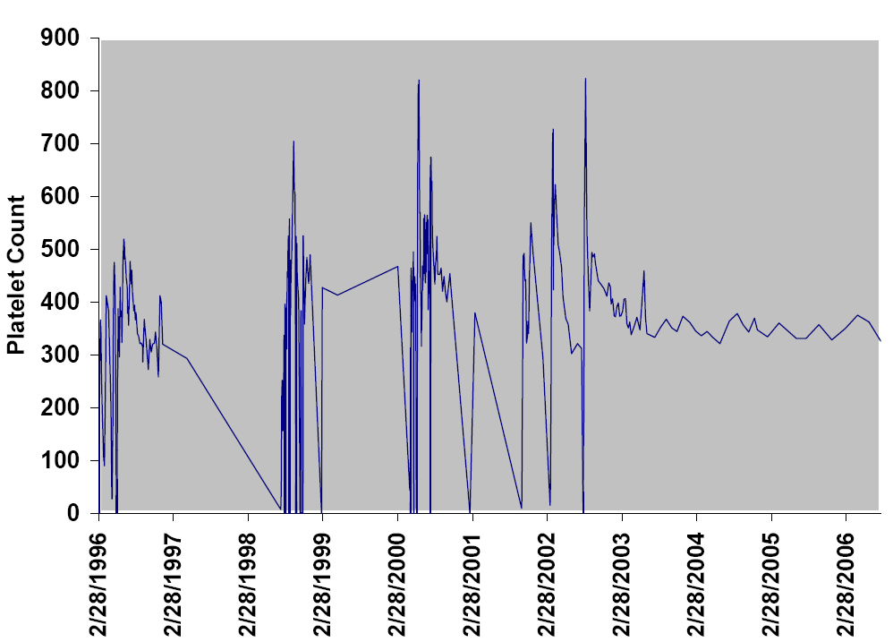
RESPONSE TO RITUXIMAB IN RELAPSING TTP
Rituximab q 6 mo

Slide 51
Should rituximab be given to prevent relapse in asymptomatic patients with low ADAMTS13 levels?
Pro
Normalization of ADAMTS13 likely to prevent relapse
Efficacy of rituximab in reversing autoimmune ADAMTS13 deficiency
Potential morbidity/mortality of relapse
Possible deleterious effects of subclinical microangiopathy associated with low ADAMTS13 (unpublished data)
Con
No clinical trial data showing overall clinical benefit
Not all patients with persistent low ADAMTS13 activity relapse
Expense
Risks of rituximab
  Infusion reactions
  Infection (PML)
  Sensitization

Slide 52
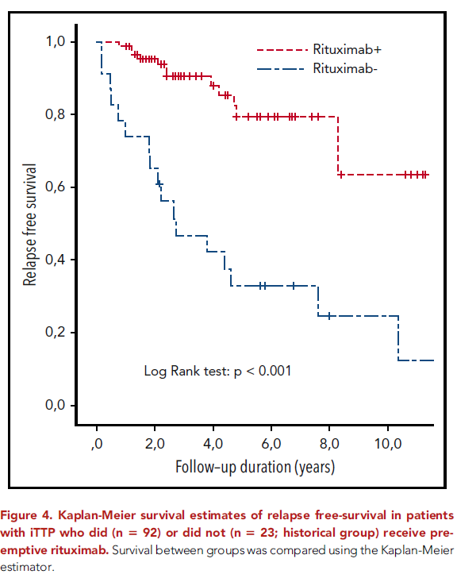
Preemptive rituximab prevents long-term relapses in immune-mediated thrombotic thrombocytopenic purpura
Jestin et al. Blood 2018;132:2143
Rituximab administered when ADAMTS13 activity <10%

Slide 53
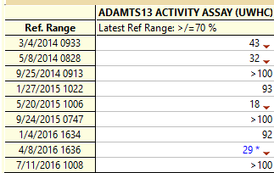
Low dose rituximab can normalize ADAMTS13 level
Rituximab 300 mg x 4 doses June 2014
Rituximab 300 mg x 4 doses June 2015
Rituximab 300 mg x 1 dose May 2016

Slide 54
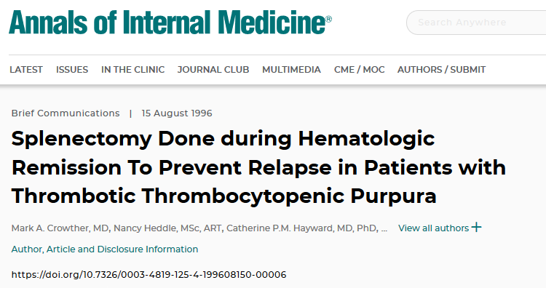
Series of 6 patients
Splenectomy lowered relapse rate from 2.3 ± 2.0 to 0.1 ± 0.1 events/yr

Slide 55
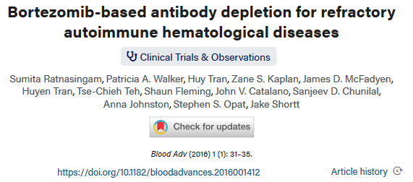
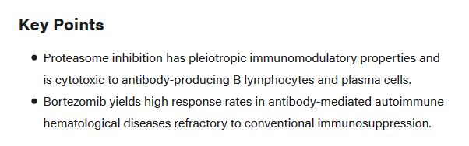

Slide 56
SUMMARY - 1
TTP is a rare disease characterized by microangiopathic hemolytic anemia associated with CNS, renal and other organ dysfunction
TTP is usually an autoimmune disorder associated with an autoantibody that neutralizes ADAMTS-13, leading to platelet agglutination by very large VWF multimers
Untreated TTP has a very high mortality, but plasma therapy ± immunosuppression is usually lifesaving

Slide 57
SUMMARY - 2
TTP should be suspected in any patient with thrombocytopenia, a high LDH, low haptoglobin, and systemic symptoms
ADAMTS13 activity < 10% confirms diagnosis
Plasma exchange with corticosteroids first line treatment
Rituximab and/or caplacizumab for severe, refractory or relapsing disease
Rituxumab helps to prevent relapse when ADAMTS13 activity is low

