Slide 1
Use hyperlinks for navigation
Next

Slide 2
Porphyrin biochemistry and the porphyrias
Enzyme
Deficiency
Succinyl CoA + Glycine
Negative feedback
ALA synthase
X-linked protoporphyria (gain of function mutation)
δ aminolevulinic acid (ALA)
PBG synthase (ALA dehydratase)
ALA dehydratase porphyria
Porphobilinogen (PBG)
neurotoxic
PBG deaminase
Acute intermittent porphyria
phototoxic
Hydroxymethylbilane
Uroporphyrinogen III cosynthase
Congenital erythropoietic porphyria
Uroporphyrinogen III
Uroporphyrinogen decarboxylase
Porphyria cutanea tarda
Coproporphyrinogen III
Coproporphyrinogen oxidase
Hereditary coproporphyria
Protoporphyrinogen IX
Protoporphyrinogen oxidase
Variegate porphyria
Protoporphyrin IX
Ferrochelatase
Erythropoietic protoporphyria
HEME
Notes:
The porphyrias represent a set of diseases that all result from accumulation of toxic intermediates generated during synthesis of the tetrapyrrole heme ring
Most of them are caused by genetic defect that interfere with the normal metabolism of these intermediates (PCT is usually an acquired not a genetic defect)
Disease manifestations depend on which metabolites accumulate and to what degree, and in which organ (liver, marrow or both) the disease is expressed
This diagram shows the eight biochemical steps involved in heme production, the enzyme that catalyzes each step, and the disease that results if the enzyme activity is low
First step and last 3 steps in mitochondria, others in cytosol
Heme concentrations regulate ALA synthase; if heme levels are low the conveyor belt speeds up, intermediates build up causing toxicity
HMB and the porphyrinogens are unstable, will be converted spontaneously to toxic porphyrins if not acted on by the next enzyme in the sequence
[follow HEME link}
Clinical manifestations of porphyria reflect either the neurotoxic effects of the early intermediate molecules or the phototoxic effects of the later ones

Slide 3
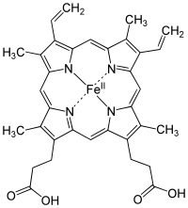
Heme-containing proteins
Hemoglobin
Myoglobin
Neuroglobin
Cytoglobin
Cytochrome p450s
Cytochrome oxidase
Catalase
Peroxidases
75-85% of heme synthesis in marrow (fairly constant), 15-25% in liver (variable)
  Small amounts made in other cells
Disease expression in porphyria may involve either or both organs
Move oxygen from blood to brain
Heme = ferrous protoporphyrin IX
Next
Notes:
Here is the end product of the pathway
All of the heme proteins function as iron binding and oxygen binding proteins
Heme ring plus histidine residue in heme protein bind with five of six electron pairs in Fe++; the sixth pair is available for oxygen binding
Most heme synthesis is in the marrow or liver
Although other cells make heme they don’t make enough to generate poteintially toxic levels of heme precursors in the setting of porphyria
Manifestations of porphyria depend on the type of intermediates that accumulate (neuro- or photo-toxic) and on the organ(s) where the condition is primarily expressed (liver and/or marrow)

Slide 4
Disease
Site of expression
ALA dehydratase deficiency
Acute intermittent porphyria
Congenital erythropoietic porphyria
Porphyria cutanea tarda
Hereditary coproporphyria
Variegate porphyria
Erythropoietic protoporphyria
Liver
Liver
Marrow
Liver
Liver
Liver
Liver and marrow
Differential organ-specific disease expression may reflect presence of different enzyme isoforms in liver and marrow and/or differences in transcriptional control of enzyme production
Back
Notes:
In all but two of the porphyrias toxic porphyrin intermediates accumulate in the liver; heme manifestations are limited or absent
In CEP accumulation of toxic molecules in RBC causes hemolysis
No hemolysis in EPP although protoporphyrins accumulate in RBC
[back to main slide]

Slide 5
X-linked protoporphyria
Very rare
Gain of function mutation in ALA synthase leads to over-production of protoporphyrin in RBC precursors
  Loss of function mutations cause congenital sideroblastic anemia
Hemizygous males affected; rarely in females due to skewed X-inactivation
Severe photosensitivity beginning in infancy
Water-insoluble protoporphyrin excreted in bile, stool
Protoporphyrin gallstones may cause cholestatic liver disease
Mild hemolysis in some patients
Clinically indistinguishable from erythropoietic protoporphyria
Diagnosis: elevated free erythrocyte protoporphyrin, genetic testing for ALA synthase mutations
Back

Slide 6
ALA dehydratase porphyria
Very rare, recessive inheritance (<10 documented cases)
Neurovisceral symptoms similar to AIP
ALA, coproporphyrin III but not PBG elevated in urine
ALAD gene sequencing confirms dx
Back

Slide 7
Acute intermittent porphyria - 1
Dominant inheritance – partial deficiency of PBG deaminase
  2nd most common porphyria behind PCT
Female predominance (estrogen effect?)
Neurotoxicity
No photosensitivity
Increased urine ALA, PBG, other porphyrin precursors during attacks
  Urine turns purple with exposure to UV light/sunlight
Normal urine PBG in symptomatic patient makes diagnosis very unlikely
PBGD gene sequencing confirms diagnosis
Back
Next

Slide 8
Acute intermittent porphyria - 2
Attacks precipitated by induction of ALA synthase, increased demand for heme synthesis, or accelerated heme catabolism
  Hormonal changes during menstrual cycle
  Fasting
  Smoking
  Infection (induction of heme oxygenase→increased heme turnover)
  Drugs that induce cytochrome p450 enzymes and increase heme turnover in liver
  Other forms of metabolic stress (e.g. surgery, alcohol)
Back
Next

Slide 9
Acute intermittent porphyria - 3
Clinical features of acute attack
  Abdominal pain, N/V, constipation
  Motor neuropathy can lead to respiratory paralysis
  Encephalopathy (PRESS), psychosis, seizures, coma, brain ischemia
  “Adrenergic crisis”with hypertension, arrhythmias
  Hyponatremia (SIADH, dehydration)
Back
Next

Slide 10
Acute intermittent porphyria - 4
Management of acute attacks
  Pain control (opiates, antiemetics, phenothiazine)
  Hemin (ferric protoporhyrin IX - suppresses heme synthesis)
  Carbohydrates (po, or iv dextrose)
  Magnesium for seizures
  Some patients may require mechanical ventilation
Back
Next

Slide 11
Acute intermittent porphyria - 5
Prevention of attacks
  Avoid porphyrogenic drugs
  Smoking cessation, alcohol avoidance
  Maintain nutrition
  Suppress ovulation (Lupron)
  Givosiran (siRNA that reduces ALAS production)
  Liver transplant curative for intractable cases
Back

Slide 12
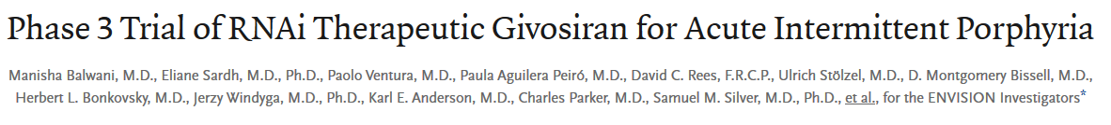
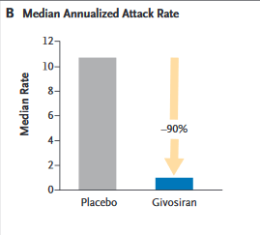
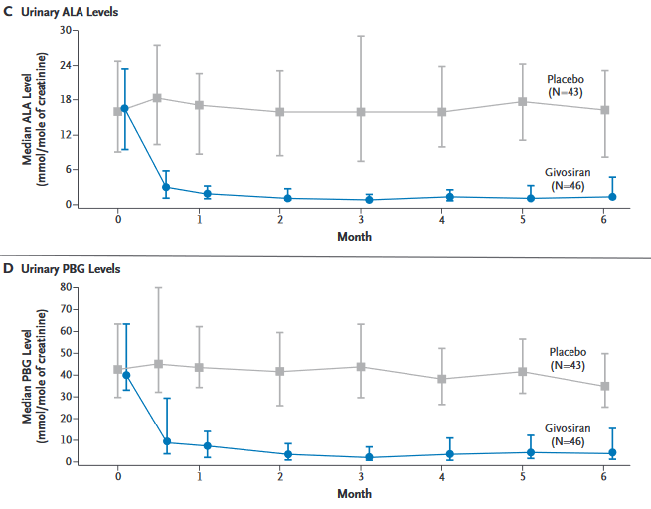
94 patients with acute hepatic porphyria (89 had AIP) given either givosiran or placebo for 6 mo
90% reduction in attack rate
Marked reduction in urinary ALA, PBG
Back
NEJM 2020; 382:2289

Slide 13
Congenital erythropoietic porphyria
Autosomal recessive, rare
Near complete deficiency of URO-S causes massive accumulation and urinary excretion of uroporphyrin I and coproporphyrin I (derived from hydroxymethylbilane by non-enzymatic reactions)
Severe photosensitivity beginning in infancy
Mild to severe hemolytic anemia due to accumulation of toxic porphyrin metabolites in RBC, combined with decreased heme synthesis
Porphyrins accumulate in teeth causing erythrodontia
  This finding along with sun avoidance and disfiguration from light-induced skin damage (photomutilation) may have helped create the vampire legend
May benefit from splenectomy to prolong RBC survival and reduce erythropoietic drive
Back

Slide 14
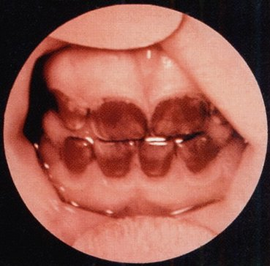
Erythrodontia in CEPP
Back

Slide 15
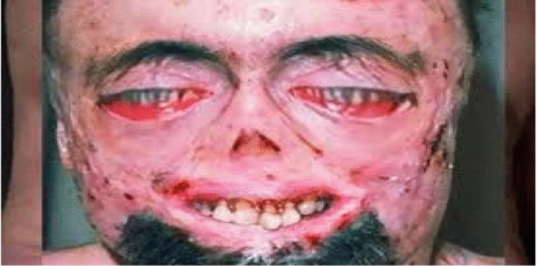
Back

Slide 16
Porphyria cutanea tarda - 1
Most common form of porphyria (5-10/100,000 affected, male predominance)
Caused by ↓activity (≤20%) of uroporphyrinogen decarboxylase (UROD)
  Homozygous UROD deficiency causes hepatoeythropoietic porphyria, with severe lifelong photosensitivity and liver injury
Multifactorial pathogenesis – liver disease, iron overload important contributors
  Some cases due to exposure to polyhalogenated aromatic hydrocarbons
Increased urine + plasma uroporphyrin, heptacarboxyporphyrin with minimal elevation of PBG, ALA
  Brown urine with pink fluorescence under UV light
Late-onset photosensitivity (blue light) – blistering lesions on sun-exposed areas, hypertrichosis
DDx: Variegate and coproporphyria, late-onset EPP
Next
Back

Slide 17
Porphyria cutanea tarda - 2
Management
  Iron depletion (phlebotomy or chelation, target low normal ferritin)
  Hydroxychloroquine is alternative to iron depletion
  Avoid triggers (alcohol, estrogen, tobacco)
    Transdermal estrogen OK once remission achieved
  Treat HCV if present
  Monitor plasma or urine uroporphyrin levels
Back

Slide 18
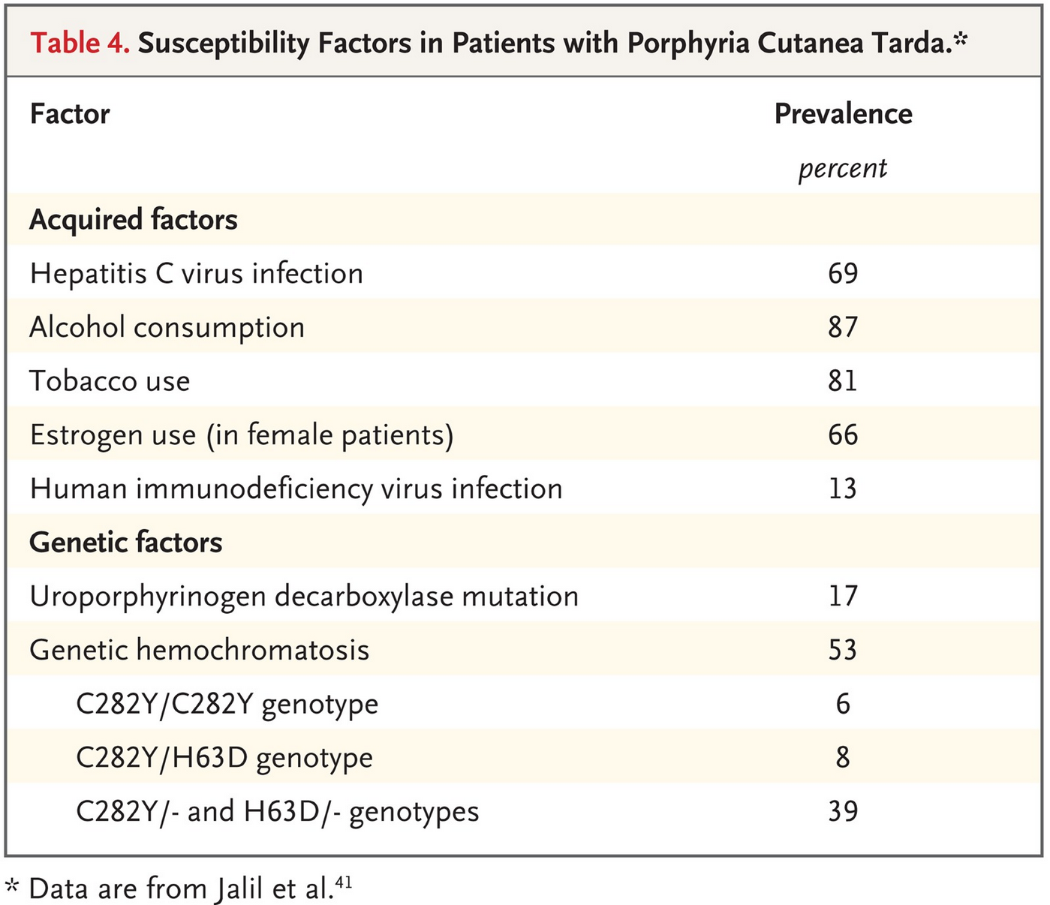
Bissell et al, NEJM 2017
Jalil et al, Clin Gastroenterol Hepatol 2010
Back

Slide 19
Hereditary coproporphyria
Autosomal dominant – partial deficiency of coproporphyrinogen oxidase (CPOX); much less common than AIP
Neurovisceral symptoms identical to AIP but generally milder; some patients have photosensitivity
Marked increase in urinary and fecal coproporphyrin (> 10x normal) during acute attacks; ALA and PBG, uroporphyrins also increased
Genetic testing available
Management similar to AIP
Back

Slide 20
Variegate porphyria
Autosomal dominant, partial deficiency of protoporphyrinogen oxidase (PPOX)
  Less common than AIP but relatively common in some areas (S Africa)
Both neurovisceral symptoms (similar to AIP but usually milder) and skin manifestations (as in PCT) can occur
Elevated urinary coproporphyrin, ALA, PBG, fecal protoporphyrin and coproporphyrin during acute attacks – may be normal in remission
Genetic testing is available
Management similar to AIP (plus sunlight avoidance)
Back

Slide 21
Erythropoietic protoporphyria - 1
The most common erythropoietic porphyria, 3rd most common overall (behind PCT and AIP)
Partial deficiency of ferrochelatase, autosomal dominant or recessive
  AD inheritance when mutation paired with splice site polymorphism in trans that reduces enzyme production by 20-40% (most common in Japan)
Marrow reticulocytes and hepatocytes accumulate protoporphyrin, which is deposited in tissues and excreted in bile and stool (water-insoluble)
  Gallstones and liver damage from porphyrin accumulation may occur
Marked elevation in RBC and fecal protoporphyrin
Photosensitivity beginning in childhood
  Sensitivity to blue spectrum, includes indoor sunlight and some artificial lighting
Back
Next

Slide 22
Erythropoietic protoporphyria - 2
Management
Avoidance of sunlight (indoor & outdoor)
  Risk of vitamin D deficiency
Oral ß-Carotene quenches oxygen radicals generated by photochemical action on protoporphyrin
UV sunscreens ineffective (don’t block blue spectrum)
Activated charcoal and colestipol enhance protoporphyrin excretion, prevent enterohepatic recirculation
Afamelanotide (monthly sq injection) enhances melanin production, blocks blue-spectrum light
Back

Slide 23
Porphyrin biochemistry and the porphyrias
Enzyme
Deficiency
Succinyl CoA + Glycine
Negative feedback
ALA synthase
X-linked protoporphyria (gain of function mutation)
δ aminolevulinic acid (ALA)
PBG synthase (ALA dehydratase)
ALA dehydratase porphyria
Porphobilinogen (PBG)
PBG deaminase
Acute intermittent porphyria
Hydroxymethylbilane
Uroporphyrinogen III cosynthase
Congenital erythropoietic porphyria
Uroporphyrinogen III
Uroporphyrinogen decarboxylase
Porphyria cutanea tarda
Coproporphyrinogen III
Coproporphyrinogen oxidase
Hereditary coproporphyria
Protoporphyrinogen IX
Protoporphyrinogen oxidase
Variegate porphyria
Protoporphyrin IX
Ferrochelatase
Erythropoietic protoporphyria
HEME

Slide 24
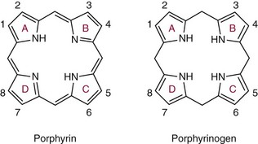
Phototoxicity in porphyria
-6 H
Porphyrinogens are unstable, spontaneously oxidized to porphyrins
In porphyria, these porphyrins are “dead end” metabolites that can’t proceed down the heme synthesis path
Porphyrins have conjugated double bonds that allow them to efficiently absorb high energy UV or blue light.
Injury occurs as a consequence of energy transfer to surrounding tissue (skin, RBC).
High levels of RBC or plasma porphyrins can cause phototoxicity
Next

Slide 25
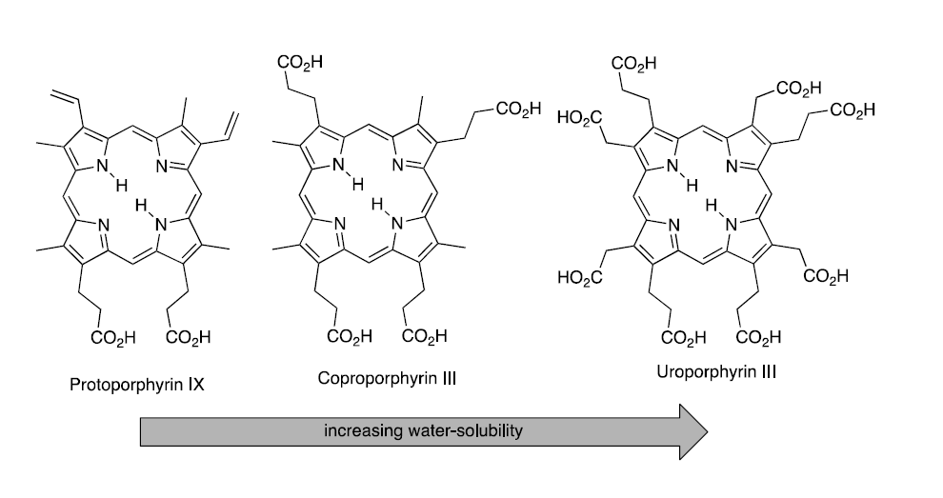
Decarboxylation makes porphyrins less water soluble
Water-soluble porphyrins can enter the plasma and are excreted in urine
Insoluble porphyrins are retained in cells and excreted in bile, can cause liver damage
Back
Notes:
This has implications for diagnosis – do the excess porphyrins show up in urine, plasma or stool?
Also implications for pathophysiology – where do these molecules do their damage?
Note that the order of these molecules on the slide is the inverse order of their appearance in the metabolic sequence

Slide 26
Neurologic injury in porphyria
δ-ALA is likely cause of neurotoxicity rather than PBG
Toxicity occurs in the absence of PBG accumulation in ALA dehydratase deficiency
Lead poisoning and tyrosinemia produce similar symptoms (both cause decreased PBG synthase activity and accumulation of δ-ALA)
Deficiency of neuronal heme proteins and other factors may contribute
Back

Slide 27
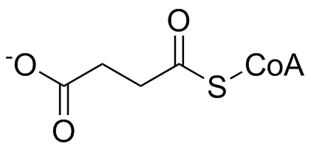
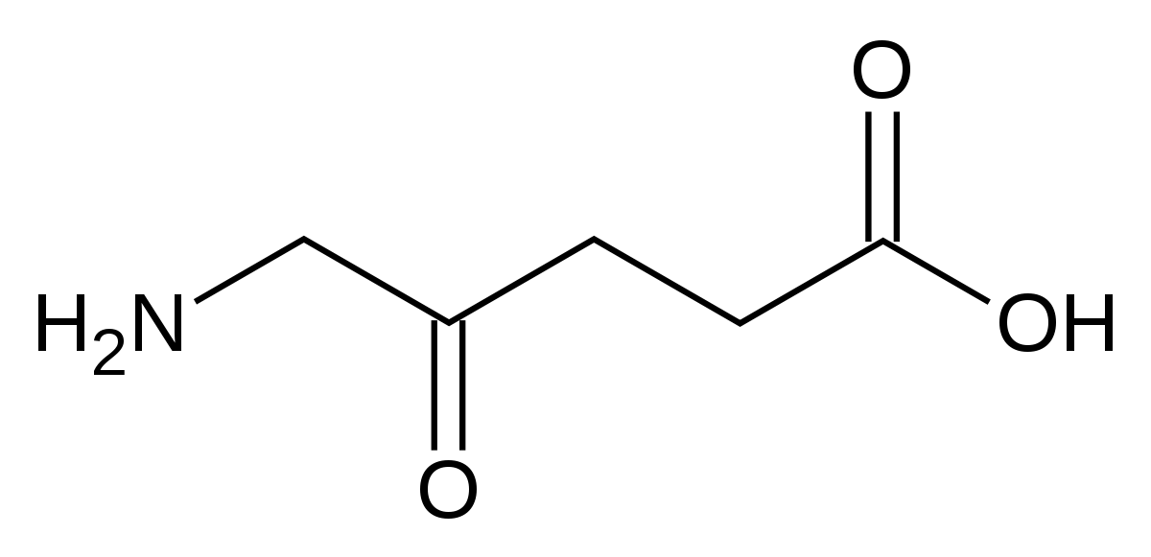
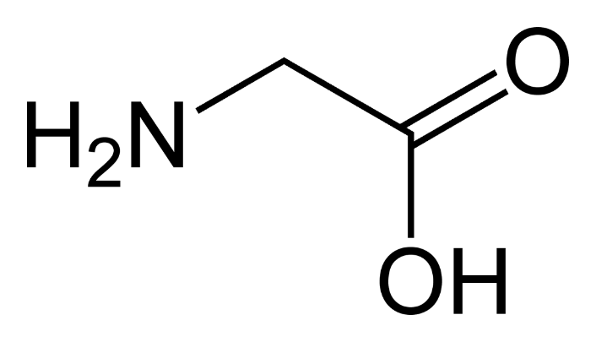
Succinyl CoA + Glycine→Delta aminolevulinic acid
+
ALA synthase
Condensation of glycine + succinyl CoA to form δ-ALA
Back
Next

Slide 28
Role of ALA synthase and heme in the porphyrias
2 genes for ALAS – one on X chromosome codes for erythroid form (ALAS-E) , one on chromosome 3 codes for “nonspecific” form (ALAS-N)
ALAS-E (RBC) under control of erythroid transcription factors, has iron-responsive element. Not repressed by heme, upregulated by iron
ALAS-N (in liver) is increased in presence of porphyrogenic chemicals, metabolic stress, or fever and repressed by heme
Decreased heme levels due to low production or increased catabolism (e.g., in infection) de-repress ALAS gene transcription, leading to increased ALA production
Back
Next

Slide 29
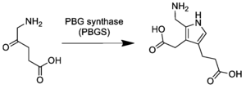
Delta aminolevulinic acid→porphobilinogen
ALA Dehydratase (also called PBG synthase)
2 molecules of δ-ALA condense to form porphobilinogen
Back
Next

Slide 30
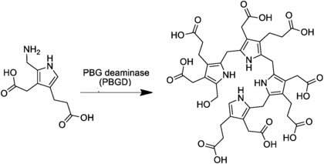
Porphobilinogen→hydroxymethylbilane
4 molecules of PBG condense to form HMB
Back
Next
Notes:
Partial PBGD deficiency is responsible for AIP.

Slide 31
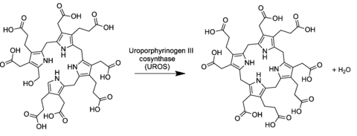
Hydroxymethylbilane→uroporphyrinogen III
HMB cyclizes to form Uro’gen III
Back
Next
Notes:
Hydroxymethylbilane will form toxic cyclic intermediates non-enzymatically if allowed to accumulate – this is what happens in AIP

Slide 32
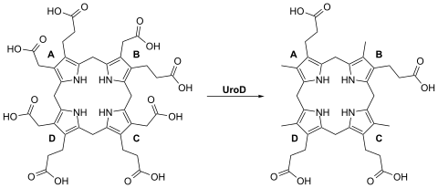
Uroporphyrinogen III→coproporphyrinogen III
Decarboxylation of Uro’gen III to Copro’gen III
Back
Next

Slide 33
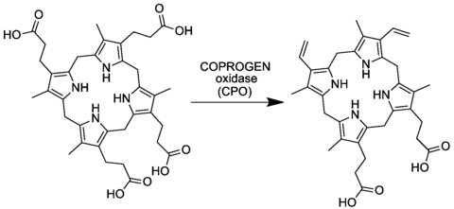
Coproporphyrinogen III→protoporphyrinogen IX
Oxidative decarboxylation of Copro’gen III to Proto’gen IX
Back
Next

Slide 34
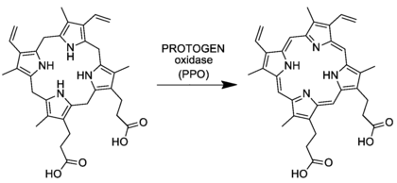
Protoporphyrinogen IX→protophyrin IX
Oxidative decarboxylation of Proto’gen IX to form Protoporphyrin IX
Back
Next

Slide 35
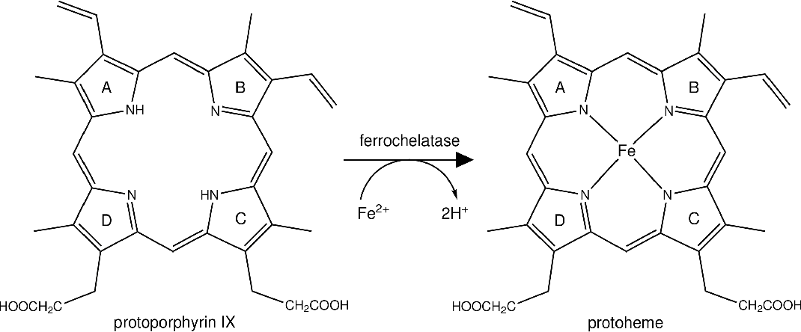
Protoporphyrin IX→heme
Iron atom inserted to form Heme
Back

Slide 36
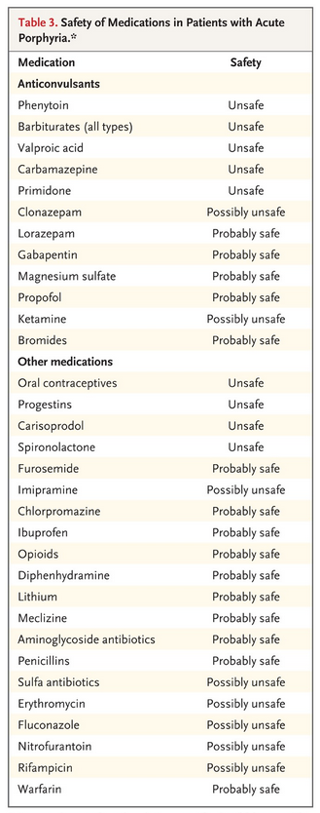
Back
Bissell et al, NEJM 2017

Slide 37
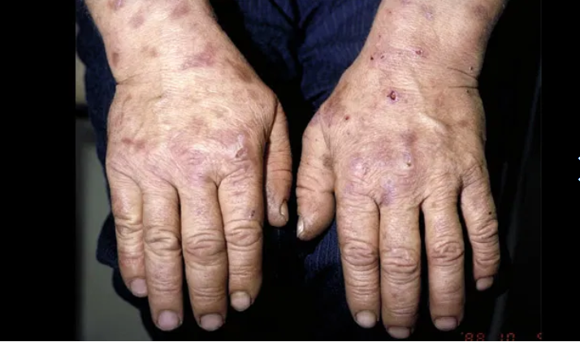
Back

Slide 38
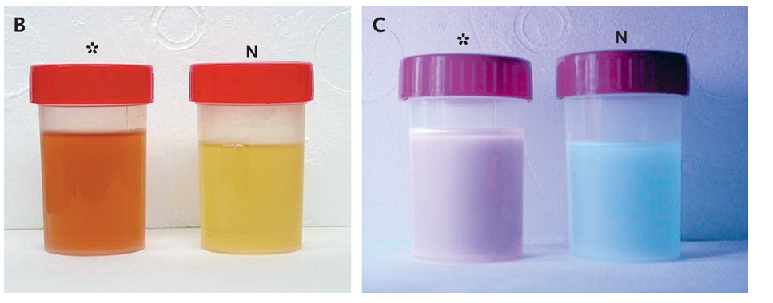
Urine appearance in PCT
Ambient light
UV light
Patient Normal
Patient Normal
Back

Slide 39
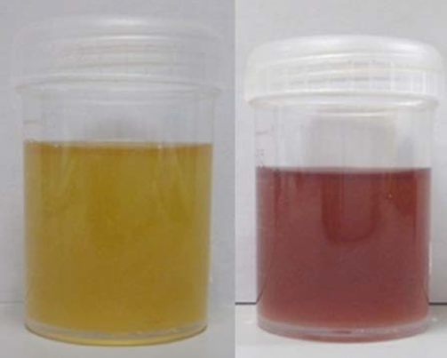
Day 1
Day 3
Back

