Slide 2

The Destruction of Red Cells
It’s Gonna Be A Bumpy Ride
Notes:
This session covers some forms of hemolytic anemia caused by antibodies bound to RBC

Slide 3
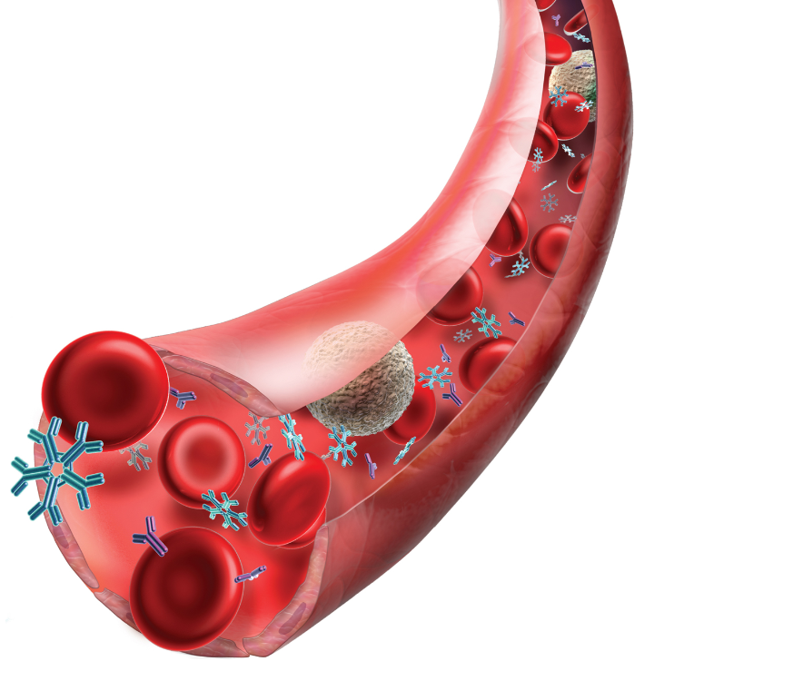
Immune-mediated Hemolysis
Eliot Williams MD PhD
Department of Medicine
Science 2015;347:1058

Slide 4
Learning Objectives
Describe the pathophysiology, diagnosis and treatment of autoimmune hemolytic anemia
List the important differences between warm autoimmune hemolytic anemia and cold agglutinin disease
Describe three different mechanisms of drug-induced immune hemolytic anemia

Slide 5
Immune Hemolytic Anemia
Antibody-mediated destruction of RBC
Antibodies may be
  Directed against foreign RBC (alloimmune)
      after transfusion
      from mother to fetus
  Directed against own RBC (autoimmune)
  Drug-induced
Direct Antiglobulin Test (DAT, also known as Coombs test) positive in most cases
Notes:
In this session I’ll be discussing autoimmune hemolytic anemia and drug-induced immune hemolysis. Alloimmune hemolysis following transfusion or due to maternofetal red cell incompatibility will be discussed in other parts of this course.

Slide 6
Detection of Red Cell Antibodies-1
Most detection methods rely on physical agglutination of RBC by antibody
IgM antibodies directly agglutinate RBC (useful in ABO typing)
IgG antibodies need help to agglutinate RBC
  Reduce RBC surface charge (albumin)
  Add second antibody to link RBC together (Coombs reagent)
Notes:
To diagnose immune hemolytic anemia it is necessary to be able to detect antibodies bound to a patient’s red cells. IgM antibodies will agglutinate red cells directly since one IgM molecule can bind to more than one red cell – this can be detected by the naked eye.
IgG antibodies bound to red cells are detected by adding a second antibody against the IgG itself. This second antibody is known as a Coombs reagent after the physician who developed this test method.

Slide 7
Detection of Red Cell Antibodies-2
Direct Antiglobulin (Coombs) Test: detects IgG antibodies (or complement C3) on patient’s red cells
  Useful in evaluation of hemolytic anemia
Indirect Antiglobulin (Coombs) Test: detects RBC IgG antibodies in patient serum
  Used by blood bank to screen for “unexpected” RBC antibodies present in patient blood prior to transfusion
Notes:
The Coombs reagent can be used to detect antibodies bound to red cells, using a method known as the direct antiglobulin or direct Coombs) test, A variation of this method is used to detect complement C3 bound to red cells, which is also useful in the diagnosis of immune hemolysis.
The indirect Coombs test is used in blood banking, to detect antibodies in a patient’s plasma or serum. This will be discussed elsewhere in the course

Slide 8
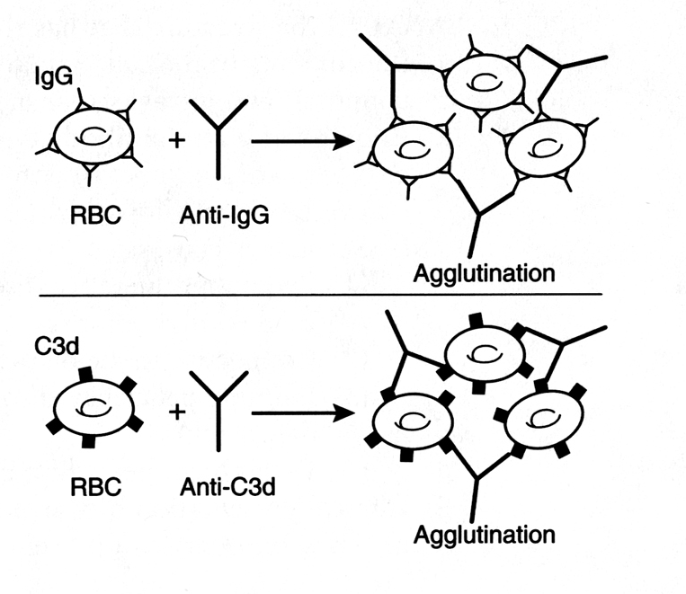
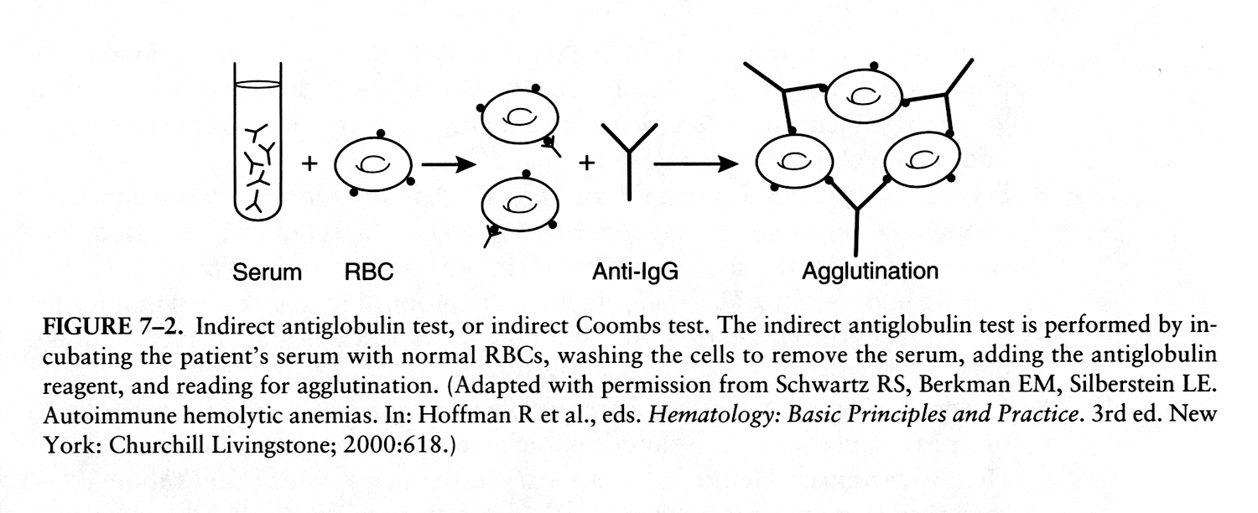
Direct Antiglobulin Test: patient RBC + Anti-IgG or anti-C3; detects IgG or complement on patient’s RBC
Indirect Antiglobulin Test: patient serum plus normal RBC; detects anti-RBC antibodies in patient’s serum
Notes:
A patient with autoimmune hemolytic anemia will have either IgG or C3 – or both – bound to his or her RBC. This is how we detect the presence of either molecule on RBC. In a patient with evidence of hemolysis, a positive direct antiglobulin test for either IgG or C3 is presumptive evidence that hemolysis is immune in origin. Note that a positive DAT can occur in either autoimmune hemolysis or alloimmune hemolysis (for example, during an immune transfusion reaction)
You may wonder why we don’t have a DAT that detects IgM directly. Most IgM antbodies don’t bind well at 37 degrees. However, if they bind even transiently to RBC in the circulation they will usually fix some complement as well, which remains bound to the RBC and can be detected by the C3 version of the DAT.
In practice the DAT is done using polyspecific antibodies that recognize both IgG and C3. If a positive result is obtained the test is repeated with monospecific antiserum to determine if the positive result was due to IgG, C3, or both.

Slide 9
Immune Hemolytic Anemia
Hemolysis is primarily extravascular
  Antibody-coated RBC ingested by macrophages
  Exception: Complement-mediated intravascular hemolysis with IgM isoantibodies in ABO transfusion rxn, rarely with other IgM or IgG antibodies
Spleen is more efficient in clearing RBC coated with IgG antibodies
Liver more efficient in clearing cells sensitized by IgM autoantibodies
Notes:
When IgG binds to the RBC membrane its Fc domain is recognized by macrophages, particularly in the spleen. They may snip off part of the membrane or ingest the entire cell. Hemolysis is thus mainly extravascular, although there is often an element of intravascular lysis.
When IgM binds to the membrane it rapidly fixes complement. If the entire membrane attack complex is formed the cell will undergo intravascular lysis. If the IgM binds only transiently to the membrane there will more likely be only partial complement fixation. The cell will not lyse immediately, but will be recognized by macrophages that see the residual complement and ingest the cell. The liver appears to be more important than the spleen in this setting.

Slide 10


Autoimmune Hemolytic Anemia
“Warm” antibodies:
Typically IgG
React best @ 37° C
70% of cases
“Cold” antibodies
Typically IgM
React best below 37°
30% of cases
Notes:
Autoimmune hemolysis can be separated into two categories based on whether the antibody causing hemolysis is IgG or IgM. IgG antibodies bind best to their target antigens at 37 degrees and are therefore called warm antibodies.
IgM antibodies often bind best at temperatures less than 37 degrees. They are therefore termed cold antibodies. Autoimmune hemolysis caused by IgM antibodies is called cold agglutinin disease.
Most autoimmune hemolysis is due to IgG antibodies – less than a third of cases due to IgM antibodies.

Slide 11
Warm vs Cold Antibodies
Type | Warm | Cold
Immunoglobulin | IgG | IgM
Temperature at which antibody is most active | 37° | Variable – usually ≤ 32°, often < 10°
Complement activation | None or partial | Partial, occasionally complete
Antibody specificity | Broad (“panagglutinin”) occasionally Rh system | Usually i or I
Main site of RBC destruction | Spleen | Liver or intravascular
Underlying cause (if any) | B-cell malignancy, autoimmune disease | B-cell malignancy, infection (EBV, mycoplasma)
Notes:
Comparison of warm and cold antibodies. In addition to the difference in temperature dependence they differ in their ability to recruit complement to the red cell (IgM does this routinely, IgG only in some cases).
Most IgG antibodies have a broad specificity for red cell antigens, making it impossible to define a specific antigen target, although occasionally they can be shown to have specificity for a single antigen (usually one within the Rh system).
IgM antibodies, in contrast, are often specific for one of two red cell antigens – I or i.
A clinically important difference relates to where RBC are mainly destroyed when coated with antibodies. IgG coated RBC are preferentially destroyed in the spleen, whereas antibodies that have bound IgM are preferentially destroyed in the liver, or undergo intravascular lysis. For this reason splenectomy is more effective in treating warm autoimmune hemolytic anemia than cold agglutinin disease.
Most cases of autoimmune hemolysis are idiopathic, that is, not associated with any underlying disease. Some cases are associated with cancers, particularly B-cell lymphomas (discussed next year), autoimmune disorders, or certain infections.

Slide 12
Hemolysis Due to Warm Autoantibodies
DAT positive for IgG ± C3
Most RBC destruction in spleen
Peripheral blood often shows spherocytes
Treatment:
  Corticosteroids (interfere with macrophage Fc receptor function and decrease autoantibody production)
  Splenectomy for relapsed disease or steroid failure
  Alternative immunosuppressive Rx for refractory disease (eg, anti-CD20 antibody rituximab)
  Transfusion if needed (may be hard to crossmatch blood)
Notes:
If a patient with hemolytic anemia has a positive DAT for IgG with or without C3 they can be assumed to have IgG-mediated immune hemolytic anemia. This can occur following a transfusion (discussed elsewhere), in a baby due to maternofetal RBC incompatibility (discussed elsewhere) or due to autoimmunity. The antibodies cause membrane damage, which in turn causes affected RBC to become spherocytes, and eventually the IgG-coated RBC will be ingested by a macrophage.
We can treat IgG-mediated autoimmune hemolysis with immunosuppressive drugs such as corticosteroids (eg, prednisone) or rituximab, an monoclonal antibody that targets B-lymphocytes
Splenectomy can be curative but is less often used today because medical treatment is usually able to control the disease
Red cell transfusion is often necessary, but in some cases the presence of a strong autoantibody can make it difficult to identify compatible donor RBC units.

Slide 13
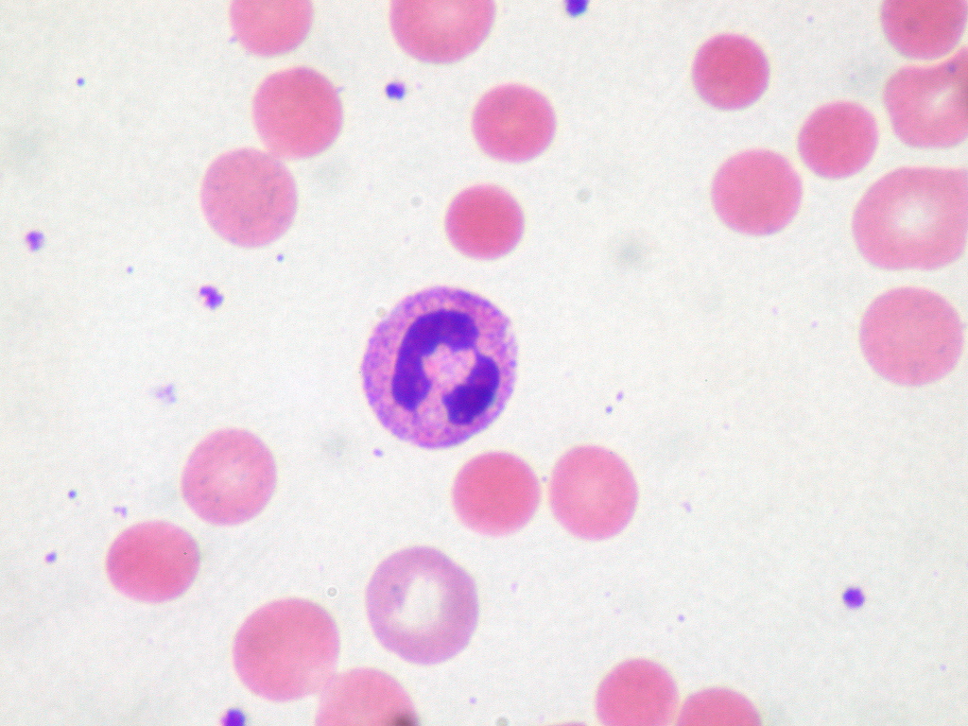
Warm Autoimmune Hemolytic Anemia
Notes:
Blood smear with spherocytes. This is a manifestation of membrane damage caused by interaction of macrophages with IgG-coated RBC

Slide 14
Cold Agglutinin Syndrome
IgM antibody-mediated
Most common targets are I or i antigens
May complicate infections (mycoplasma, EB virus, hepatitis C) and B-cell lymphomas
Hemolysis more likely if antibody binds to RBC at or near body temperature
Partial complement fixation; DAT positive for C3 and negative for IgG
May cause cold-induced RBC sludging (acrocyanosis) in addition to hemolysis
Notes:
Cold agglutinin disease refers to autoimmune hemolysis caused by IgM antibodies. This sometimes complicates infections or B-cell lymphomas, but is most often idiopathic.
Not all cold agglutinins cause hemolysis – their ability to do so is closely related to their “thermal amplitude” – that is, the highest temperature at which they bind to RBC. If this is a temperature within a few degrees of body temperature they are much more likely to cause symptoms
A patient with hemolytic anemia and a DAT positive for C3 but negative for IgG would be presumed to have cold agglutinin disease.
Some patients, in addition to hemolysis, have very bothersome symptoms caused by intravascular RBC sludging as circulating RBC are agglutinated by IgM

Slide 15
Most cold agglutinins are clinically benign
Most of these antibodies are active only at low temperatures (<25°) and so don’t bind at physiologic temperatures
Most common targets are I or i antigens: Anti-i antibodies rarely cause hemolysis
These antibodies may be found by the lab when blood cools to room temperature and then clumps, but most of them do not cause hemolysis or any symptoms
Likelihood of causing disease depends on “thermal amplitude”, the highest temperature at which they bind to RBC
Notes:
Only a minority of cold agglutinins cause hemolysis or other symptoms, because most of these antibodies don’t bind to RBC until the temperature is less than 25 degrees. However, they may be detected incidentally by the laboratory when a tube of blood is allowed to cool to room temperature, as shown in the next slide

Slide 16
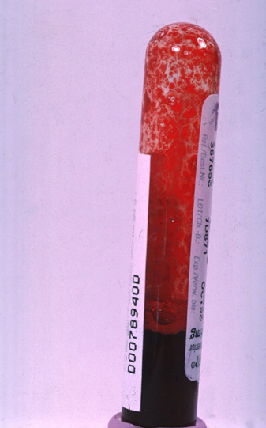
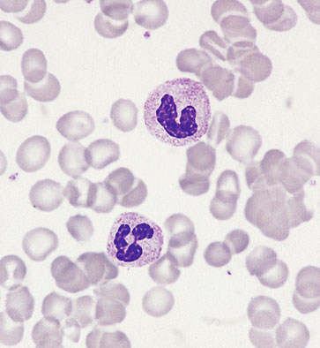
RBC clumping in cold agglutinin disease
Microscopic

Slide 17
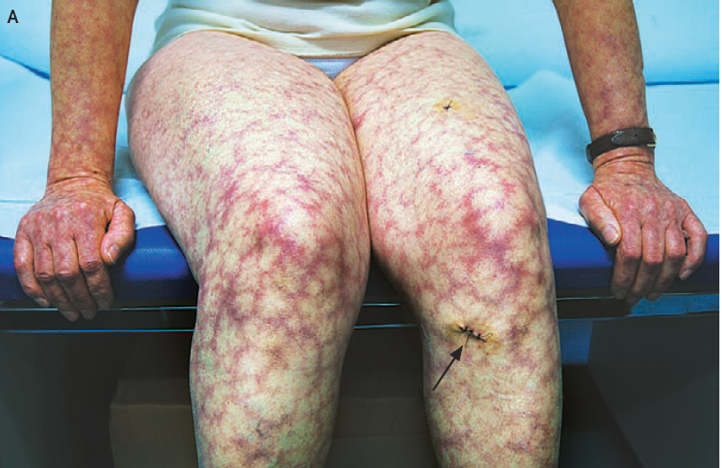
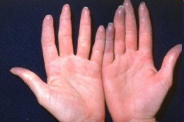
RBC clumping in cold agglutinin disease
In the patient
N Engl J Med 2007;356:284
Notes:
This is what can happen if the cold agglutinin is active at a temperature close to 37 degrees.

Slide 18
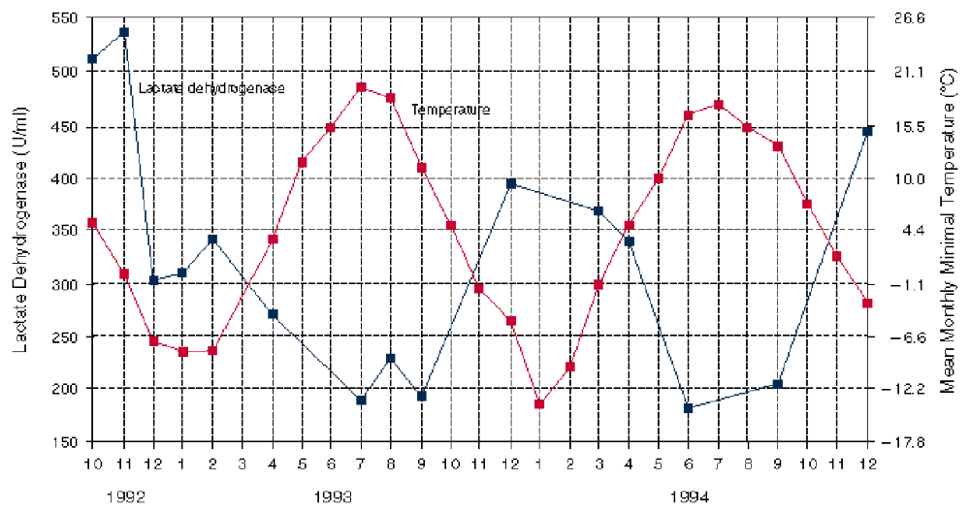
Effect of Ambient Temperature on Hemolysis in Cold Agglutinin Disease
Notes:
As you might expect, winter is hard on patients with cold agglutinin disease. This shows the relationship between ambient temperature (red line) and hemolysis (blue line, as indicated by serum LDH level) in a patient with the disease.

Slide 19


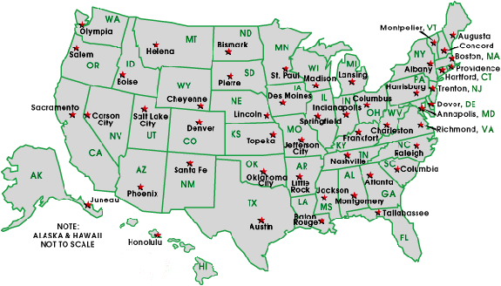
Cold Agglutinin Disease Treatment
Corticosteroids less effective than warm Ab hemolysis
Splenectomy often ineffective
Alternative immunosuppression (anti-CD20 monoclonal Ab rituximab)
Avoid cold exposure
Notes:
These patients don’t respond as well to corticosteroid treatment or splenectomy as do patients with warm autoantibodies. Rituximab is often effective, however. Keeping warm when it’s cold outside is crucial, and many patients choose to spend the winter in warmer climates.

Slide 20
Drug-induced Immune Hemolysis

Slide 21
Mechanisms of Drug-induced Hemolysis
Drug binds to RBC membrane, antibody binds to drug-membrane complex
  Usually IgG antibodies, extravascular hemolysis
  Beta-lactam antibiotics most common cause
Drug binds to antibody in plasma, immune complex deposits on RBC membrane
  Often IgM antibodies w/complement fixation, intravascular hemolysis
  Quinidine is prototype drug
Drug stimulates immune system to make autoantibodies vs RBC
  IgG antibodies, extravascular hemolysis
  Alpha-methyldopa (an antiquated antihypertensive agent) is prototype drug
Notes:
3 mechanisms by which drugs may cause antibody-mediated hemolysis.
Drug acts as a hapten, binding to rbc membrane creating a neoantigen that attracts antibodies which then cause extravascular hemolysis
Drug forms complex with antibody in plasma, immune complex binds to RBC. This can result in intra- or extravascular hemolysis depending on how effectively the immune complex fixes complement
Drug stimulates production of a true autoantibody. This is a rare phenomenon (as far as we know). Nobody uses alpha-methyldopa anymore

Slide 22
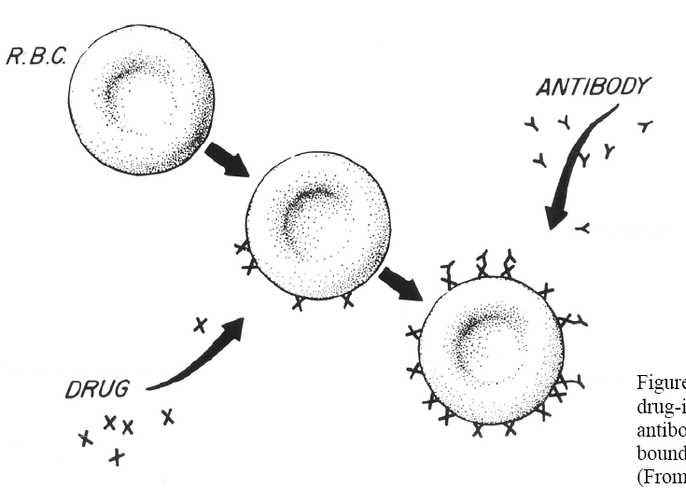
Haptenic type of drug-induced hemolysis. The antibody attaches to the drug bound to the red cell membrane. (From Garratty G, Petz L: Drug-induced hemolytic anemia, Am J Med 58:398).

Slide 23
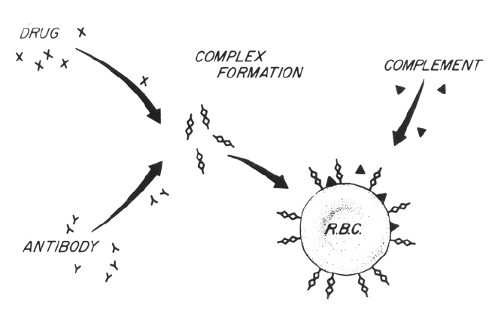
Immune-complex type of drug-induced hemolysis. The antibody is usually IgM and fixes complement, leading to intravascular hemolysis. (From Garratty G, Petz L: Drug-induced immune hemolytic anemia, Am J Med 58:398).

Slide 24
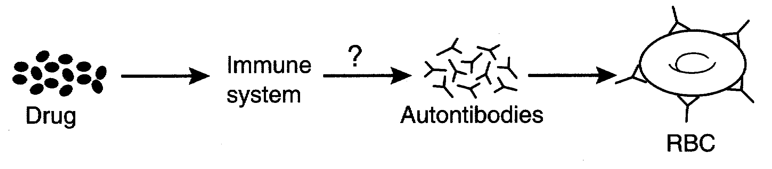
True autoimmune type drug-induced hemolysis. The drug stimulates autoantibody formation, and hemolysis can then occur even in the absence of the drug.

Slide 25
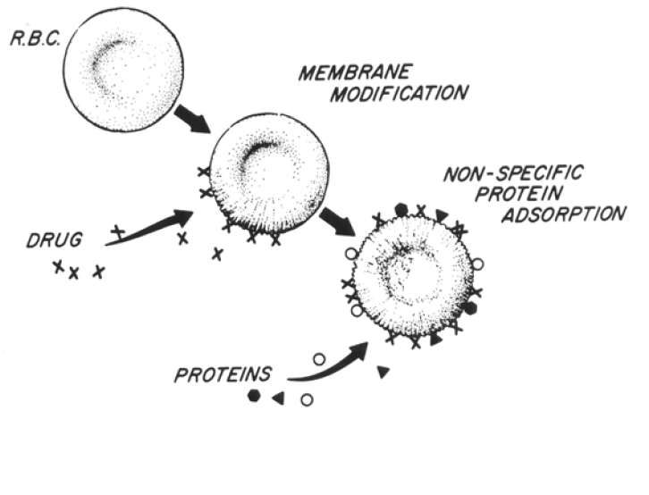
Some drugs may cause positive DAT but no hemolysis
Membrane modification type of drug-induced immunoglobulin adherence reaction. Hemolysis does not occur in this nonspecific reaction. (From
Garratty G, Petz L: Druginduced hemolytic anemia, Am J Med 58:398).
Notes:
Some drugs can cause a “false positive” DAT – they alter RBC membrane properties causing nonspecific binding of proteins including IgG. The Fc portion of the immunoglobulin is not exposed in a manner that allows binding to macrophages.

