Slide 1
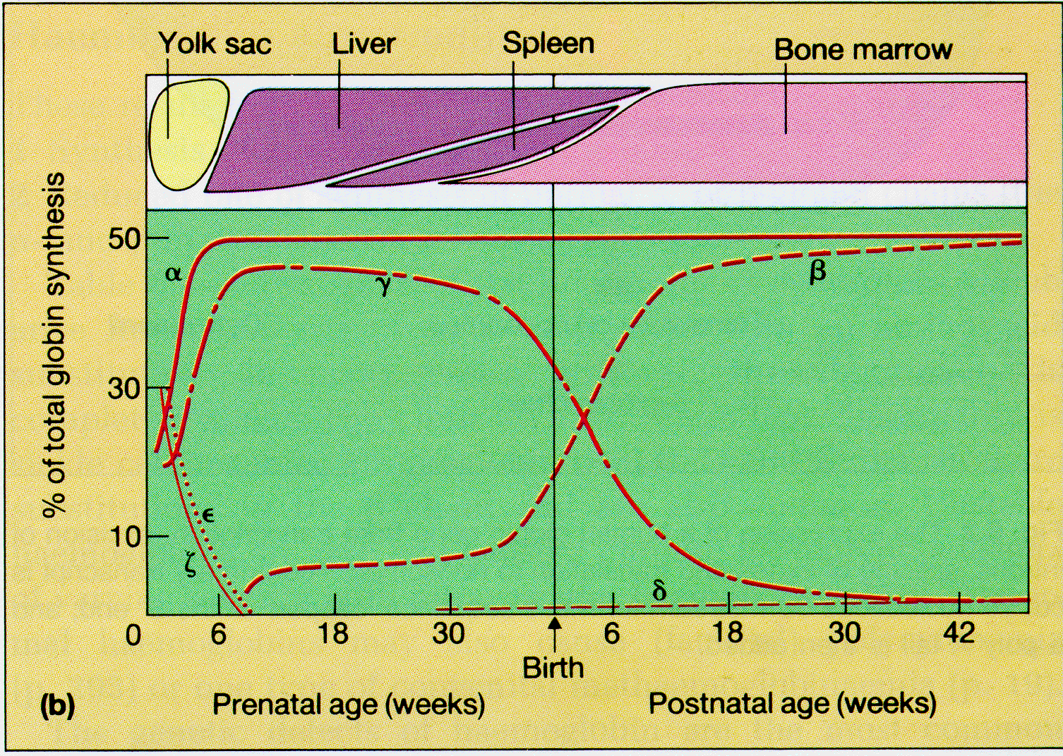
Hemoglobin Synthesis

Slide 2
Hemoglobin synthesis
25%
25%
0.5%
1.5%
48%
α
α
γ
δ
β
α
α
γ
δ
β
25%
25%
0.5%
1.5%
48%
Chromosome 16
Chromosome 11

Slide 3
Hemoglobins in normal adults
α
β
α
γ
α
δ
β
α
γ
α
δ
α
HbA
HbF
HbA₂
98%
~1%
<3.5%

Slide 4
Hemoglobinopathy definition
An inherited mutation of the globin genes leading to a qualitative abnormality of globin synthesis

Slide 5
Thalassemia definition
An inherited mutation of the globin genes leading to a quantitative abnormality of globin synthesis

Slide 6
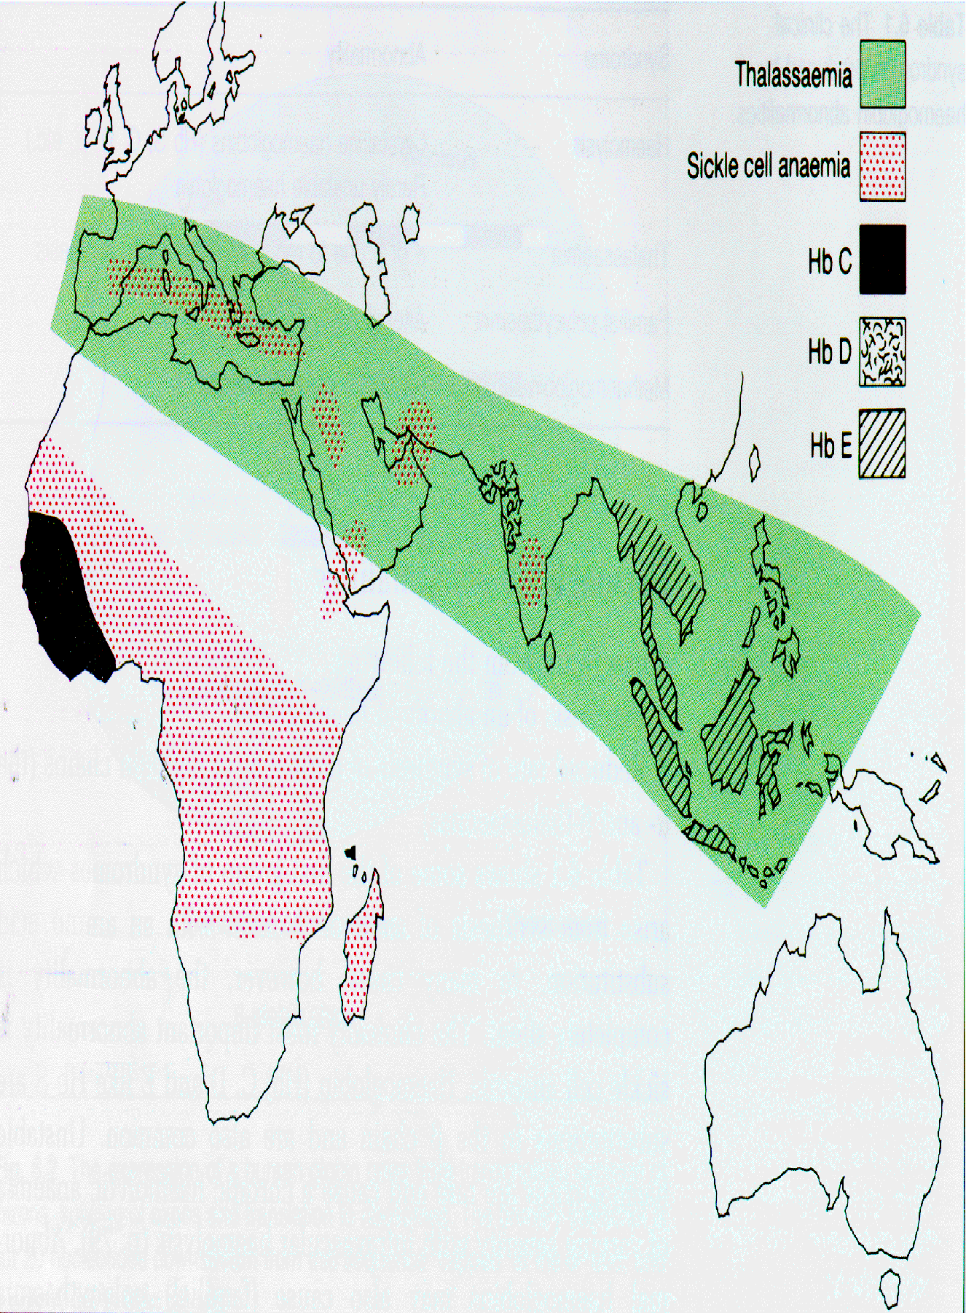
Geography of Hemoglobinopathies

Slide 7
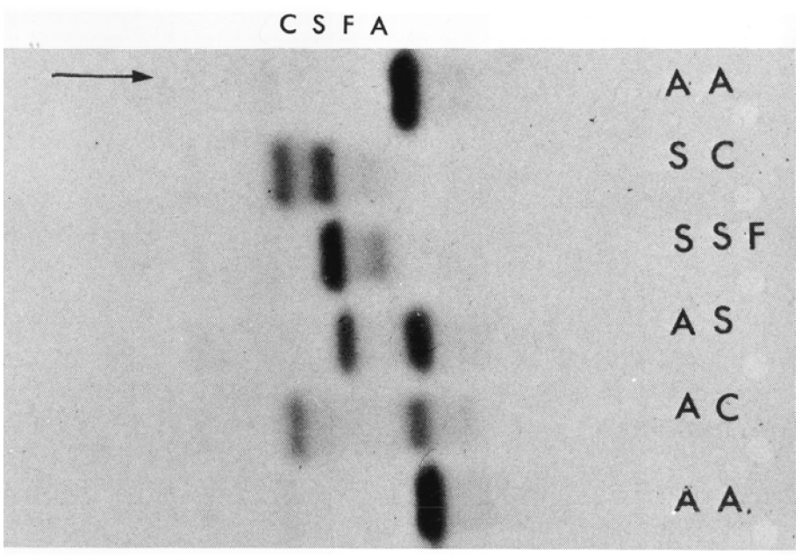
Hemoglobin Electrophoresis
Separation of various hemoglobins with electrophoresis on cellulose acetate, pH 8.6. Hemolysates represented are AA (normal adult), SC (hemoglobin SC disease), SSF (homozygous sickle disease, SS, with increased F), AS (sickle trait), and AC (C trait).

Slide 8
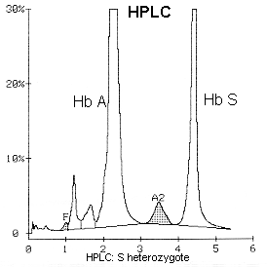
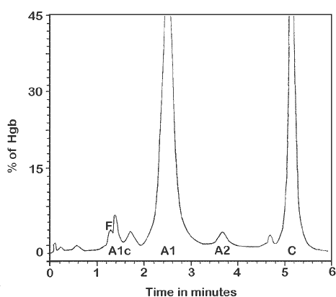
Hemoglobin Analysis by HPLC

Slide 9
Sickle Cell Anemia
Wide spectrum of disorders
1 / 600 African Americans affected
1 / 8 African Americans - sickle trait
Hb SS ~ 60% of sickle cell disease
Hb SC and Sβ-thal ~ 40%

Slide 10
Sickle trait
β^{S}/β; 8% of African-Americans
Asymptomatic
Partial protection from malaria
Sickling may occur in renal medulla → decreased urinary concentrating ability, hematuria
Rare complications at high altitude (splenic infarction)
Sudden death following strenuous exercise (rare)

Slide 11
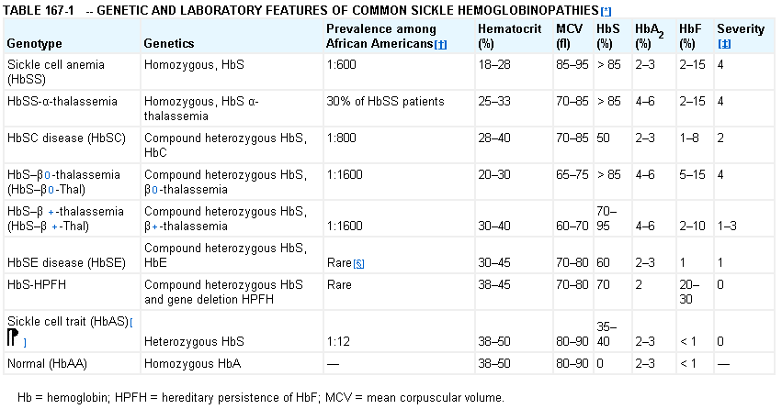
Genetic and Laboratory Features of Sickle Hemoglobinopathies
(Modified from Steinberg, M., Cecil Medicine 2007)
Notes:
11
*Other abnormal globin genes can be found as compound heterozygotes with the HbS gene. The most common of these are α-thalassemia,In West and Central Africa, disease is most common, 2% of all newborns have sickle cell disease. About 30% of African Americans carry an α -thalassemia gene, which can alter the phenotype of sickle cell disease by causing microcytosis, reduced cell density, and less hemolysis. ‡ Vaso-occulsive severity genotype. This is a qualitative ranking of the clinical vaso-occlusive severity clinical heterogeneity. § SE a rare genotype, the rising Asian population in the United States (HbE is a Southeastern Asian gene) will make it more frequent with time. phenotype of HbSE disease is not defined. It may resemble HbS–β+ thalassemia with symptoms appearing mainly in adults. Sickle cell trait should not be classified as a form of sickle cell disease. About 8% of African Americans are carriers of HbS and are normal with a normal lifespan. The few abnormalities traceable to the presence of HbS include hyposthenuria, increased risk of urinary tract infection during pregnancy, hematuria.

Slide 12
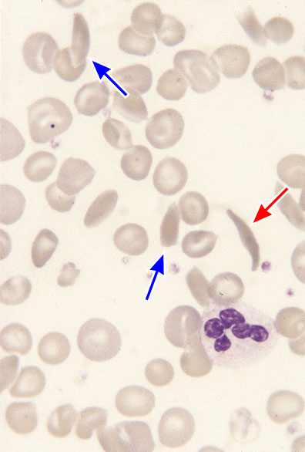
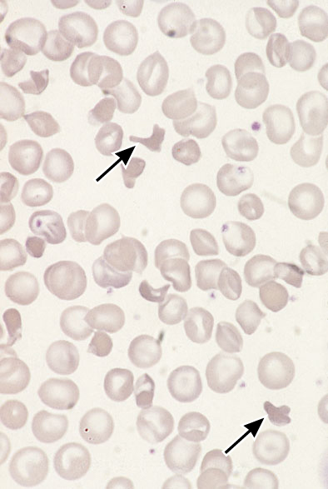
SS
SC

Slide 13
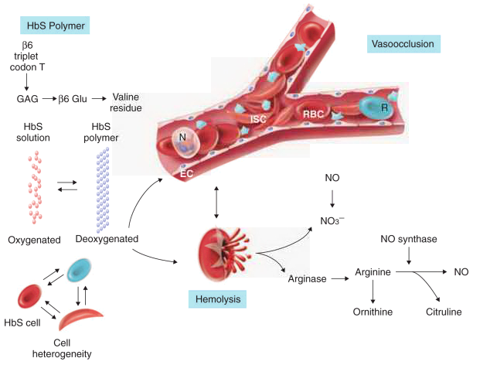
Pathophysiology of Sickle Cell Anemia
HbS Polymer
Vaso-occlusion
NO
Arginine
Hemolysis
(Modified from Steinberg, M., Cecil Medicine 2007)
Notes:
Adenine-thymidine codon 6 b globin gene chr 11 –valine instead of glutamic acid
Hgb S polymerizes when deoxygenated injure RBC – Heterogenous population of cells damaged membrane cytoskeletons, decreased cation and H2O content and altered lipid membrane distribution
In the vessel these RBC interact with endothelium, wbc,plat – result in vasoconstriction and vasoocclusion
As well, these damaged RBC hemolyze– release heme- heme scavanges NO- hgb is reduced resulting in meth hgb and nitrate
NO – when available binds soluable guanylate cyclase and converts cGTP to GMP and relaxes smooth muscle
When NO depleted – increased vasoconstriction, increased platelet activation and aggregation and cell adhesion
Impaired homeostatic vascular function of NO – inhibiting platelet activation,transcriptional repression of genes for adhesion molecules
Hemoglobin,heme iron catalyze production of oxygen free radicals and protein nitration –less NO availabilityand activated endocthelium increased
Lysed RBC –liberate arginase - less arginine as substrate for NO
BALANCE OF VASOCONSTRICITON VS VASODILATION SCEWED TOWARD VASOCONSTRICTION,ENDOTHELIAL ACTIVATION,PROLIFERATION
Deoxygenation of mutant Hb leads to
↑ K⁺ efflux
↑ cell density / dehydration
↑ polymerization
Sickled cells adhere to endothelial cells
Endothelial factors ↑ vasoconstriction
Blood flow ↓ promotes vaso-occlusion

Slide 14

Sickle Cell: Molecular Basis
Glutamate → Valine at 6th position β globin
Sickle Hb forms polymers when deoxygenated
Polymerized sickle Hb injures RBC membrane and distorts its shape
Distorted RBC is hemolyzed

Slide 15
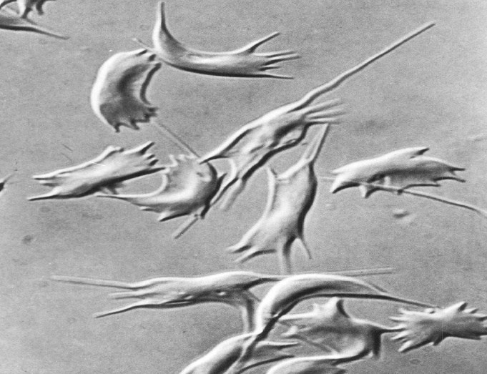
Sickle Cells – Electron Microscopy

Slide 16
Sickle Cell: Pathophysiology
Deoxygenation of mutant Hb leads to
    ↑ K⁺ efflux
    ↑ cell density / dehydration
    ↑ polymerization
Sickled cells adhere to endothelial cells
Endothelial factors ↑ vasoconstriction
Blood flow ↓ promotes vaso-occlusion
“Vicious cycle” with decreased blood flow, hypoxemia / acidosis, increased sickling
Some cells become irreversibly sickled

Slide 17
FACTORS THAT INCREASE Hgb S POLYMERIZATION
Decreased oxygen
Increased intracellular hemoglobin S concentration (SS > SC, S-thal)
Increased 2,3-DPG
Decreased pH
Slowed transit time through the circulation
Endothelial adhesion

Slide 18
FACTORS THAT DECREASE Hgb S POLYMERIZATION
Lower concentration of Hb S (compound heterozygosity for α thal)
Increased HbF levels
  Genetic basis
  Hydroxyurea

Slide 19
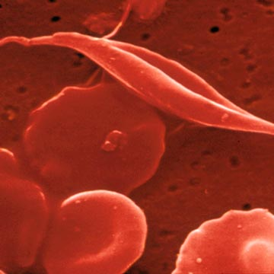
Clinical Features of Sickle Cell Anemia
Painful episodes
Pneumococcal disease
Acute chest syndrome
Splenic infarction
Splenic sequestration
Stroke
Osteonecrosis
Priapism
Retinopathy
Leg ulcers
Gallstones
Renal abnormalities
Osteopenia
Nutritional deficiencies
Placental insufficiency
Pulmonary hypertension
Notes:
TABLE 167-2 -- FEATURES OF SICKLE CELL ANEMIA
The features of sickle cell anemia change as life advances ( Table 167-2 ). The switch from HbF to HbS underlies the clinical shift in life's first decade. This time is typified by acute problems: high risks of severe life-threatening infection, acute chest syndrome, splenic sequestration, and stroke. Chronic organ damage (renal failure, pulmonary hypertension, and late effects of previous cerebrovascular disease) becomes paramount in adults.
Notes - The clinical manifestation and their management could fill a day – this morning I will focus on some of what seem to be the most challenging and significant in contributing to early mortality, and significant morbidity

Slide 20
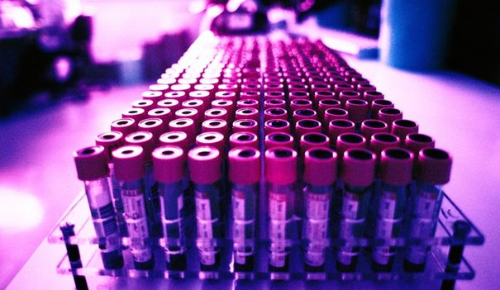
Clinical Features of Sickle Cell Anemia
Associated with higher hemoglobin | Associated with lower hemoglobin
Painful episodes | Stroke
Acute chest syndrome | Priapism
Osteonecrosis | Leg Ulcers
Proliferative retinopathy
Notes:
TABLE 167-2 -- FEATURES OF SICKLE CELL ANEMIA
The features of sickle cell anemia change as life advances ( Table 167-2 ). The switch from HbF to HbS underlies the clinical shift in life's first decade. This time is typified by acute problems: high risks of severe life-threatening infection, acute chest syndrome, splenic sequestration, and stroke. Chronic organ damage (renal failure, pulmonary hypertension, and late effects of previous cerebrovascular disease) becomes paramount in adults.
Notes - The clinical manifestation and their management could fill a day – this morning I will focus on some of what seem to be the most challenging and significant in contributing to early mortality, and significant morbidity

Slide 21
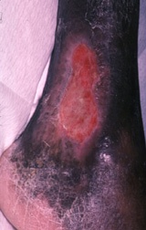

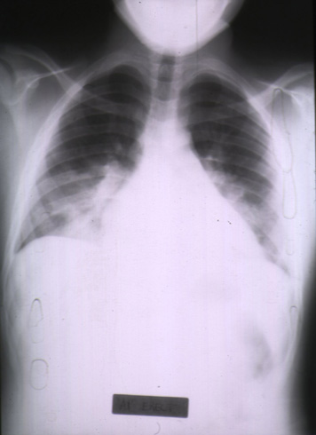
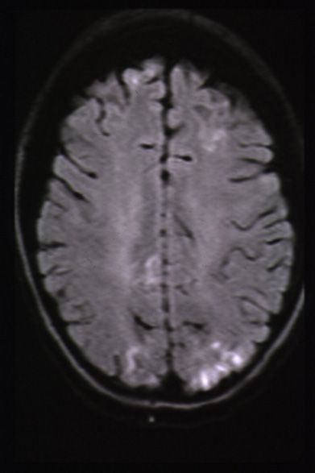
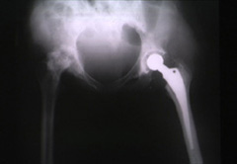
Complications of
Sickle Cell
Disease
Skin ulcer
Pneumonia
Stroke
Osteonecrosis

Slide 22
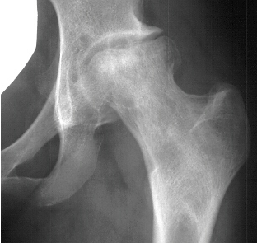
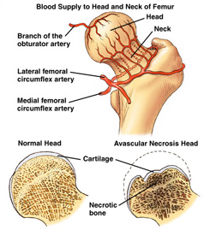
Sickle Cell – Avascular Necrosis
gait.aidi.udel.edu/.../clcsimge/sickle5
http://www.zimmer.com
Notes:
Occurs in 50% of patients – more common in SC
Incidious onset – Pain
Rx – non weight bearing, NSAIDS,
Recent study showed core decompression of the femorql head no better than aggressive physical therapy
Hip replacement….

Slide 23
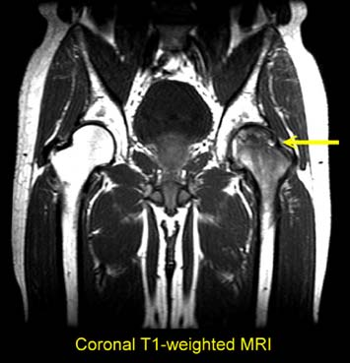
Sickle Cell – Avascular Necrosis
http://www.zimmer.com

Slide 24
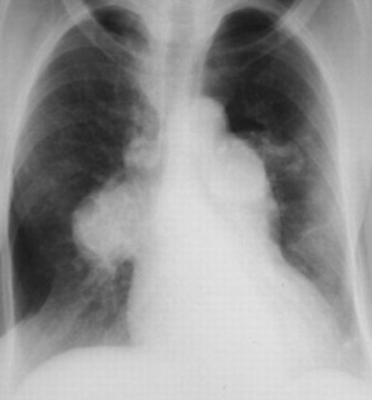
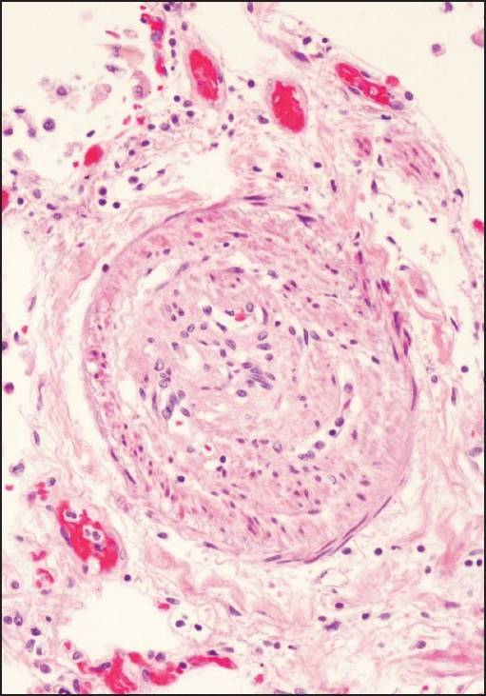
Pulmonary Hypertension
Notes:
Recently recognized as common and serious in all hemolytic anemias – but particularly here
Defined by regurgitant pulmonary jet velocity of > 2.5m/sec by echo
Found in 30-40% of adults with SS
Often unrecognized
Risk - ?recurrent ACS, Asplenia,in situ thrombosis
Inhaled NO – Promising
L-Arginine at high doses
Silfenadil – phosphodiesterase 5 inhibitor( viagra)

Slide 25
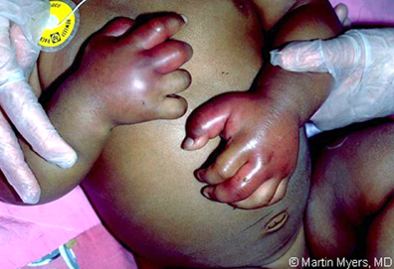
Sickle Cell – Dactylitis
http://aapredbook.aappublications.org/week/116_09.jpg
Notes:
Pain is damage – ischemia – tissue injury
Can be acute or chronic
Usually PE not helpful – but here obvious
As patient grows pain moves from hands/feet to long bones usually
Can be associated with increase temp,WBC,
50% as common in SC compared to SS
Painful episodes inversely related to percentage of fetal hemoglobin

Slide 26
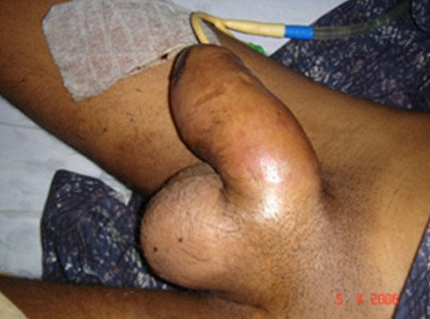
Priapism
Notes:
Occurs in 40% of boys and men
Major episode often follows a history of stuttering attacks – leads to impotence
Men with priapism have higher incidence of stroke, renal failure, leg ulcers – vasculopathic phenotype
RX – Analgesia, heat, fluids, aspiration, oral or intracavernous alpha-adrenergic agonists may reverse

Slide 27
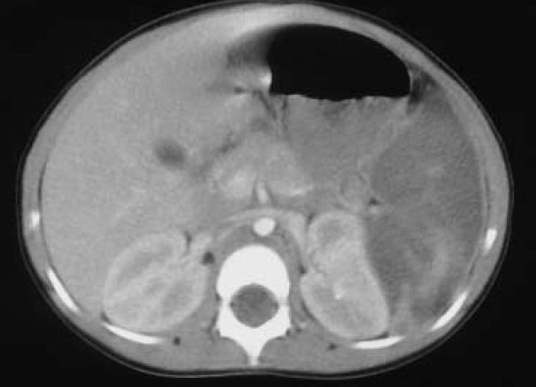
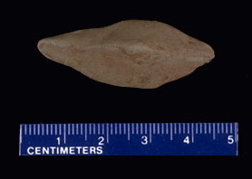
Sickle Cell – Splenic Complications
Splenic Sequestration
Autosplenectomy
Sheth, S. et al Pediatr Radiol 2000
pathology.mc.duke.edu/.../spleen1.jpg
Notes:
Most patient infarct spleen by age 4, but in Africa persistnat splenomegaly can persist if infected with malaria also some patients with milder phenotypes – still functionally asplenic
Defective splenic function from birth – historically encapsulated organisms killed small children – since late 70’s with routine penicillin prophylaxis decreased mortality
Immunization schedule -

Slide 28
Sickle Cell Anemia - treatment
Opiates and hydration for painful crises
Pneumococcal vaccination
Retinal surveillance
Transfusion for serious manifestations (eg stroke); exchange transfusion
Hydroxyurea
Stem cell transplant

Slide 29
Hemoglobin C
Glutamate → lysine at 6th position in beta chain
Hb tends to crystallize
Prevalent in west Africa
Homozygous state – chronic hemolytic anemia
Compound heterozygosity with Hb S produces sickle phenotype

Slide 30
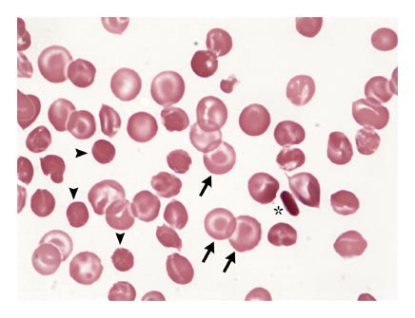
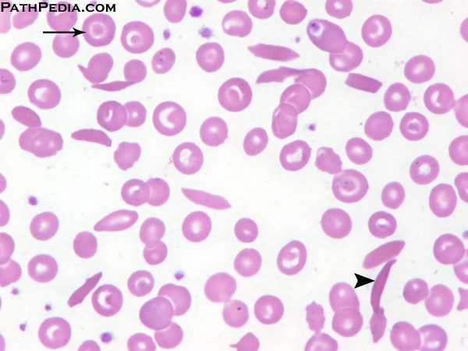
Hemoglobin C
Homozygous: target cells, tactoids
Hemoglobin SC

Slide 31
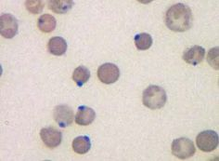
Other hemoglobinopathies
Unstable hemoglobins
  Heinz body formation
  Multiple mutations reported; dominant inheritance
  Hemolytic anemia (may be precipitated by oxidative stress)
Heinz bodies (supravital stain)

Slide 32
Other hemoglobinopathies
Hemoglobin M
  Congenital methemoglobinemia, cyanosis
Hemoglobin with low oxygen affinity
  Right shifted dissociation curve, decreased EPO
  Mild anemia (asymptomatic)
Hemoglobin with high oxygen affinity
  Left shifted dissociation curve, increased EPO
  Erythrocytosis
These all have dominant inheritance
Many benign/asymptomatic mutations described

Slide 33
The Thalassemias
Syndromes in which the rate of synthesis of a globin chain is reduced
  beta thalassemia - reduced beta chain synthesis
  alpha thalassemia – reduced alpha chain synthesis

Slide 34
THALASSEMIA
Diminished or absent synthesis of normal globin chains (α or β); genetically heterogeneous
Heterozygous state protects from malaria, hence more common in southern European, African, Asian peoples
Unbalanced globin chain synthesis causes microcytosis, ineffective erythropoiesis and hemolysis

Slide 35
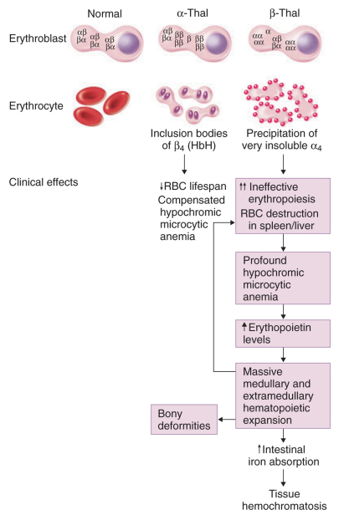
Thalassemia

Slide 36
Three α-globin genes missing: microcytosis, hemolysis, moderate to severe anemia
Two α-globin genes missing: microcytosis, minimal anemia
One β-globin gene missing: microcytosis, mild anemia
Two β-globin genes missing: transfusion-dependent anemia
Single α-globin
gene missing
normal CBC
Four α-globin genes missing: fetal demise
Decreasing globin chain production
Increasing globin chain imbalance causing:
ineffective erythropoiesis (precipitated α chains)
hemolysis (β tetramers or Hb H)
Worsening anemia

Slide 37
Alpha thalassemia
αα / αα | Normal
αα / α − | Mild microcytosis
αα / − − | Mild microcytosis
α − / − − | Hemoglobin H disease
− / − − | Hemoglobin Barts – Hydrops Fetalis

Slide 38
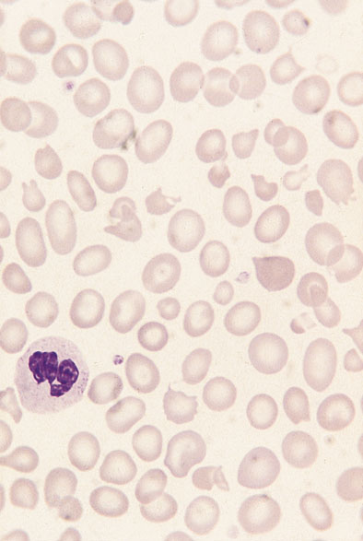
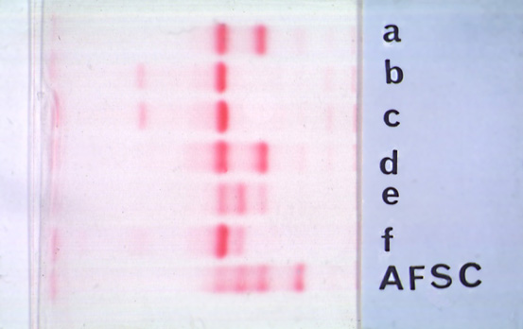
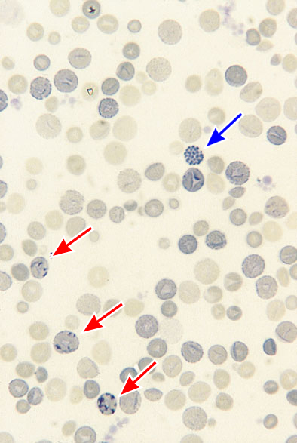
H
Hgb H disease
Hgb H inclusions (supravital stain)

Slide 39
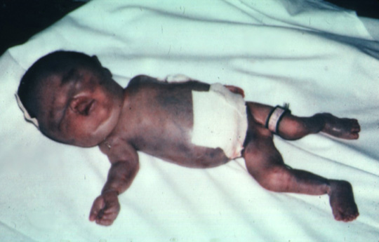
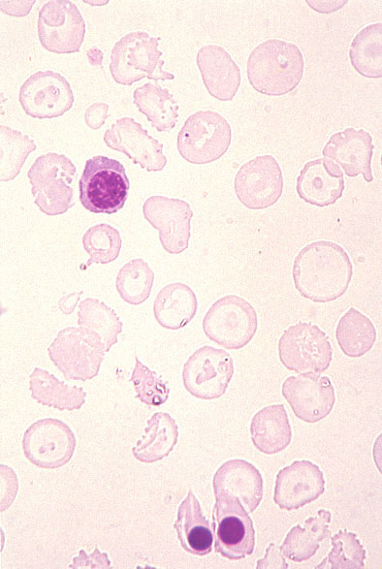
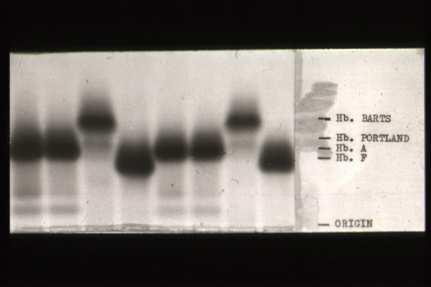
Hydrops fetalis (note gross edema)
Hydrops fetalis

Slide 40
Beta thalassemia major
No beta chain produced (no HbA)
Severe microcytic anemia occurs gradually in the first year of life (as gamma chain production stops)
Marrow expansion
Iron overload
Growth failure and death
Notes:
Beta thalassemia major: complete absence of beta globin synthesis
Severe anemia beginning in first six months of life; transfusion dependence
Eventual death from iron overload unless aggressive chelation Rx or marrow transplantation
Beta thalassemia minor (thalassemia trait): beta globin synthesis about half normal
Microcytosis with mild anemia (distinguish from Fe deficiency)
Beta thalassemia intermedia: globin chain synthesis markedly decreased but not absent
Phenotype intermediate between thal major and minor

Slide 41
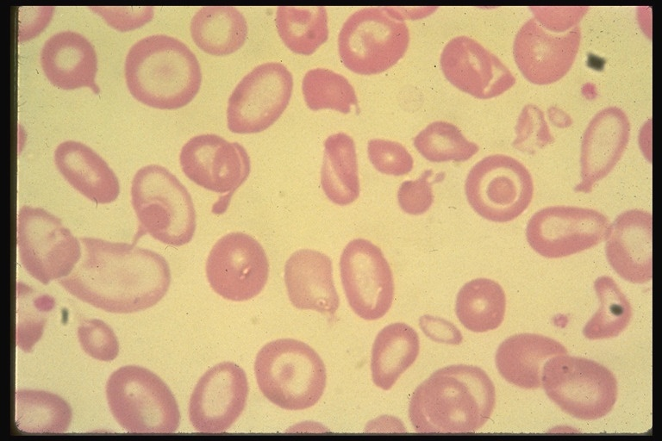
Beta thalassemia major

Slide 42
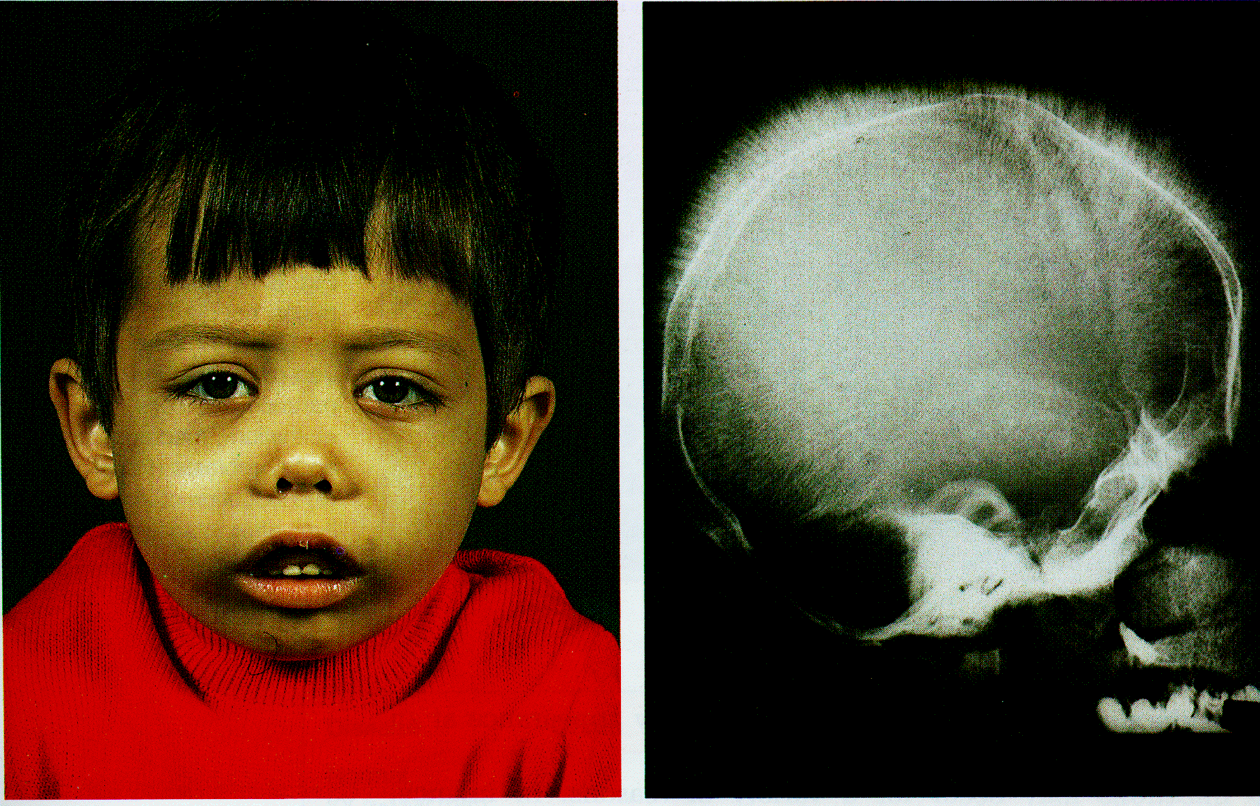
Thalassemia

Slide 43
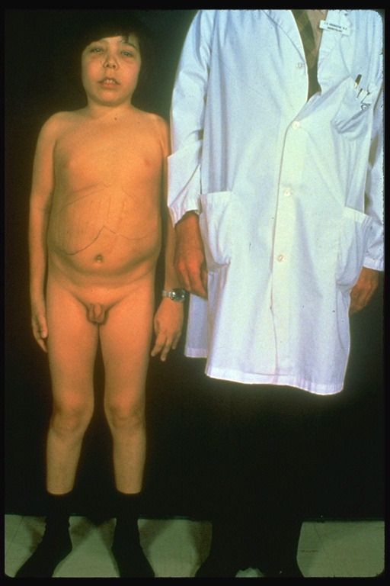
Beta thalassemia major
Male 18 years

Slide 44
Beta thalassemia major treatment
Transfusion
Iron chelation
Stem cell transplant

Slide 45
Β-Thalassemia Minor
β/ β⁰ or β/ β⁺
Microcytosis, target cells
Mild anemia – often asymptomatic
Decreased HbA production → Increased proportion of Hb A₂

Slide 46
Β-Thalassemia
Intermedia
β⁺/ β⁰ (small amount of β chain production)
Chronic anemia
Splenomegaly
Often transfusion-dependent

Slide 47
Hemoglobin E
β mutation (glutamine → lysine at amino acid 26)
Altered mRNA splicing, unstable mRNA
Heterozygous in 30% of SE Asians
Homozygous Hb E: microcytosis, hypochromia, little or no anemia
Hemoglobin E / β−thal causes thalassemia-like phenotype

