Slide 2
Laboratory Testing of Hemostasis

Slide 3
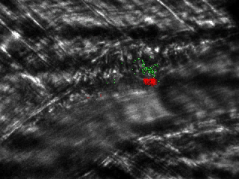
Clot formation in a mouse following vascular injury
Platelets (red)
Tissue factor (green)
Fibrin (blue)
Platelets + tissue factor (yellow)
Tissue factor + fibrin (turquoise)
Platelets + fibrin (magenta)
Platelets + fibrin + tissue factor (white)
Notes:
60 sec. Tightly coordinated and regulated formation of a clot.
Cellular (platelets) and soluble (clotting factors, fibrinogen, von Willebrand factor) components of blood, and components of the vessel wall and subendothelium (eg, tissue factor, collagen) all contribute.
Not shown: the clot must be broken down and replaced by connective tissue (fibrinolysis).
How can we analyze this in the laboratory?

Slide 4

Dissecting the hemostatic system
Notes:
In order to understand this process it’s helpful to dissect it to analyze its component parts.
We are able to do this to an extent with components found in the blood but are very limited in our ability to analyze the contributions of the vessel wall and surrounding tissue.
In this session I will discuss several tests that are useful in the diagnosis and management of bleeding and clotting disorders. I will describe how some of the tests are done to help you understand what they measure. You’ll be responsible for knowing how these tests are used to help diagnose the conditions we discuss in class, but you don’t need to memorize test methods.

Slide 5
Primary hemostasis
Platelet count
Platelet function screen
Von Willebrand factor measurements (several tests)
Platelet aggregometry
Thromboelastography
Notes:
Primary hemostasis refers to the formation of the “platelet plug” that forms the first line of defense against bleeding when a vessel is injured. These tests are useful in detecting and defining defects in this process
We will not discuss the bottom two in this course

Slide 6
Fibrin formation
Prothrombin time/INR
Activated partial thromboplastin time (aPTT or PTT)
Thrombin time
Fibrinogen level
Mixing study (screen for inhibitors)
Individual clotting factor assays
Thromboelastography
Notes:
In normal hemostasis fibrin forms around a platelet plug to stabilize the clot. We are able analyze this process in reasonably good detail in the lab using the tests listed here.

Slide 7
Fibrinolysis
D-dimer (higher levels indicate more lysis)
  Used to screen for DVT/PE
Alpha-2 antiplasmin
  Cannot distinguish increased consumption due to rapid plasmin generation from decreased production due to liver disease
Thromboelastography
Notes:
We have only a limited ability to analyze the fibrinolytic process.
Both of these tests are indirect indicators of fibrinolytic activity.
D-dimer is a proteolytic fragment of fibrin generated during clot lysis – higher levels found when thrombosis occurs or during intravascular coagulation. This test is sensitive but not very specific.
Alpha-2 antiplasmin is consumed when plasmin (the enzyme that lyses fibrin) is generated – lower antiplasmin levels may indicate increased and dysregulated fibrinolysis

Slide 8
Regulation
Antithrombin activity
Protein C activity
Protein S activity
Notes:
These plasma proteins are among the most important regulators of the clotting process. Low levels of any of these three proteins can predispose to pathologic thrombosis.

Slide 9
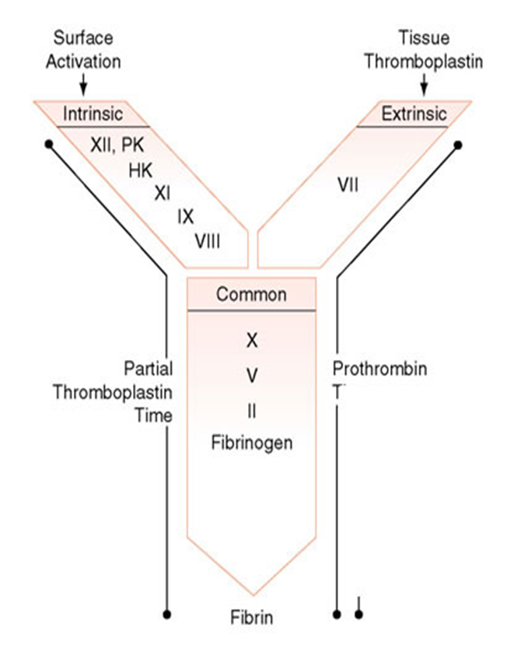
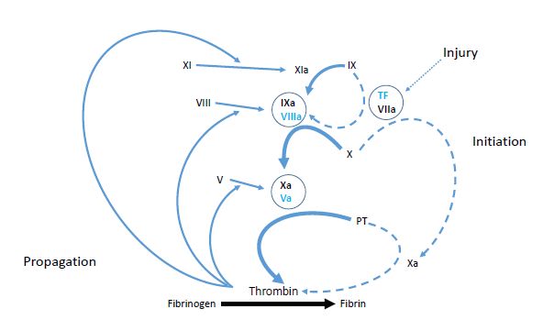
PTT
PT/INR
Notes:
The left hand diagram is more representative of physiologic clotting, since it shows the connections between the so-called intrinsic and extrinsic arms of the clotting cascade.
The right hand diagram shows these as separate pathways, which is more representative of how we analyze the cascade in the laboratory.

Slide 10
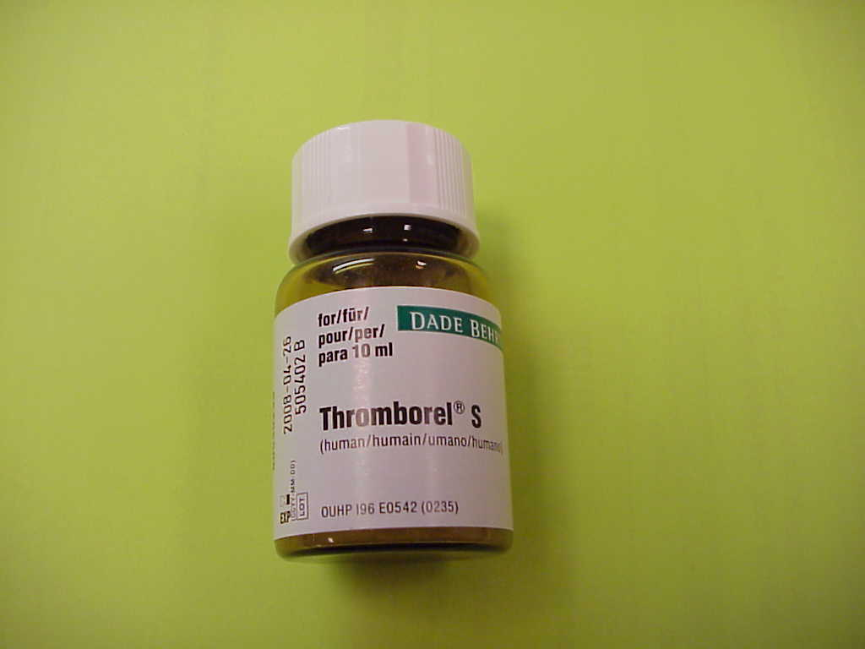
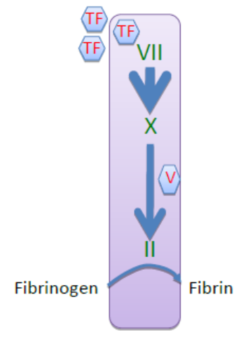
The Prothrombin Time
Add thromboplastin (excess of tissue factor + phospholipid + calcium) to citrated plasma. High concentrations of TF allow the system to bypass the amplification step mediated by VIII and IX.
Sensitive to plasma levels of VII, X, V, II and fibrinogen.
Not sensitive to XI, IX, VIII or contact factor levels
More sensitive than aPTT to warfarin effect
Usually expressed as International Normalized Ratio (INR)
Thromboplastin:
Tissue factor
Phospholipid
Calcium
Notes:
The prothrombin time is a measure of how long it takes a fibrin clot to form after adding a relatively high concentration of tissue factor plus phospholipid and calcium (the latter to overcome the citrate used to keep the blood from clotting prior to testing)
Because the concentration of TF is very high in this test factors VIII, IX, and XI do not contribute significantly to fibrin formation.
The prothrombin time will be prolonged if levels of one or more of the factors in the so-called extrinsic pathway are significantly reduced (II, V, X, VII or fibrinogen) or in the presence of some coagulation inhibitors (for example the direct factor Xa or thrombin inhibitors)
It is widely used to monitor the anticoagulant effect of warfarin
For reasons I will discuss shortly the prothrombin time (measured in seconds) is usually expressed as a unitless variable called the INR

Slide 11
Uses of the PT/INR
Best single test of the integrity of the fibrin clotting system
Detects most clinically significant acquired coagulopathies
Does not detect the most common inherited clotting factor deficiencies (VIII, IX, XI)
Routinely used to monitor warfarin therapy
Insensitive to heparin at usual therapeutic concentrations
Notes:
The prothrombin time will detect most acquired clotting defects.
You can generally assume that if the PT/INR is prolonged there is a hemostatic defect with a severity proportional to the degree of test abnormality.

Slide 12
Why the INR?
Tissue factor in the thromboplastin may be recombinant, or derived from human or animal tissue
Phospholipid composition varies among thromboplastins
As a result different thromboplastins have varying sensitivity to the effect of warfarin
The INR was developed in an attempt to make PT results from different laboratories comparable to one another
Notes:
The tissue factor and phospholipid used to do the prothrombin time test may come from several different sources depending on the specific reagent. This causes variability in the sensitivity of the test to decreases in clotting factor levels.
The INR system was developed to overcome this variability and make results from different laboratories more comparable
This is particularly important when monitoring warfarin, since drug dosing is based on the INR. The INR system was developed explicitly for this purpose.

Slide 13
ISI
(
)
Patient PT
Mean Normal PT
INR =
ISI (International Sensitivity Index) is specific to the type of thromboplastin used to perform the PT
The INR is useful in allowing us to compare PT results from different laboratories, mainly when monitoring the effect of the anticoagulant warfarin
Notes:
You won’t be asked to calculate an INR in this class – we will give you the value. This is how the laboratory calculates it.
The ISI is a variable that is provided by the manufacturer of the thromboplastin reagent, and is specific for that reagent. A higher ISI means the reagent is less sensitive to variations in clotting factor levels. Most laboratories today choose reagents with an ISI of around 1

Slide 14
Reagent A: ISI = 1.24, mean normal = 12.6 sec
PT = 22 sec
1.24
(
)
22.0
12.6
INR =
= 2.0
Reagent B: ISI = 2.46, mean normal = 12.2 sec
PT = 16.2 sec
2.46
(
)
16.2
12.2
INR =
= 2.0
In real life INR values obtained using different thromboplastins don’t always agree this well
Notes:
This is how the INR system works in theory. Prothrombin times done on the same plasma sample using different reagents give very different prothrombin times, but after conversion to an INR the results are the same in both labs
In practice the system doesn’t work this well all the time, but it is still much better than using the raw prothrombin time number.

Slide 15
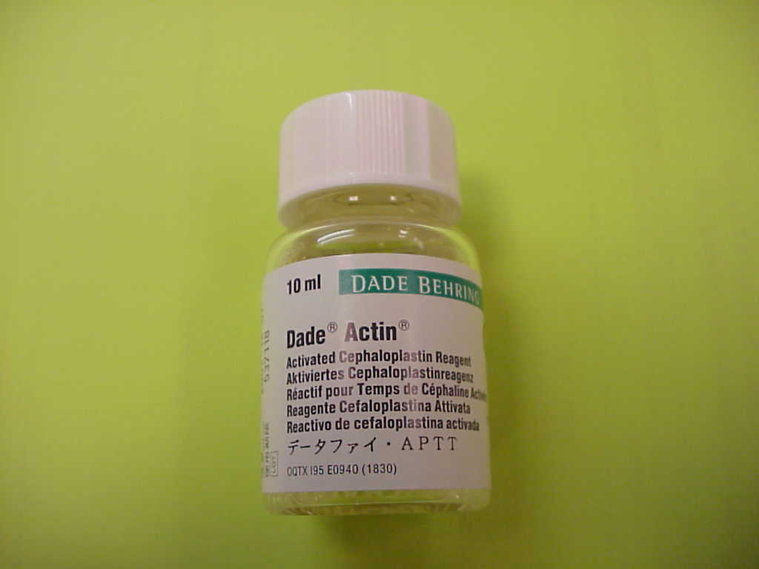
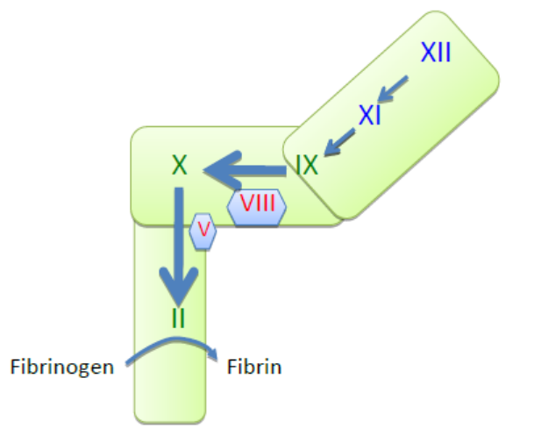
Activated partial thromboplastin time (aPTT)
Incubate citrated plasma with phospholipid + contact system activator (eg, silica, kaolin), which generates XIIa→XIa→IXa. Then add calcium to allow clotting to proceed to completion.
Sensitive to levels of contact factors, XI, IX, VIII and all of the “common pathway” factors
Not sensitive to VII level.
More sensitive to heparin than PT
“Partial thromboplastin”
Phospholipid +
Activator (provides surface for generation of XIIa)
Notes:
The PTT is a test that interrogates the so-called “intrinsic” arm of the clotting cascade.
Clotting is initiated by adding to patient plasma phospholipid plus a contact activator (finely dispersed negatively charged particles) which generates factor XIIa. This in turn activates factor XI, and factor Xia activates factor IX. When calcium is added, the pathway can then proceed to completion (IXa and VIIIa activate X, Xa and Va generate thrombin, thrombin generates fibrin. The time needed for fibrin to form is reported in seconds.

Slide 16
Uses of the PTT
Screen for inherited clotting factor deficiency (hemophilia, factor XI)
Monitor heparin therapy
Screen for acquired coagulation inhibitors
  Factor VIII antibody
  Lupus anticoagulant
A long PTT does not always indicate a bleeding disorder
  Factor XII deficiency
  Lupus anticoagulant
Notes:
The PTT is prolonged in the three most common inherited clotting factor deficiencies (VIII, IX, XI)
It is often used to monitor the anticoagulant drug heparin
It is prolonged in the presence of other coagulation inhibitors (eg, factor VIII antibody, lupus-type anticoagulant, direct Xa and thrombin inhibitor drugs)
It is less sensitive to common pathway defects than the INR
It may be significantly prolonged by lupus-type inhibitors or factor XII deficiency, which do not generally cause bleeding

Slide 17
What causes a long PT/INR and a normal PTT?
PTT
PT/INR
Factor VII deficiency
Mild deficiency of “common pathway” factors
  Warfarin
  Vitamin K deficiency
  Liver disease
High factor VIII levels can mask mild common pathway defects so PTT may not be prolonged

Slide 18
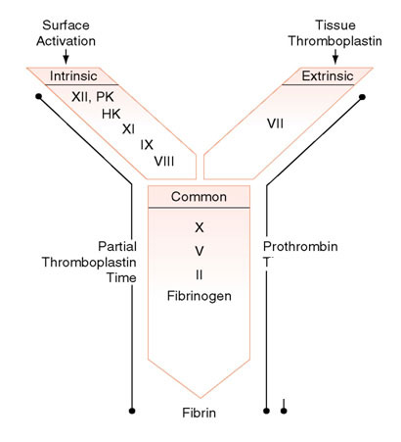
What would cause a long PTT with a normal INR?
Deficiency of VIII, IX, XI
Deficiency of a contact factor (usually XII) (does not cause bleeding)
Heparin
Factor VIII inhibitor
Lupus-type inhibitor (antiphospholipid antibody)
PTT
PT/INR

Slide 19
What if both PT/INR and PTT are long?
Liver disease
Vitamin K deficiency
Warfarin
DIC
High level of heparin
Other inhibitor affecting common pathway (eg, direct thrombin inhibitor)
Isolated deficiency of X, V, II, fibrinogen (rare)
PTT
PT/INR
Notes:
When both the INR and PTT are long there is a defect in the “common pathway”. The most important of these are shown here.

Slide 20
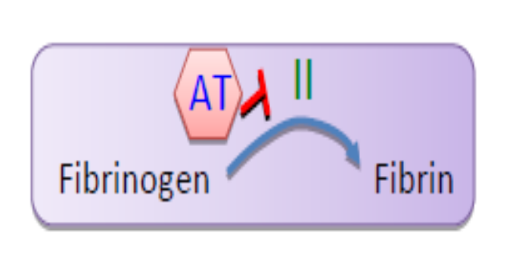
Thrombin time
HEP
Thrombin + plasma, measure time to clot formation. Very sensitive to heparin* and other thrombin inhibitors, eg, dabigatran.
Also prolonged by low fibrinogen, dysfibrinogenemia, high levels of fibrin degradation products.
*Note: Too sensitive to use to monitor heparin. aPTT used for that purpose
Notes:
The thrombin time is a fairly simple test – add thrombin to plasma, measure the time until a fibrin clot forms
Very sensitive to thrombin inhibitors such as heparin

Slide 21
Mixing Study
Purpose: to determine whether long aPTT or PT is due to clotting factor deficiency or circulating inhibitor (eg, factor VIII inhibitor, anticoagulant drug, lupus-type inhibitor)
Mix patient plasma 1:1 with normal plasma, measure aPTT or PT
Failure to correct prolonged clotting time by mixing with normal plasma implies presence of a circulating inhibitor
Note: warfarin does not act as a circulating inhibitor. It inhibits synthesis of clotting factors by the liver
Notes:
The PTT or INR can be prolonged if the level of one or more clotting factors is low, but also by the presence of a substance (usually either an antibody or drug) that actively inhibits the clotting cascade. The mixing study is designed to tell the difference between these two possibilities.

Slide 22
Mixing Study: Factor Deficiency

Slide 23
Mixing Study: Circulating Inhibitor

Slide 24
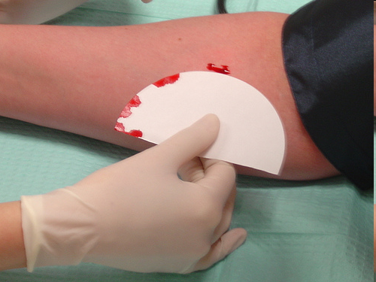
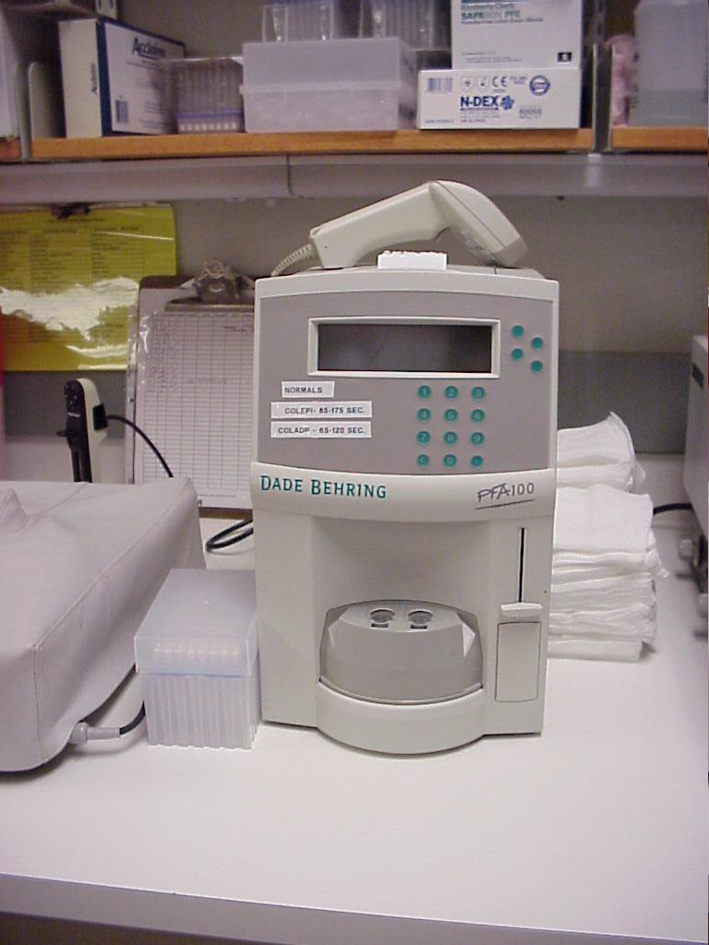
Bleeding time vs PFA-100
Bleeding time: measure duration of bleeding after small skin incision
  Difficult to standardize
  Poor specificity
  Rarely used today
Platelet function analysis (PFA-100): measure how long it takes flowing blood to clot in collagen coated tube in presence of ADP or epinephrine (done by machine)
  Better standardized
  Moderately sensitive to defects in platelet function, von Willebrand disease
Bleeding time
PFA-100
Notes:
Platelet function is considerably more complex and difficult to analyze in the laboratory than fibrin formation. The PFA-100 is an instrument that measures the time needed for a platelet plug to form when whole blood is passed through a capillary tube coated with collagen plus either ADP or epinephrine. It is used to screen for defects in primary hemostasis. If an abnormal result is obtained, additional testing may be required to understand the cause.
Note that this test (like all of the tests described previously) is done ex vivo, and does not measure the contribution of the blood vessel to the clotting process. The bleeding time was an in vivo test that was sensitive to the contribution of the vessel, but it had a number of disadvantages that outweighted this one advantage so it’s rarely used today (not done at all at UW Hosp)

Slide 25
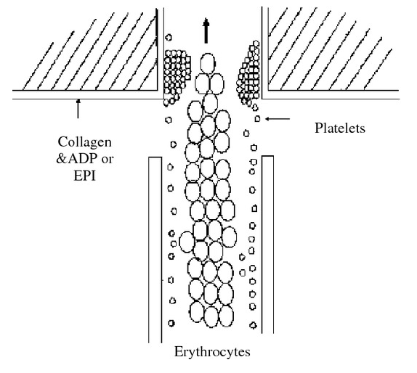
How the PFA-100 works
Citrated whole blood passed through a capillary tube coated with collagen plus either ADP or epinephrine
Platelets adhere to collagen (requires VWF from patient plasma) and are activated
Platelet plug forms and occludes tube
Time to occlusion is measured
Notes:
The PFA-100 attempts to re-create the situation that arises in vivo when vascular endothelium is damaged and subendothelium is exposed to flowing blood. It is done in citrate-anticoagulated blood, so the clotting cascade is not activated. The end point is formation of a platelet plug that occludes the capillary tube. Unlike the tests described earlier, this test is done under flow conditions. This feature is particularly important in analyzing defects in primary hemostasis since platelets play a more important role in clotting when blood flow in the area of an injury is faster.

Slide 26
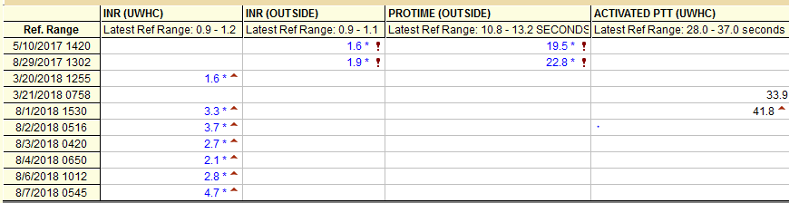
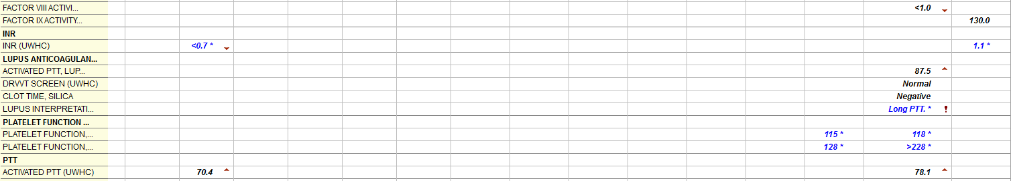


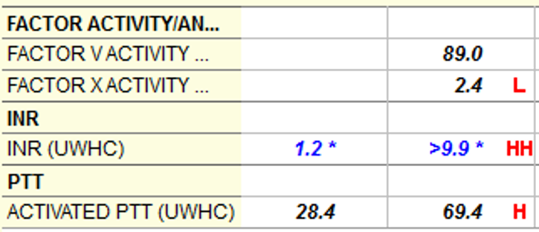
Severe liver disease
Acquired factor VIII inhibitor (factor VIII level less than 1% of normal)
Lupus-type anticoagulant (positive mixing study)
Severe vitamin K deficiency
Notes:
Some examples of the effects of clotting factor deficiency and circulating inhibitors on various clotting tests

Slide 27
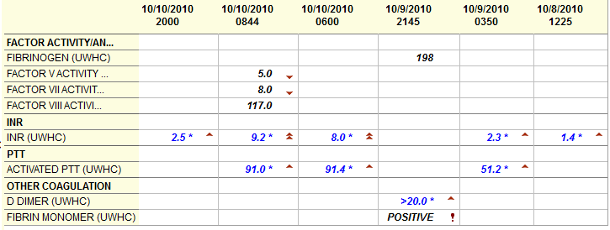
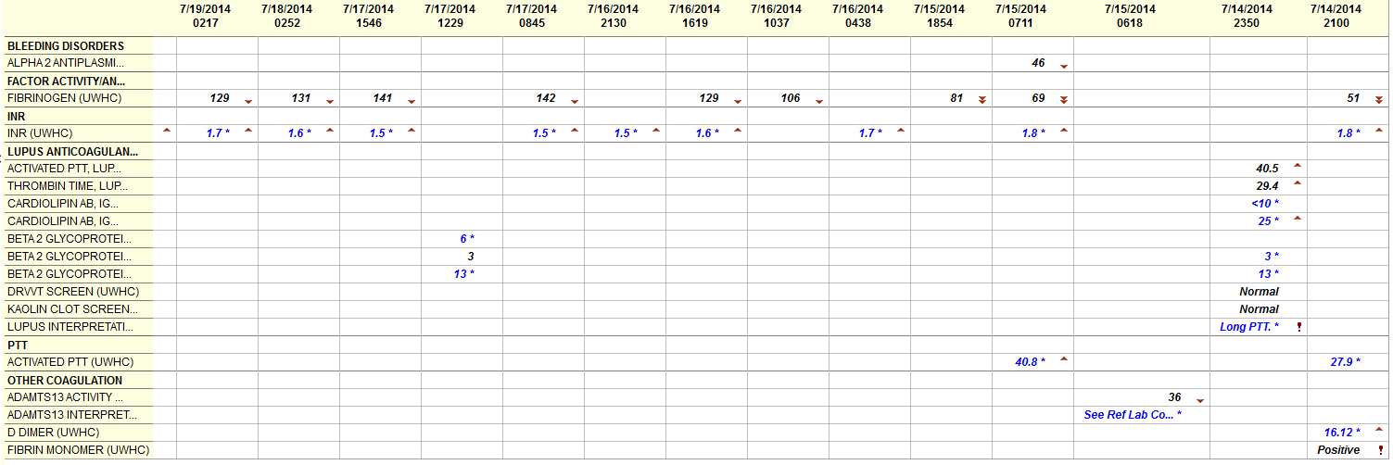
A case of fulminant liver failure caused by herpes simplex virus. The very long INR and PTT are due to very low levels of the clotting factors made by hepatocytes (factors V and VII both < 10% of normal). Interestingly fibrinogen is normal, perhaps because it has a much longer half life than the other factors made in the liver, and factor VIII, which we believe is made in endothelial cells rather than hepatocytes, is also normal.
The positive fibrin monomer indicates the presence of unclotted fibrin in the blood, an indication of DIC which complicated this illness. Very high D-dimer is a manifestation of increased fibrinolysis due to DIC.
A patient with severe chronic liver disease complicated by bacterial sepsis with DIC. Again, the fibrin monomer is positive and D-dimer level is very high. Fibrinogen level is very low in this case, likely due to decreased synthesis from long standing liver disease, with superimposed excess fibrinolysis (and fibrinogenolysis) from DIC. The low antiplasmin level is also a manifestation of increased fibrinolysis; generation of excess plasmin leads to consumption of its inhibitor alpha-2 antiplasmin. ADAMTS13 is often consumed in DIC, but the level here is not as low as would be seen in TTP.
Notes:
Two examples of more complex coagulopathies due to liver disease complicated by DIC

Slide 28
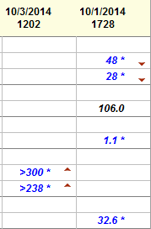
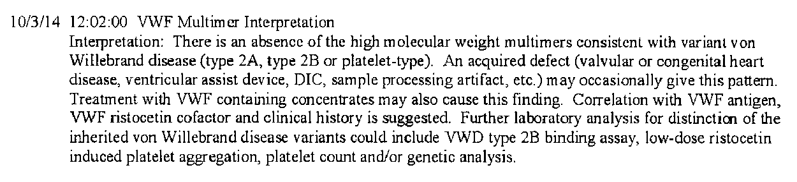
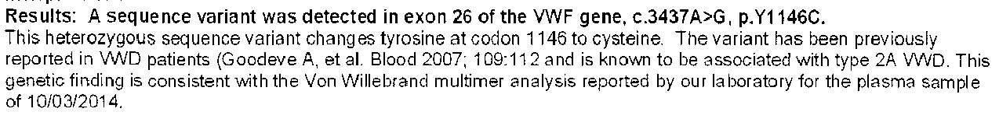
Von Willebrand factor antigen
Normal = 55-160%
Low von Willebrand factor activity causes defective platelet adhesion, giving rise to the abnormal PFA result.
INR and PTT are normal since all of the other clotting factor levels (including factor VIII) are normal
The relatively low von Willebrand factor activity in comparison to the antigen level suggests the presence of a dysfunctional protein
Electrophoretic analysis of VWF shows a deficiency of the largest, “stickiest” multimers
Gene sequencing reveals a mutation that causes excessive proteolytic degradation of larger VWF multimers by ADAMTS13. This is a “type 2A” variant of von Willebrand disease.
Von Willebrand factor activity
Normal = 50-170%
Factor VIII activity
Normal = 60-180%
INR
PFA, collagen/ADP
PFA, collagen/epinephrine
Normal = 65-120 sec
Normal = 85-175 sec
PTT
Normal = 26-35 sec
Notes:
A patient with an abnormal PFA result due to von Willebrand disease. This turned out to be a variant of VWD caused by a dysfunctional VWF protein. The exact nature of the dysfunction was determined by gene sequencing.
You won’t be responsible for knowing how to diagnose VWD variants in this class

Slide 29
Notes:
If you are viewing this prior to the lectures on bleeding and clotting disorders I encourage you to watch it again after you’ve heard those lectures. Some of the material here may make more sense to you once you know more about the conditions in which the tests described here are used.

